Slide 1
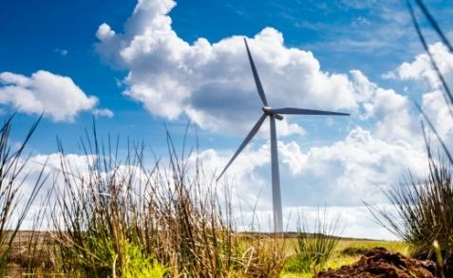



Slieve Kirk Wind Park
Environment Energy Output Operations Team Construction Design Community Social Responsibility
Key
No of turbines: 12 + 20
Turbine Type: Siemens 2.3MW
Electricity Production 73MW
Location: Derry/Limavady
Investment by SSE : £125m
Employment during Construction :152
Local suppliers :21
Location
Slieve Kirk Wind Park is Northern Ireland’s first and largest grouped wind farm development. The £125million generation site has been delivered through the development of the original 27MW Slieve Kirk wind farm near Ardmore with a 46MW expansion of capacity developed at Glenconway Hill, Glenconway is located on the Baranailt Road (B69) to the south of Limavady. The wind park was developed by SSE Renewables, Northern Ireland’s No.1 renewable energy developer.
Advantages
• open areas of land heavily exposed to the wind
• proximity to a 33kv electrical supply
•no special environmental classification
•no special restrictions on use of the land
Disadvantages
The location is open countryside and many people feel that the countryside should be left untouched.

Slide 2
Slieve Kirk Wind Park
Energy Output
Energy Output
Advantages
Slieve Kirk Wind Park is expected to generate around 200GWh of electricity each year, producing enough green energy to power over 65,000 Northern Ireland homes. The green energy generated at Slieve Kirk powers Airtricity, Northern Ireland’s second largest energy provider.
A project of this sort will generate income for up to 25 years. At present, electricity generated by wind power attracts not only a base level electricity price, but also various enhancements due to it being a clean renewable source. (base level electricity price between 14-19p/kwh)
Disadvantage The amount of electricity produced depends on the strength of the wind, if there is no wind then no electricity is produced .
Key
No of turbines: 12 + 20
Turbine Type: Siemens 2.3MW
Electricity Production 73MW
Location : Derry/Limavady
Investment by SSE : £125m
Employment during Construction :152
Local suppliers :21

Slide 3
Slieve Kirk Wind Park
Environment Energy Output Operations Team Construction Design Community Social Responsibility
Operations Team
Here’s a video of SSE Ireland’s Wind Operations Manager, Ciaran Maguire discussing what it’s like to work for SSE:
http://www.youtube.com/watch?v=uh3H1YcwmTI If YouTube unavailable use this link
http://news.sse.com/listing/2013/07/irish-wind-farm-creates-seven-new-jobs/
Proper Management of operating wind farms is critical to maximising returns from a wind farm investment. Besides day to day management of the wind farm, the Operations Manager will seek to pro-actively extract every possible hour of availability from the turbines.
Safety
Health and safety management is often included in the scope of the Operations Manager. A Health & Safety Management Plan, incorporating risk assessments, method statements and procedures, must be created and maintained for the life of the wind farm.
Key
No of turbines: 12 + 20
Turbine Type: Siemens 2.3MW
Electricity Production 73MW
Location : Derry/ Limavady
Investment by SSE : £125m
Employment during Construction :152
Local suppliers :21

Slide 4
Slieve Kirk Wind Park
Construction Design
Construction
8,000m of access tracks (suitable to carry loads up to 140 tonnes up an 18% gradient), 6km of public road upgrade at Slieve Kirk.
Design
Onshore wind energy
Wind turbines produce electricity by harnessing the natural power of the wind to drive a generator.
Most commercial-scale wind turbines consist of rotor blades which rotate around a horizontal hub. The hub is connected to a gearbox and generator, these are located inside the nacelle. The nacelle houses the electrical components and is mounted at the top of the tower.
The first wind farm in the UK was built at Delabole in 1991. Since then, onshore wind energy has established itself as a mature, clean energy-generating technology.
Wind energy overtook hydro in 2007 to become the largest renewable generation source, contributing 2.2% of the UK's electricity supply. Onshore wind comprises the bulk of this.
Key
No of turbines: 12 + 20
Turbine Type: Siemens 2.3MW
Electricity Production 73MW
Location : Derry/Limavady
Investment by SSE : £125m
Employment during Construction :152
Local suppliers :21

Slide 5
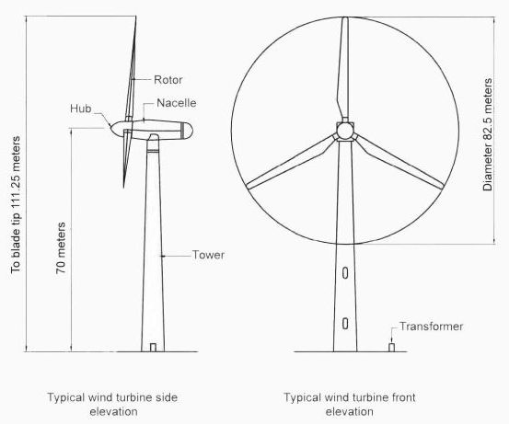

Slide 6
Slieve Kirk Wind Park
Community
Advantage
The Community Fund aims to support energy efficiency and sustainability projects in the locality of wind farms. The fund is paid out annually; starting one year after the wind farm starts producing electricity and operates for the lifetime of each site.
http://www.sse.com/Ireland/CommunityFund/
http://irelandnews.sse.com/listing/2013/08/slieve-kirk-awards-funding-to-thirteen-community-groups/
Operation Energy is an interactive website for teachers and pupils which offers a variety of energy focused teaching resources, activities and games, all of which support learning across the Northern Ireland curriculum. Teachers can choose from over 60 free classroom activities with 10 energy focused lessons plans for Foundation, KS1 and KS2. For pupils, it has exciting games, home energy pledges and a media gallery.
http://www.operation-energy.com/
http://irelandnews.sse.com/listing/2013/10/eco-schools-pupils-help-to-launch-airtricity's-power-down-day/
http://irelandnews.sse.com/listing/2013/10/sustainable-students-visit-airtricity%e2%80%99s-bessy-bell-wind-farm/
Disadvantage
Wind farms produce noise.
The Turbines may spoil the view for people living near by them, depending on people’s aesthetic sense.
Key
No of turbines: 12 + 20
Turbine Type: Siemens 2.3MW
Electricity Production 73MW
Location : Derry/Limavady
Investment by SSE : £125m
Employment during Construction :152
Local suppliers :21

Slide 7
Slieve Kirk Wind Park
Social Responsibility
Key
No of turbines: 12 + 20
Turbine Type: Siemens 2.3MW
Electricity Production 73MW
Location : Derry/Limavady
Investment by SSE : £125m
Employment during Construction :152
Local suppliers :21
Social Issues
73MW Slieve Kirk Wind Park has been built at a total capital investment cost of £125million of which £36million has been spent directly with around 75 local supply chain businesses supporting local jobs and enterprise.
http://irelandnews.sse.com/listing/2013/11/case-study-slieve-kirk-wind-park-local-economic-benefits/
http://irelandnews.sse.com/listing/2013/11/video-slieve-kirk-wind-park-'our-local-supply-chain'/

Slide 8
Key Questions
• What is renewable energy?
• Why has Northern Ireland been chosen as a location for wind farms?
• What is the significance of renewable energy in Northern Ireland? What does it mean for me?
Prior Learning
• know about sources of renewable and non-renewable energy
• know about human and physical features, including some of the ways people affect the environment
• be aware that environmental change can be sustainable
• be able to use maps to locate places and identify geographical patterns
• be able to construct maps to convey geographical understanding
• have developed their Using ICT and Communication skills (if Using ICT and Communication tasks are being used as assessment opportunities)

Slide 9
There are topical articles about renewable energy in Northern Ireland available online. Give each group a range of these and ask them to research wind power in Northern Ireland. You could ask the pupils to find other links that offer reliable information, depending on their skills levels.
Challenge each group to speak for 30 seconds, without hesitation or repetition, on why wind power is important for Northern Ireland.

Slide 10
Objectives
• develop geographical skills to interpret spatial
patterns including map work;
• develop enquiry and fieldwork skills through:
-- questioning;
-- planning;
-- recording;
-- analysing;
• interpreting information; and
• drawing conclusions relating to a range of
secondary sources;
• develop critical and creative thinking skills
to solve geographical problems and make
informed decisions; and
• develop a sense of place through the study of:
-- a local context; and
-- an issue of topical significance.

Slide 11
Task
Explain to the pupils that they are going to examine the location of Slieve Kirk. Invite each group to log onto NI Maps and search for Slieve Kirk.
Encourage them to:
use the tools in NI maps to measure distance on the map to houses, pylons and major roads;
find the grid reference of their chosen site at www.irish.gridreferencefinder.com/; and record the mean wind speed at their selected site. Wind speeds for any post code in NI are available at http://www.actionrenewables.co.uk/resources/windmap/ the Post Code for Slieve Kirk BT47 3RL
Give each group the set of cards in Resource 1. Ask them to compare these cards with their suggestions regarding the reasons why Slieve Kirk was chosen as a location.
Next, ask each group to sort the cards using the Diamond Rank strategy. This means that they rank the cards with the factors that they think were most important when Slieve Kirk was being considered as a site for a wind farm at the top, with those less important at the bottom (template available in Resource 1).
Give each group time to report their results and to compare with others, so that they can discuss and justify their choices and decisions. Allow groups to rearrange the cards if they change their mind.
Ask the class to group the cards under the headings ‘Physical Factors’ and ‘Human Factors’
About NI Maps
NI Maps has been provided by C2k for all schools in Northern Ireland. With direct relevance to Northern Ireland's curriculum, NI Maps provides all teachers and learners in schools with online access to detailed Ordnance Survey Northern Ireland (OSNI) maps and aerial photographs for use in their teaching and learning.

Slide 12

Resource 1
Slieve Kirk is situated outside the Causeway Coast AONB, no special environmental classification. | Slieve Kirk’s Peak is 370 m above sea level. The turbines are located on the ridge to the East of Slieve kirk. Open areas of land heavily exposed to the wind. | Average wind speeds at this site are around 10 metres per second. When the wind speed is approximately 4 m/s the machine rotor will run up to synchronous speed.
Construction of Northern Ireland’s 1st 110kV Wind farm substation and 1st 110kV contestable overhead line grid connection at Slieve Kirk for SSE Renewables. | The Wind farm owner has pledged a further £18.5m towards the economy over the next 25 years through annual commercial rates payments, landowner lease contributions and community funding. | Slieve Kirk Wind farm land is bounded by and accessed by Bigwood Road, Kildoag Road and Castlewarren Road,
Slieve Kirk Wind Park is expected to generate around 200GWh* of electricity each year, producing enough green energy to power over 65,000 Northern Ireland homes. | The green energy generated at Slieve Kirk will significantly decarbonise energy generation in the country, further contributing to Northern Ireland’s 40% target of renewable electricity generation by 2020. | The project is being delivered on an upland blanket bog, no special restrictions on use of the land.

Slide 13
Commercial Wind Farms – Key Issues
Energy output – which will be dependent on the location and the technology being used,
Costs – the costs of installing and maintaining the equipment and subsequent connection to the electrical grid system,
Environmental issues – the impact on the local environment in terms of effect on land use and the natural habitat,
Social issues – the possible impact on local residents who may object to large wind turbines impacting on the visual nature of the location and possible noise effects.
Review the SKWP Case Study and evaluate the decision to locate a Wind Farm by considering the key issues above.

Slide 14
Links
http://www.airtricity.com/uk/home/
http://www.operation-energy.com/
http://www.keepnorthernirelandbeautiful.org/
http://www.eco-schoolsni.org/
http://www.iwea.com/_wind_information
http://www.renewableuk.com/

