Slide 1


Food Waste Challenge
Making the most of food at school & home
Notes:
This challenge is run by Keep Northern Ireland Beautiful, Eco-Schools NI with support from the Department of Agriculture, Environment and Rural Affairs, (DAERA)
Primary schools that register to take part in the Food Waste Challenge will receive a Resource Pack which will include Family food waste pledges and internal household bin stickers to prompt family members to use the food caddy.
The challenge will allow schools to focus on Food Waste and the benefits of creating compost from food which then can be used to grow more food etc. They will learn how composting can be good for the environment, and the benefits that can be gained in terms of saving the school money. The resource will focus on the actions that pupils can take in school and at home to address food waste issues based on the 3Rs principles. Reduce, Reuse and Recycle.
This will allow pupils to take that message home and allow for great family interaction on the project, through the photo competition for example.
The photo competition will invite pupils to submit a photo of them being food waste heroes at home. One winning pupil photo will be chosen from each council area and the school will receive a prize.

Slide 2
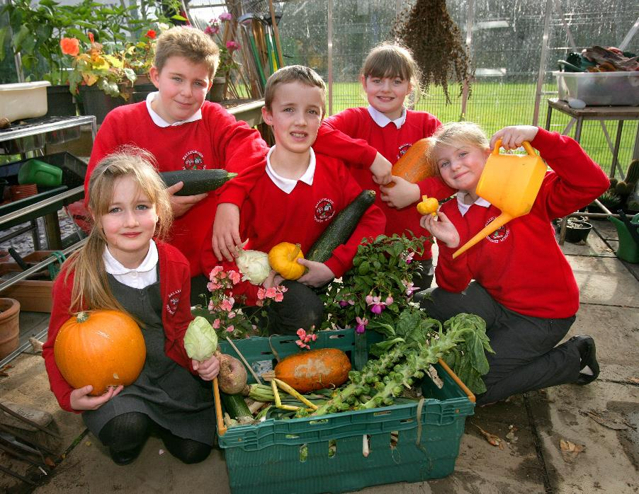
Food Waste Challenge
We love food!
Notes:
What are your favourite foods?
You might want to select a child to tell you their favourites. Not only does food taste good, it is important for lots of reasons, e.g.
It gives us energy
It helps us grow
It helps us learn

Slide 3
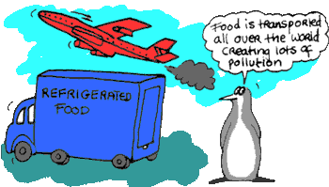
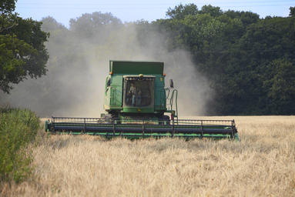

Where does our food come from?
Notes:
Points you might like to draw out include:
Farmer grows it
Driver transports it, storage at supermarket or shops
Energy taken to prepare it
Blueberries travel 3500 miles to the UK. That’s Belfast to London 25 times!
Bananas travel almost 5000 miles to the UK! That’s from Belfast to Dublin and back 25 times!
Rice has to travel a massive 7000 miles to reach us! That’s the same as going from Belfast to Paris 14 times!
So a lot of energy goes into our food before it gets on our plates.
The water and nutrients that go into growing the food and the energy that goes into transporting and cooking food are all very valuable; so if we just waste the food when it reaches us, all this effort is wasted too.

Slide 4
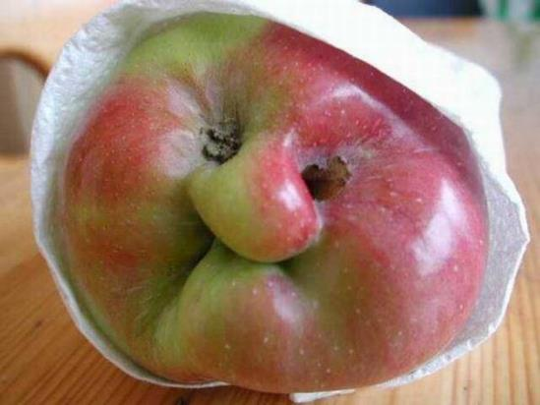
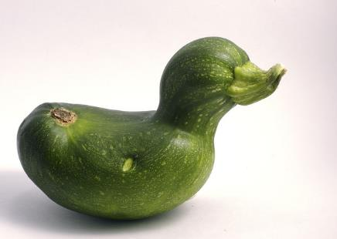
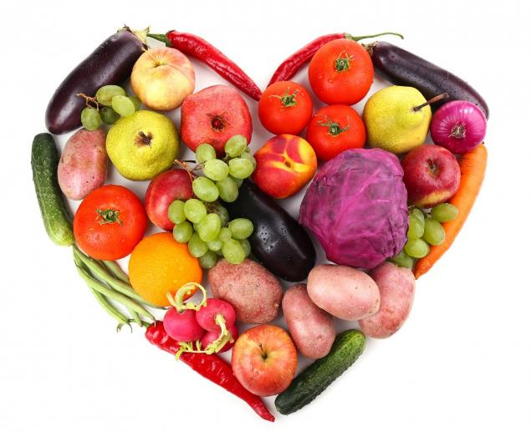
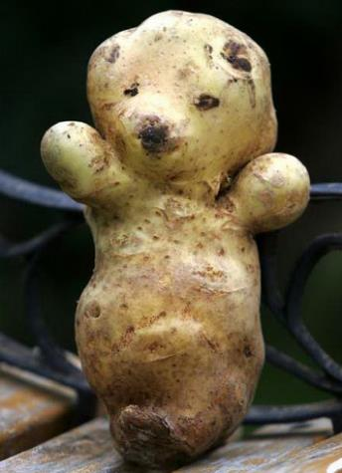
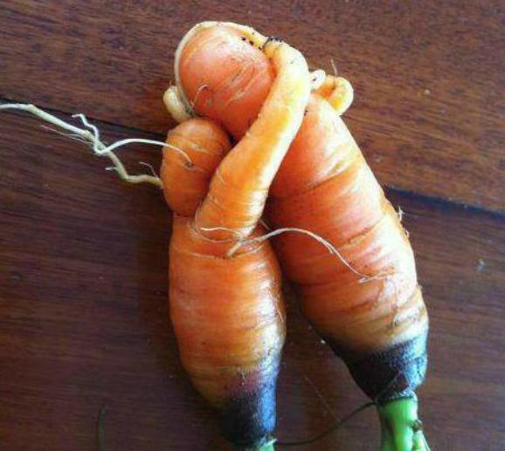
Even ugly veg need love!
Notes:
All food, including these ‘ugly’ veg. have used energy to grow them. Unfortunately, they are thought to be of no use and are dumped by farmers/producers as we do not want them The following links provide info. on ugly food waste:
https://www.nationalgeographic.com/magazine/2016/03/global-food-waste-statistics/
http://www.endfoodwaste.org/ugly-fruit---veg.html
https://foodtank.com/news/2017/08/ugly-fruit-and-veg-campaign/
http://www.telegraph.co.uk/foodanddrink/10393981/Tesco-food-waste-Why-half-of-your-shopping-basket-may-end-up-in-the-bin.html
https://www.alternet.org/food/its-time-eat-ugly-food-you-wont-believe-how-much-were-wasting
http://time.com/3761942/why-people-are-falling-in-love-with-ugly-food/

Slide 5
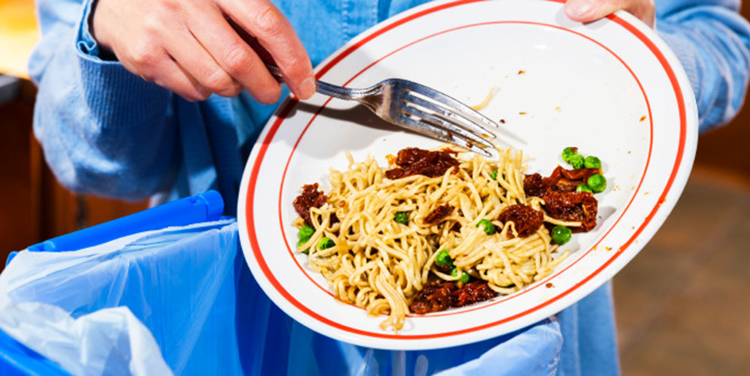
Why is wasting food a problem?
Notes:
Ask pupils to suggest any other reasons why it is a problem that so much food is getting thrown away. Answers might include:
The ethical problem of wasting food when people in the world are hungry
The importance of food to health and to learning at school
Bad for the environment
We waste more food than packaging, and food waste has a significantly greater impact on the environment.
Estimates suggest that food waste has at least 10x the environmental impact of packaging waste and that’s excluding the impact of methane from food in landfill.
Give them these facts and figures:
Every day we throw away 24 million slices of bread in the UK. Stacked up that’s as high as 27 Mount Everest’s!
Around 7 million tonnes of food is thrown away by households in the UK every year, and most of it could have been eaten.
Little by little all this waste adds up, over a year the average family throws away around £700 of food shopping – equivalent to an annual electricity or telephone bill.
Some of the waste is made up of things like peelings, cores and bones, but the majority is, or once was, perfectly good food.
Most of it ends up in landfill sites where it rots and releases methane, a damaging greenhouse gas. Throwing away food is also a huge waste of the energy, water and packaging used in its production, transportation and storage. If we all stopped wasting the food which could have been eaten, it would have the same CO2 impact as taking 1 in 4 cars off UK roads.

Slide 6
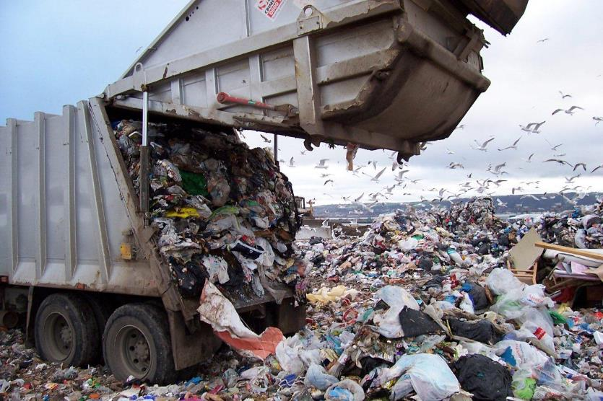
What happens when we throw our food in the wrong bin?
Notes:
When we throw food away with other rubbish it is taken to a landfill site, usually by our councils. Our landfill sites are getting filled up, so we’re running out of space to bury the things we throw away. And there’s another problem: when food rots in a landfill site it makes a gas called methane. The methane rises out of the landfill site and up into the atmosphere.
You might want to make the connection with climate change here:
We’ve got a blanket of gases around the earth, and the methane from the landfill sites is making that blanket get thicker.
Ask children to suggest what happens to something or somebody if you wrap them in a thick blanket.
Yes, it gets hot! And that’s what’s happening to our planet, it’s getting hotter, and we call it Global Warming.
Depending on time available / age of pupils, ask them to volunteer some of the problems they have heard about that are associated with climate change e.g. flooding due to sea level rises, polar bears dying due to ice melting.

Slide 7
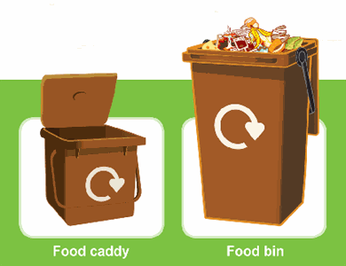
What happens to food waste after the council collect it?
It is mixed with garden waste, shredded and then composted in an enclosed system for around 2-4 weeks (temperatures of up to 70°C speed up the process and ensure any harmful microbes are killed off).
The material is then left outside to mature for a further 1-3 months with regular turning and checks to ensure quality, before going on to be used as soil conditioner.
Sometimes your council recycling amenity centre will offer free bags of this compost for you to use at home or school.
Notes:
Brown bin and food waste is turned into compost. In some other parts of the UK it’s used to create energy from the Biogases produced.
Possible extension work on this could be to look at Anaerobic Digestion and Biogas.
Below are some links on Anaerobic Digestion and Biogas, just copy and paste these into Google:
Here is a link to Biogas information: http://www.bbc.co.uk/schools/gcsebitesize/science/triple_aqa/humans_and_environment/biofuels/revision/4/
Here is a link to Anaerobic Digestion: http://www.biogen.co.uk/Anaerobic-Digestion/What-is-Anaerobic-Digestion

Slide 8
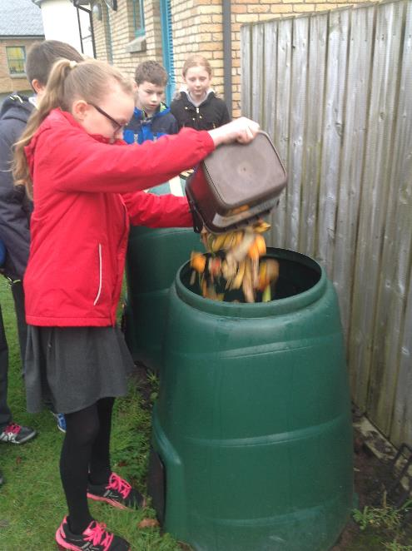
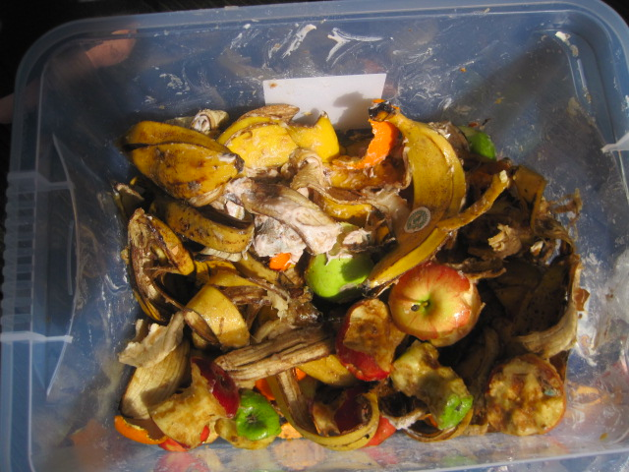
If you throw that food in the wrong bin you are:
Wasting all the energy that got that food from farm to fork
Wasting money
Adding to the mountain of wasted food in landfill
Adding to climate change
Always put food waste in the food waste bin!
Notes:
It is not just the food that is wasted when it goes in the bin but also all the energy, transport and storage costs and environmental impact at each stage of the journey that is wasted. So, make sure and put the food waste in your food waste bin.

Slide 9
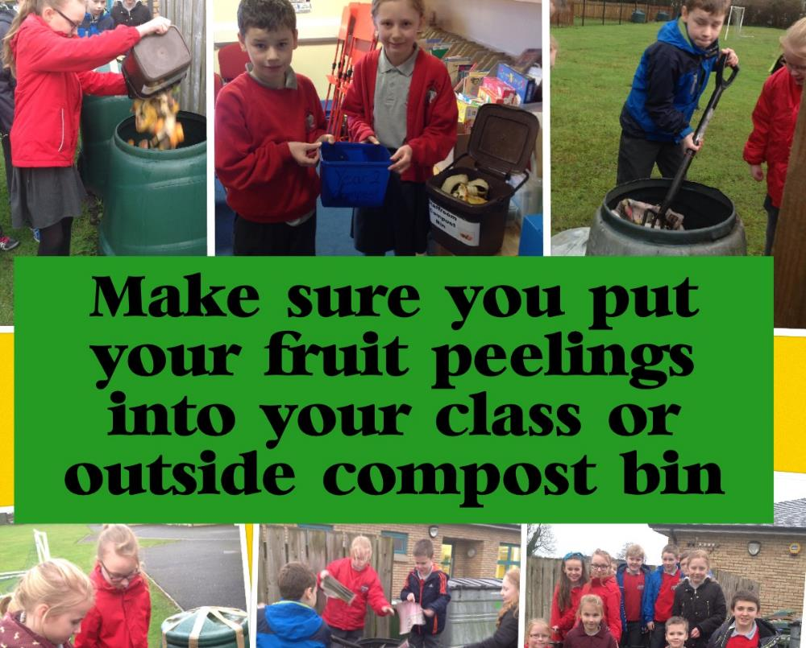
½ of the rubbish in schools’ bins is
Food!
Notes:
Source: ECO-UNESCO

Slide 10


is the best option
Reduce waste
  buy only what you need
  manage portion sizes
  check sell by dates
  use a shopping list
  store food properly
Save the environment
Save money
Notes:
Reduce is always the best option because it will use fewer natural resources and less energy in the first place. We can try and reduce food waste by managing portion sizes, planning our food shopping for the week and making sure we understand sell by dates on packaging properly.
The following links will give you more info on this:
https://www.lovefoodhatewaste.com
http://www.bbc.co.uk/guides/zpg6sg8
https://www.recyclenow.com/recycling-knowledge/food-recycling

Slide 11
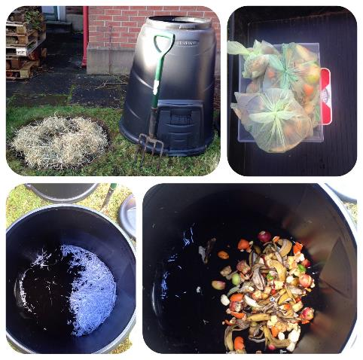
Food Waste Challenge
Recycling Food
Why recycle Food Waste?
Recycling food waste saves energy. e.g. recycling just 35 used tea bags can save enough energy to power a TV for an hour.
Recycling food waste saves resources: it makes compost, so there is less need to take materials from the earth.
Recycling food waste means less pollution: if food is put in the rubbish bin and not recycled, it releases a harmful greenhouse gas called Methane.
Notes:
This campaign is focusing on how we can recycle food waste. Pupils will learn about how they can recycle their food waste, where they can recycle their food waste, what are the advantages of recycling food waste – create compost etc.. And they will learn how this is linked to helping protect the environment.
The challenge will also allow the pupils to carry out home based actions too and get their family involved as well.

Slide 12
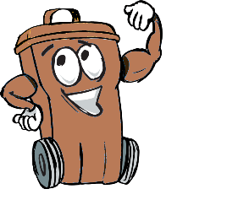
What can you do to help in school?
Take part in the Eco-Schools Food Waste Challenge:
  Complete a school waste audit – does your school recycle food? (see toolkit for info).
  Enter the data into the Data Zone on the Eco-Schools website
  Have an assembly/let everyone know about food waste
  Create a compost heap (see toolkit for info)
Notes:
The challenge will allow schools to focus on food waste and the local circular economy benefit of creating compost from food which then can be used to grow more food etc. This will allow pupils to take that message home and allow for great family interaction on the project, through the photo competition for example.
The next slide gives you some info. on the benefits of composting.

Slide 13

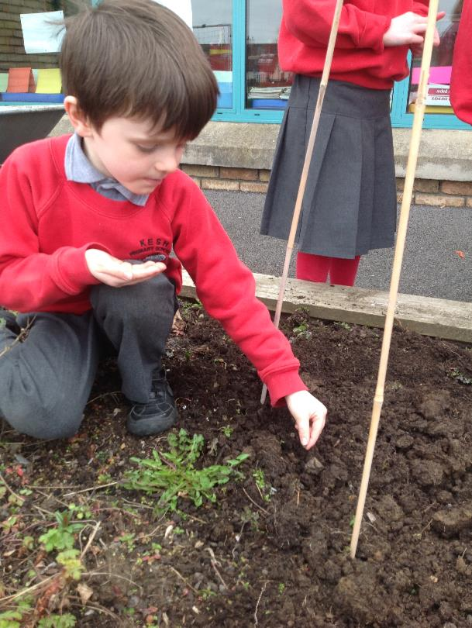
Why Compost At School?
It’s great for the environment
It saves the school money
It creates a valuable resource
It’s a great teaching resource
        If composting is not practical at your school you should
        find out about getting a food waste bin collected by your
        council or waste collection company.
Notes:
Compost
Composting is a form of recycling: the nutrients in organic waste are processed and returned to the soil to
help more plants to grow.
Example: A compost bin biodegrades your fruit, vegetable and garden waste into fertiliser. Some bins also
use worms to produce compost from cooked and uncooked kitchen waste.
Action: You can either compost in your kitchen and garden or, if your council has the facility, send your waste
to a commercial composter. Compost from these sites is often available for sale.
Note: It can take up to 5 weeks for an orange or banana peel to decompose. It can take up to 2 months for an apple core to decompose
It’s great for the environment: Putting organic waste such as fruit & veg scraps and garden waste in a landfill site creates Methane and toxic liquids causing pollution. Less waste going to landfill sites means less waste being transported. It also reduces the overall need for landfill sites.
It saves the school money: Your school, as all schools, pay for their waste to be disposed of, so, produce less waste and you will reduce the cost. It’s much cheaper to dispose of food waste when it has been collected in the correct food waste recycling bins.
By producing compost you are making potting compost, organic fertilizer and soil conditioner, reducing the need to buy them.
It creates a valuable resource: Compost helps grow healthy plants. Adding compost to soil improves the structure and texture of the soil.
It’s a great teaching resource: Compost provides lots of opportunities to deliver the National Curriculum, through topics such as recycling, ecology, food production and soil fertility.
It also provides a great way to make sustainable development a part of the life and ethos of your school. It will help your schools work towards Eco-Schools Awards, including the prestigious Green Flag.
Taking part in the Food Waste Challenge will get everyone in the school community involved in making the school environment better. And it will create a real sense of social environmental responsibility within the school and local community as well as personal pride for the pupil's, as this challenge allows for the pupil’s to carry out work at home too.

Slide 14

Food Waste Challenge School Actions
All of the actions listed in this presentation , and the other suggested school and home actions, in the work sheets, support the Waste topic and count towards your Silver/Bronze certificates and your Green Flag Award.
Notes:
Remember that the Food Waste Challenge can be part of the Waste topic within the overall Eco-Schools Green Flag process.
All of the actions that the pupils carry out at school and especially at home all count as evidence for the process.
Data collected from the waste audits should be entered into the Data Zone on the Eco-Schools website.

Slide 15
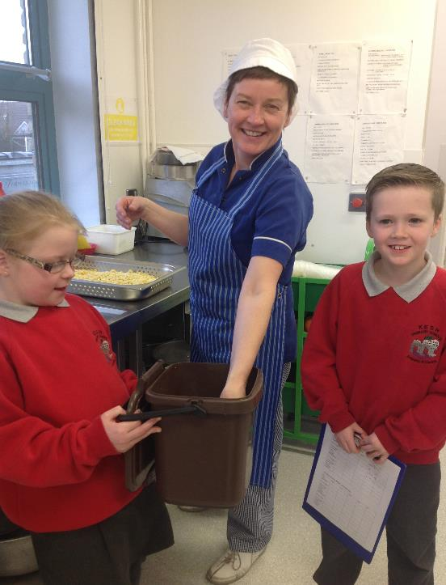
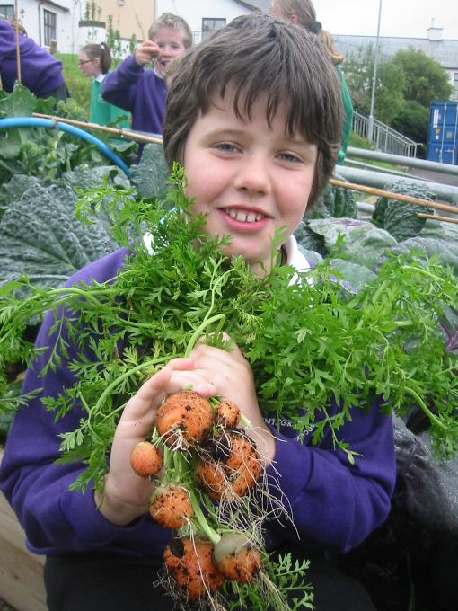

Be a Food Waste Hero
Notes:
Finish on a positive upbeat note, emphasising how food is delicious and good for us, and how everybody in the school can work together to reduce food waste and look after the planet. And you can reduce, reuse and recycle your food waste at home and your family can help too.
You might want to re-iterate:
We all need to eat the healthy food we are given to have enough energy to learn and to grow.
It takes a lot of effort to bring the food that is prepared for you every day to you (remember the farmer growing the food etc.)
The school cooks (or grown ups at home if you have a packed lunch) have put a lot of care into preparing the food for you.
Wasting food is not good for the environment.
Recycling food is good for the environment by producing compost from food waste, and it can save your school money too.

Slide 16

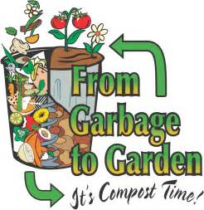

Food Waste Challenge
Useful Contact Information & Websites
Eco-Schools :028 9073 6920
chris.callan@keepnorthernirelandbeautiful.org
www.wrap.org.uk
www.recyclenow.com/local-recycling
Notes:
Your local council will also have resources and information on food waste and recycling facilities in your area. Their recycling education officer could even provide a talk to your school on the topic. The school could research what their local council are doing about Food Waste for schools and homes.
The link for WRAP will give you great information and ideas on food waste in schools. The link for Recycle Now will allow you to search for food waste recycling facilities that are close to you.

