Slide 1



















Slide 2










WELCOME,
STUDENTS!

Slide 3










LESSON FOR THE DAY
KEY STAGE 1

Slide 4








LANDFILL DEFINITION
CONCEPTS AND DEFINITIONS
A landfill is a place where we bury WASTE in the ground. We put WASTE in landfills because it's smelly and ugly.
Imagine if you just threw your WASTE out into the street: gross, right? Nobody wants to look at that. So we take it somewhere people don't live, and we bury it in the ground.
Then we don't have to smell it or look at it.
WHAT IS WASTE?
Waste is rubbish that goes to landfill
LANDFILL? WHAT IS THAT?
When you take out the trash, do you know where it goes?
On a truck!
But where does the truck go? Where is it taking all that waste and what happens to the waste afterwards?
That waste is probably going to a landfill.

Slide 5
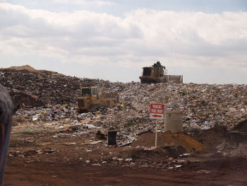
LANDFILL DEFINITION
CONCEPTS AND DEFINITIONS
A landfill is a place where we bury WASTE in the ground. We put WASTE in landfills because it's smelly and ugly.
Imagine if you just threw your WASTE out into the street: gross, right? Nobody wants to look at that. So we take it somewhere people don't live, and we bury it in the ground.
Then we don't have to smell it or look at it.
Problems with Landfills
When waste is in a landfill, we don't have to look at it.
But there are big problems with landfills.

Slide 6

What’s wrong with landfills?
2
Example 3
1
3
1
Landfills pollute the environment. The waste that we throw away includes a lot of dangerous chemicals. When rain falls on a landfill, it can wash the chemicals out into nearby lakes, rivers, and streams. This is bad for fish. It's also bad for people who drink the water.
Another problem is gas from landfills.
When waste rots in a landfill, it makes dangerous gasses.
These gasses are bad for the environment.
They can also cause health problems for people that live near the landfill.
Landfills are bad for animals. They aren't built where people live, but animals do live there.
We're basically dumping a bunch of waste all over those animals' homes.

Slide 7



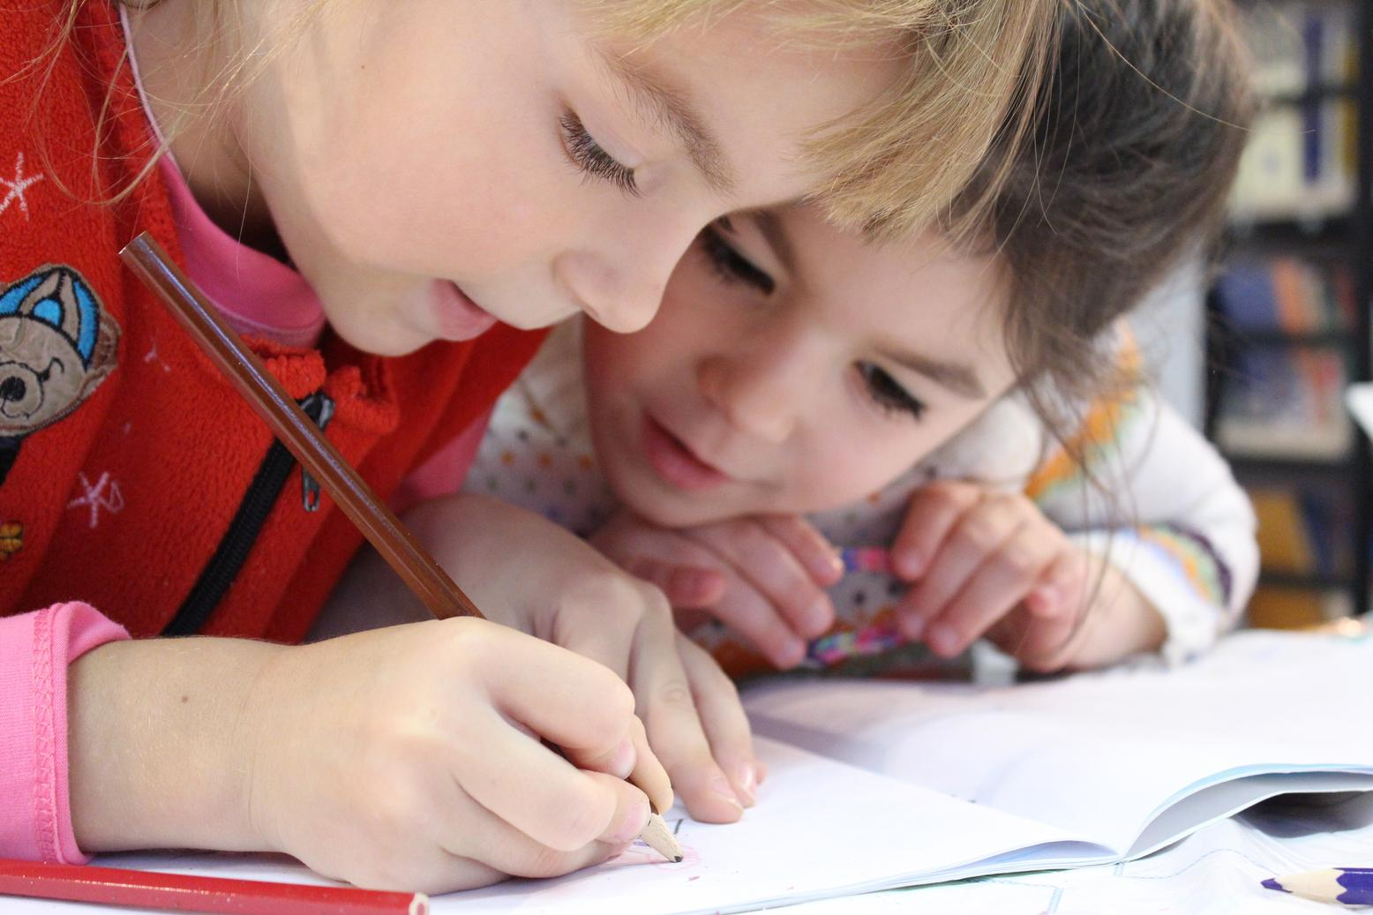
EXERCISE
This exercise can either be done in the classroom or at home!
Do you want to know how much waste goes to landfill and how you can do to reduce that?
Carry out a simple waste audit with the help of your teacher and/or your parents and count the number of bags of dry recyclable material, paper and non-recyclable material you and your friends collect.
Can you weigh them? How many Kilograms?
Remember to add this information to your Data Zone.
Tip
Do you want a fun way to do that?
1. Register for the Litter Less Campaign (LLC).
2. Organise small groups of little waste heroes and assign a role to each group.
3. The LLC toolkit to measure your data on dry recyclable material and paper will help you to keep track every month of what goes to landfill, what you can recycle and what you can reduce!
AND HOW MUCH YOUR SCHOOL CAN SAVE FROM LESS WASTE BEING SENT TO THE LANDFILL.

Slide 8
WORKSHEET
Goals
These study assessments will help you to:
Define landfill
Know one of their biggest problems
Understand why waste is placed there
Find ways to reduce waste
Name a positive thing happening with landfills
Question 1:
What is one big problem with landfills?
Question 2:
Why do we put waste in landfills?
Landfills are bad for the environment
Landfills do not hold enough waste
Landfills tend to catch fire in the summer
We are running out of space for landfills
It’s gross and smelly and nobody wants to look at it
It helps make the ground more stable
We do not put garbage in landfills
It reduces the formation of dangerous gases

Slide 9

ACTIVITY TIME
Did you know that a very important but sometimes forgotten waste is the WASTE OF WATER?
Waste No Water
You Will Need
Non-breakable containers (soup can, milk carton, etc – get them from your audit and remember to keep some for this game)
Water

Slide 10
ACTIVITY TIME
Did you know that a very important but sometimes forgotten waste is the WASTE OF WATER?
Waste No Water
How To:
Divide the kids into two teams.
Fill a clean container with water for each team. Ensure that the containers are of the exact size and are filled to the brim with water.
Now set a start and finish point.
When you signal ‘go’, the first player from the team has the run for the finish line, turn around, go back to his team and pass the container to the next person in line.
The team with the most water in the bowl or container will be the winner.

Slide 11
ACTIVITY TIME
Wrigley Litter Less Campaign
Run Your Campaign to tackle waste
How To:
The Eco-Committee can nominate a team in charge of the campaign.
Any pupil in the school can be part of this team
Why not organising more teams?
Register for the campaign. (Contact Eco-Schools NI team for more info)
Ensure that the whole school is aware of the campaign.
Continue to collect data about waste in school – this will contribute towards your school’s Green Flag!
Each month one of the teams will help the Eco-Committee collect data.

Slide 12


VIDEO

Slide 13

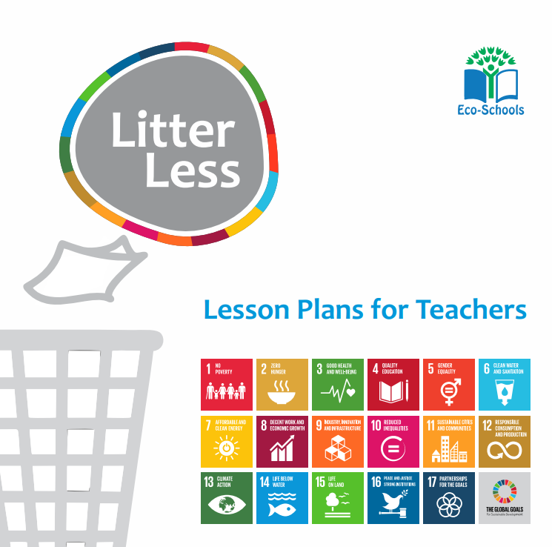
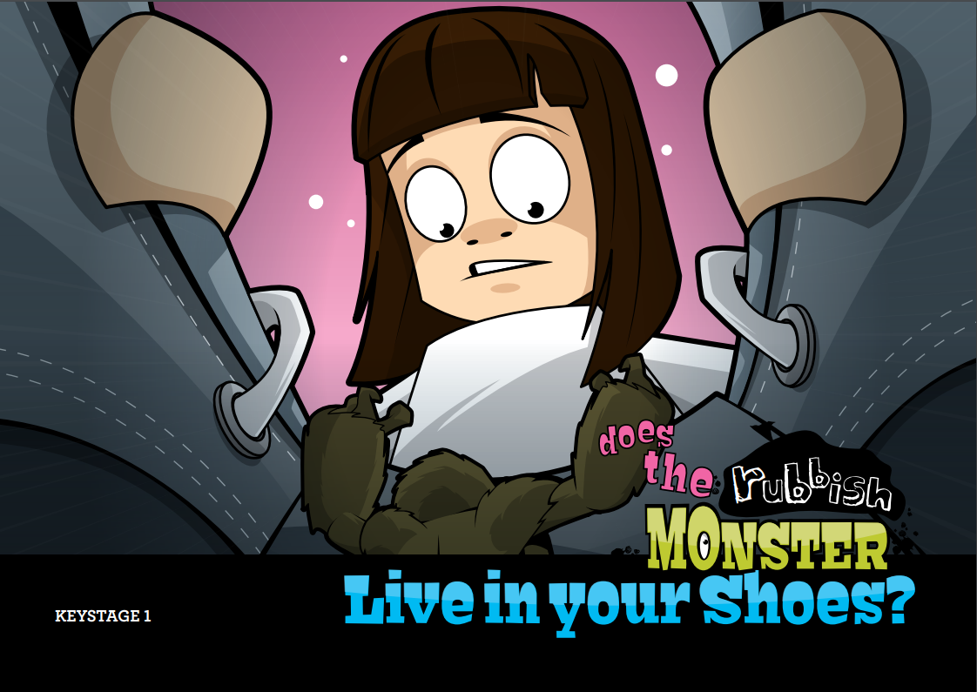
ADDITIONAL RESOURCES
Eco-Inspiration-Waste
Litter Less Eco-Schools Lesson Plans
Rubbish Monster KS1
https://www.eco-schoolsni.org/eco-schoolsni/documents/006534.pdf
https://www.eco-schoolsni.org/eco-schoolsni/documents/007474.pdf
https://www.eco-schoolsni.org/eco-schoolsni/documents/006510.pdf

