Slide 1




















Slide 2








WELCOME,
STUDENTS!

Slide 3
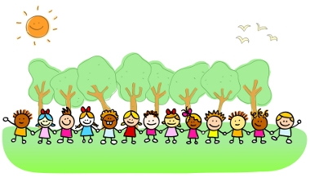




OUTDOOR LEARNING
KEY STAGE 4

Slide 4
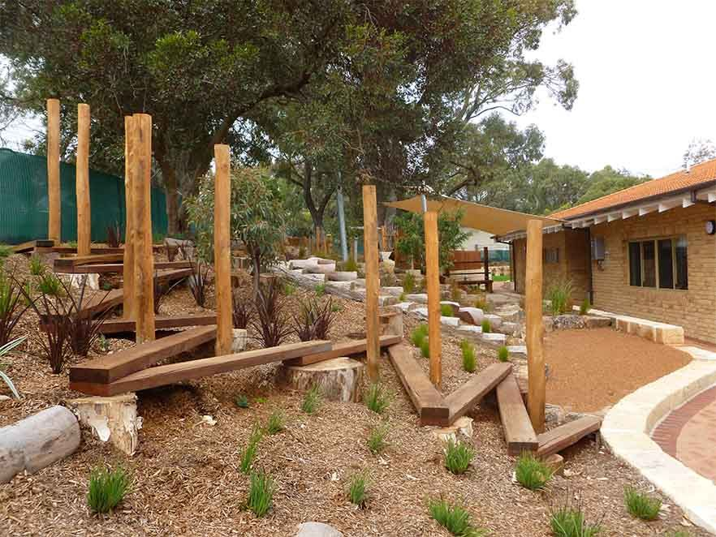

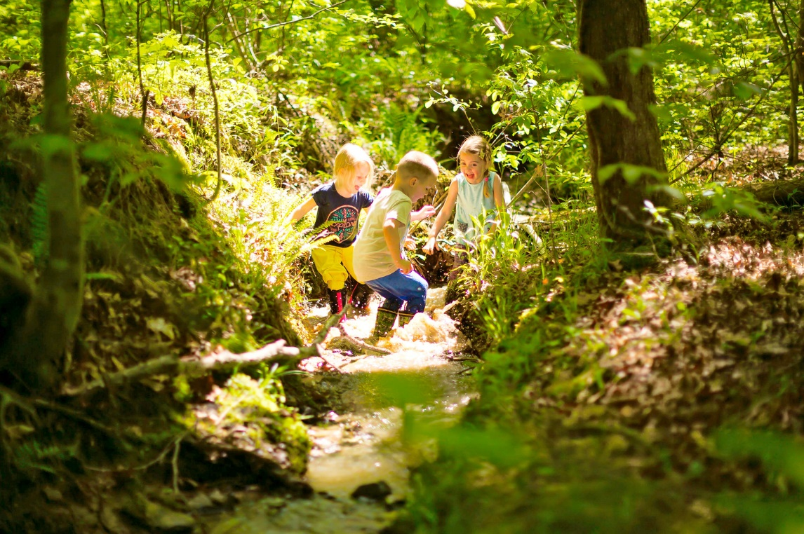
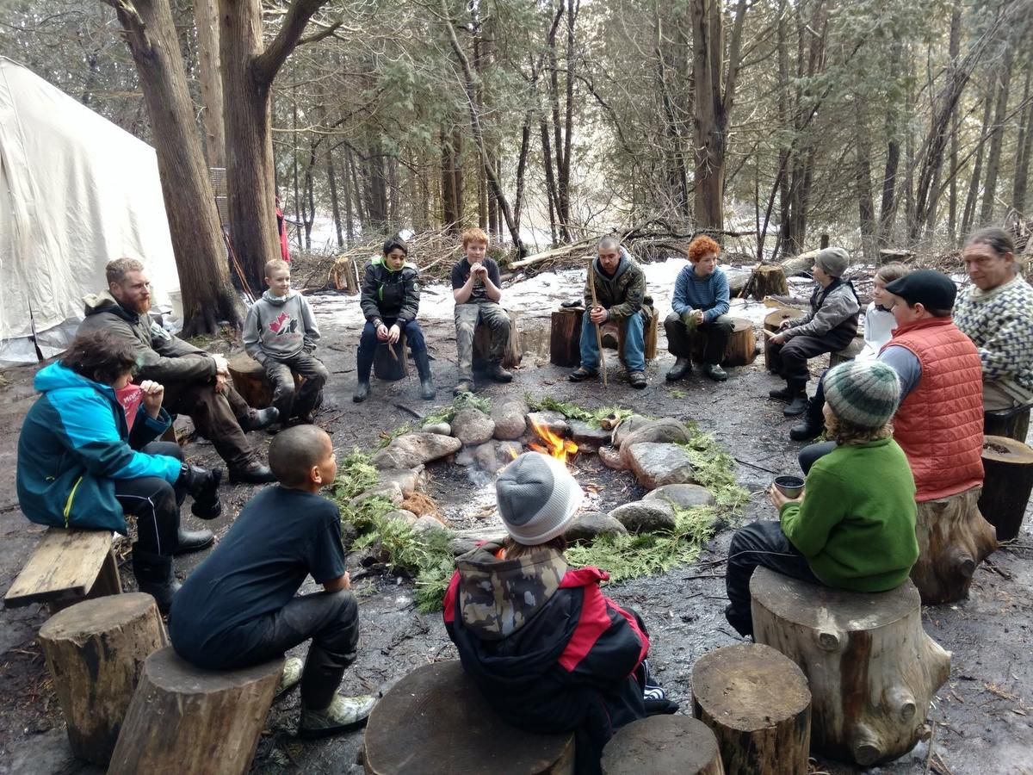
What is outdoor learning?
Outdoor Learning is a broad term that includes:
Discovery
Experimentation
Connecting to the natural world
Engaging in environmental activities

Slide 5

We are always learning!!
We learn both inside and outside the classroom.
We learn something new everyday.
We learn by seeing new things
hearing new sounds
smelling new things
touching new things
tasting new things.
We use all 5 of our senses when we learn outdoors.

Slide 6
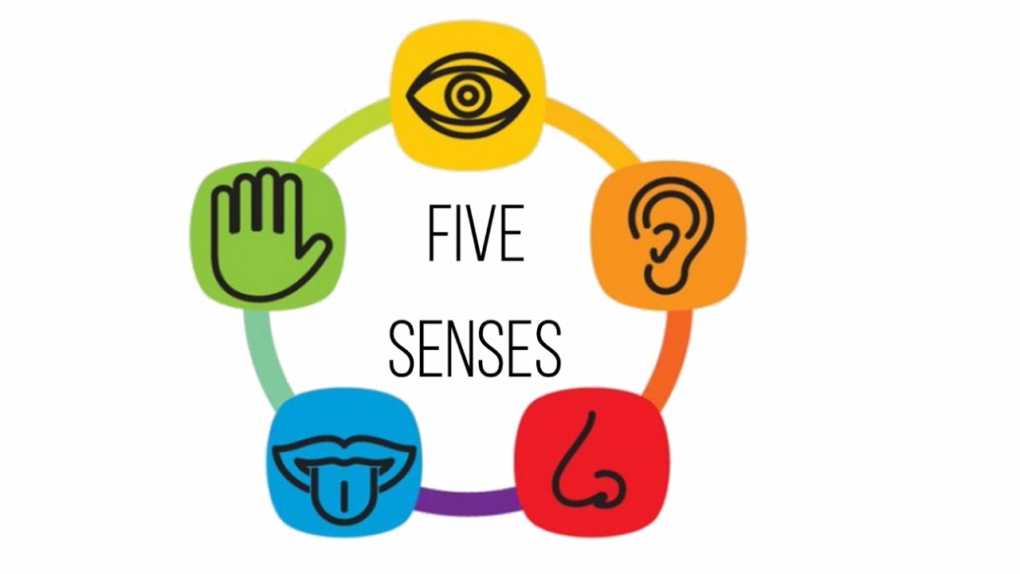
sight
touch
sound
taste
smell

Slide 7
Children will appreciate
colour
texture
smell
sound
shape

Slide 8


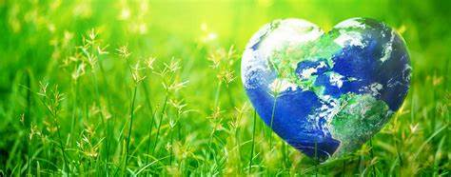
Benefits of outdoor learning
HEALTH
LEARNING
ENVIRONMENT

Slide 9


Benefits to learning
Playing outside helps children to develop physically, emotionally, cognitively, imaginatively and improve motor skills.
Develop creativity and problem solving skills.
Enhances enquiry skills and personal development.
They are able to interact with other children teaching them how to take turns, communicate and cooperate with each other.

Slide 10
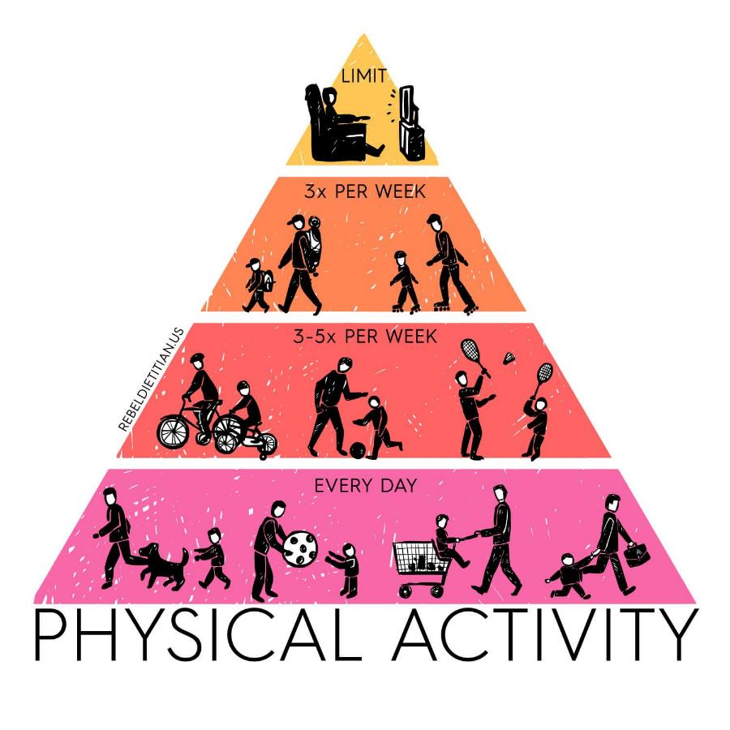
Benefits to health
Improves health and levels of physical activity in children.
Physical health can also influence a child’s ability to learn.
It is important for children who learn best through active movement. Different ways of moving improves coordination.
Burning off excess energy could help improve concentration levels.

Slide 11

Benefits to health
Spending time in nature and the natural light can improve your mood and reduce stress and depression.
Time in green spaces significantly reduces your cortisol, which is a stress hormone. Nature also boosts endorphin levels and dopamine production, which promotes happiness.

Slide 12
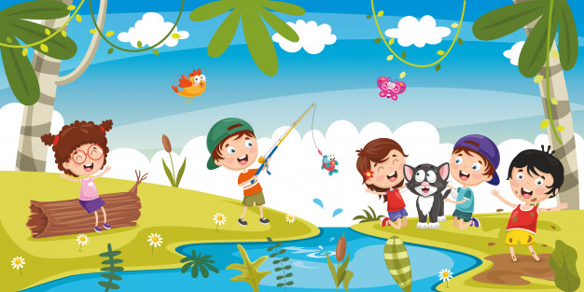
Benefits to ENVIRONMENT
Develop a love, appreciation and respect for nature and all that is living.
Develop a love and understanding of how we can look after the environment.
Develop a lifelong love of the outdoors.

Slide 13
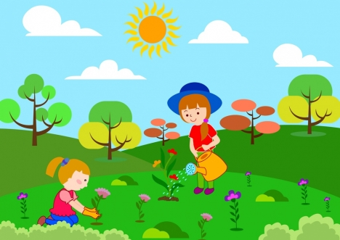
Benefits to ENVIRONMENT
Gives children contact with natural world and offers them experiences that are unique to outdoors, such as direct contact with weather and the seasons.
Helps children to understand and respect nature, the environment and the interdependence of humans, animals, plants and life cycles.

Slide 14
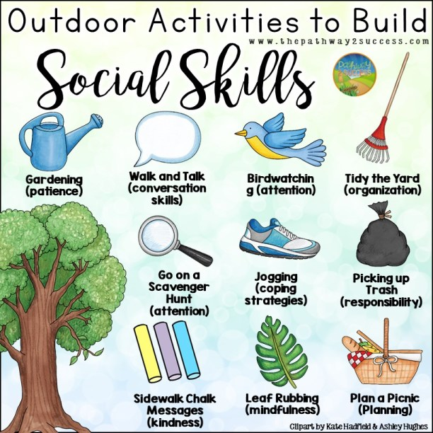


Slide 15

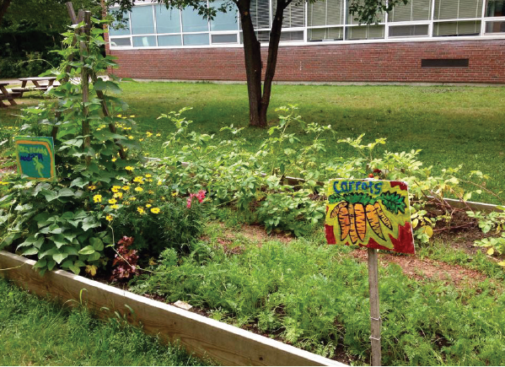
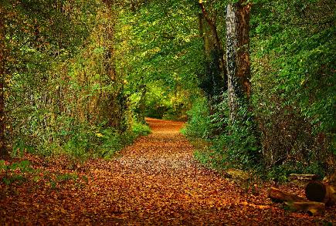
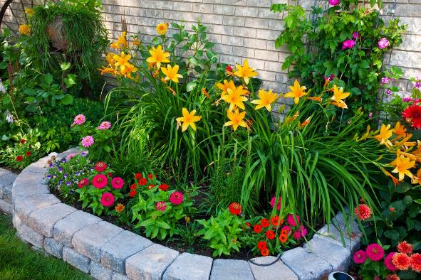
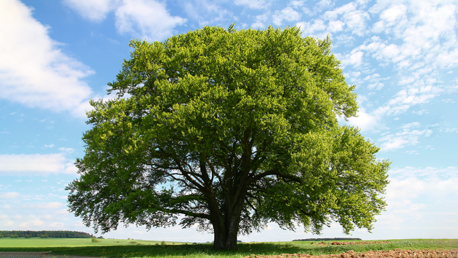
What do you see outside?

Slide 16
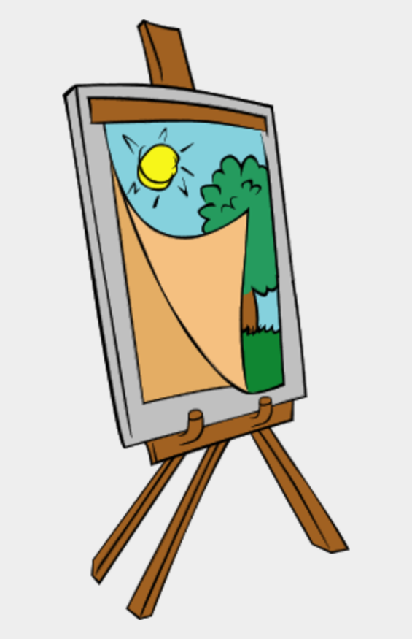
AL FRESCO ARTISTRY
Take your art lesson outdoors!!
What do you see?
A landscape
Plants
A tree
Birds
Draw what you see!!
Notes:
AL FRESCO ARTISTRY
The benefits of art for young children, where do we start? It promotes self-expression, confidence, creativity, accountability, attention to detail and the ability to accept feedback and criticism. And there’s nothing prouder than seeing one’s work adorning the classroom walls.
If weather permits, why bother confining your class to the indoors when it’s art time? Combine the benefits of art with the health effects of the outdoors. Challenge your learners to find something they find interesting - it might be a whole landscape, a simple plant, or perhaps a tree.

Slide 17
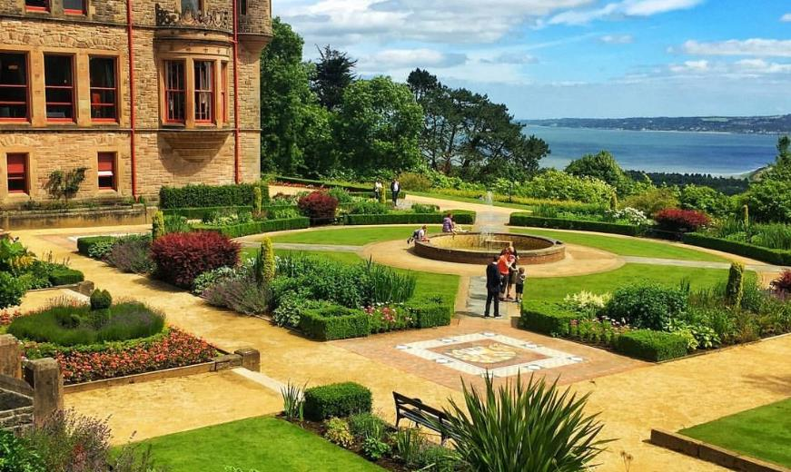
TEXTURE WALK AND REPORT
Explore your local natural area – school grounds or even your local park.
Describe what you see!!
How does it look?
What does it feel like?
What does it smell like?
What can you hear?
Notes:
TEXTURE WALK AND REPORT
Ask your class to explore their local natural areas - school grounds, or just nearby greenery - and get tactile with the surroundings. This is a fantastic physical and writing exercise.
Before setting off, have a classroom-wide thought shower about the potential words you might want to use to describe the texture walk. Get those imagination juices flowing - and perhaps ask them to find something that matches every adjective you brainstormed.
This activity combines physical activity - a refreshing walk - with the potential for follow-up English language learning. Ask the kids to describe what they discovered by writing a short report about ‘My Texture Walk’ - and challenge them to stretch their vocabulary. What did they enjoy, or find displeasing? What surprised them

Slide 18
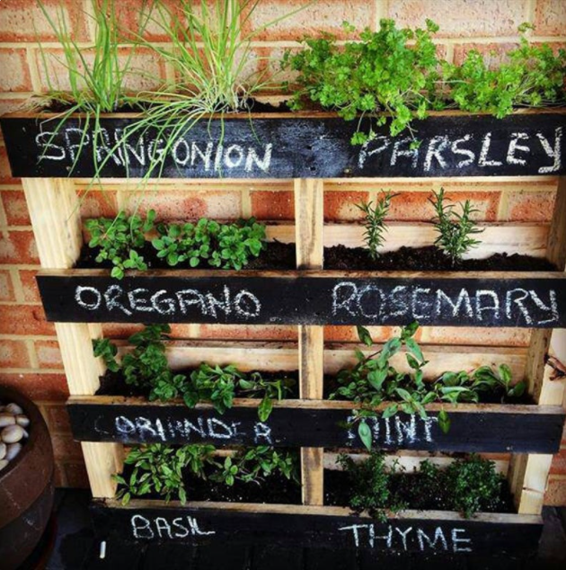
Bring the outdoors in!!
Grow your own mini herb garden!!
Visit your local garden centre to buy herb and pots.
Plant your herbs.
Place plants in a sunny window that receives at least 6 hours of strong sunlight each day.
Notes:
CLASSROOM MINI-GARDEN
We love this one as it’s not a one-off lesson - it’s something that grows and develops, providing endless opportunities for follow-up gardening lessons, as well as lessons about plant life and our ecosystem.
A mini-garden consisting of some specially-chosen plants is an unbelievably rich environmental learning resource. Teach the children about the natural environment and encourage them to be better global citizens!
If there’s not an abundance of space, we’re sure you’ll still be able to find a patch for some modest plants, or even potted plants outside. Why not ask the kids to draw what they’re growing?

Slide 19
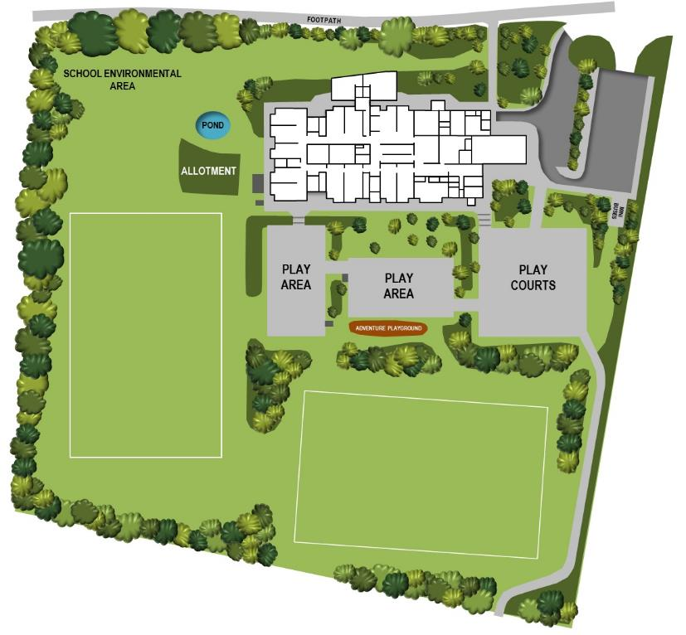
Plot the school grounds
Draw a detailed map of your school grounds.
Don’t forget to include the buildings, the carpark, the playground.
Are there any green areas?
Where do any animals live?
Don’t forget to label areas or create a key!!
Notes:
PLOT THE SCHOOL GROUNDS
Head outside for some geography, art and physical activity. Their job will be to create a detailed map of the school grounds. Grab the clipboards and head outdoors!
Challenge your young learners to include a key in the corner, and make use of symbols. Why not ask them to produce a written report about their experience, too? How would they describe the area they charted?
Make sure to include the best places to play, where the creepy crawlies live, and every other mini detail on the map! Get the students thinking about the direction, shape, and placement of all the things surrounding them at school

Slide 20
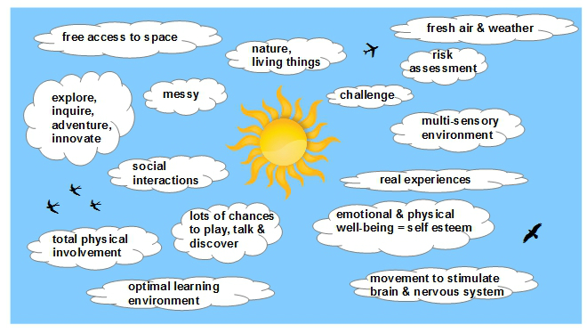

Slide 21
