Slide 1




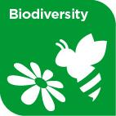










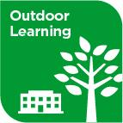

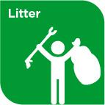


Slide 2









WELCOME,
STUDENTS!

Slide 3
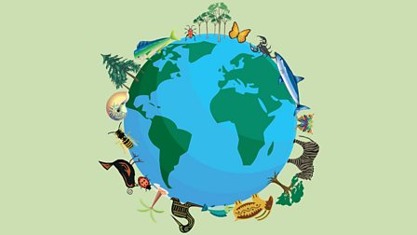
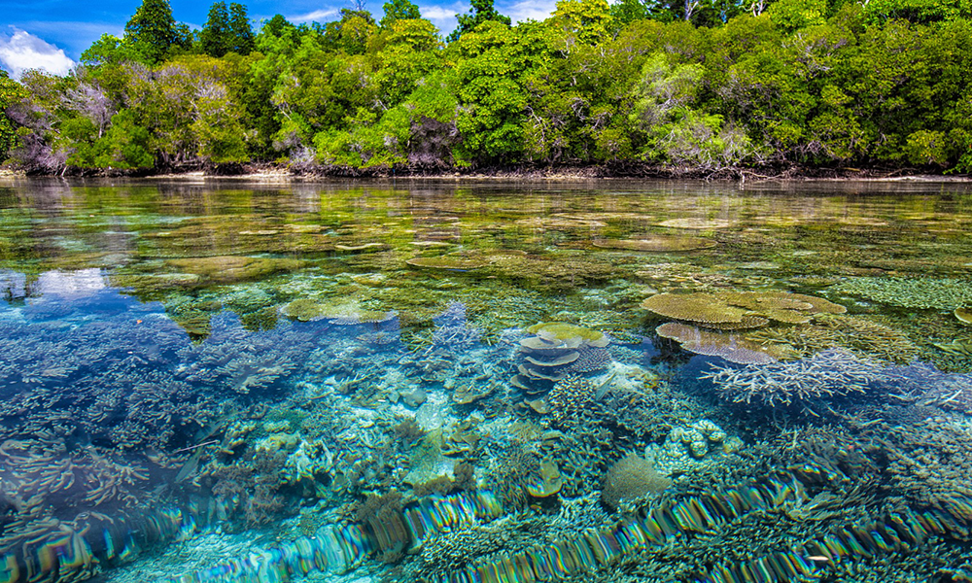

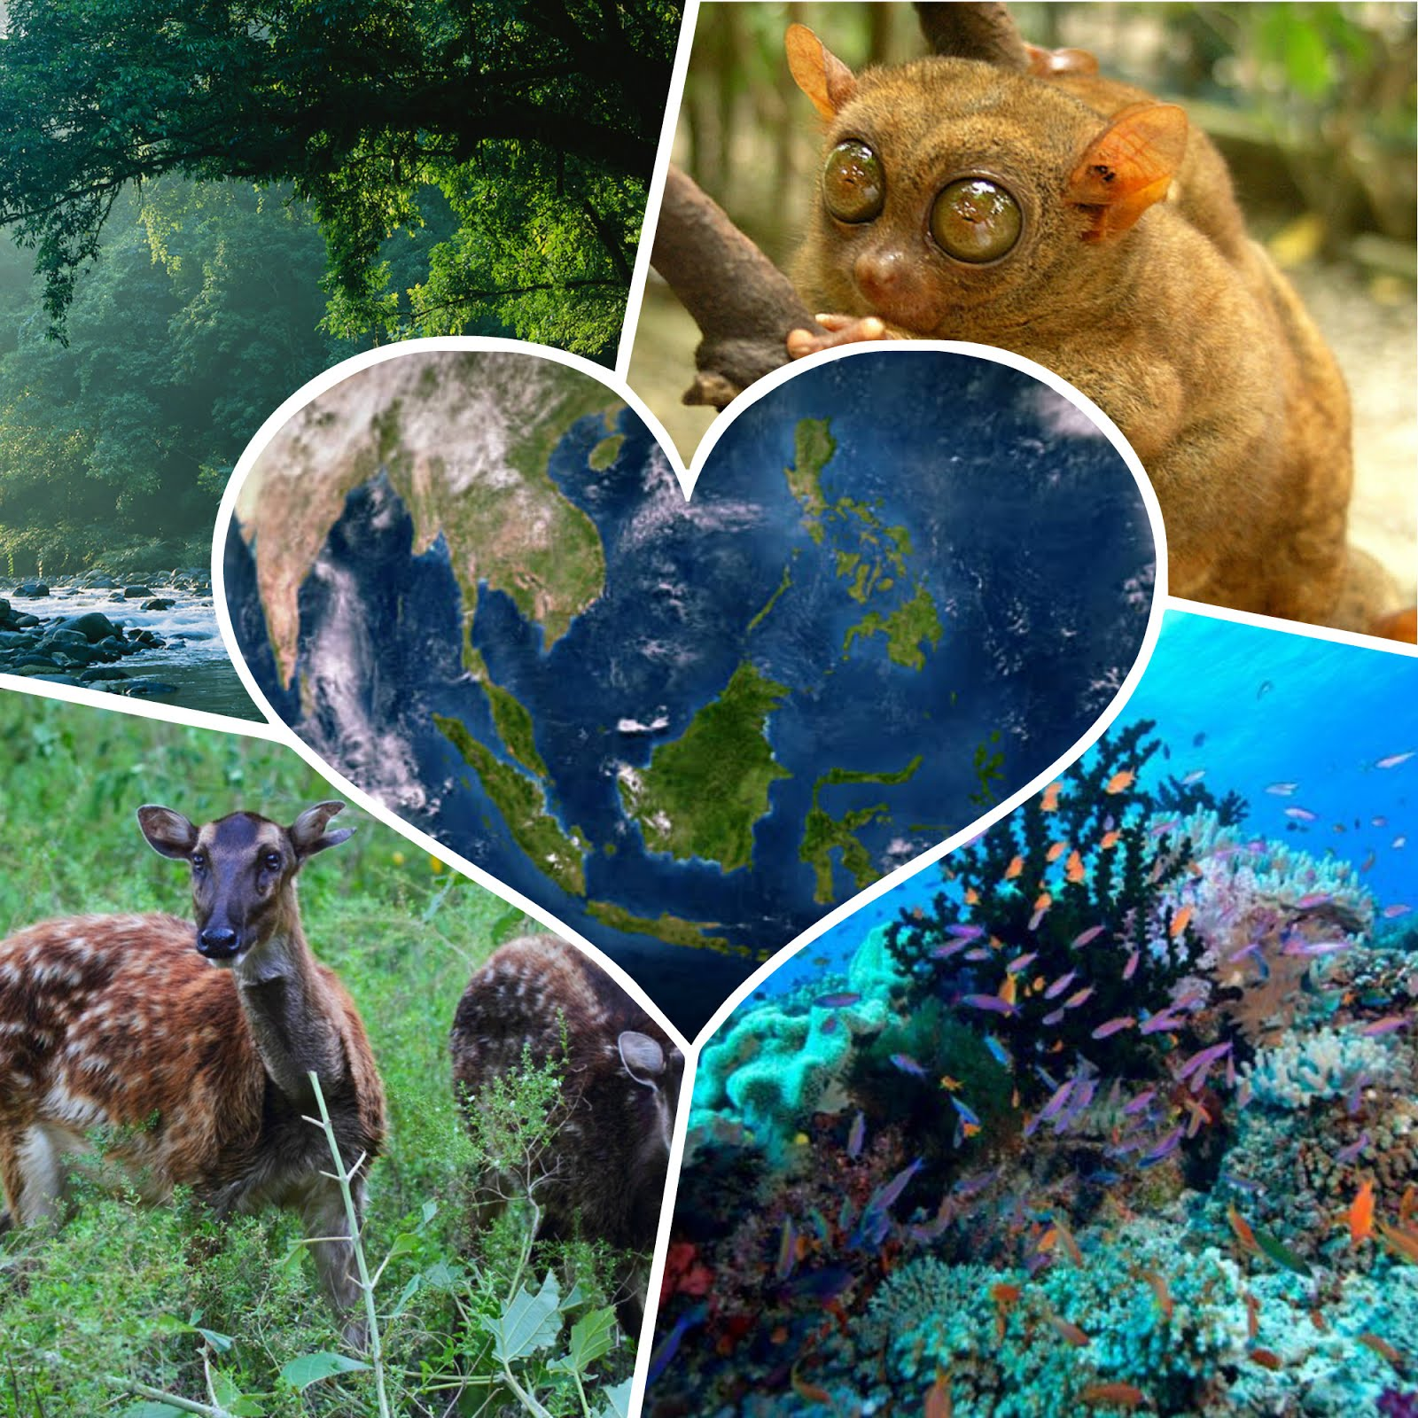
BIODIVERSITY
KEY STAGE 4

Slide 4
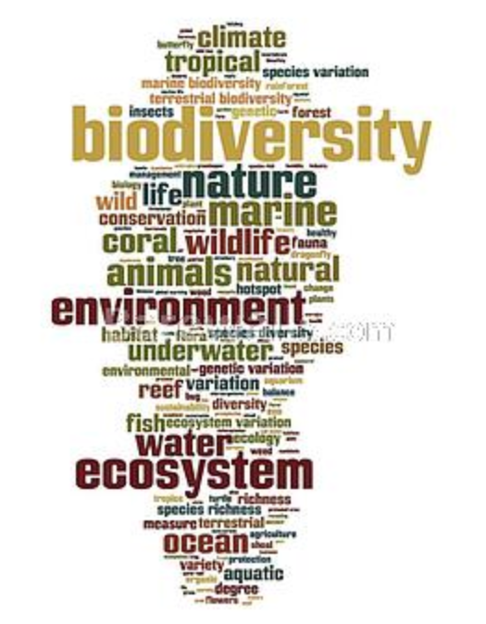
WHAT IS BIODIVERSITY?
BIO means LIFE
DIVERSITY means RANGE OF DIFFERENT THINGS
Biodiversity is all of the plants and animals species that are living.

Slide 5
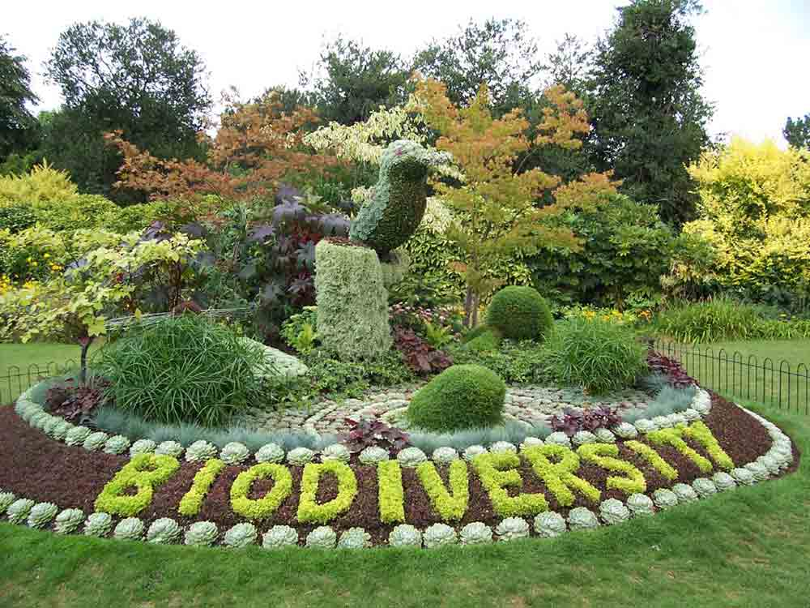

Slide 6
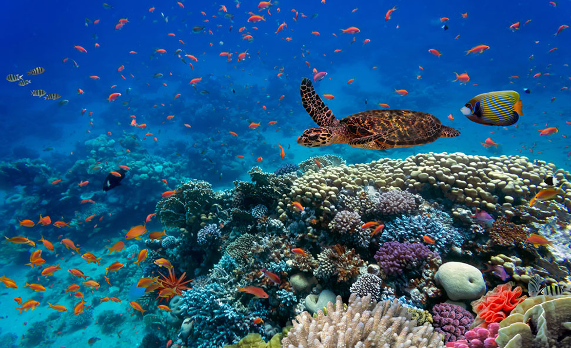
High biodiversity means many species of animal and plants.
High biodiversity

Slide 7
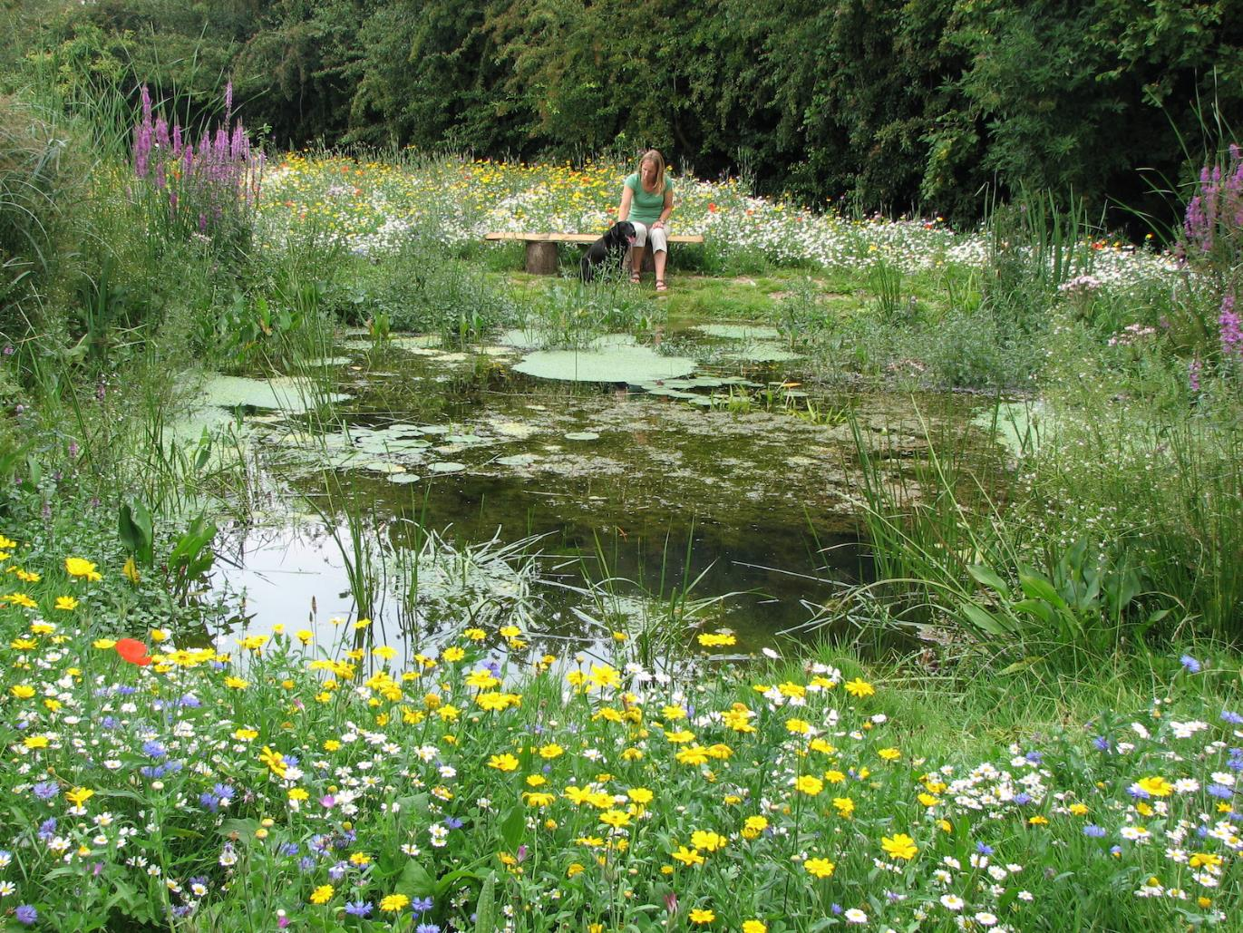

Slide 8
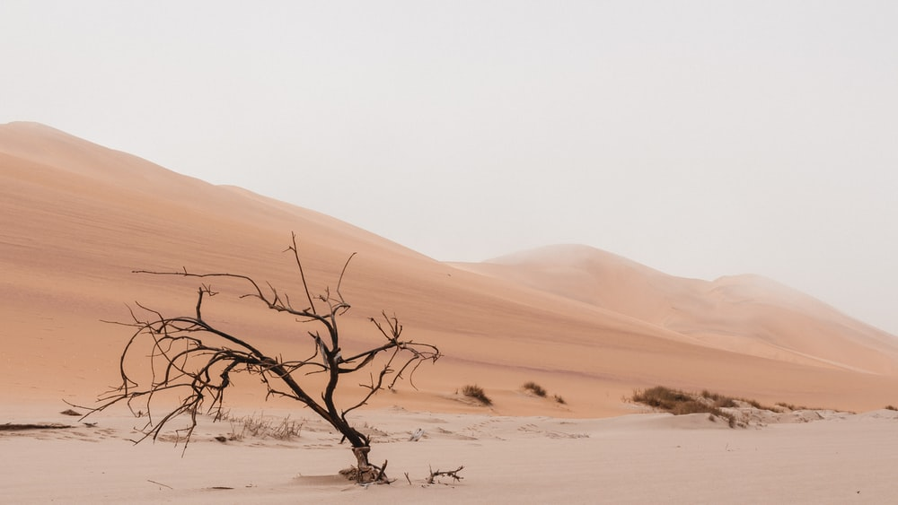
Low biodiversity means very few species of animals and plants.
low biodiversity

Slide 9
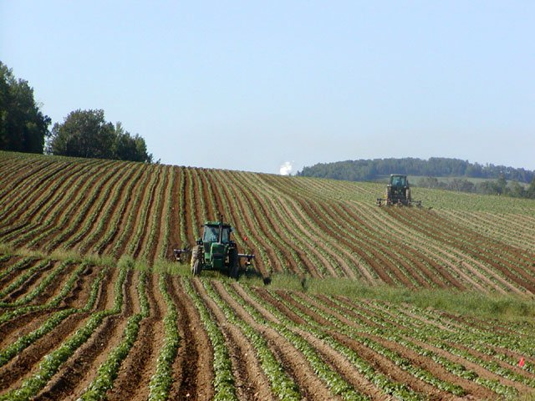

Slide 10

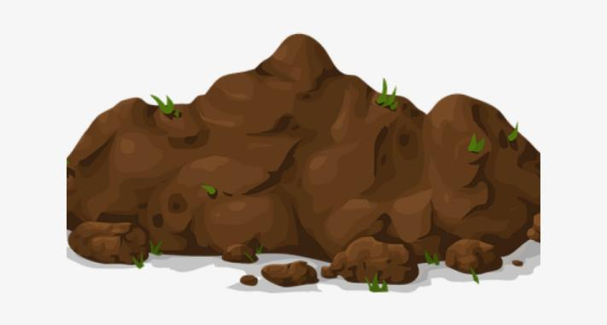
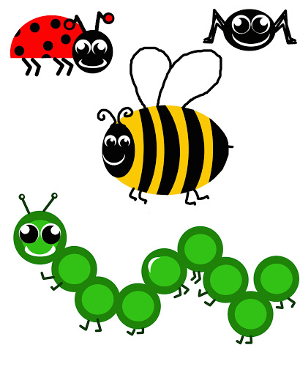
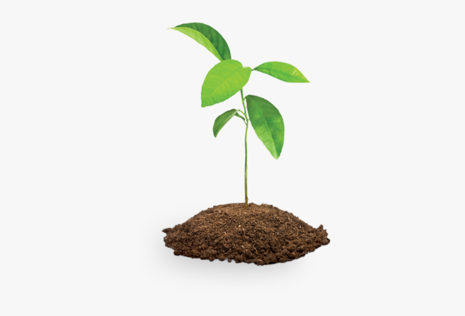
What is an ecosystem?
An ecosystem is a way that living things work together in their surroundings.
They need water, soil, plants, animals.
They all work together so if you take 1 thing away they wont work as well.

Slide 11
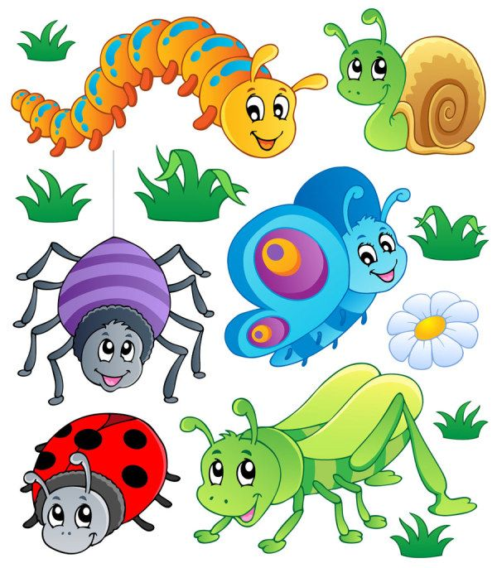
What is a minibeast?
A minibeast is a creepy crawly
They are the little bugs that crawl around the garden.
They provide food
pollinate flowers
spread seeds
help break down waste

Slide 12
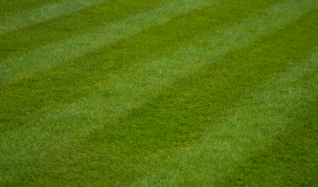
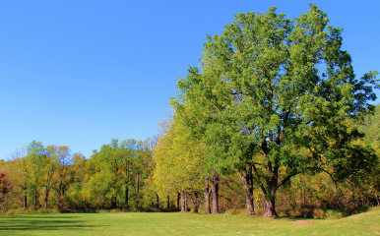
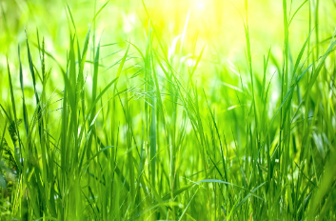


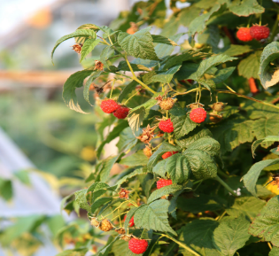
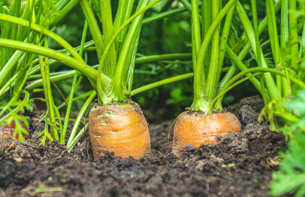



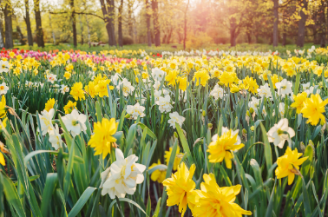
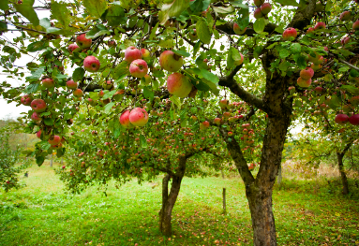
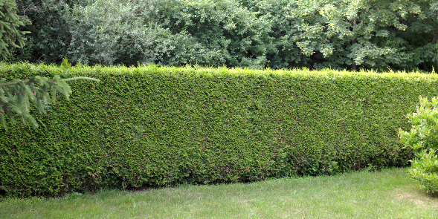


Types of plants

Slide 13
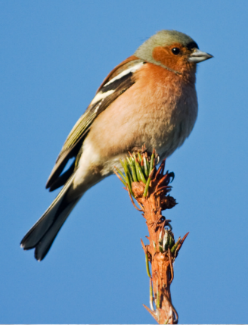
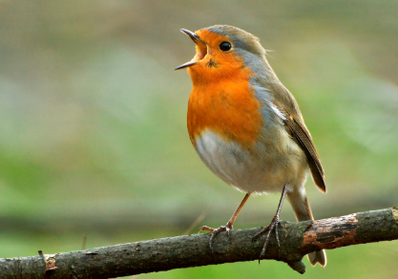
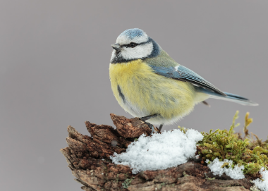



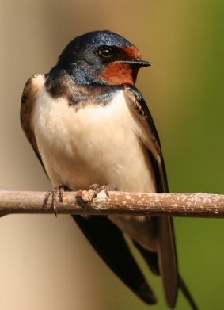
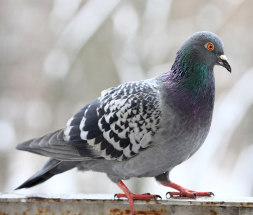
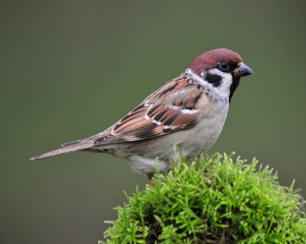
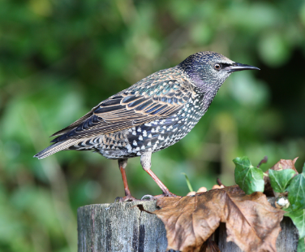




Types of birds

Slide 14
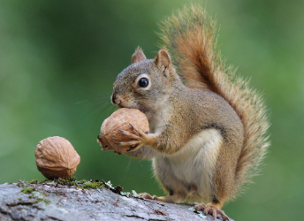
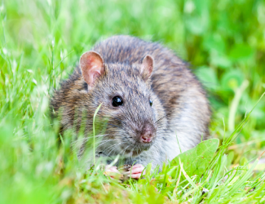

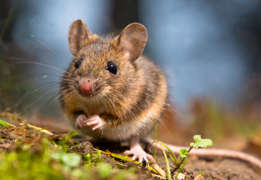
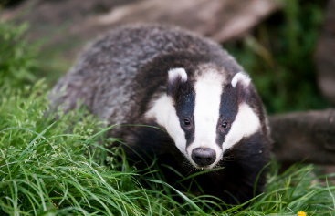

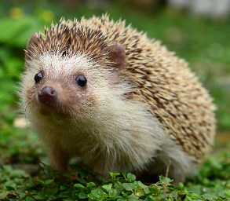


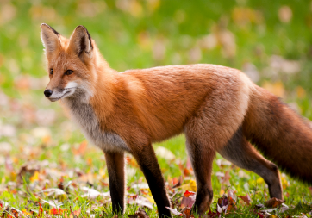


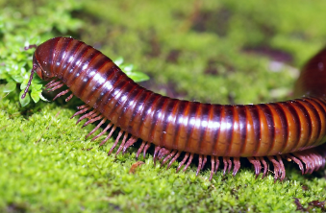
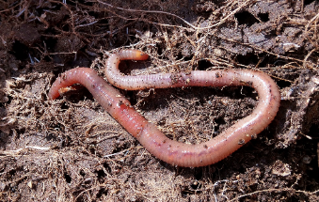
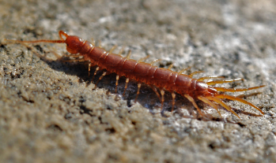



Types of animals
soil dwellers

Slide 15
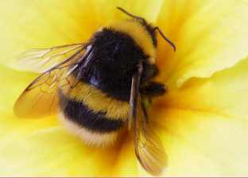
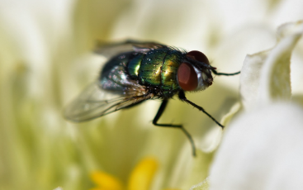
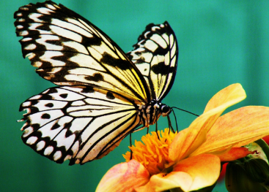
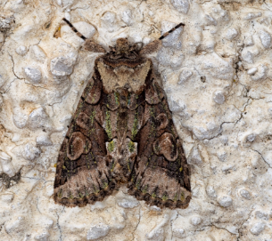


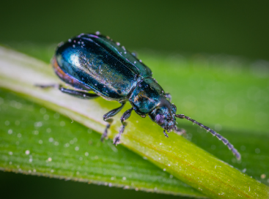

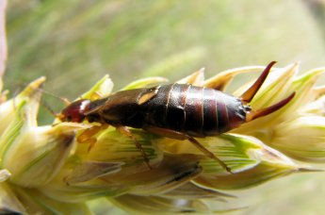
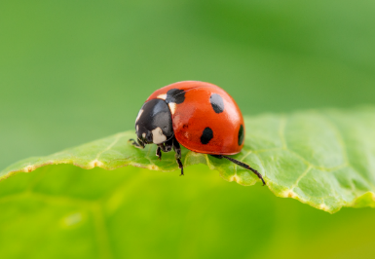


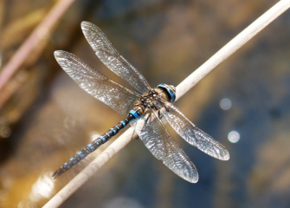


Types of insects

Slide 16
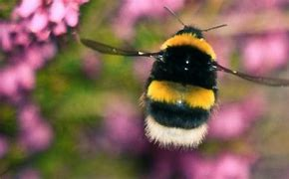
Types of bees
There are 99 different species of bees in Ireland.
1 honeybee
21 different bumblebees
77 solitary bees.
Bumblebees and solitary bees are known as wild pollinators.

Slide 17
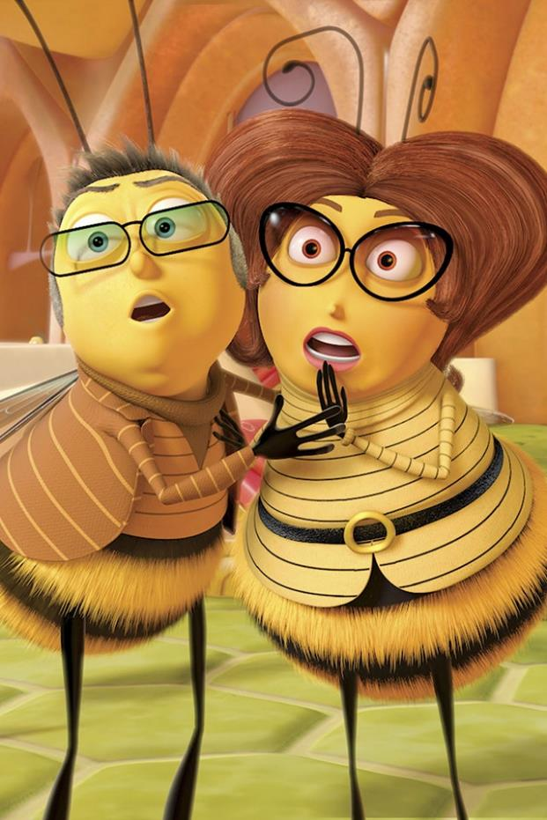
Types of bees
Honeybees live in hives and are managed and cared for by beekeepers.
Bumblebees have fat furry bodies. They make their nests on the ground, hidden in long grass or other vegetation.
Solitary bees nest in tiny holes in wood or hollow stems or make burrows in bare soil.

Slide 18


Bees are IMPORTANT FOR OUR ENVIRONMENT
As bees visit plants seeking nectar, pollen catches on their bodies and passes between plants, fertilising them – that's pollination.
Many plants would not be able to fertilise without bees and other pollinators, so this relationship is symbiotic as both bee and flower help each other to reproduce and succeed.

Slide 19

There are around 70 crops in the UK that depend or benefit from bee pollination.
Pollination by honey bees, wild bees and bumblebees is incredibly valuable for farmers. It is estimated that it would cost UK farmers £1.8 billion a year to pollinate their crops manually if wild bees disappeared.

Slide 20


Slide 21





3 REASONS HONEY BEES ARE IMPORTANT
They Pollinate Food Crops
Honeybees travel incredible distances to look for nectar.
As a result, we are able to enjoy many foods like cucumbers, cherries, apples, limes and lemons.

Slide 22


3 REASONS HONEY BEES aRE IMPORTANT
They Pollinate Wild Plants
Wild plants are major components of biodiversity.
They provide food to a wide variety of insects, birds and animals that constitute nature.
Without wild plants, these key players in the ecosystem would disappear.
There would be no milk, meat and other important foods we get directly from animals and birds.

Slide 23

3 REASONS HONEY BEES aRE IMPORTANT
They Produce Honey
It is only bees who can produce honey for us.
Natural honey is an important food that has immense benefits on our health.
Honey also reduces coughs, increases athletic performance, heals wounds and fight bacteria.

Slide 24


Slide 25






Bees are not the world's only pollinators. Flies, wasps, moths, beetles, butterfies and even some birds all pollinate, but they only visit flowers enough to feed themselves.
Estimates suggest we have over 1500 pollinating insect species in Britain, thought the true figure is likely to be much higher.

Slide 26
Bees are IMPORTANT FOR OUR ENVIRONMENT
Bees are a fantastic symbol of nature.
By keeping the cycle of life turning, bees boost the colour and beauty of our countryside.
Some 80% of European wildflowers require insect pollination.
Pollinators allow plants to fruit, set seed and breed. This in turn provides food and habitat for a range of other creatures.
So the health of our natural ecosystems is fundamentally linked to the health of our bees and other pollinators.

Slide 27
Bees are in danger of dying out!!
Pollution and disease
Pesticides and herbicides
Climate change
Habitat loss
Invasive species
Notes:
HABITAT LOSS – less forage and shelter for bees. Its vitals for bees to have enough flowers to forage and safe places to use for nesting among vegetation, soil, and hedges.
Since WW2 we’ve lost 97% of wildflower meadows leaving bees with little natural habitat.
CLIMATE CHANGE – changes in climate may be disrupting bee nesting behaviour. It may also affect the timing of flowering plants that bees rely on for food. Eg apple trees could be in blossom at a different time from when the bees are active.
PESTICIDES – these can have adverse effects on bees by reducing their breeding success and resistance to disease. Scientists have found that exposure to pesticides can impair honeybees ability to navigate, bumblebees ability to reproduce.
PEST AND DISEASE – honeybee diseases can spread to wild bumblebees.
INVASIVE BEES – some species that are not naturally found in UK can be disruptive or worse for native bees. Eg Asian Hornet recently arrived in UK and could devastate British bee species.

Slide 28
Climate change
Habitat loss
Changes in climate may be disrupting bee nesting behaviour. It may also affect the timing of flowering plants that bees rely on for food. E.g. apple trees could be in blossom at a different time from when the bees are active.
Less forage and shelter for bees. Its vitals for bees to have enough flowers to forage and safe places to use for nesting among vegetation, soil, and hedges.
Pesticides and herbicides
Invasive species
These can have adverse effects on bees by reducing their breeding success and resistance to disease. Scientists have found that exposure to pesticides can impair honeybees ability to navigate, bumblebees ability to reproduce.
Some species that are not naturally found in UK can be disruptive or worse for native bees. E.g. Asian Hornet recently arrived in UK and could devastate British bee species.

Slide 29

HABITAT PROTECTION
First and foremost is to protect existing natural habitats. This is key because once we destroy a complex, established ecosystem, it can be difficult or impossible to recreate what was there before.
Native hedgerows are vital for pollinators and wildlife. Off-road hedgerows should be allowed to grow.
It is important to reduce mowing grassy areas. This allows common wildflower to naturally grow among the grass.

Slide 30
HABITAT PROTECTION
Next comes restoration of existing areas to encourage plants to re-establish themselves. If grassland or hedges are cut too often or too hard they lose their value for bees (and countless other valuable bugs too). Trees and shrubs, verges and parks need to be allowed to flower and fruit. Bees need the nectar that flowers provide, while birds need the seeds.
Bees need to survive the winter and safe spaces to rear the next generation. Leaving rough uncut areas in parks or around hedgerow bottoms are perfect places for this.

Slide 31

HABITAT PROTECTION
Last but not least comes the creation of new habitat. Here every little does help, and the more we scale up our action, the more bees and other pollinating insects will benefit.
And not only insects. Higher quality green spaces bring us closer to nature. We know that our mental and physical health and well-being improve the more we are exposed to nature in our everyday lives.

Slide 32

Why do we need to protect our pollinators?
Farmers need pollinators to ensure good yields of high quality produce. Without pollinators the livelihood of farmers would be impacted.
Gardeners rely on pollinators for growing their own fruit and vegetables to feed their families.
Environment 78% of wild plants need insect pollination. Without these the landscape would be a much less beautiful place.
These plants provide shelter for our native wildlife.

Slide 33

WHAT CAN WE DO TO HELP?
Plant for pollinators: Grow more nectar-rich flowers, shrubs and trees to provide for pollinators throughout the year.
Let your garden grow wild: Leaving patches of land to grow wild let wildflowers grow and make great nesting and feeding sites.
Put away the pesticide: They can harm pollinators and many other beneficial invertebrates. Consider alternatives and only use pesticides as a last resort.

Slide 34

WHAT CAN WE DO TO HELP?
Leave the lawnmower: Cut your grass less often and remove cuttings to let plants flower.
Build a bee hotel and avoid disturbing or destroying nesting or hibernating insects in grass margins, bare soil, hedgerows, trees, dead wood or walls.

Slide 35
4 things you can do to save our bees!!
When planning your garden, plant flowers and shrubs that will flower in Spring or Autumn.
Have a little more space? Grow a fruit bush.
When gardening consider leaving an area uncut to allow daisies, dandelions and other flowers to grow.
Don’t have a garden? You can grow flowers and plants in pots.

Slide 36
Pollinator plan for your school
Draw a habitat map of your school.
Identify areas where you can take action to help pollinators.
www.pollinators.ie pollinating insects and what they need to survive.
Protect wildlife spots you already have.
Areas of long grass with wildflowers, flowerbeds or native trees.
Reduce mowing.
Make your own “Don’t Mow” or “Pesticide free zone” signs for school.

Slide 37





Plant pollinator friendly flowers.
Plant pollinator friendly trees.
The best native trees are:
hawthorn
willow
Blackthorn
Wild cherry
Crab apple

Slide 38




SUMMER
Plant pollinator friendly flowers for every season of the year.
The best ones are:
AUTUMN
Monarda
SPRING
WINTER
Perennial Wildflower
Crocus
Snowdrop

Slide 39




SUMMER
Plant pollinator friendly herbs for every season of the year.
The best ones are:
AUTUMN
Chives
Sage
SPRING
WINTER
Marjoram
Rosemary

Slide 40




SUMMER
Plant pollinator friendly fruit and veg for every season of the year.
The best ones are:
AUTUMN
Strawberry
SPRING
WINTER
Runner beans
Kale
Raspberry

Slide 41


Reduce or eliminate pesticides in your school.
Find out from the school caretaker if they use pesticide and could they reduce it?
Only use herbicide for health and safety reasons. E.g. to stop areas becoming slippery.

Slide 42


Slide 43

Provide safe nesting sites for bees.
Bumblebees are solitary bees live in small colonies.
They aren’t aggressive.
They are no risk to the public.

Slide 44









Slide 45



Slide 46



Slide 47



