Slide 1



















Slide 2







WELCOME,
STUDENTS!

Slide 3






Healthy eating
KEY STAGE 2

Slide 4
Avoid eating too many fatty foods
Drinking lots of water every day
Eating food that is good for us
What is Healthy Living?
Getting some form of exercise every day
Getting plenty of sleep every night

Slide 5


Ther are 5 main food groups
Fruit and vegetables
Carbohydrates
Proteins
Dairy
Fats

Slide 6
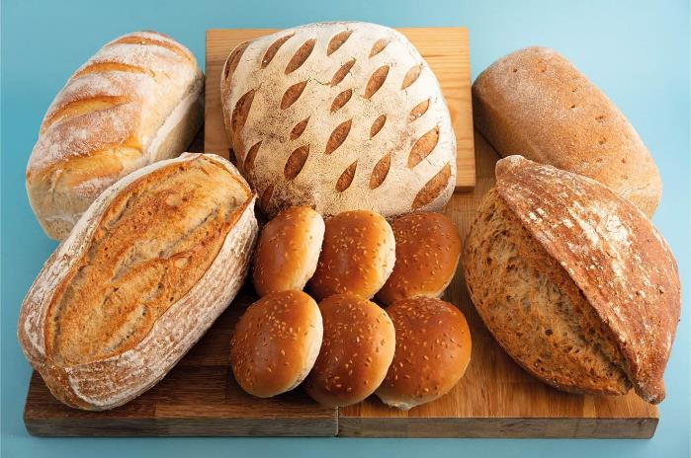
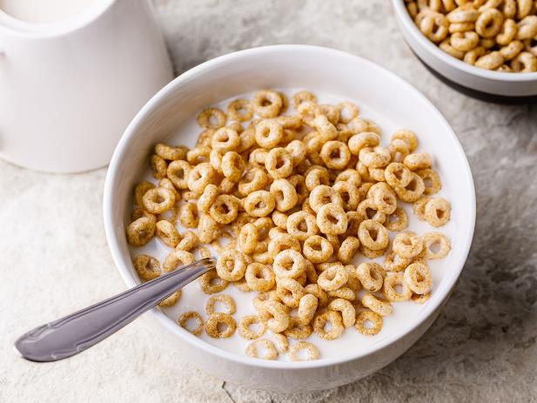
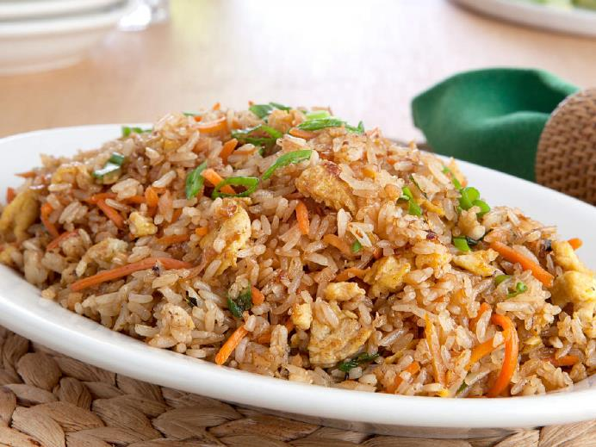

carbohydrates
Bread, rice cereal and pasta are healthy.
They give us energy.

Slide 7



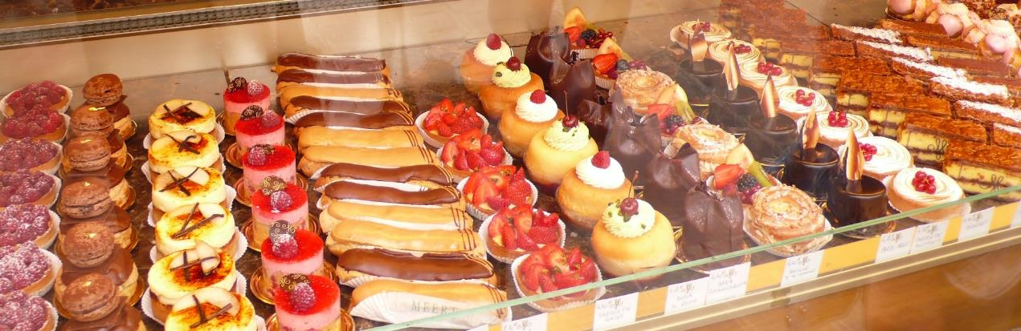
carbohydrates
Sweets, sugary drinks, pastries, sugary cereals are “bad” carbohydrates.
They also give us energy but should only be eaten as a treat!!.

Slide 8


Slide 9
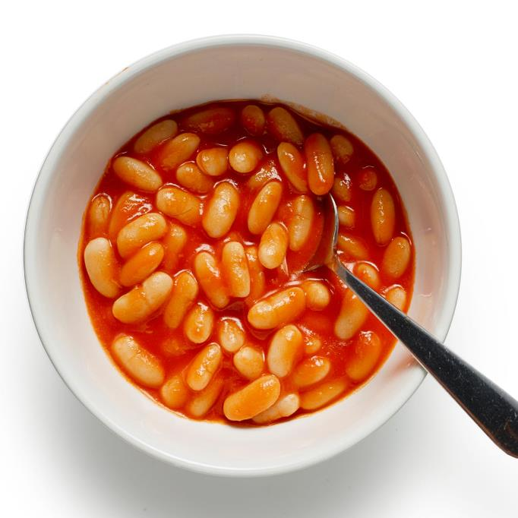

protein
Meat - beef, chicken
Fish
Beans
Eggs
These help muscles to grow and repair

Slide 10


dairy
Dairy products include food items such as yogurt, cheese and butter.
These contain Calcium for healthy teeth and bones.

Slide 11
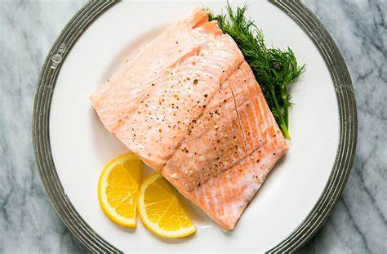
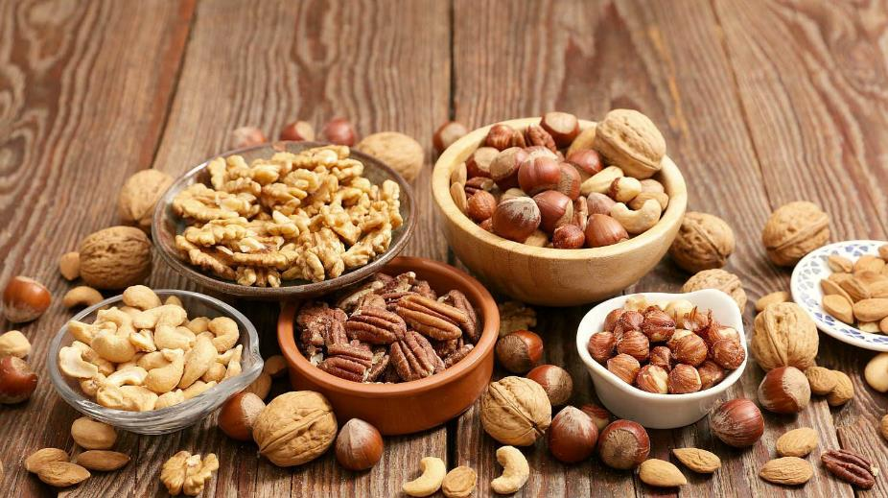
fats
There are good fats like seeds and nuts. Fish like salmon is also a healthy fat.
Fats give us energy

Slide 12
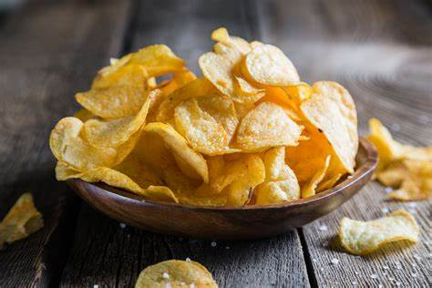
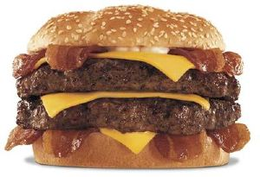
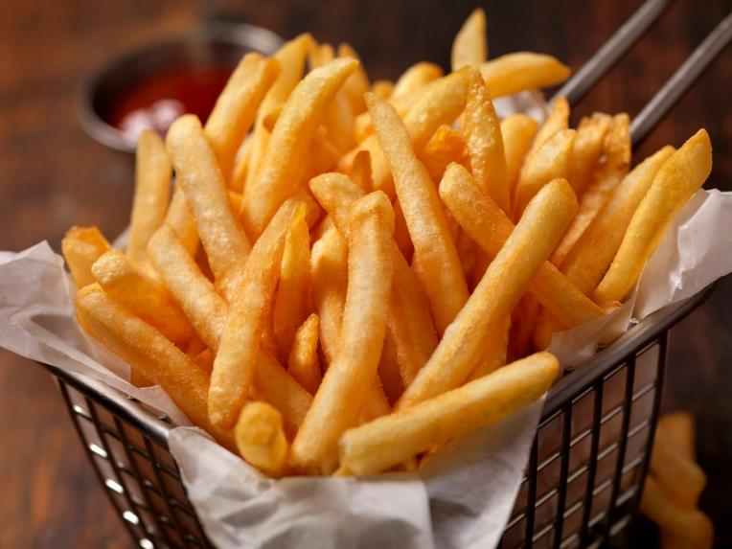
fats
There are “bad” fats. These come from processed foods and animal products.
You can eat these but not every day!!!

Slide 13

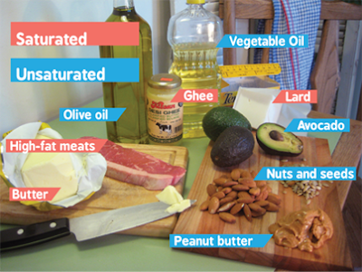

Slide 14
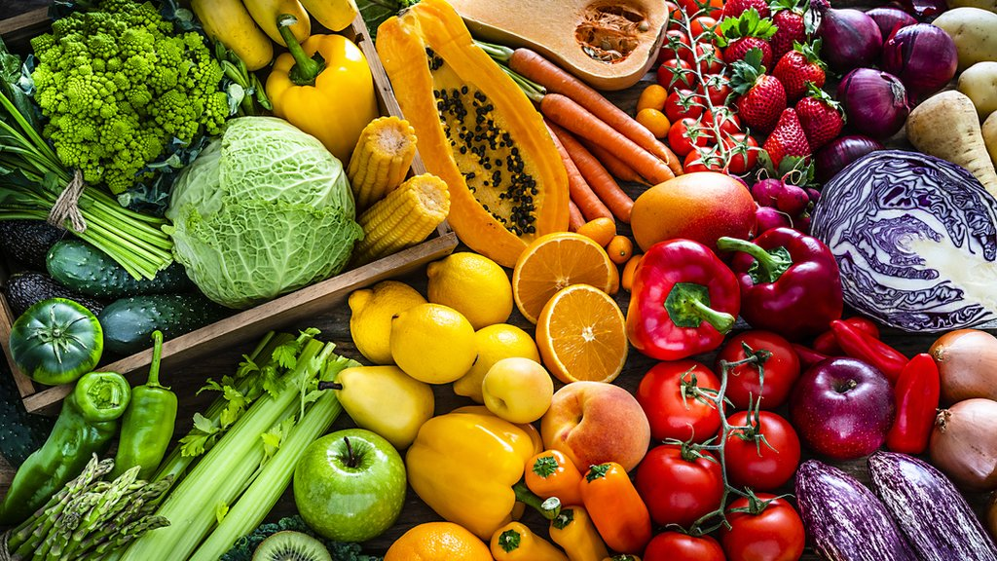
FRUIT AND VEGETABLES
We should try to eat 5 portions of fruit and veg every day.
Theses gives us vitamins and minerals that keep us healthy.

Slide 15
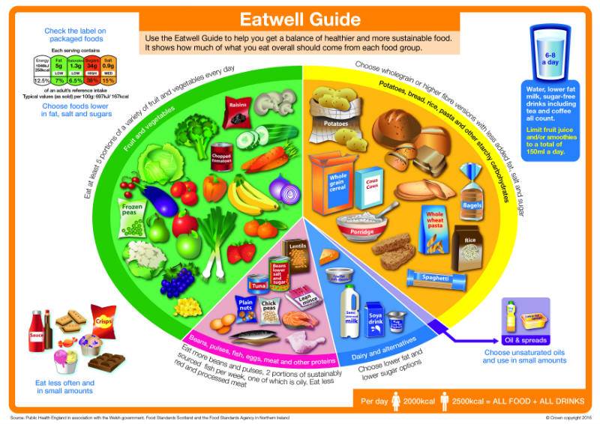

Slide 16
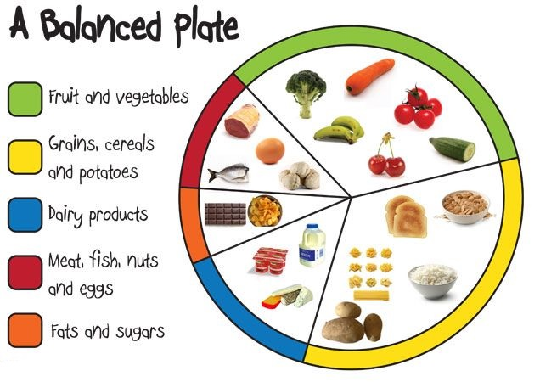

Slide 17
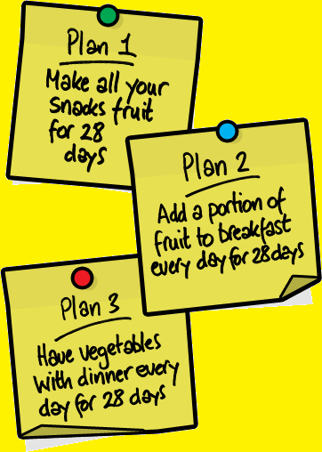
Our body needs a balanced diet. This should include:
At least five portions of fruit and vegetables per day
Starchy foods such as bread, rice, potatoes and pasta. Choose wholegrain varieties wherever possible
Milk and dairy products such as cheese and yogurts
Meat, fish, eggs, beans and other non-dairy sources of protein
Only a small amount of foods and drinks high in fats and/or sugar

Slide 18

We should drink 6-8 glasses of water a day. – around 1.2 to 1.5 litres.
Water, lower fat milk and sugar-free drinks, including tea and coffee, all count.
WATER IS THE BEST!!!

Slide 19
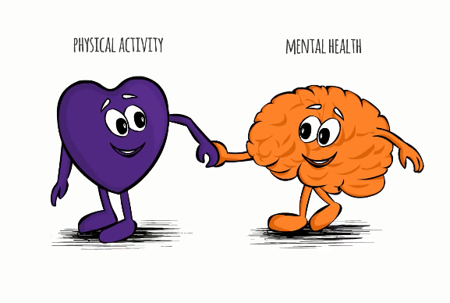
Benefits of healthy diet
There is research to suggest that what we eat may affect not just our physical health, but also our mental health and wellbeing.
Improving your diet may help to:
improve your mood
give you more energy
help you think more clearly.
Notes:
Read more: https://www.which.co.uk/news/2019/06/three-food-waste-facts-everyone-needs-to-know/ - Which?
Read more: https://www.which.co.uk/news/2019/06/three-food-waste-facts-everyone-needs-to-know/ - Which?

Slide 20
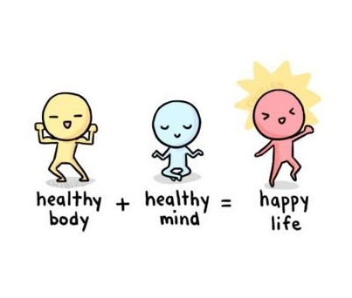
Exercise and healthy mind
Exercise can have a big impact on your mood.
Exercise can:
increase your energy levels
help you get a good night's sleep
help you get out and be with people
help you feel more in control
Notes:
Read more: https://www.which.co.uk/news/2019/06/three-food-waste-facts-everyone-needs-to-know/ - Which?
Read more: https://www.which.co.uk/news/2019/06/three-food-waste-facts-everyone-needs-to-know/ - Which?

Slide 21

Exercise and healthy mind
Children and young people need to aim for 60 minutes of activity spread throughout the day.
Walking to school
Playground activities
Skateboarding
Rollerblading
Walking the dog
Cycling
Notes:
Read more: https://www.which.co.uk/news/2019/06/three-food-waste-facts-everyone-needs-to-know/ - Which?
Read more: https://www.which.co.uk/news/2019/06/three-food-waste-facts-everyone-needs-to-know/ - Which?

Slide 22


Exercise and healthy mind
Activities to strengthen muscles and bones
Walking
Running
Gymnastics
Basketball
Football
Rugby
Tennis
Sits ups or press ups
Notes:
Read more: https://www.which.co.uk/news/2019/06/three-food-waste-facts-everyone-needs-to-know/ - Which?
Read more: https://www.which.co.uk/news/2019/06/three-food-waste-facts-everyone-needs-to-know/ - Which?

Slide 23
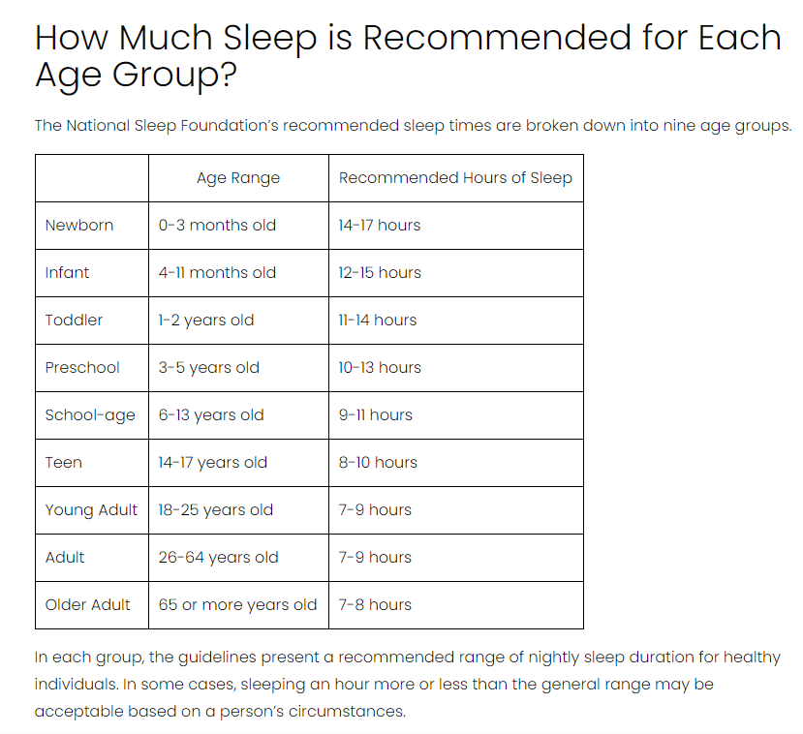


Slide 24

Exercise and healthy mind
Improve you sleep pattern by going to bed at the same time.
Make sure your bed and pillow is comfortable.
Minimise disruptions from light and sound.
Turn off electronic devices for half hour or more before bed.
Don’t drink sugary drinks before bed
Notes:
Read more: https://www.which.co.uk/news/2019/06/three-food-waste-facts-everyone-needs-to-know/ - Which?
Read more: https://www.which.co.uk/news/2019/06/three-food-waste-facts-everyone-needs-to-know/ - Which?

Slide 25
Bitesize.
Key Stage 1
World Around Us
Food and Farming – What is healthy eating?

Slide 26
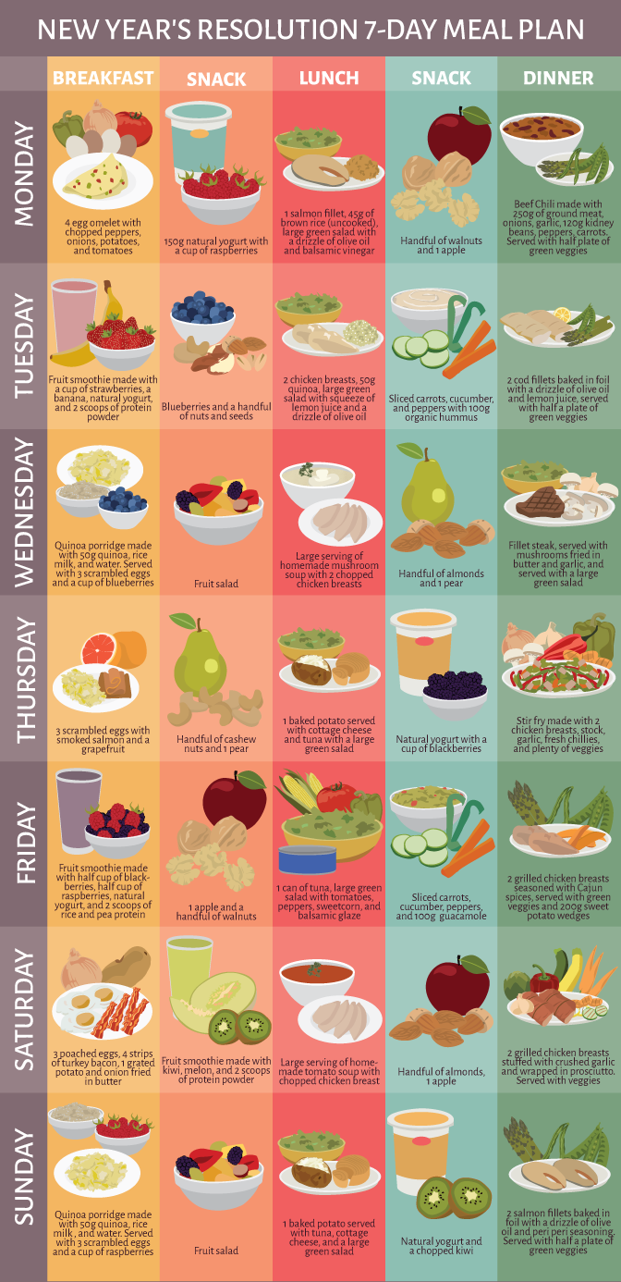
Plan a healthy meal plan
BREAKFAST
SNACK
LUNCH
SNACK
DINNER
SNACK
Notes:
Plan a healthy meal plan for 1 day.
Design your own healthy lunchbox on the template in KS2 LUNCHBOX

Slide 27
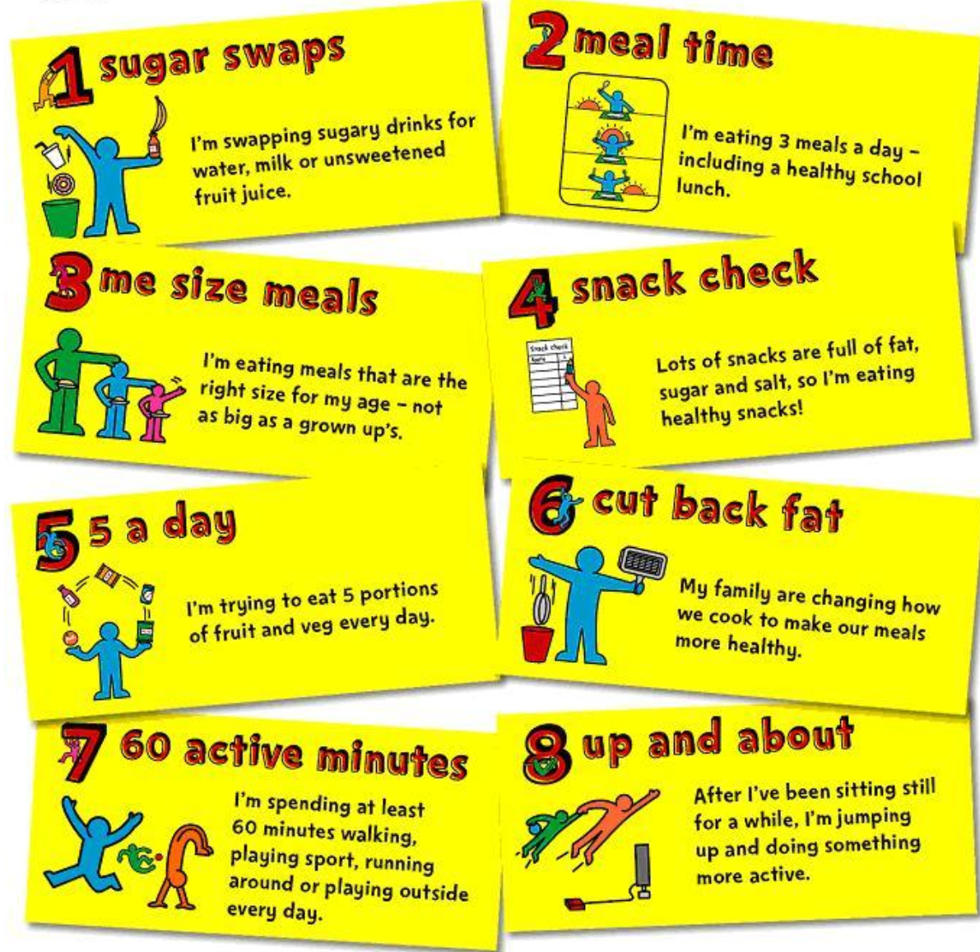
Notes:
Create a poster with at least 5 things you should do to make sure you lead a healthy life.

Slide 28





MATERIALS NEEDED FOR CLASS
List the things your students need to get ready before class. It can be a particular textbook, the accomplished homework due for the day, or any specific materials for the topic you're about to discuss. You can also match it with corresponding photos or icons.

Slide 29





CLASS OBJECTIVES AND RULES
Objectives inform students the learning outcomes of the class. What will they know? What will they be able to do? Why is this important to know? It's an effective way to assess their learning progress.
Rules provide the structure necessary for an engaging and productive class. Keep it simple and easy to follow. It can be general to cover different situations or very specific to your students.

Slide 30




LESSON FOR THE DAY
KEY STAGE 2

Slide 31







CONCEPTS AND DEFINITIONS
Get the ball rolling by introducing the lesson's key concepts and its corresponding definitions. Duplicate this page as many times as needed to give you more space for discussion. Pair the concepts and definitions with relevant images too for a more visualized presentation of the lesson.

Slide 32

EXAMPLES AND ILLUSTRATIONS
Example 1
Example 2
Example 3

Slide 33




EXERCISE
Add instructions or guidelines here.
You can also put in the amount of time allotted for this.
Individual exercises extend a student’s grasp of the lesson. It allows them to synthesize on their own and think of ways they can apply their new learnings in real life. Duplicate this page as many times as needed to give you more space for discussion.

Slide 34

Question 2: Write the question you want to ask your students and allot space for the answers.
WORKSHEET
Answer 2:
Add instructions or guidelines here. You can also put in the amount of time allotted for this.
Question 1: Write the question you want to ask your students and allot space for the answers.
Question 3: Write the question you want to ask your students and allot space for the answers.
Answer 1:
Answer 3:

Slide 35

ACTIVITY TIME
Add instructions or guidelines here.
You can also put in the amount of time allotted for this.
Like seatworks, student-led activities that can be done by pairs or by group widen their grasp and interpretation of the lesson. Be creative with the activity. Duplicate this page as many times as needed to give you more space for discussion.

Slide 36

SUPPLEMENTAL VIDEO
Let your students watch relevant educational videos that help reinforce the lesson for the day. It’s no secret that it helps students stay interested and engaged. Duplicate this page as many times as needed.

Slide 37



ADDITIONAL RESOURCES
Duplicate this page as many times as needed to give you more space for discussion.
Photos or screenshots of relevant articles are also effective in reinforcing a class lesson.
Maximize this space for additional resources you want to share with your students.
It's something they can easily look back on or search online in case they need a refresher.

Slide 38



CLASS RECAP
Discussion Point
Discussion Point
Discussion Point
Discussion Point
Discussion Point
Cap off a productive class with key summary points students can easily remember.
You can provide this for the class as a way of wrapping up everything you've discussed.
You can provide this for the class as a way of wrapping up everything you've discussed.
You can provide this for the class as a way of wrapping up everything you've discussed.
Recaps can also be led by students for a more enriching experience.

Slide 39


HOMEWORK
Add instructions or guidelines here. You can also put additional details on when and how to submit.

Slide 40


























FREE ICONS
Use these free recolorable icons and illustrations in your Canva design.

Slide 41





















FREE RESOURCES
Use these free recolorable icons and illustrations in your Canva design.

