Slide 1



















Slide 2







WELCOME,
STUDENTS!

Slide 3
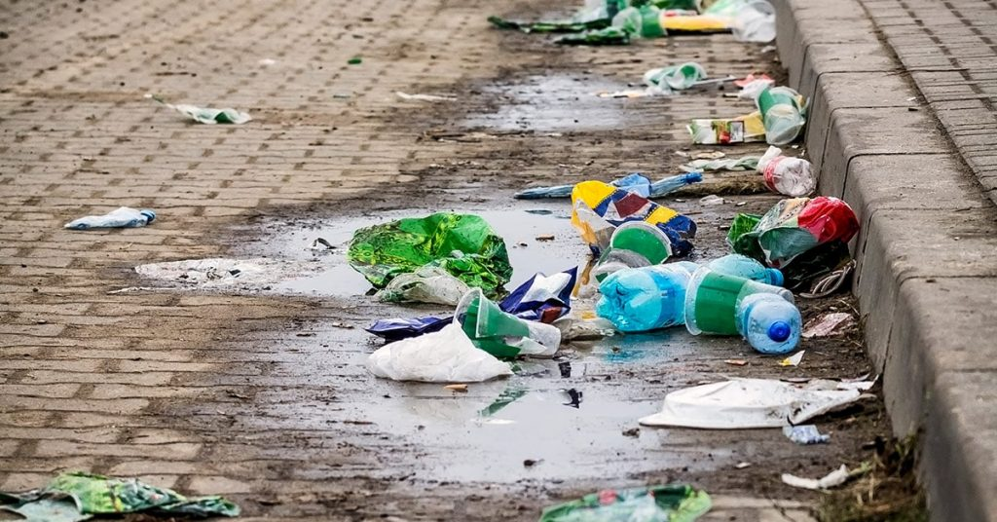
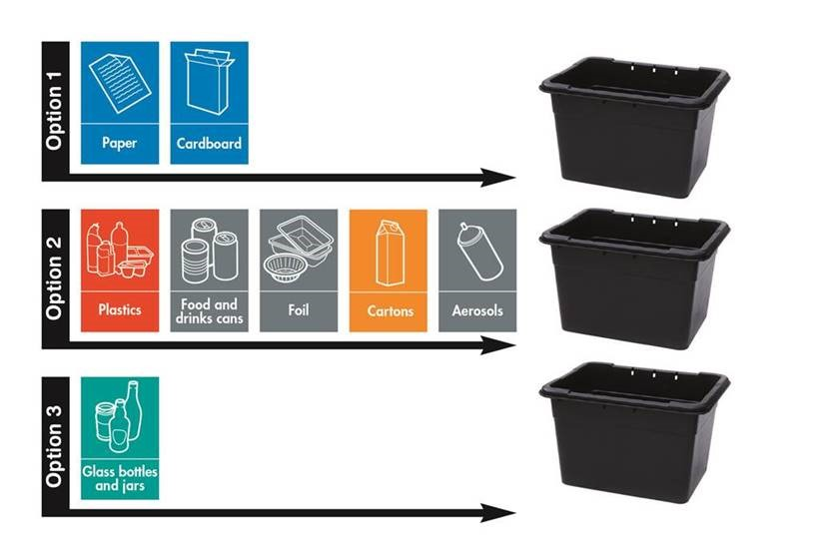
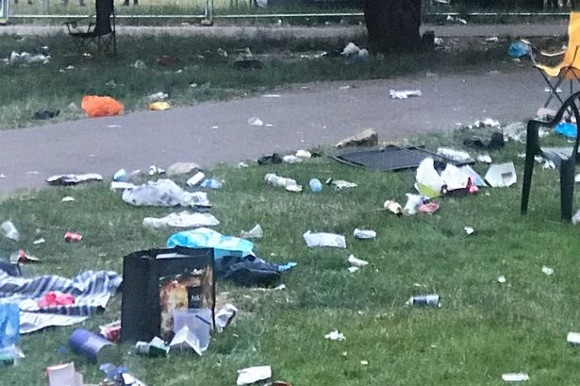

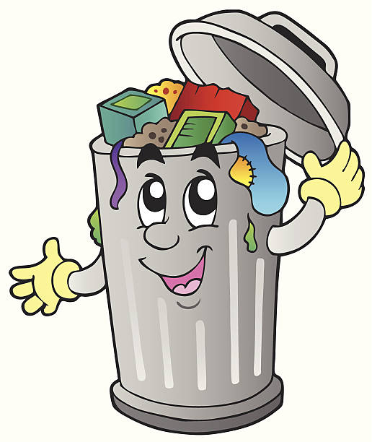



What is litter?
Key stage 4

Slide 4
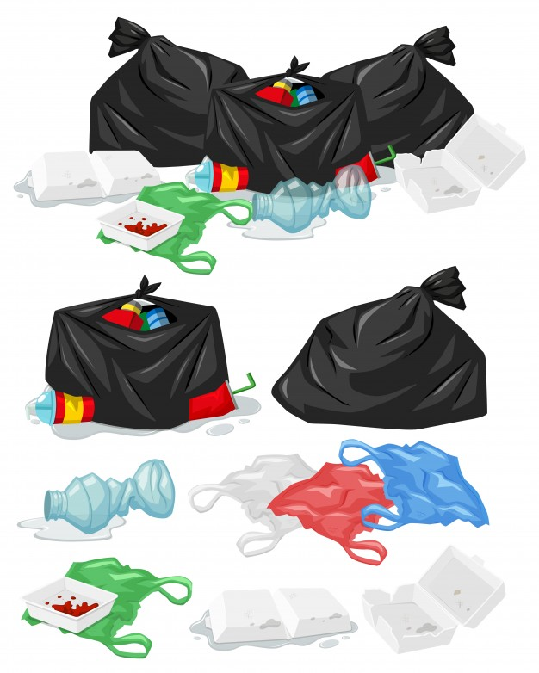
Class objectives
What are the different types of litter?
How does littering affect the environment?
How does littering affect the school
environment?
What can I do to stop littering in school?

Slide 5




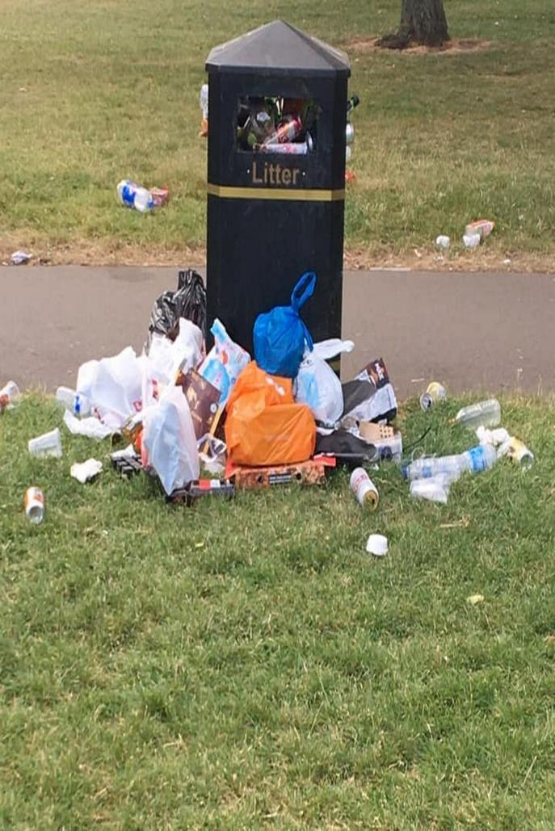


What is litter?
Rubbish such as paper, cans, bottles and bags left lying in an open place or public.
Litter consists of waste products that have not been thrown away properly.
To litter means to drop and leave objects, often man-made, such as aluminium cans, cardboard boxes or plastic bottles on the ground and leave them there for others to dispose of.
.
Notes:
Litter consists of waste products that have been discarded incorrectly, without consent, at an unsuitable location. Litter can also be used as a verb; to litter means to drop and leave objects, often man-made, such as aluminum cans, paper cups, fast food wrappers, cardboard boxes or plastic bottles on the ground, and leave them there indefinitely or for other people to dispose of as opposed to disposing of them correctly.
Litter can remain visible for extended periods of time before it eventually biodegrades, with some items made of condensed glass, styrofoam or plastic possibly remaining in the environment for over a million years

Slide 6
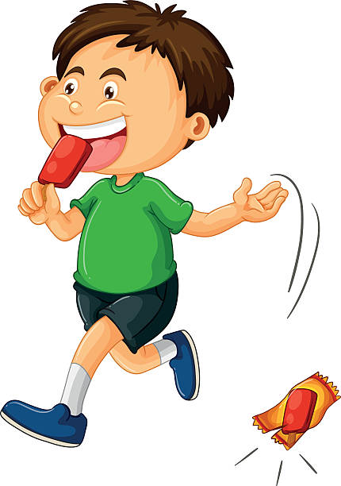
Why do people litter?
Sometimes people are just careless.
Sometimes dirty spaces prompt them to throw more rubbish.
Sometimes they are just lazy or forgetful.
Bins may not be available at many places which could also be a reason for people to litter.
.

Slide 7
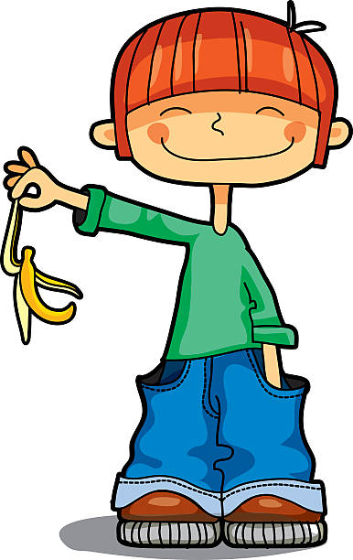
WAYS PEOPLE LITTER
People do it knowingly as well as unknowingly.
It could be waste that is spilt on the ground or near the waste bin or under a bench in a park or buried in sand on the beach.
People could throw an empty packet of crisps they just finished eating on the street instead of putting it in a bin.
Littering happens when people do not throw the waste in the bin appropriately.
.

Slide 8
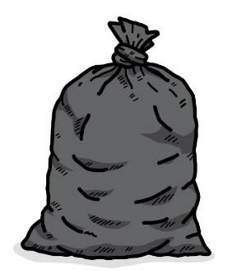



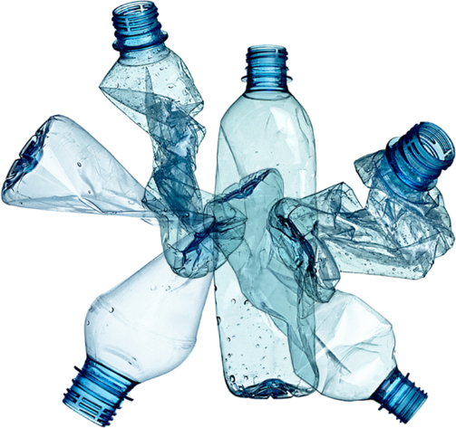
What is most common litter in your school?
different types of litter in school
Plastic bottles
Glass bottles
Sweet, chocolate, crisp wrappers
Paper and card
Food waste

Slide 9
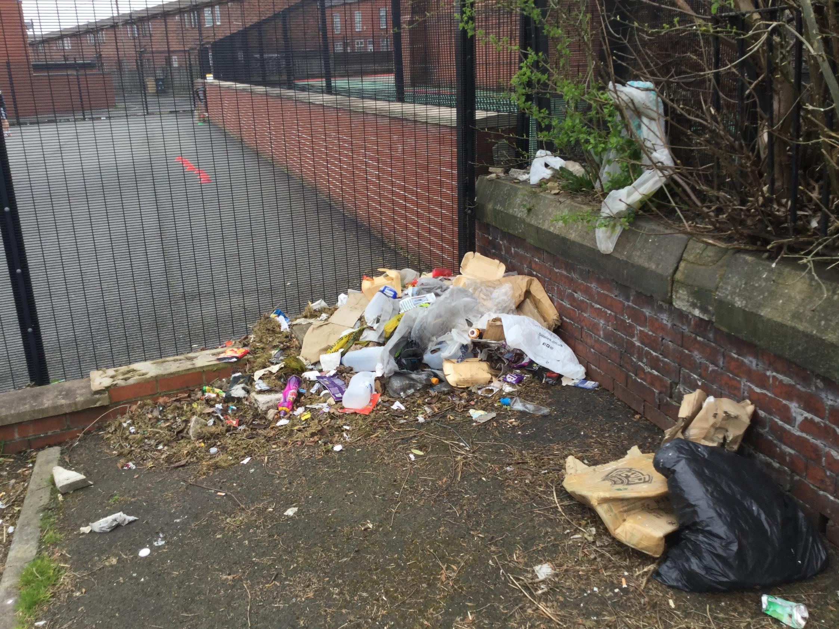
Notes:
Questions. Why is the rubbish on the ground? who put the rubbish there? Why leave it on the ground?
Can you think of other rubbish you have seen?

Slide 10
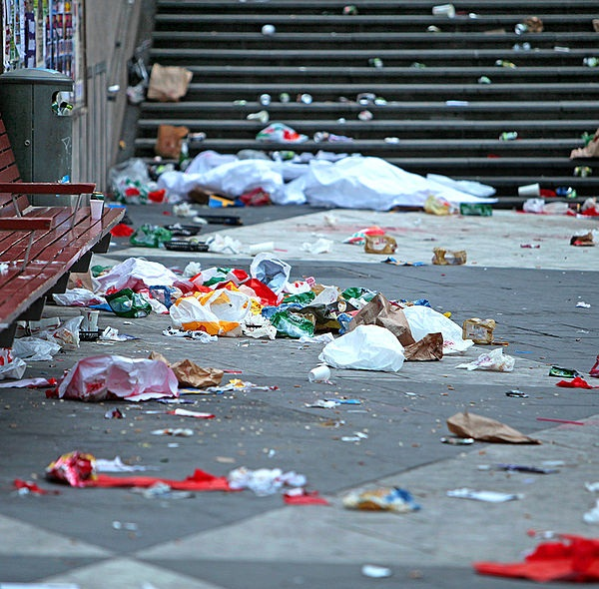
Notes:
Questions. Do you like this picture? Why/why not? Would you like to see this every day? How does this make you feel? Happy/sad, annoyed, angry.
Who is responsible for this? Who should tidy it up?

Slide 11
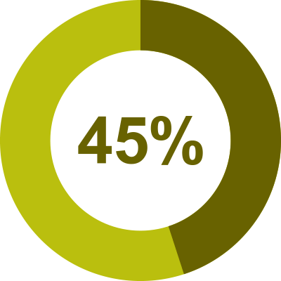

Are you 1 of them???!!!
45% of Northern Ireland public openly admit to littering!!!
Are you guilty????
.
Notes:
To litter means to drop and leave objects, often man-made, such as aluminium cans, cardboard boxes or plastic bottles on the ground and leave them there for others to dispose of.

Slide 12
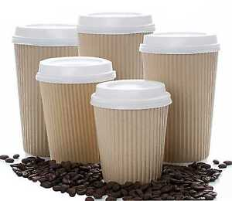
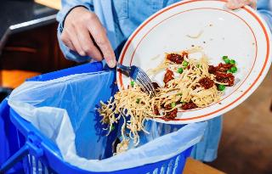
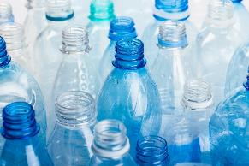

Example 3
Example 2
An estimated 1.3 billion tonnes of food is wasted globally each year, one third of all food produced for human consumption
In Northern Ireland we use 145 million single use plastic bottles every year.
31,841 disposable coffee cups are thrown away every year in Northern Ireland.
Notes:
According to Keep Northern Ireland Beautiful. Litter Composition Producer Report 2019-2020

Slide 13

Who is responsible?
Just 25 manufacturers - largely food and drinks companies - are responsible for more than 75% of the branded litter discarded by the public here.
Of the top 25 companies - seven are responsible for manufacturing a staggering 52% of branded litter here.
Who you think are the top 7 companies???
Notes:
According to Keep Northern Ireland Beautiful. Litter Composition Producer Report 2019-2020
Coca cola 6.3% - 81,065 items, Boost drinks 4.2% - 54,097 items, Lucozade 2.4% - 3,516%, Cadbury 2.4% - 30,866 items, Red Bull 2.4% - 30,866 items, Mars 2.2% - 29,242 items, McDonalds 2% - 26,643 items,

Slide 14


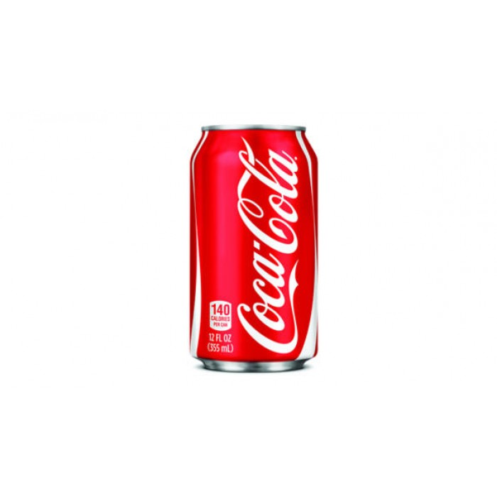


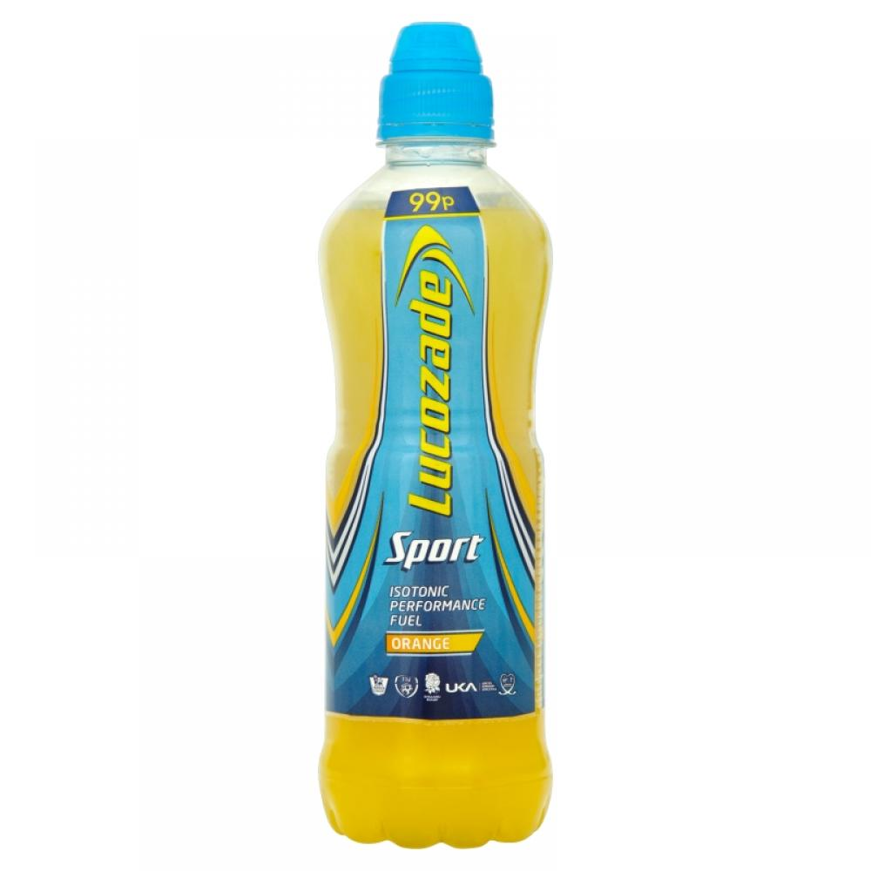
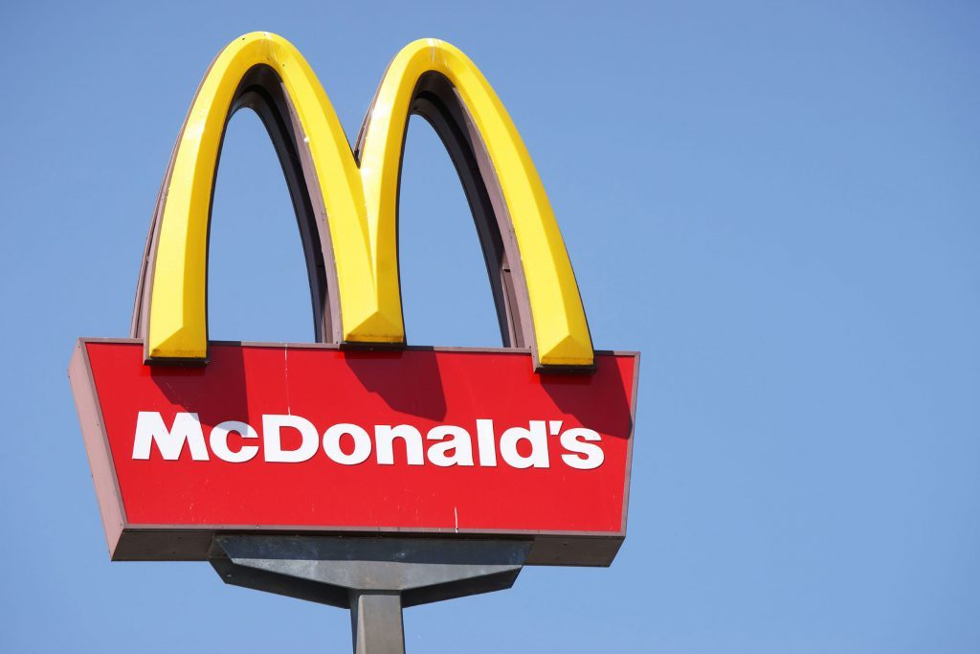
Notes:
Put these in order from top to bottom. Who creates the most litter and who creates the least litter?

Slide 15
1
2
3
4
5
6
7
Notes:
1. Coca cola. 2. Boost. 3. Lucozade. 4. Cadbury. 5. Red Bull. 6. Mars. 7. Mc Donalds

Slide 16
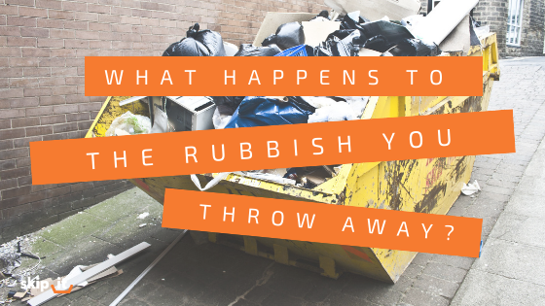
Startling statistics
1.3 million pieces of litter on Northern Ireland’s streets.
That equals 28 tonnes of rubbish
Plastics make up 71% of rubbish collected.
The annual clean up bill is an estimated £29million
Notes:
According to Keep Northern Ireland Beautiful. Litter Composition Producer Report 2019-2020

Slide 17
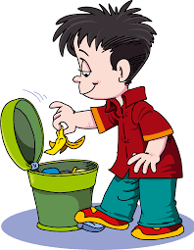
Where should we put our rubbish?

Slide 18
plastic
food
Not all rubbish can be put in together.
We have to separate it into different types.
Some we can recycle……use again.
We can recycle
glass
wood
paper

Slide 19
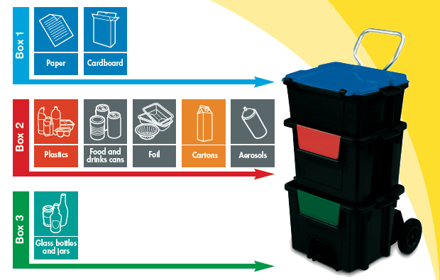
These are the most common recycling bins.

Slide 20
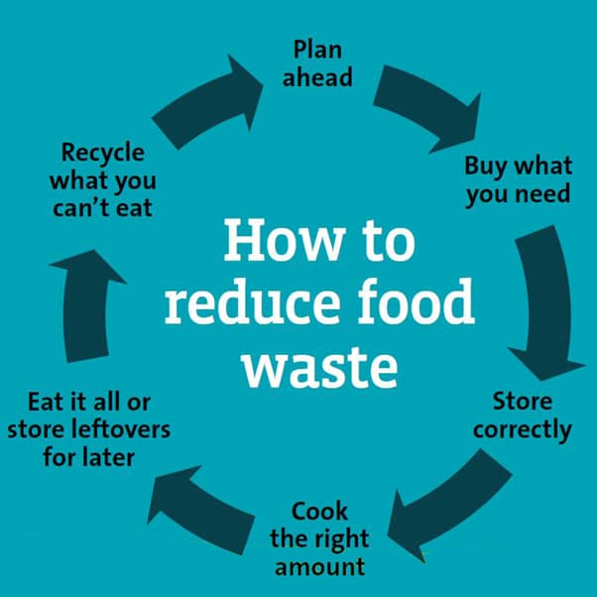


Slide 21
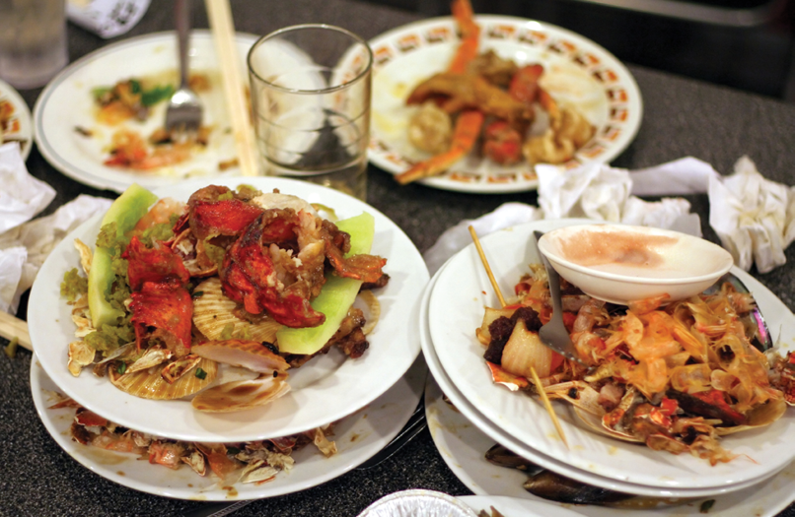
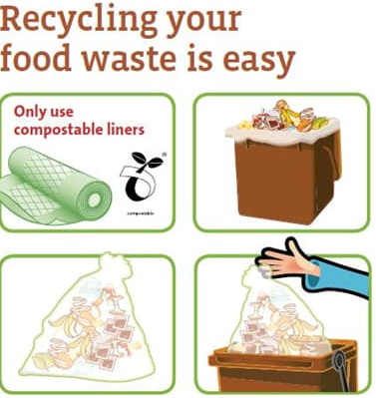
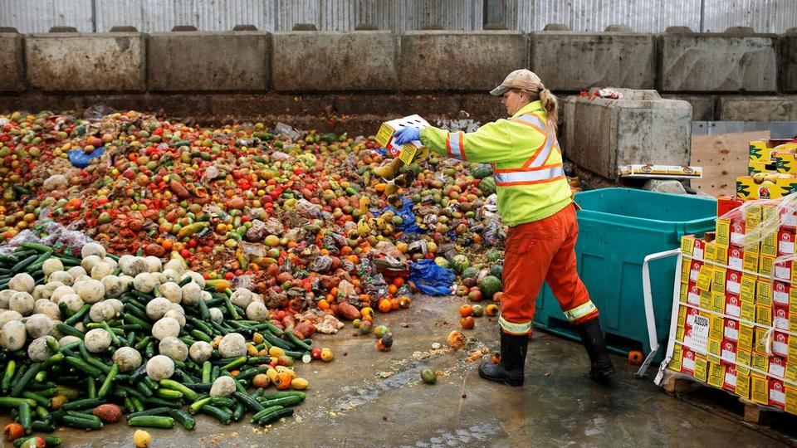

Slide 22
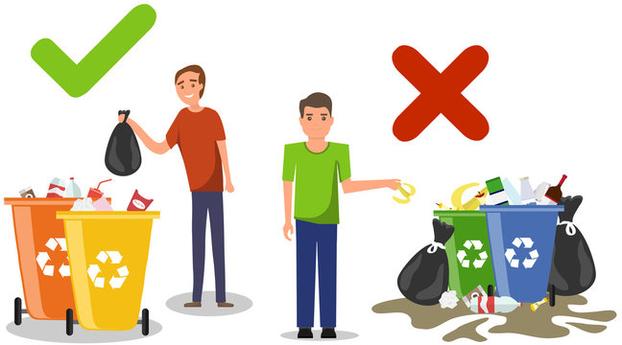
Where should you put plastic after you are finished with it?
paper
glass
food

Slide 23
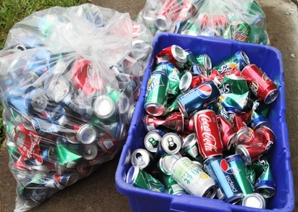

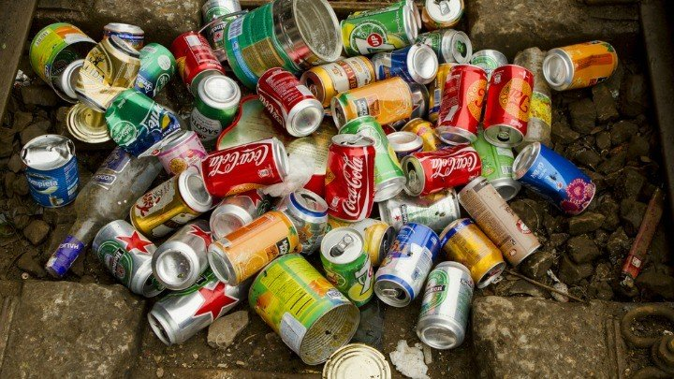

Put your aluminium cans in recycling boxes.
Don’t throw aluminium cans on the ground.

Slide 24
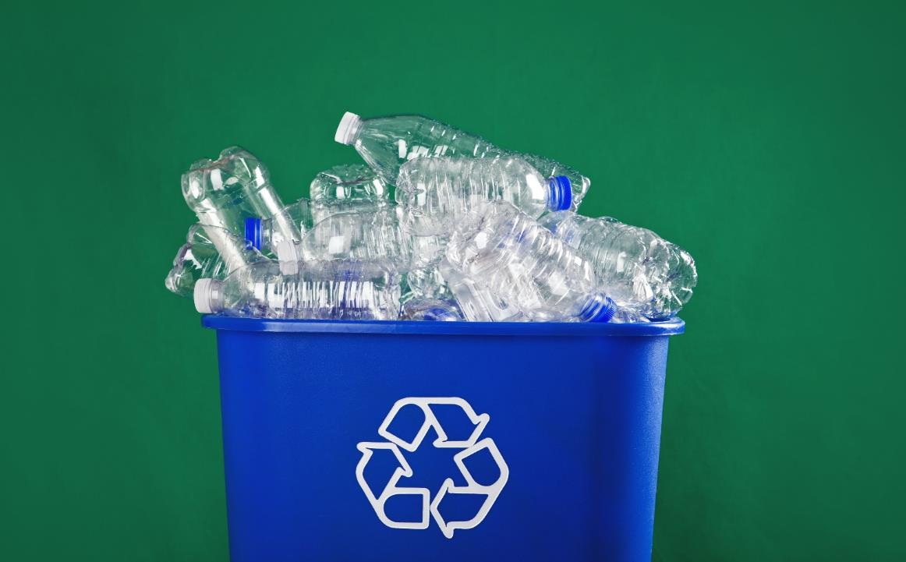
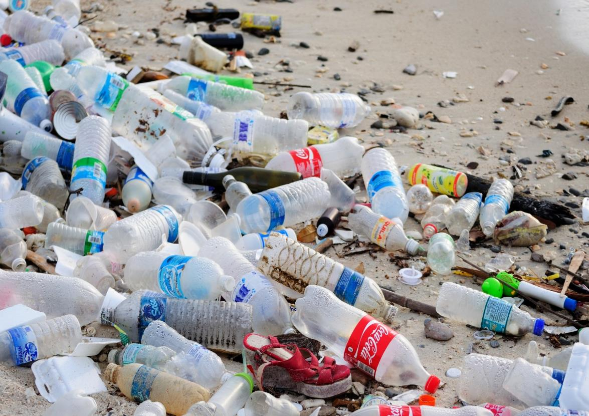

Put your plastic bottles in recycling boxes.
Don’t throw plastic bottles on the ground.

Slide 25
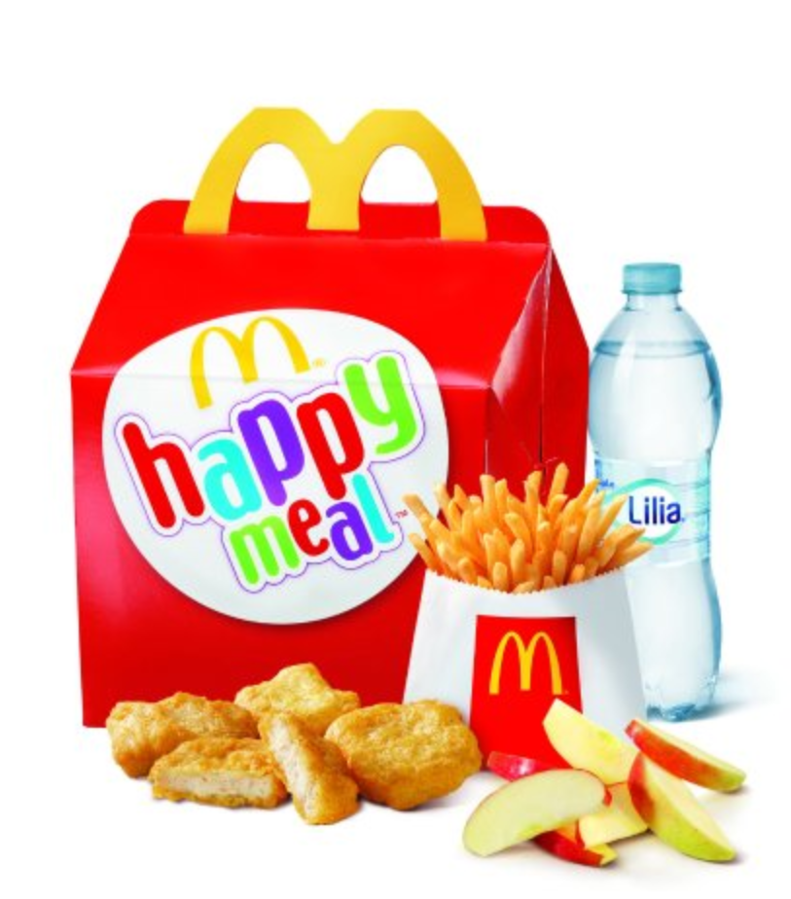
cardboard
plastic
paper
food
Remember that you can’t put food rubbish in bin that has food on it!!!

Slide 26
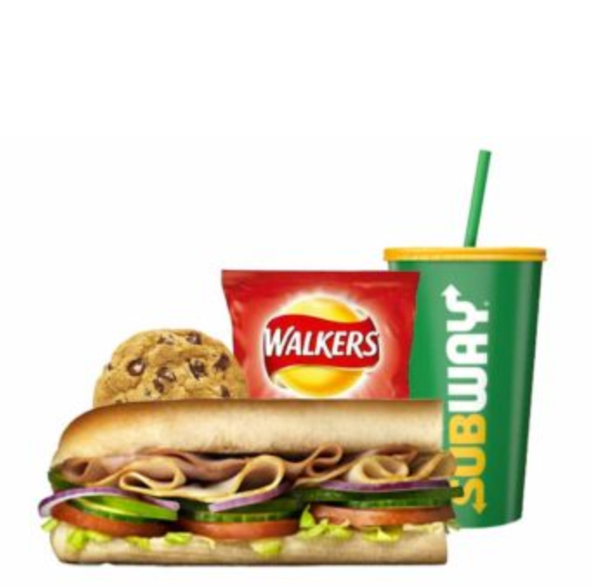
plastic
cardboard
food
Remember that you can’t put food rubbish in bin that has food on it!!!

Slide 27
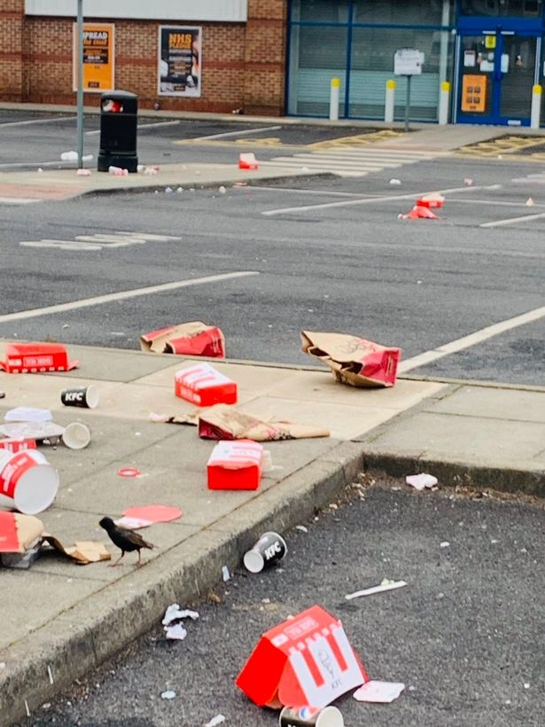
cardboard
paper
plastic
food
Remember that you can’t put food rubbish in bin that has food on it!!!

Slide 28
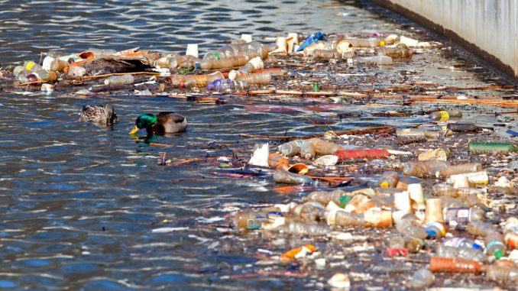
Effects of litter
Litter creates visual pollution.
It makes a place look unclean and unpleasant to the eyes.
Litter causes damage to marine life, sea and rivers.
Litter in water supply creates a toxic environment. The toxic water can kill plant life. If humans drink the water they can also become sick

Slide 29
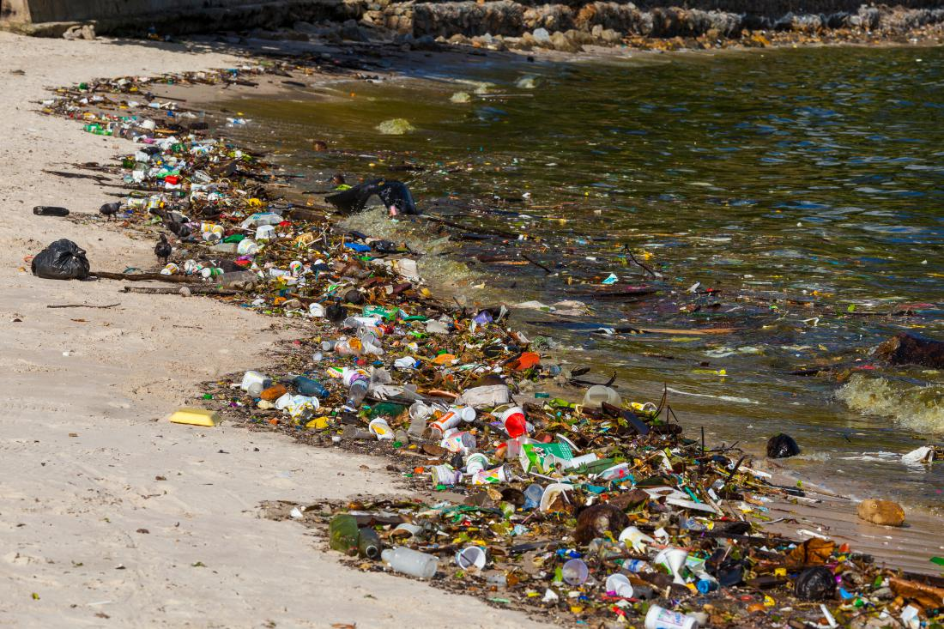
Notes:
Litter is responsible for the death of millions of animals.
Animals can get entangled in litter and die a slow painful death.
Broken glass and other sharp objects can injure animals who stand on them unknowingly.
Litter causes damage to marine life, sea and rivers.
Animals eat litter and they cant digest it – this can cause injury or death.
Litter in water supply creates a toxic environment. The toxic water can kill plant life. If humans drink the water they can also become sick

Slide 30
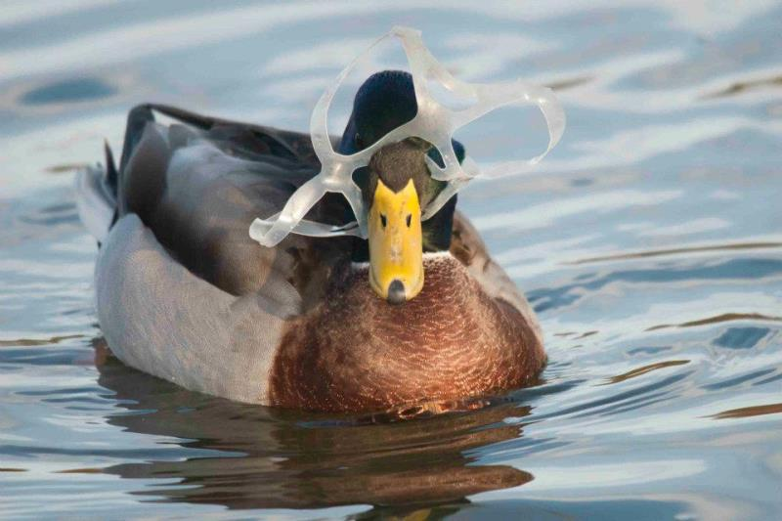
Effects of litter
Litter is responsible for the death of millions of animals.
Animals can get entangled in litter and die a slow painful death.
Animals eat litter and they cant digest it – this can cause injury or death.

Slide 31
effects of litter
Litter is responsible for the death of millions of animals.
Broken glass and other sharp objects can injure animals who stand on them unknowingly.
Litter can cause soil and air pollution
Hazardous chemicals can leak out of litter and pollute the soil and nearby water.
The pollutants can lead to respiratory problems in humans.

Slide 32
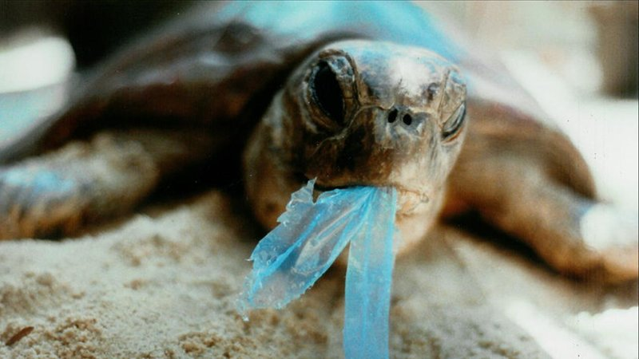
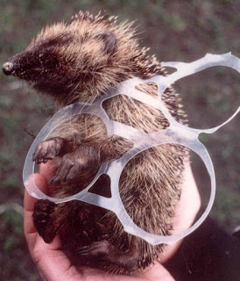
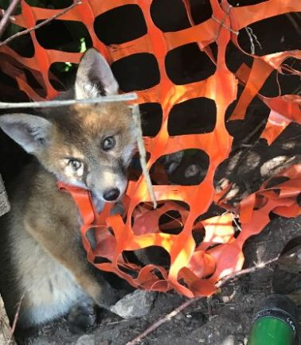
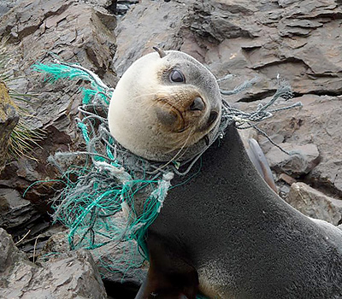
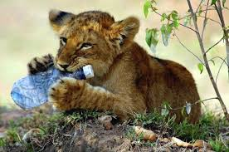
Notes:
Questions: What is happening in each of these pictures? Is it the animal’s fault? Whose fault is it?
Is it us, humans? Is it big companies?
What do you think will happen to these animals? Are they in pain? Could they die?

Slide 33
How long does trash take to decompose?
https://youtu.be/VuzPkkM3bjQ

Slide 34

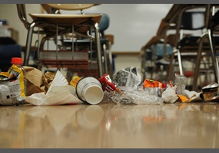
Litter in our school is increasing
How can we find out how much litter is in our school playground?

Slide 35

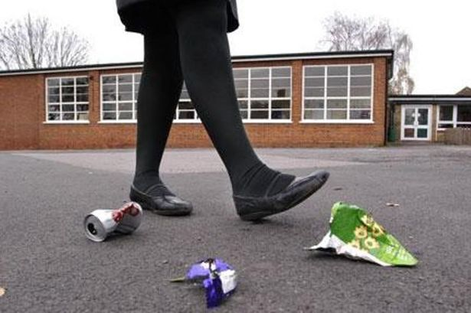
What can we do to help?

Slide 36
Many schools have a litter problem to some degree. Controlling litter, and making sure that school grounds are cleaned up regularly, is an important priority. A school with a serious litter problem:
Creates complaints from local residents and businesses
Is off-putting to visitors
Can be demoralising for staff and pupils
Can be dangerous, due to broken glass or cans on the playing field
Is breaking the law

Slide 37
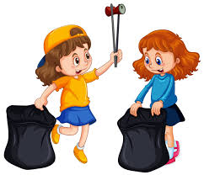
What can we do to help?
The Adopt A Spot Kit
When you register for Adopt A Spot you'll get a maximum of 5 litter pickers, 5 high vis vests, 5 pairs of gloves, bin bags, First Aid Kit, bucket, sharps box, hints and tips booklet and a certificate.
All we ask is that you record your clean ups on your profile and agree to carry out 4 clean ups a year for a minimum of 2 years.

Slide 38
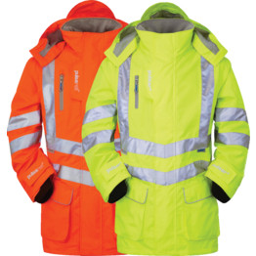
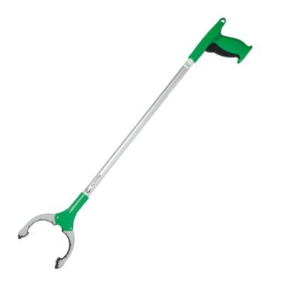

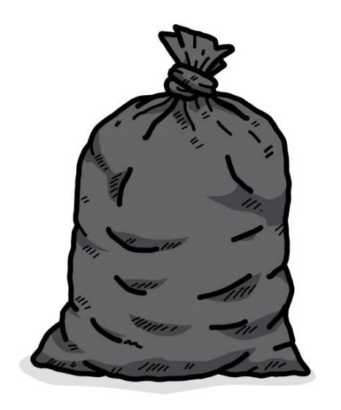
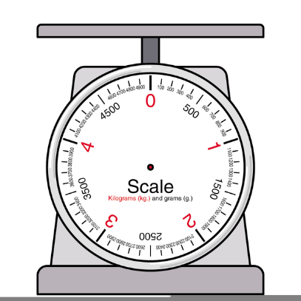

For the next task you will need

Slide 39
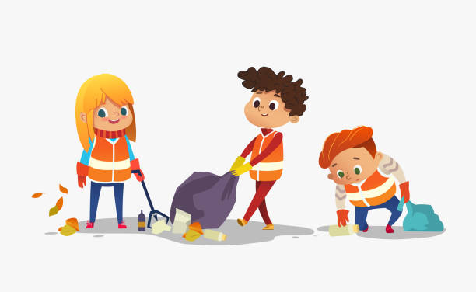
checklist
.
Hi visibility jacket
Welly boots
Litter picker
Rubbish bags
Clipboard and pen
Scales

Slide 40
POEM
There’s litter all around us
There’s litter at our feet
There’s litter in the bushes
There’s litter in the street
There’s litter all around us
And it’s a filthy sin
When at your feet just yards away
There lies an empty bin

Slide 41


ACROSTIC
Lazy people everywhere
In the world around us
Throw their
Trash on the ground
Everyone should try to
Reduce the litter in our area

Slide 42


WORKSHEET
Question 1:
Question 3:.
Where do you see litter in your school?
Do you ever throw anything on the ground and not pick it up?
Answer 1:
Answer 3:
Question 2: .
Question 2: .
Who is responsible for littering your school?
What should you do if you see someone dropping litter?
Answer 2:
Answer 2:

Slide 43

are you for or against?
Read the following articles
In teams choose 1 of the debate topics
Decide who is going to argue for/against the topic
Should students help clean the school grounds?
Should councils fine students for littering?

Slide 44



Slide 45



Slide 46

Should the top ten companies responsible for Northern Ireland’s litter problem be fined?
Should they have to pay for the clean up?
Who is responsible, the multinational companies, or us, the consumers?

Slide 47


EXERCISE
https://youtu.be/Yomf5pBN8dY

Slide 48






CLASS OBJECTIVES AND RULES
Objectives inform students the learning outcomes of the class. What will they know? What will they be able to do? Why is this important to know? It's an effective way to assess their learning progress.
Rules provide the structure necessary for an engaging and productive class. Keep it simple and easy to follow. It can be general to cover different situations or very specific to your students.

Slide 49




LESSON FOR THE DAY
KEY STAGE 4

Slide 50




CONCEPTS AND DEFINITIONS
Get the ball rolling by introducing the lesson's key concepts and its corresponding definitions. Duplicate this page as many times as needed to give you more space for discussion. Pair the concepts and definitions with relevant images too for a more visualized presentation of the lesson.

Slide 51
EXAMPLES AND ILLUSTRATIONS
Example 1
Example 2
Example 3

Slide 52

ACTIVITY TIME
Add instructions or guidelines here.
You can also put in the amount of time allotted for this.
Like seatworks, student-led activities that can be done by pairs or by group widen their grasp and interpretation of the lesson. Be creative with the activity. Duplicate this page as many times as needed to give you more space for discussion.

Slide 53

SUPPLEMENTAL VIDEO
Let your students watch relevant educational videos that help reinforce the lesson for the day. It’s no secret that it helps students stay interested and engaged. Duplicate this page as many times as needed.

Slide 54



ADDITIONAL RESOURCES
Duplicate this page as many times as needed to give you more space for discussion.
Photos or screenshots of relevant articles are also effective in reinforcing a class lesson.
Maximize this space for additional resources you want to share with your students.
It's something they can easily look back on or search online in case they need a refresher.

Slide 55



CLASS RECAP
Discussion Point
Discussion Point
Discussion Point
Discussion Point
Discussion Point
Cap off a productive class with key summary points students can easily remember.
You can provide this for the class as a way of wrapping up everything you've discussed.
You can provide this for the class as a way of wrapping up everything you've discussed.
You can provide this for the class as a way of wrapping up everything you've discussed.
Recaps can also be led by students for a more enriching experience.

Slide 56



HOMEWORK
Add instructions or guidelines here. You can also put additional details on when and how to submit.

Slide 57


























FREE ICONS
Use these free recolorable icons and illustrations in your Canva design.

Slide 58





















FREE RESOURCES
Use these free recolorable icons and illustrations in your Canva design.

