Slide 1



















Slide 2







WELCOME,
STUDENTS!

Slide 3
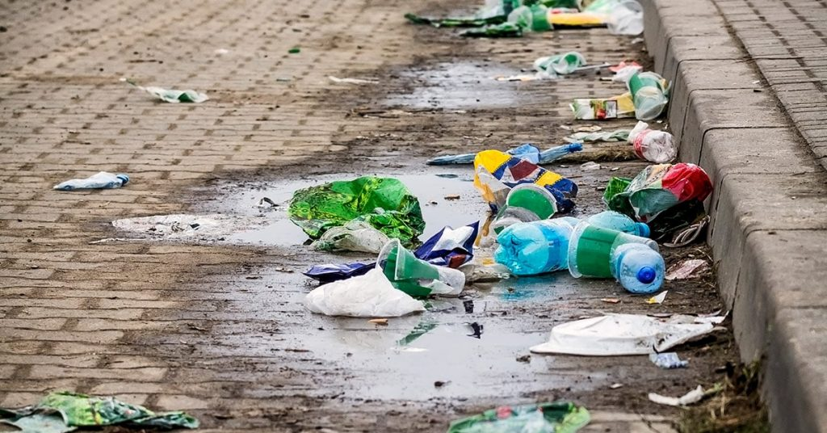
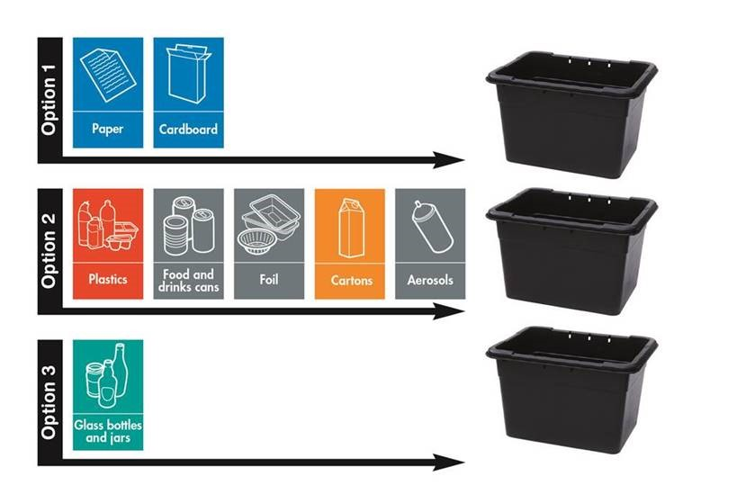
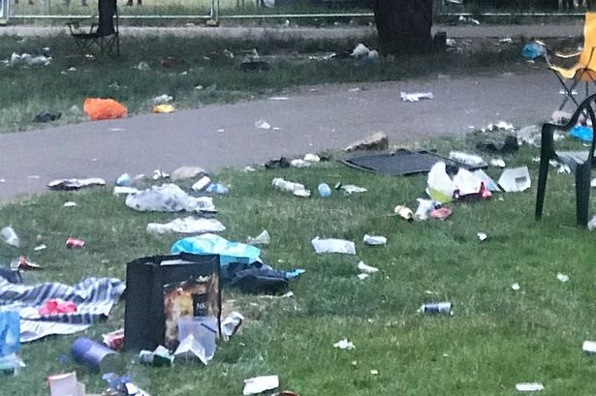

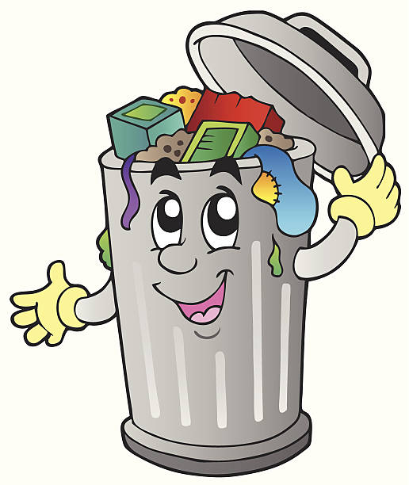
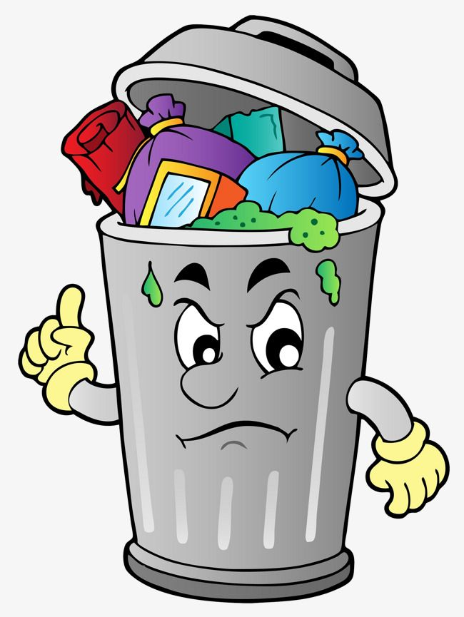

What is litter?
Key stage 5

Slide 4
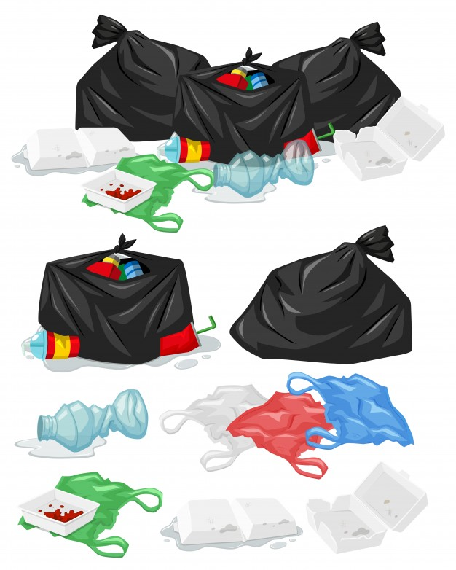
CLASS OBJECTIVES
What are the different types of litter?
How does littering affect the environment?
How does littering affect the school
environment?
What can I do to stop littering in school?

Slide 5



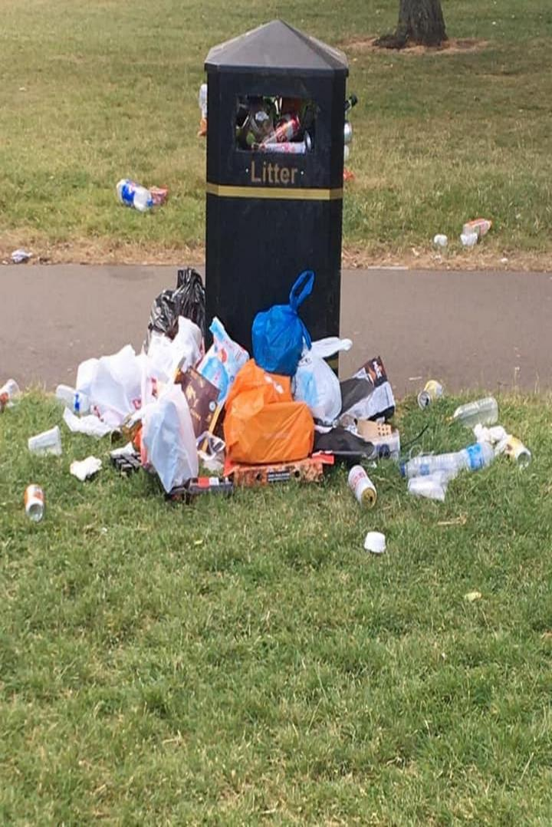



What is litter?
Rubbish such as paper, cans, bottles and bags left lying in an open place or public.
Litter consists of waste products that have not been thrown away properly.
To litter means to drop and leave objects, often man-made, such as aluminium cans, cardboard boxes or plastic bottles on the ground and leave them there for others to dispose of.
.
Notes:
Litter consists of waste products that have been discarded incorrectly, without consent, at an unsuitable location. Litter can also be used as a verb; to litter means to drop and leave objects, often man-made, such as aluminum cans, paper cups, fast food wrappers, cardboard boxes or plastic bottles on the ground, and leave them there indefinitely or for other people to dispose of as opposed to disposing of them correctly.
Litter can remain visible for extended periods of time before it eventually biodegrades, with some items made of condensed glass, styrofoam or plastic possibly remaining in the environment for over a million years

Slide 6
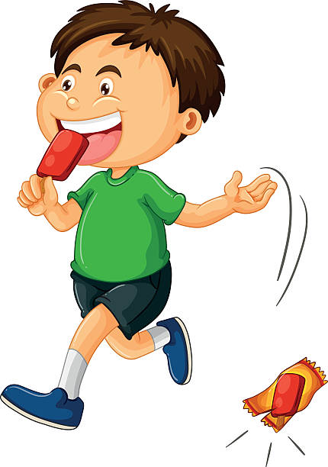
Why do people litter?
Sometimes people are just careless.
Sometimes dirty spaces prompt them to throw more rubbish.
Sometimes they are just lazy or forgetful.
Bins may not be available at many places which could also be a reason for people to litter.
.

Slide 7
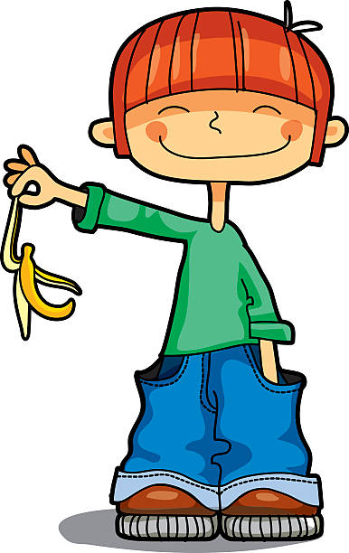

WAYS PEOPLE LITTER
People do it knowingly as well as unknowingly.
It could be waste that is spilt on the ground or near the waste bin or under a bench in a park or buried in sand on the beach.
People could throw an empty packet of crisps they just finished eating on the street instead of putting it in a bin.
Littering happens when people do not throw the waste in the bin appropriately.
.

Slide 8
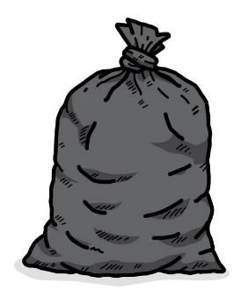


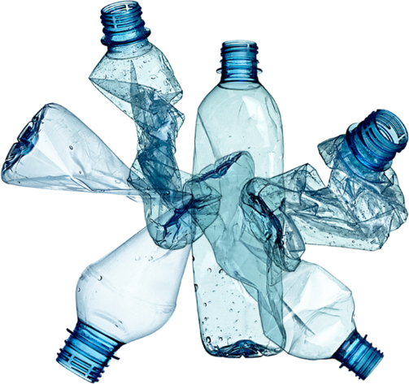
What is most common litter in your school?
different types of litter in school
Plastic bottles
Glass bottles
Sweet, chocolate, crisp wrappers
Paper and card
Food waste

Slide 9
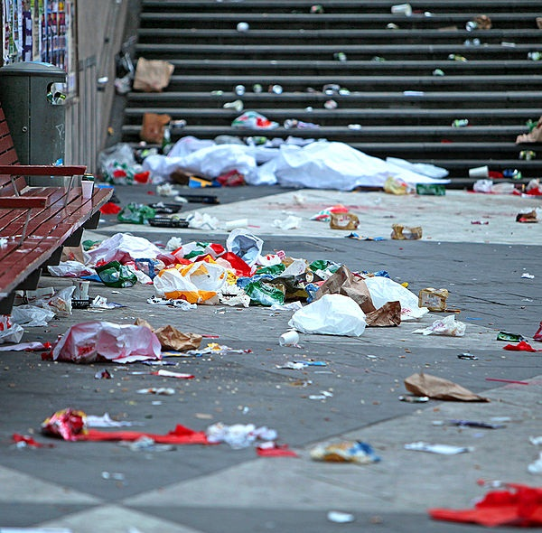
Notes:
Questions. Do you like this picture? Why/why not? Would you like to see this every day? How does this make you feel? Happy/sad, annoyed, angry.
Who is responsible for this? Who should tidy it up?

Slide 10
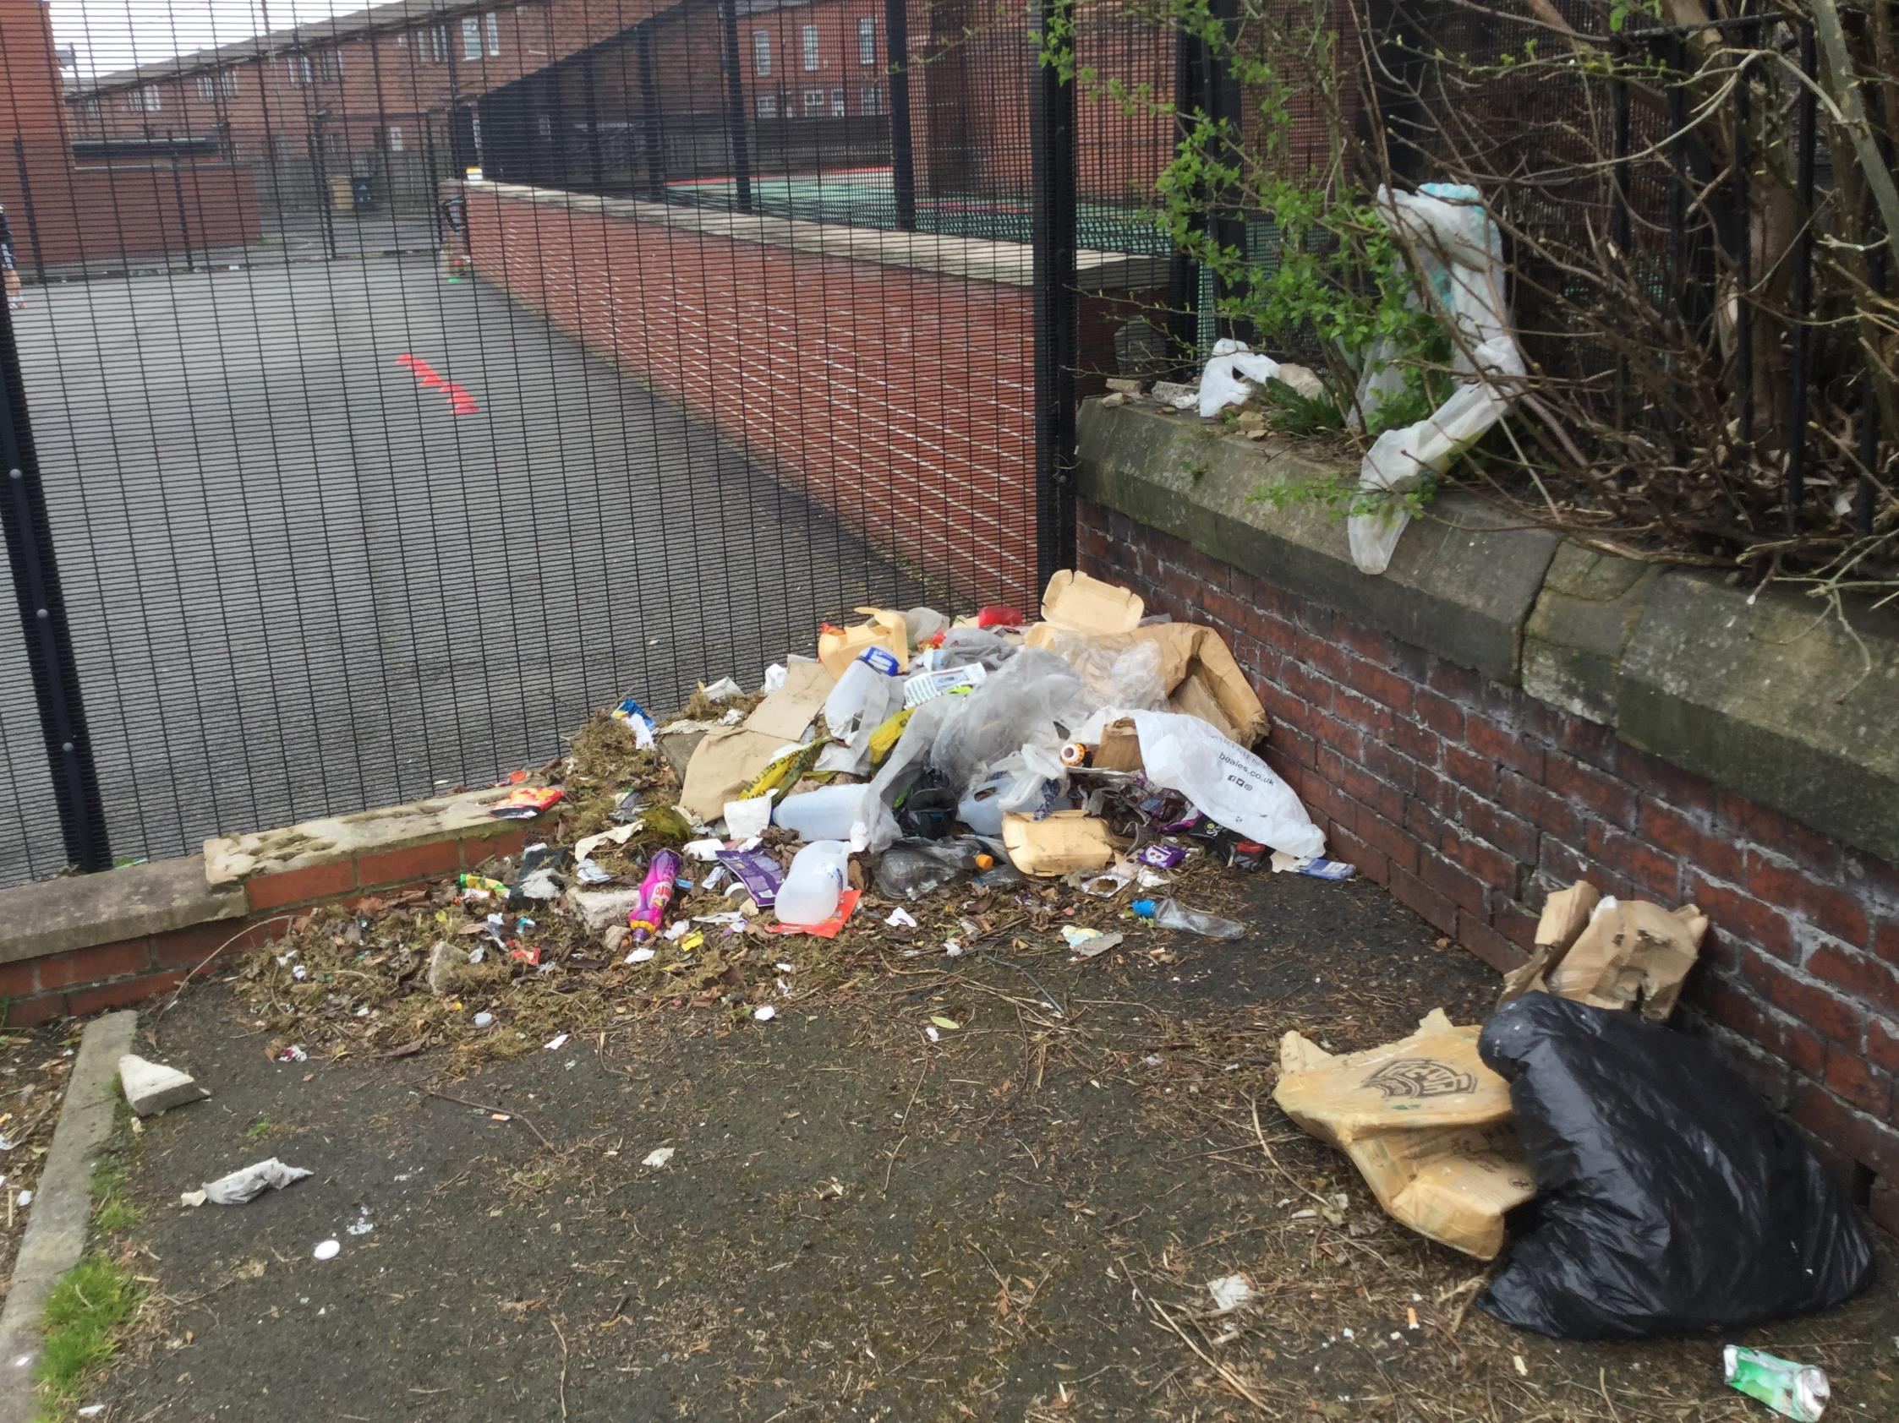
Notes:
Questions. Why is the rubbish on the ground? who put the rubbish there? Why leave it on the ground?
Can you think of other rubbish you have seen?

Slide 11
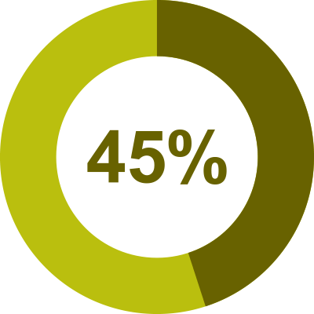


Are you 1 of them???!!!
45% of Northern Ireland public openly admit to littering!!!
Are you guilty????
.
Notes:
To litter means to drop and leave objects, often man-made, such as aluminium cans, cardboard boxes or plastic bottles on the ground and leave them there for others to dispose of.

Slide 12
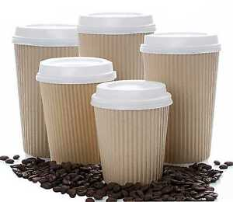
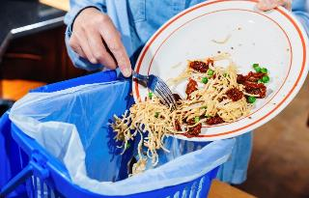
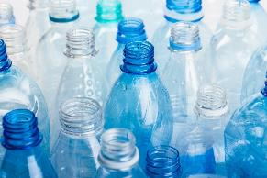

Example 3
Example 2
An estimated 1.3 billion tonnes of food is wasted globally each year, one third of all food produced for human consumption
In Northern Ireland we use 145 million single use plastic bottles every year.
31,841 disposable coffee cups are thrown away every year in Northern Ireland.
Notes:
According to Keep Northern Ireland Beautiful. Litter Composition Producer Report 2019-2020

Slide 13


Who is responsible?
Just 25 manufacturers - largely food and drinks companies - are responsible for more than 75% of the branded litter discarded by the public here.
Of the top 25 companies - seven are responsible for manufacturing a staggering 52% of branded litter here.
Who you think are the top 7 companies???
Notes:
According to Keep Northern Ireland Beautiful. Litter Composition Producer Report 2019-2020
Coca cola 6.3% - 81,065 items, Boost drinks 4.2% - 54,097 items, Lucozade 2.4% - 3,516%, Cadbury 2.4% - 30,866 items, Red Bull 2.4% - 30,866 items, Mars 2.2% - 29,242 items, McDonalds 2% - 26,643 items,

Slide 14

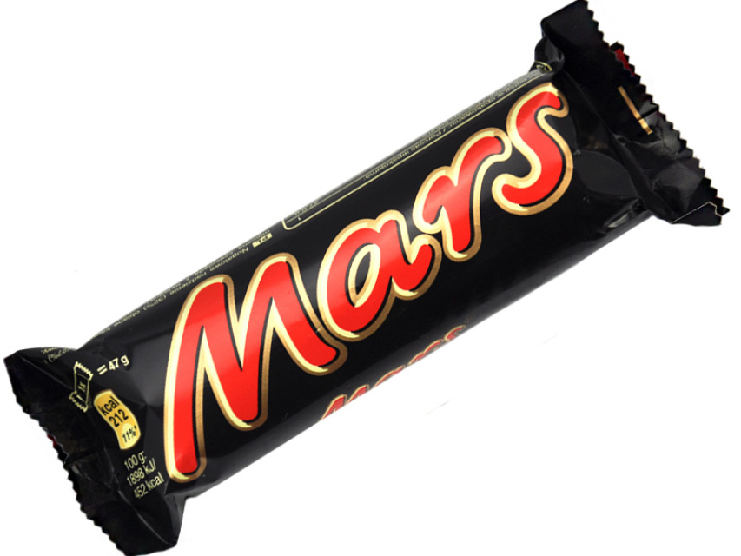
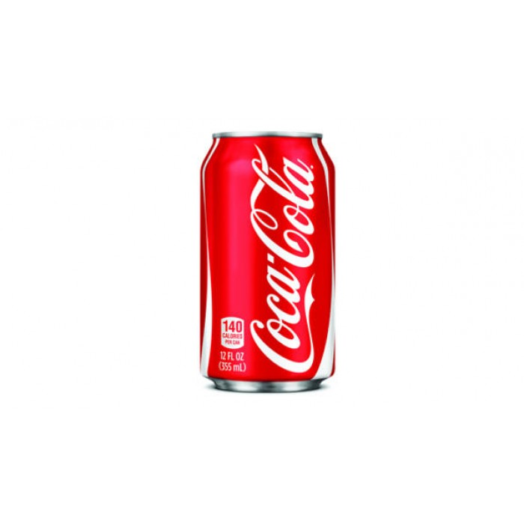

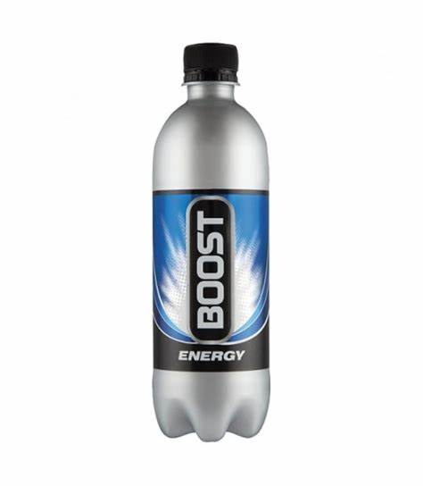
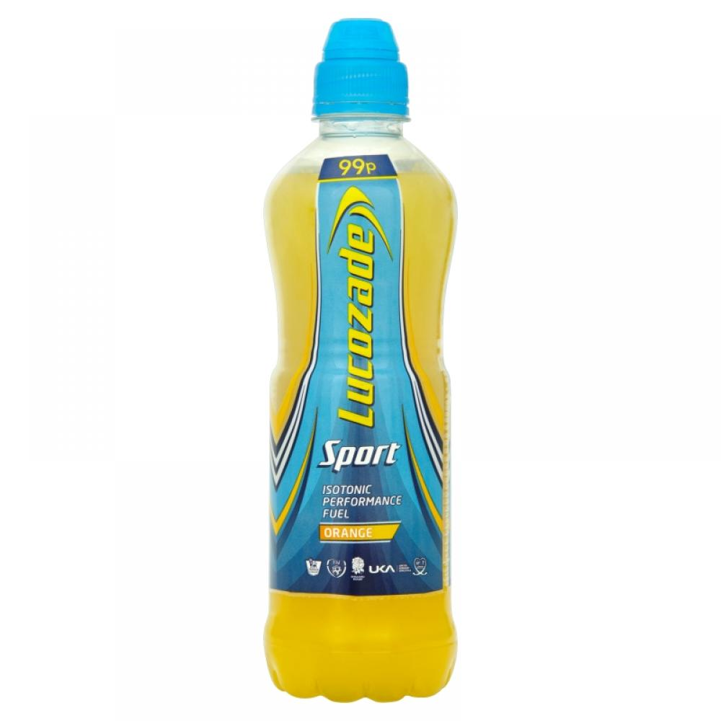
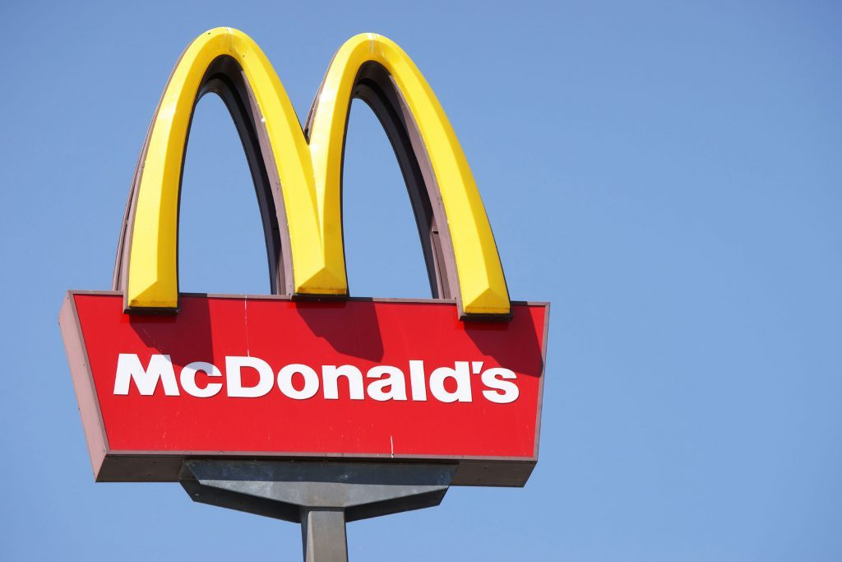
Notes:
Put these in order from top to bottom. Who creates the most litter and who creates the least litter?

Slide 15
1
2
3
4
5
6
7
Notes:
1. Coca cola. 2. Boost. 3. Lucozade. 4. Cadbury. 5. Red Bull. 6. Mars. 7. Mc Donalds

Slide 16
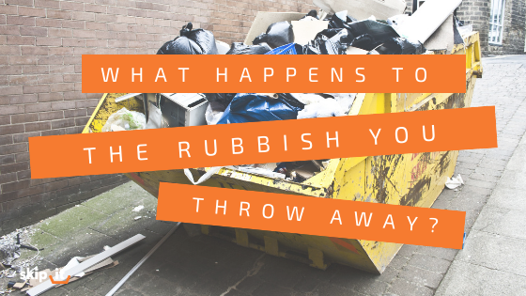
Startling statistics
1.3 million pieces of litter on Northern Ireland’s streets.
That equals 28 tonnes of rubbish
Plastics make up 71% of rubbish collected.
The annual clean up bill is an estimated £29million
Notes:
According to Keep Northern Ireland Beautiful. Litter Composition Producer Report 2019-2020

Slide 17
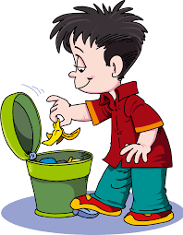
Where should we put our rubbish?

Slide 18
plastic
food
Not all rubbish can be put in together.
We have to separate it into different types.
Some re can recycle……use again.
We can recycle
glass
wood
paper

Slide 19
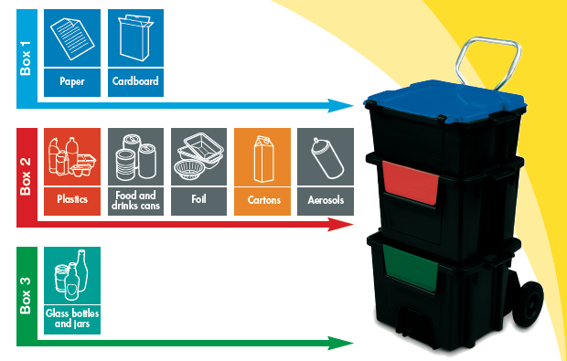
These are the most common recycling bins.

Slide 20
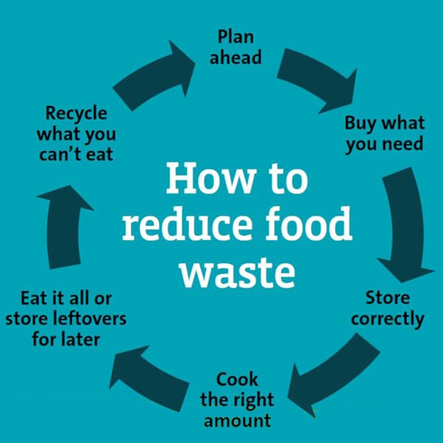
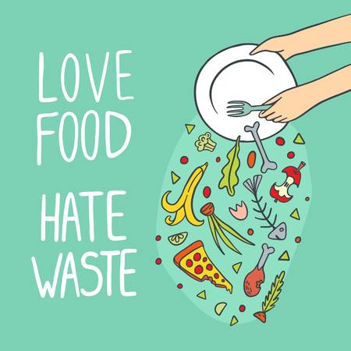

Slide 21
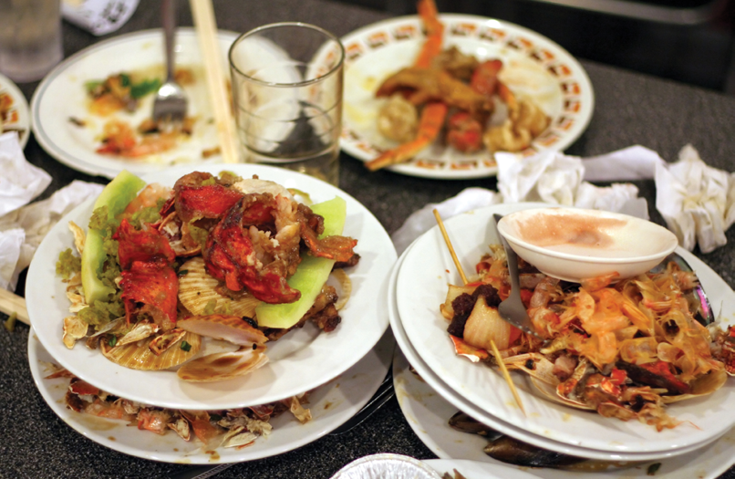
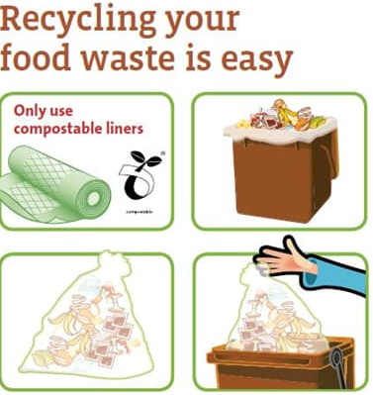
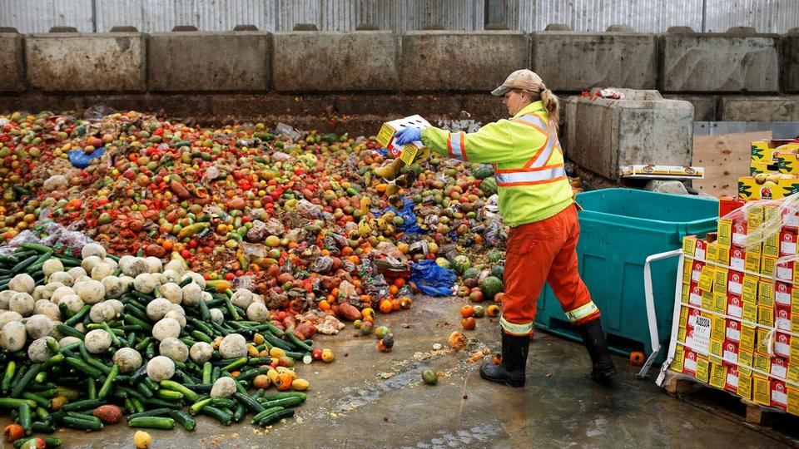

Slide 22
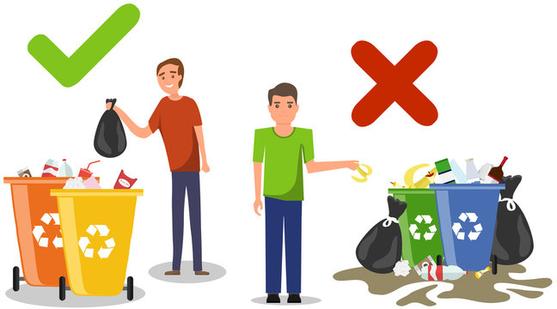
Where should you put plastic after you are finished with it?
paper
glass
food

Slide 23
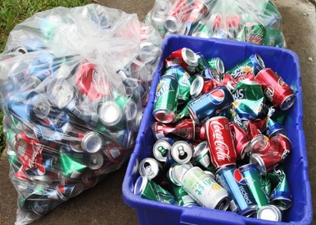

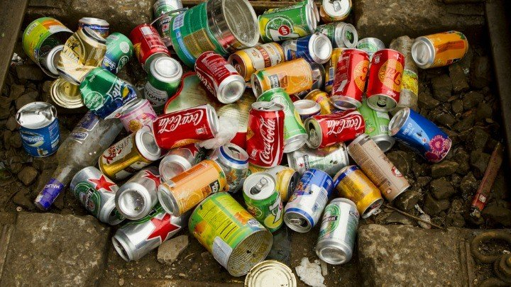

Put your aluminium cans in recycling boxes.
Don’t throw aluminium cans on the ground.

Slide 24
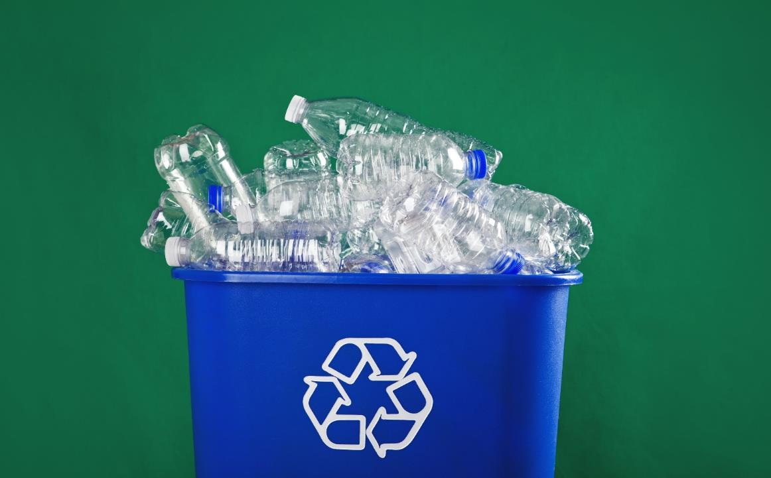
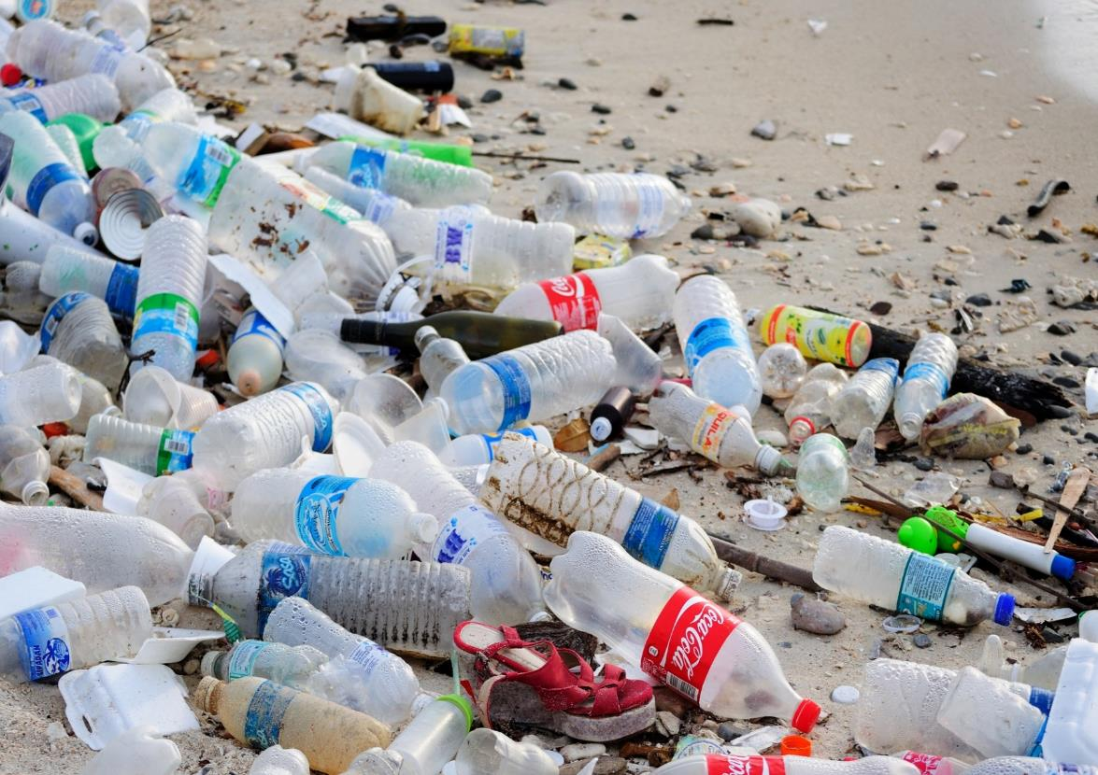

Put your plastic bottles in recycling boxes.
Don’t throw plastic bottles on the ground.

Slide 25
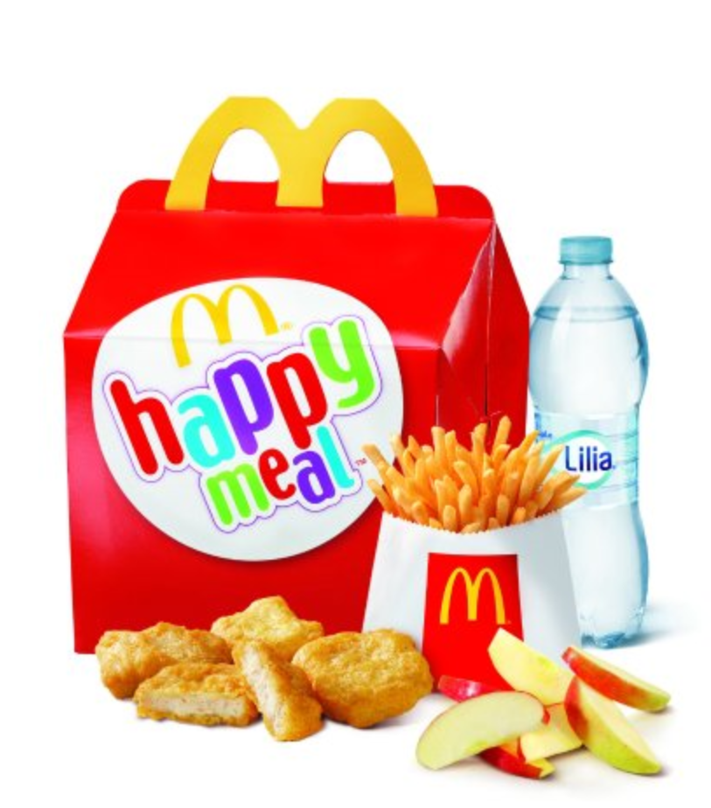
cardboard
plastic
paper
food
Remember that you can’t put food rubbish in bin that has food on it!!!

Slide 26
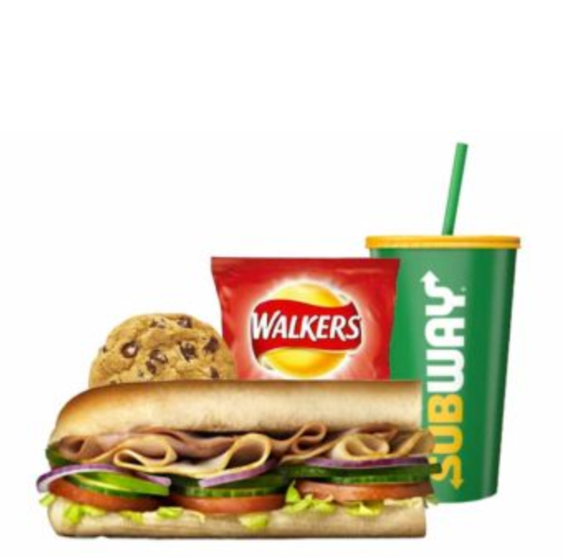
plastic
cardboard
food
Remember that you can’t put food rubbish in bin that has food on it!!!

Slide 27
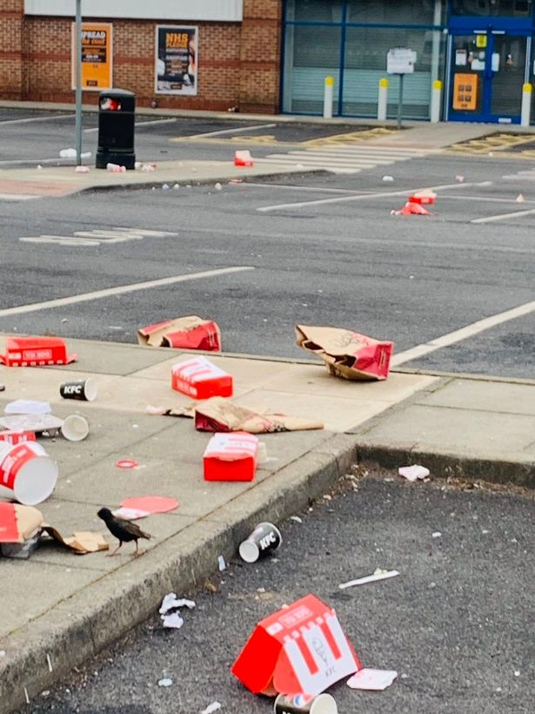
cardboard
paper
plastic
food
Remember that you can’t put food rubbish in bin that has food on it!!!

Slide 28
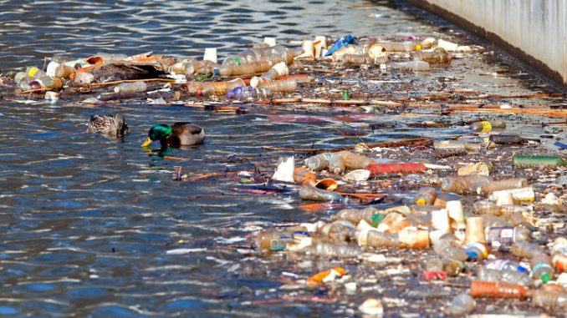
Effects of litter
Litter creates visual pollution.
It makes a place look unclean and unpleasant to the eyes.
Litter causes damage to marine life, sea and rivers.
Litter in water supply creates a toxic environment. The toxic water can kill plant life. If humans drink the water they can also become sick

Slide 29
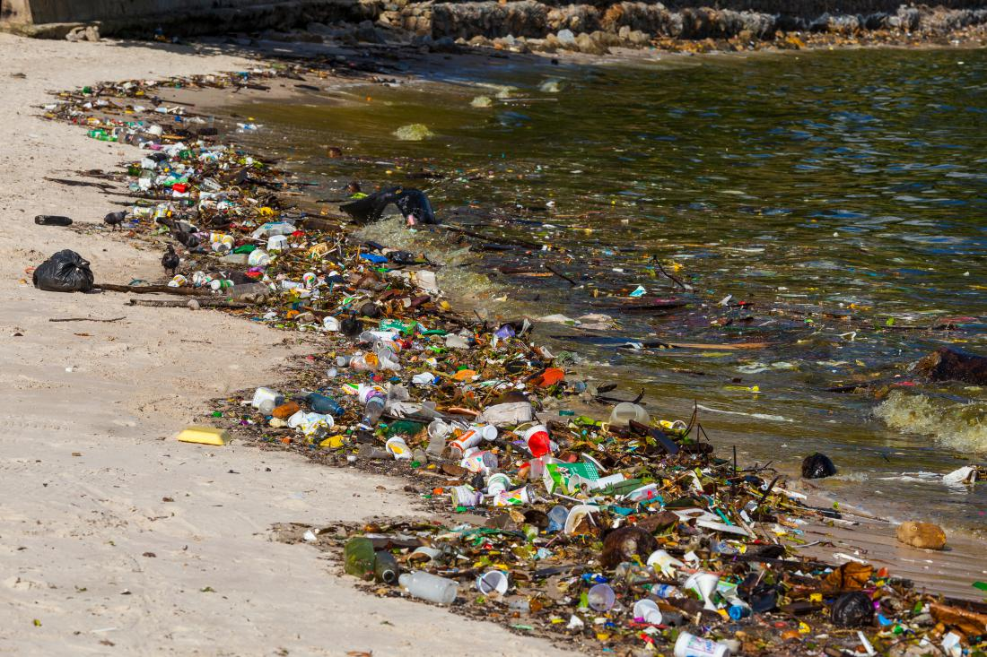
Notes:
Litter is responsible for the death of millions of animals.
Animals can get entangled in litter and die a slow painful death.
Broken glass and other sharp objects can injure animals who stand on them unknowingly.
Litter causes damage to marine life, sea and rivers.
Animals eat litter and they cant digest it – this can cause injury or death.
Litter in water supply creates a toxic environment. The toxic water can kill plant life. If humans drink the water they can also become sick

Slide 30
Effects of litter
Litter is responsible for the death of millions of animals.
Animals can get entangled in litter and die a slow painful death.
Animals eat litter and they cant digest it – this can cause injury or death.
Broken glass and other sharp objects can injure animals who stand on them unknowingly.
Litter can cause soil and air pollution
Hazardous chemicals can leak out of litter and pollute the soil and nearby water.
The pollutants can lead to respiratory problems in humans.

Slide 31
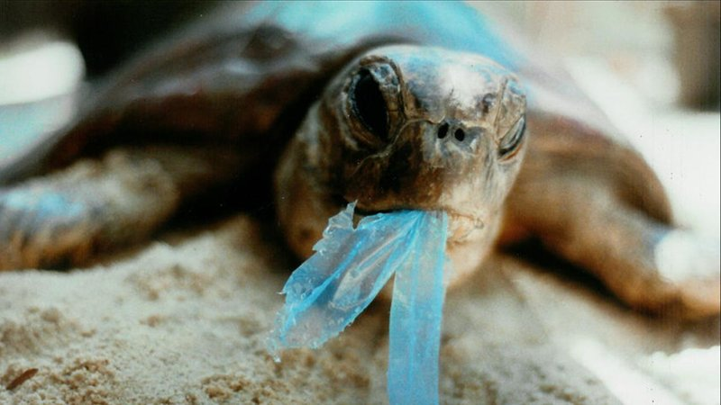
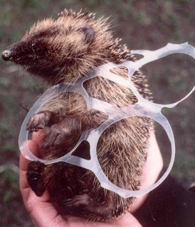
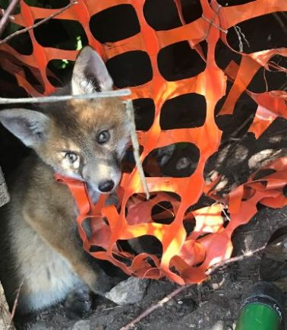
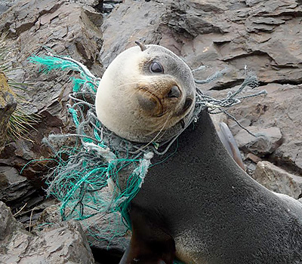
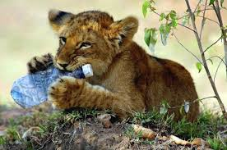
Notes:
Questions: What is happening in each of these pictures? Is it the animal’s fault? Whose fault is it?
Is it us, humans? Is it big companies?
What do you think will happen to these animals? Are they in pain? Could they die?

Slide 32
How long does trash take to decompose?
https://youtu.be/VuzPkkM3bjQ

Slide 33
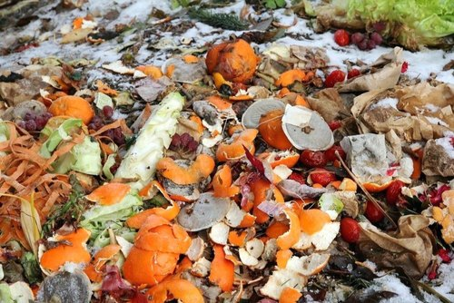
why is important not to litter?
It can last for a long time
How long does it take for the following to decompose?
Banana peel
Cigarette butt
Plastic bag
Aluminium can
Plastic bottle
Glass bottle

Slide 34
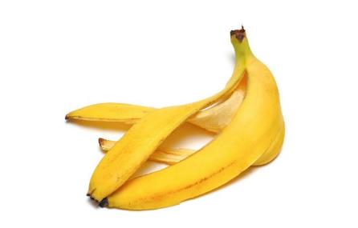
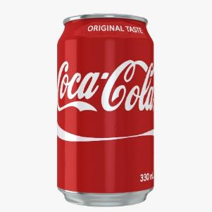
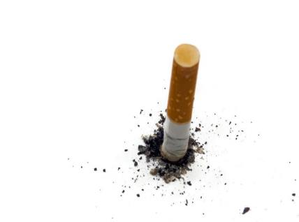
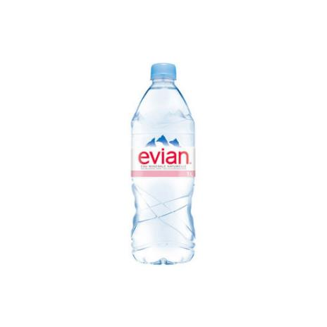


why is important not to litter?
2 weeks 200 years
1-5 years 450 years
10-20 years 1 million years

Slide 35

are you for or against?
Read the following articles
In teams choose 1 of the debate topics
Decide who is going to argue for/against the topic
Should students help clean the school grounds?
Should councils fine students for littering?

Slide 36



Slide 37



Slide 38

Should the top ten companies responsible for Northern Ireland’s litter problem be fined?
Should they have to pay for the clean up?
Who is responsible, the multinational companies or us, the consumers?

Slide 39









LESSON FOR THE DAY
KEY STAGE 5

Slide 40




CONCEPTS AND DEFINITIONS
Get the ball rolling by introducing the lesson's key concepts and its corresponding definitions. Duplicate this page as many times as needed to give you more space for discussion. Pair the concepts and definitions with relevant images too for a more visualized presentation of the lesson.

Slide 41
EXAMPLES AND ILLUSTRATIONS
Example 1
Example 2
Example 3

Slide 42




EXERCISE
Add instructions or guidelines here.
You can also put in the amount of time allotted for this.
Individual exercises extend a student’s grasp of the lesson. It allows them to synthesize on their own and think of ways they can apply their new learnings in real life. Duplicate this page as many times as needed to give you more space for discussion.

Slide 43

ACTIVITY TIME
Add instructions or guidelines here.
You can also put in the amount of time allotted for this.
Like seatworks, student-led activities that can be done by pairs or by group widen their grasp and interpretation of the lesson. Be creative with the activity. Duplicate this page as many times as needed to give you more space for discussion.

Slide 44

SUPPLEMENTAL VIDEO
Let your students watch relevant educational videos that help reinforce the lesson for the day. It’s no secret that it helps students stay interested and engaged. Duplicate this page as many times as needed.

Slide 45



ADDITIONAL RESOURCES
Duplicate this page as many times as needed to give you more space for discussion.
Photos or screenshots of relevant articles are also effective in reinforcing a class lesson.
Maximize this space for additional resources you want to share with your students.
It's something they can easily look back on or search online in case they need a refresher.

Slide 46



CLASS RECAP
Discussion Point
Discussion Point
Discussion Point
Discussion Point
Discussion Point
Cap off a productive class with key summary points students can easily remember.
You can provide this for the class as a way of wrapping up everything you've discussed.
You can provide this for the class as a way of wrapping up everything you've discussed.
You can provide this for the class as a way of wrapping up everything you've discussed.
Recaps can also be led by students for a more enriching experience.

Slide 47



HOMEWORK
Add instructions or guidelines here. You can also put additional details on when and how to submit.

Slide 48


























FREE ICONS
Use these free recolorable icons and illustrations in your Canva design.

Slide 49





















FREE RESOURCES
Use these free recolorable icons and illustrations in your Canva design.

