Slide 3

Wear Green, Be Green Day
What is Wear Green, Be Green Day?
World Environment Day is celebrated every year on 5th June.
Eco-Schools is asking schools to hold their own Wear Green, Be Green Day to raise money and encourage people to take care of our planet.
Everyone comes to school wearing something green and takes part in an activity to help the environment.

Slide 4
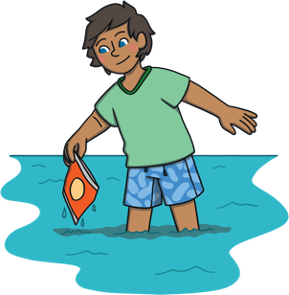
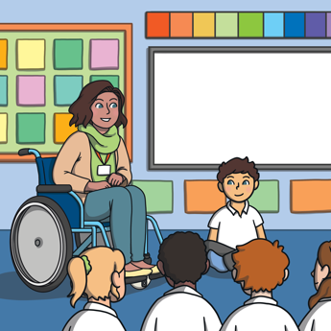
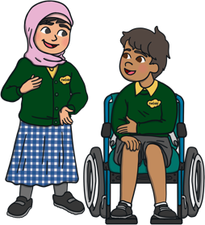
Why is ‘being green’ so important?
Talk to your partner for one minute.
Chat about what you think it means to ‘be green’
and why it is so important.
Share your ideas with the rest of the class.

Slide 5

Why is ‘being green’ so important?
We only have one planet Earth, so it’s important that we look after it!
Climate change affects animal and plant habitats across our world and we all have a responsibility to fight against it.
Litter can end up in seas and rivers, which can make animals ill.

Slide 6
Why is ‘being green’ so important?
Burning fossil fuels traps heat in the atmosphere, which can cause droughts or floods.
Animal habitats can be destroyed when we cut down trees and throw rubbish into landfill sites.
These are just a few reasons why being ‘green’ is so important!

Slide 7
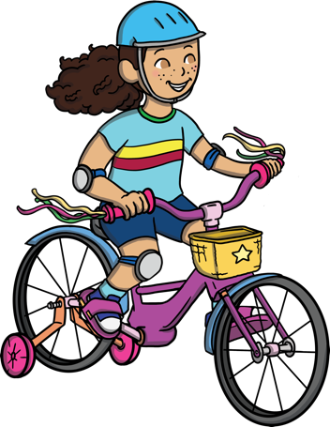
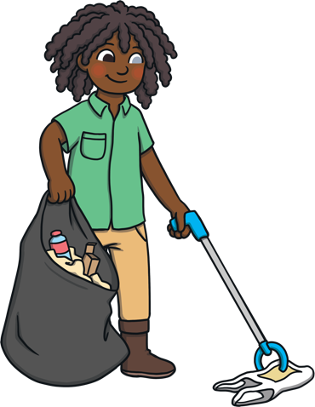
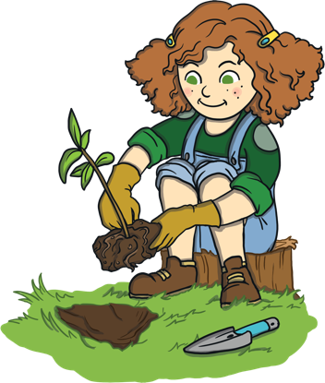
Wear Green, Be Green Ideas
Here are some ideas for your school’s Wear Green, Be Green Day.
Can you think of any of your own?

Slide 8
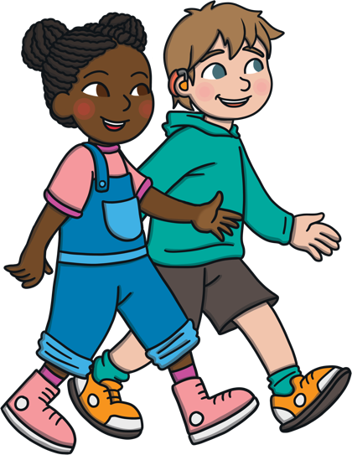
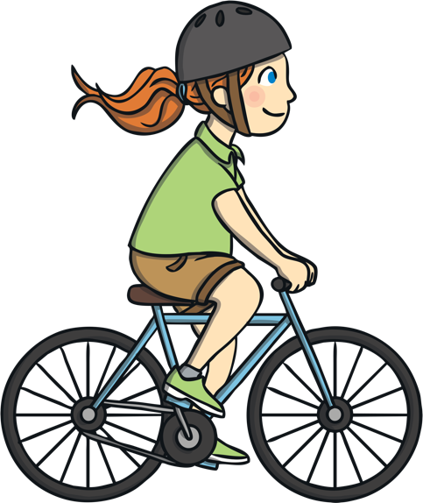
Walk or Cycle to School
Walking or cycling creates less noise and air pollution.
It also means fewer gases like carbon dioxide are put into the atmosphere.
Try to encourage as many people as possible to walk or cycle to school on Wear Green, Be Green Day.
Even if you can’t walk the whole way to school, you could try walking half the distance. Even a little bit makes a big difference!
Remember: If you are cycling, don’t forget to wear a helmet!

Slide 9



Have a Waste-Free Lunch
If you take packed lunches at school, try bringing one
that doesn’t cause any waste.
Pack a waste-free lunch by:
Using reusable containers
Avoiding packaged foods, like sweets and crisps
Using a reusable water bottle
Using a metal knife/fork/spoon that can be washed instead of thrown out

Slide 10

Turn Out the Lights!
Turning off lights and other electrical items when you’re not using them helps to save energy.
Always turn lights off when you leave a room.
In your classroom, decide if you really need the lights on, or if opening the curtains will let in enough natural light instead.
Ask your friends in other classes if they have remembered to turn off the lights in their classrooms, too!

Slide 11
Plant Something
Thousands of wildlife species rely on plants and trees for food and shelter.
Plants also release oxygen into the air.
Perhaps your class could try planting some seeds or a tree in your school grounds.
Check online to see what plants can be grown at this time of year.

Slide 12
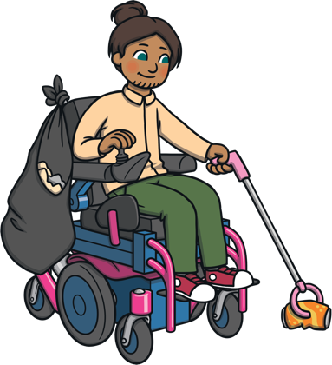
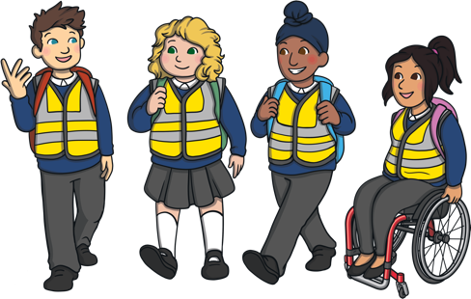
Do a Litter Pick
Doing a litter pick is a great way to take care of your school grounds or local area.
All you need are some litter pickers, biodegradable bin bags and hi-vis vests.
You could take a tally of the different kinds of litter
you come across during your litter pick.

Slide 13

Plan a Paper Free Lesson
Help your teacher to plan a lesson where nobody uses any paper!
Ideas:
Role-play scenarios where people do/do not look after the environment.
Work in groups to make models using recyclable materials.
Use iPads to record your own TV adverts explaining why recycling or saving energy is so important.

Slide 14

Take Part in the Litter Less Campaign
The Litter Less Campaign started in 2011 and has helped to teach millions of students all over the world about caring for the planet.
Perhaps your school could sign up to the campaign and make a big effort to cut down on the amount of litter and waste being produced.
The activities are short, simple
and fun!

Slide 15
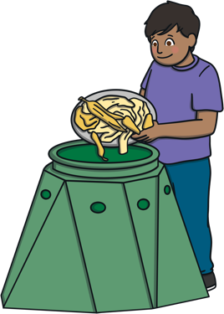
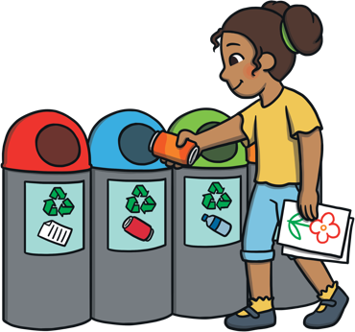
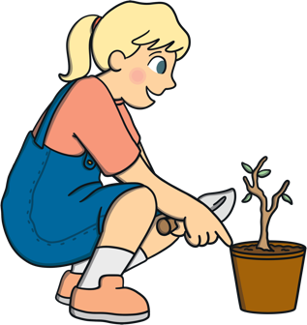
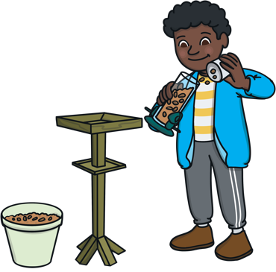
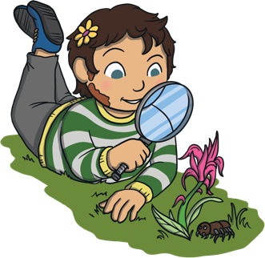
How will you create a ‘Green Day’ in your school?

