Slide 1
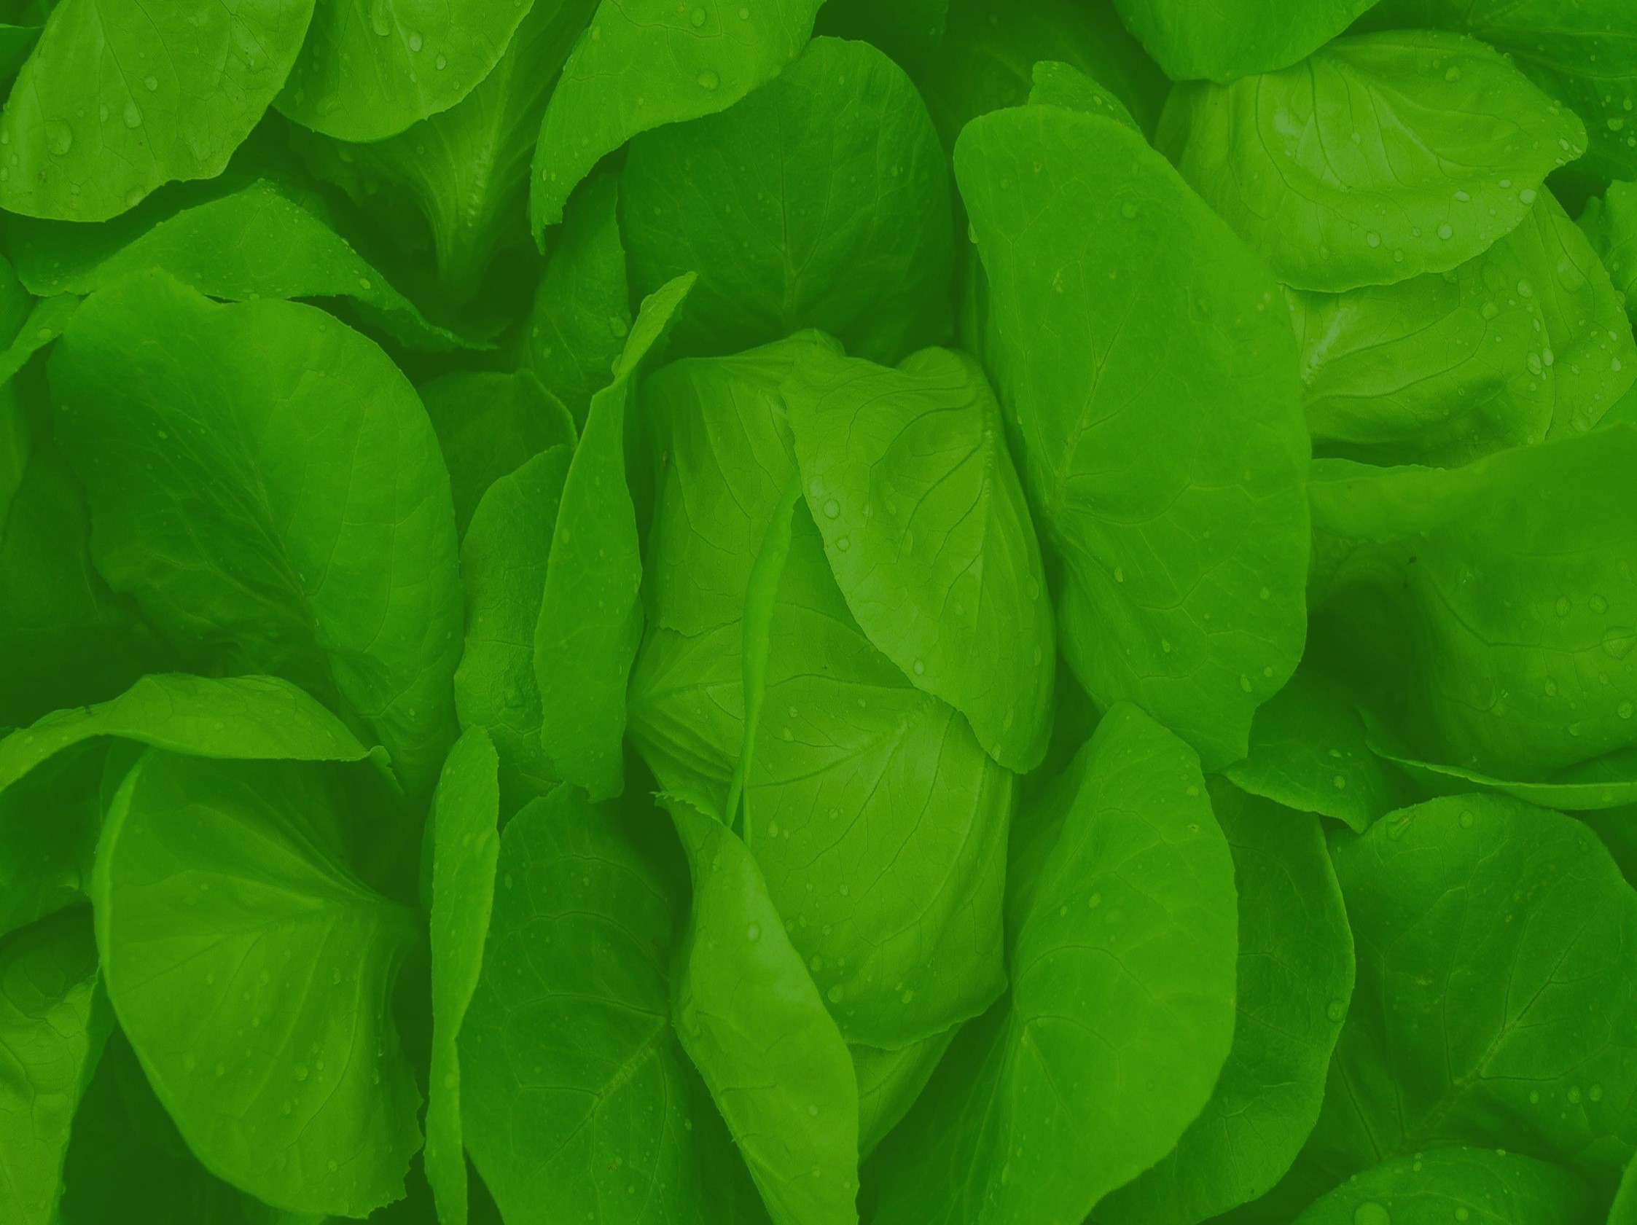


Spring Fruit and Vegetable Growing

Slide 2
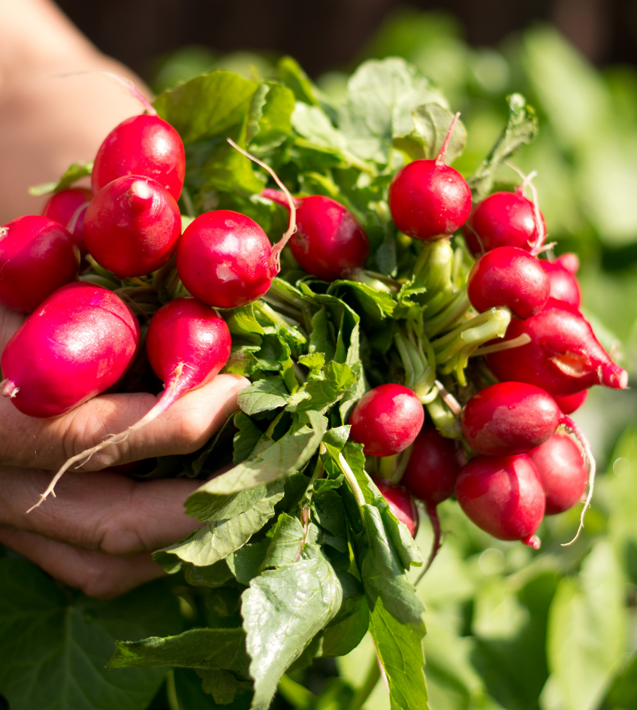
Radishes
Fill a small pot (with drainage holes) 3/4 full with peat-free compost.
Sow the seeds in a thin layer on the surface of the compost.
Cover with a thin layer of compost, water and place on a sunny windowsill.
In about 4-6 weeks your radishes will be ready to harvest, when the roots are 2-3cm long!

Slide 3
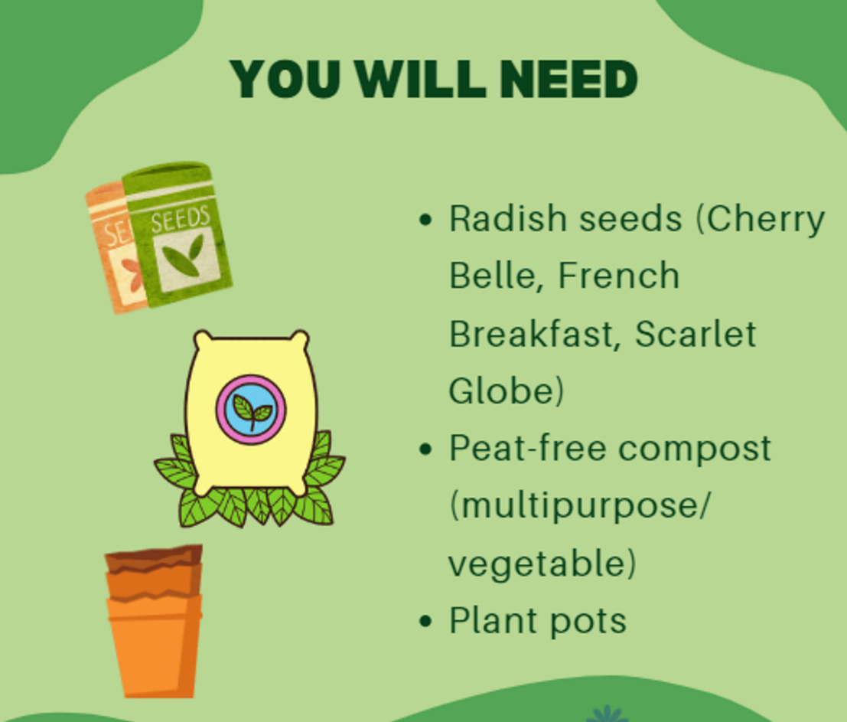
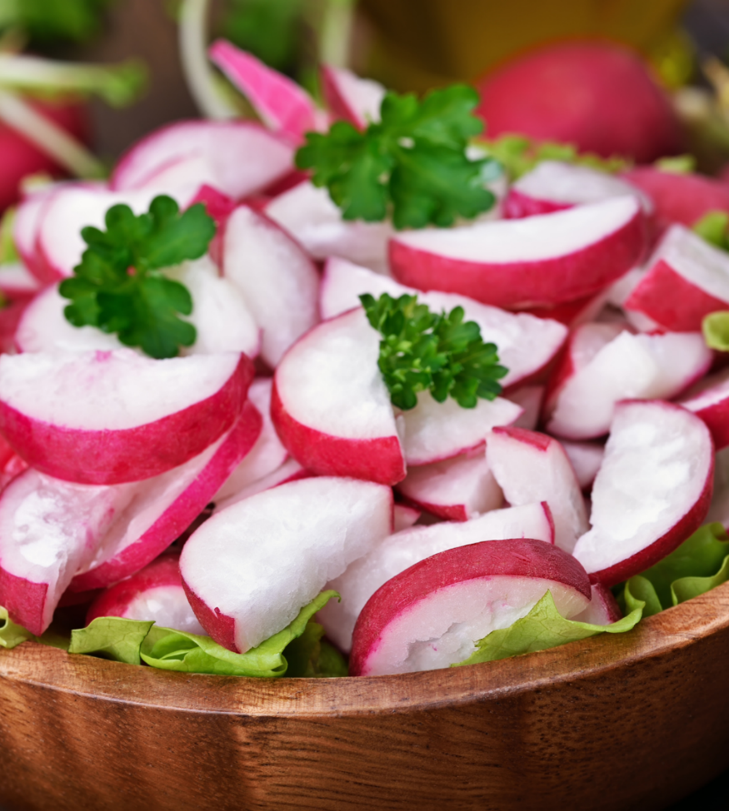
You will need:

Slide 4
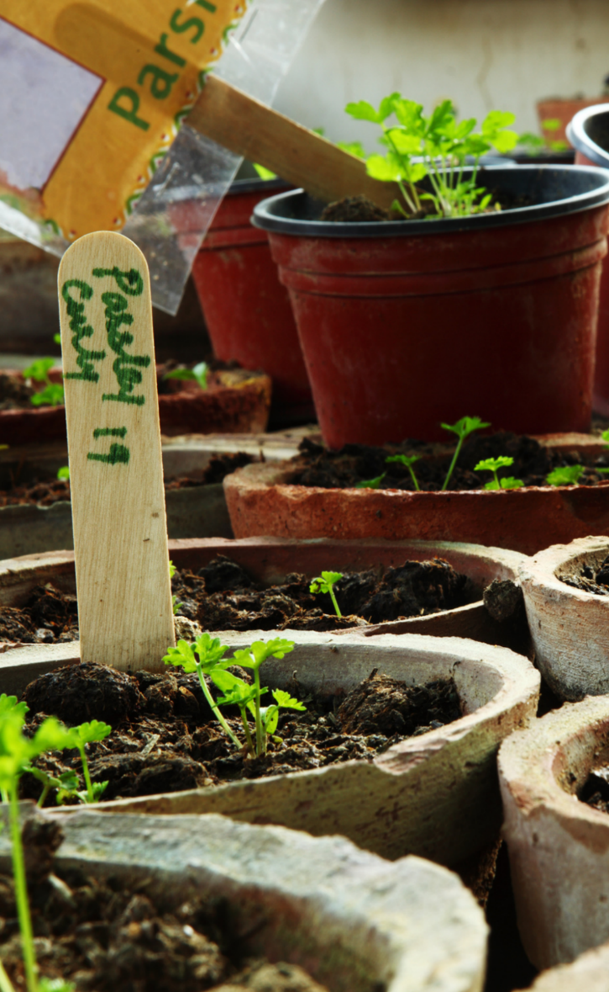
Herbs – Basil/Parsley/Coriander
Fill a small pot (with drainage holes) 3/4 full with peat-free compost and scatter a few herb seeds over the surface.
Cover lightly with compost, water and leave in a sunny windowsill.
Transplant the herb to a larger pot once roots begin poling out the bottom of the pot.
Your herbs are ready to harvest when the plants are 15cm tall!
https://ccea.org.uk/growing/march.php

Slide 5
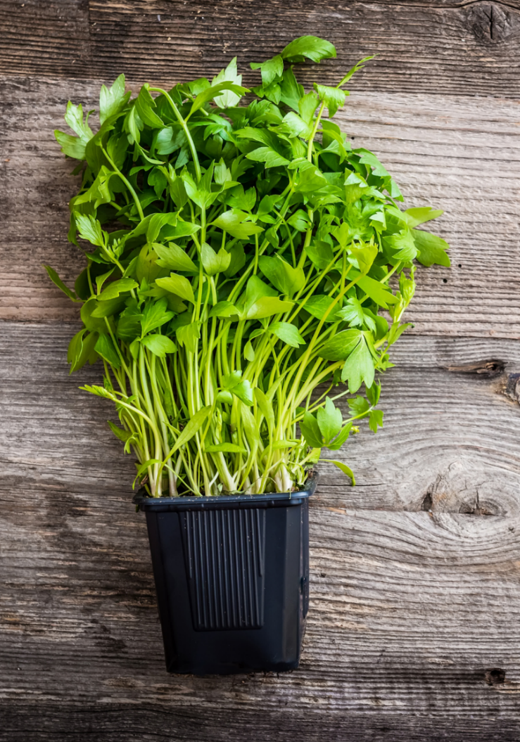
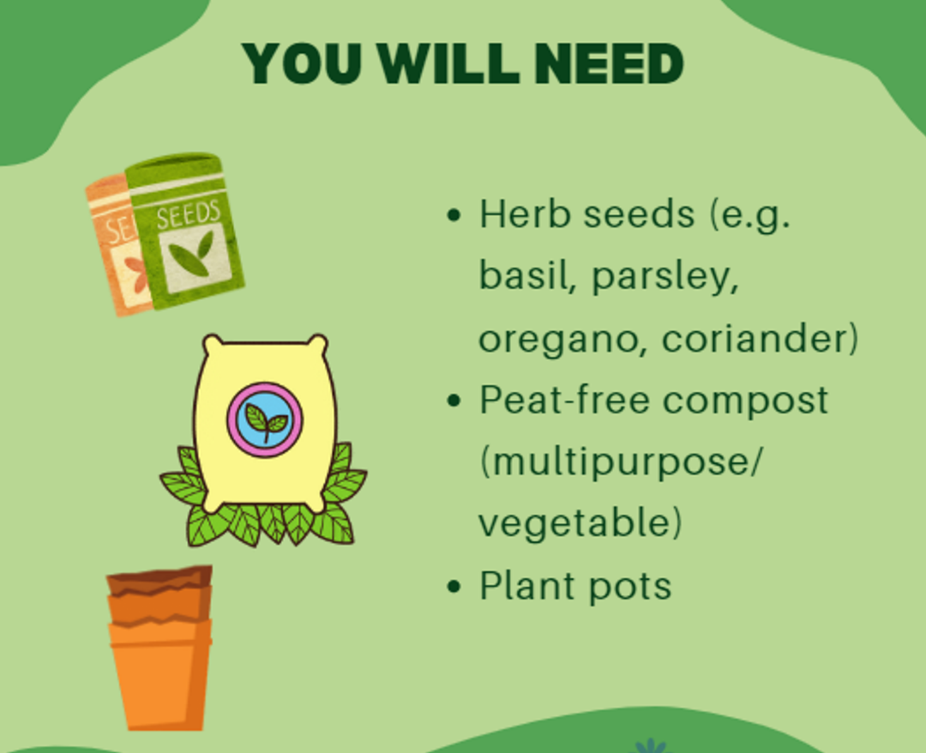
You will need:

Slide 6

Chillis
Fill a small pot (e.g. 7.5cm) with drainage holes, 3/4 full with peat-free compost.
Sow a few seeds on the surface of the soil, cover with thin layer of compost.
Water and cover pot top in cling film. Place on a warm, bright windowsill.
Remove cling film when seeds germinate, water soil when dry.
Transplant seedlings into 5cm pots when they reach about 2-3cm tall. Repot as necessary.

Slide 7
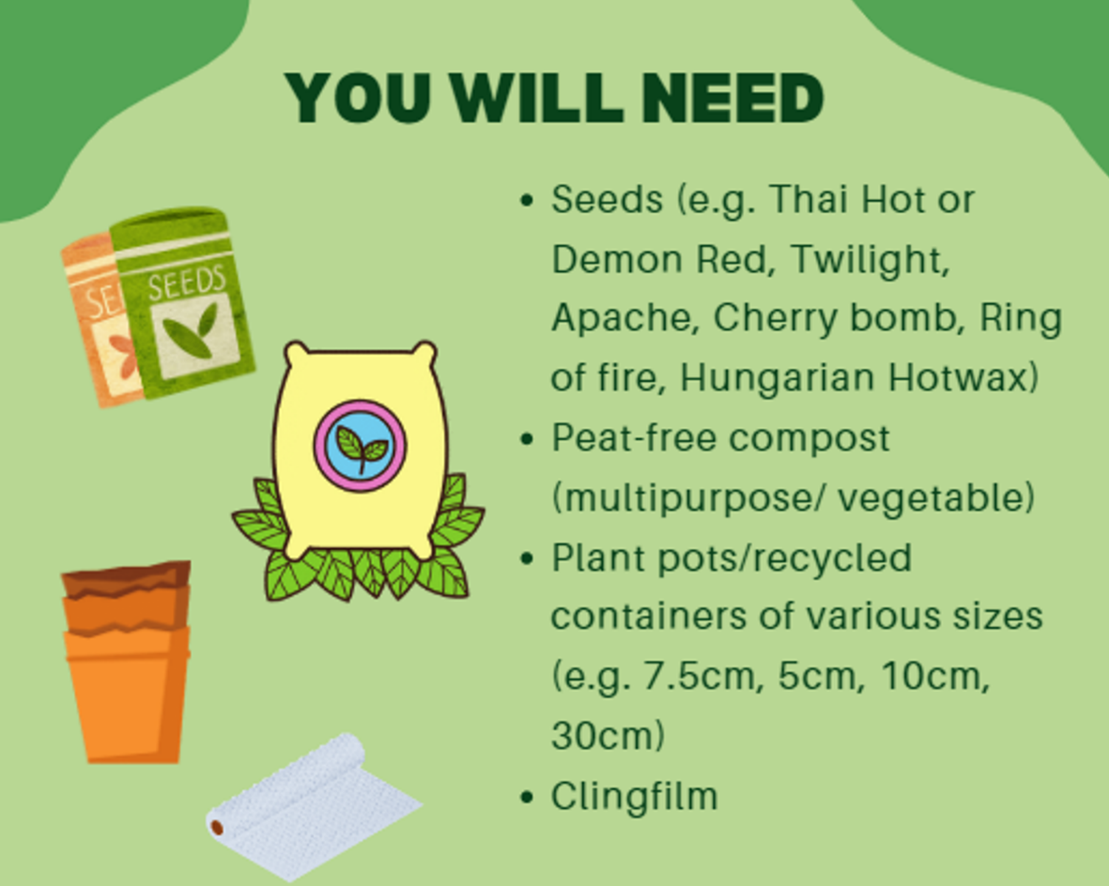
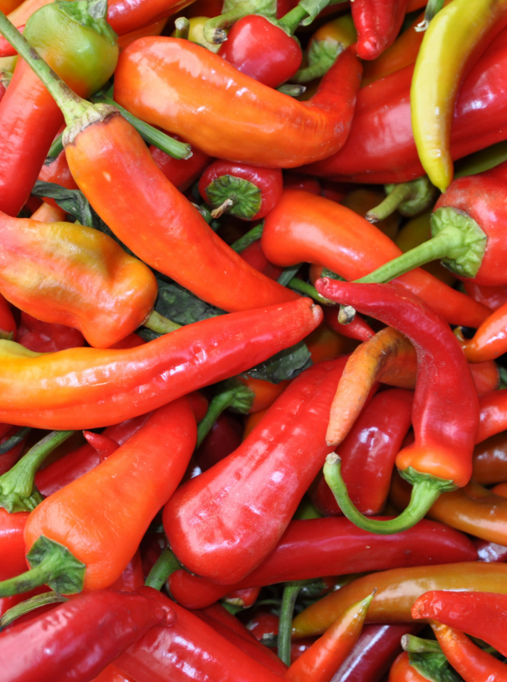
You will need:

Slide 8
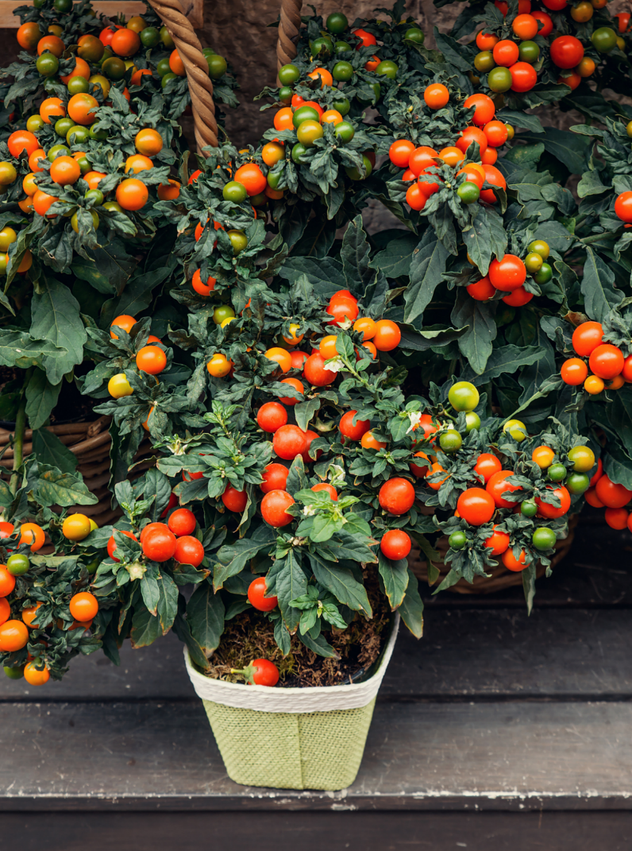
Tomatoes
Fill a small pot (e.g. 7.5cm) with drainage holes, 3/4 full with peat-free compost.
Sow a few seeds on the surface of the soil, cover with thin layer of compost.
Water and cover pot top in cling film. Place on a warm, bright windowsill.
Remove cling film when seeds germinate, keep compost damp.
Transplant seedlings into 5cm pots when they reach about 2-3cm tall. Repot as necessary.
How to Grow Tomatoes - BBC Gardeners World Magazine

Slide 9
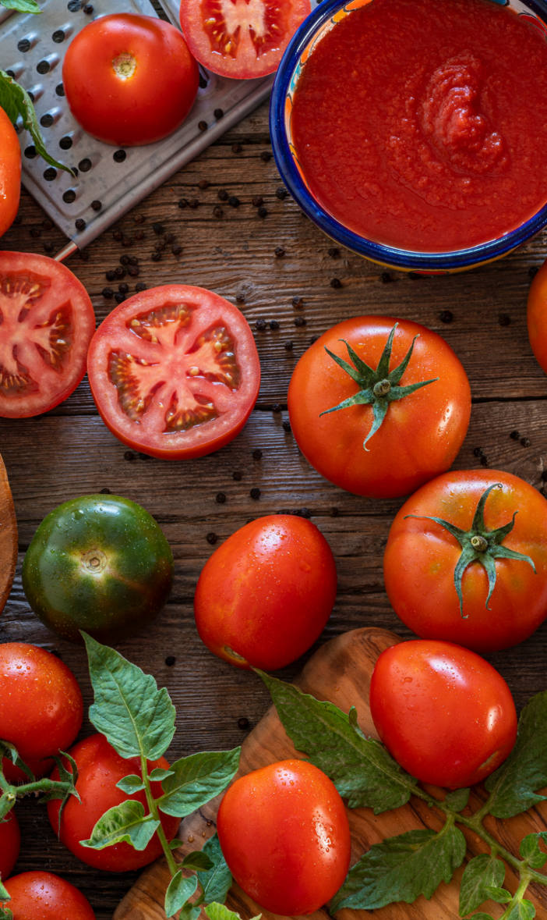
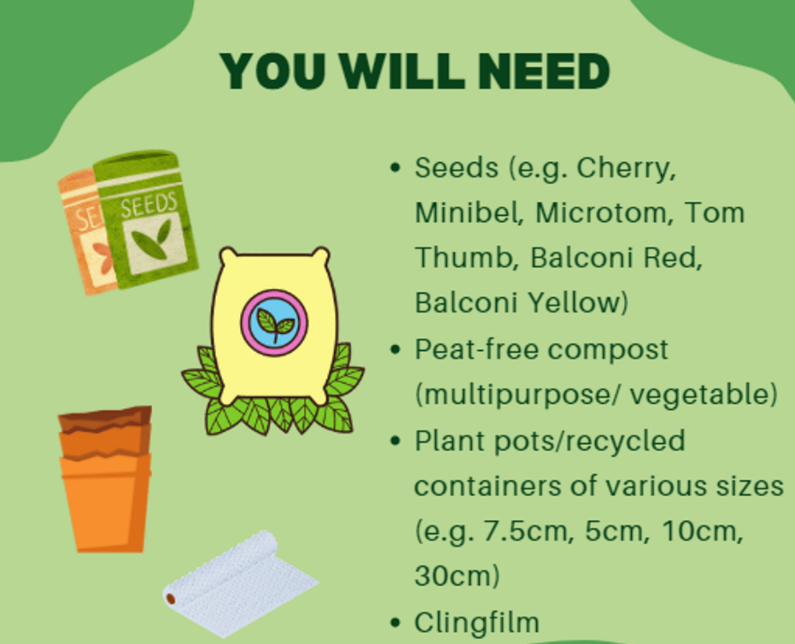
You will need:

Slide 10
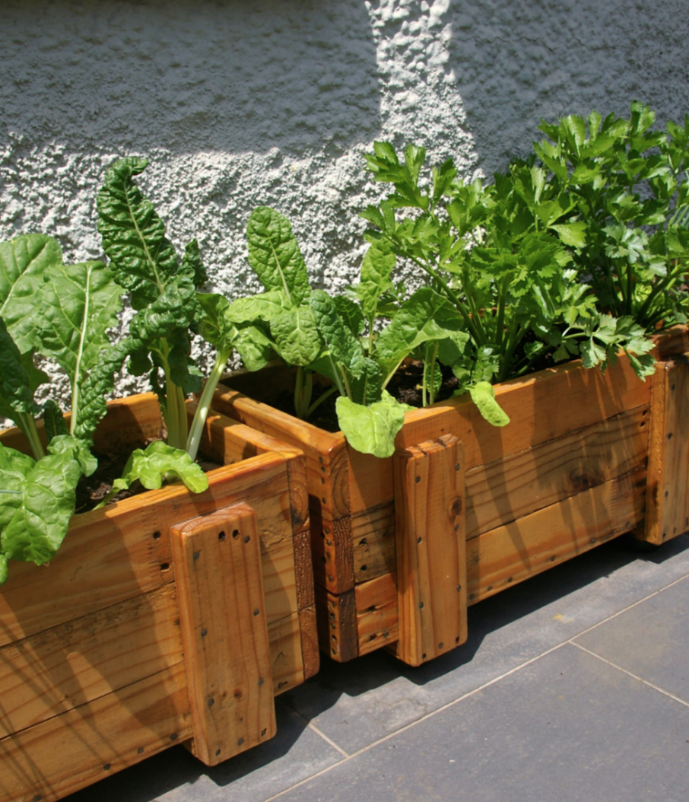
Spinach
Fill a wide, large pot (with drainage holes) 3/4 full with peat-free compost.
Sow seeds 1/2 inch deep in containers.
Water well. Place pot in semi-shade if sowing in spring, and in a sunny spot in the autumn.
Seedlings should germinate in 5-14 days. Thin seedlings out to at least 3 inches apart.
Water soil when dry.
Your spinach will be ready to harvest in 6-10 weeks!

Slide 11
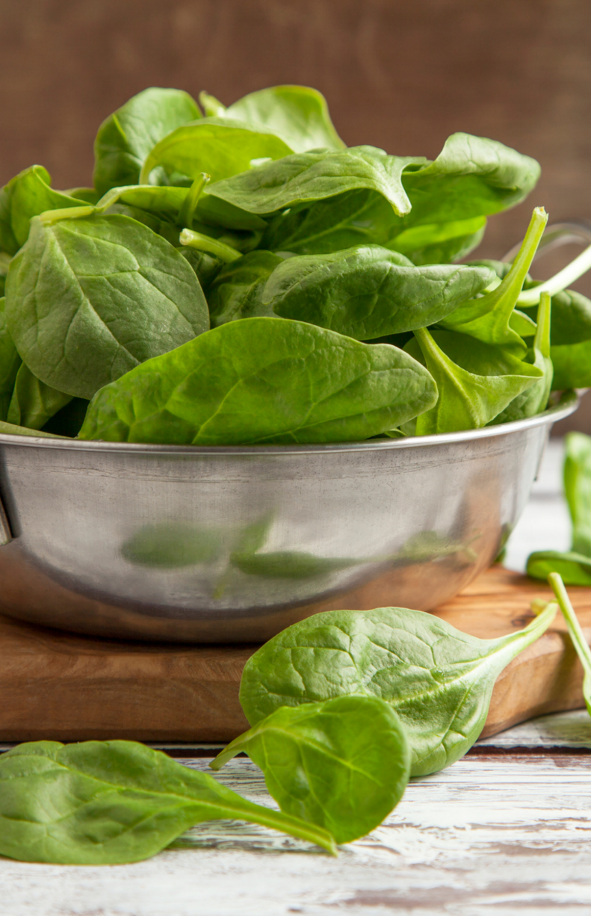
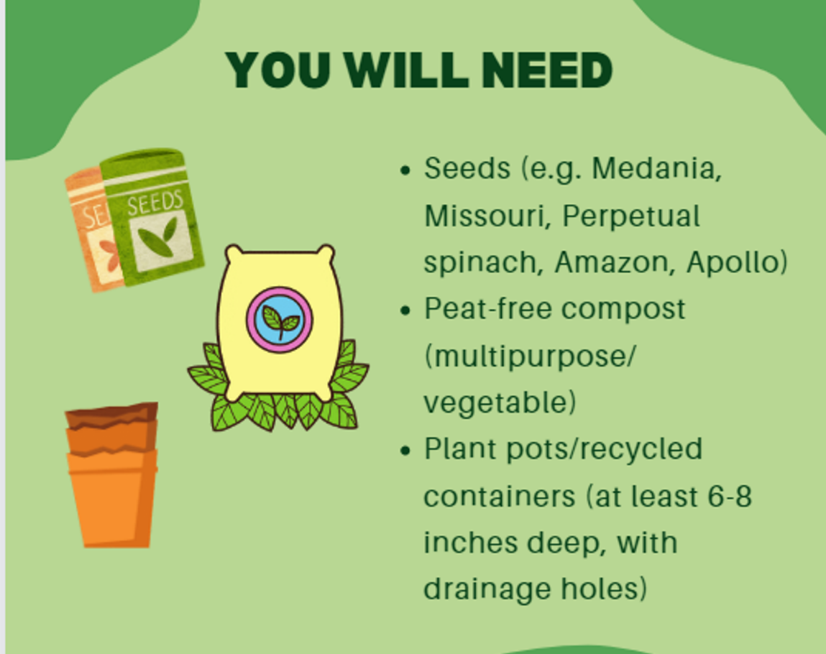
You will need:

