Slide 1


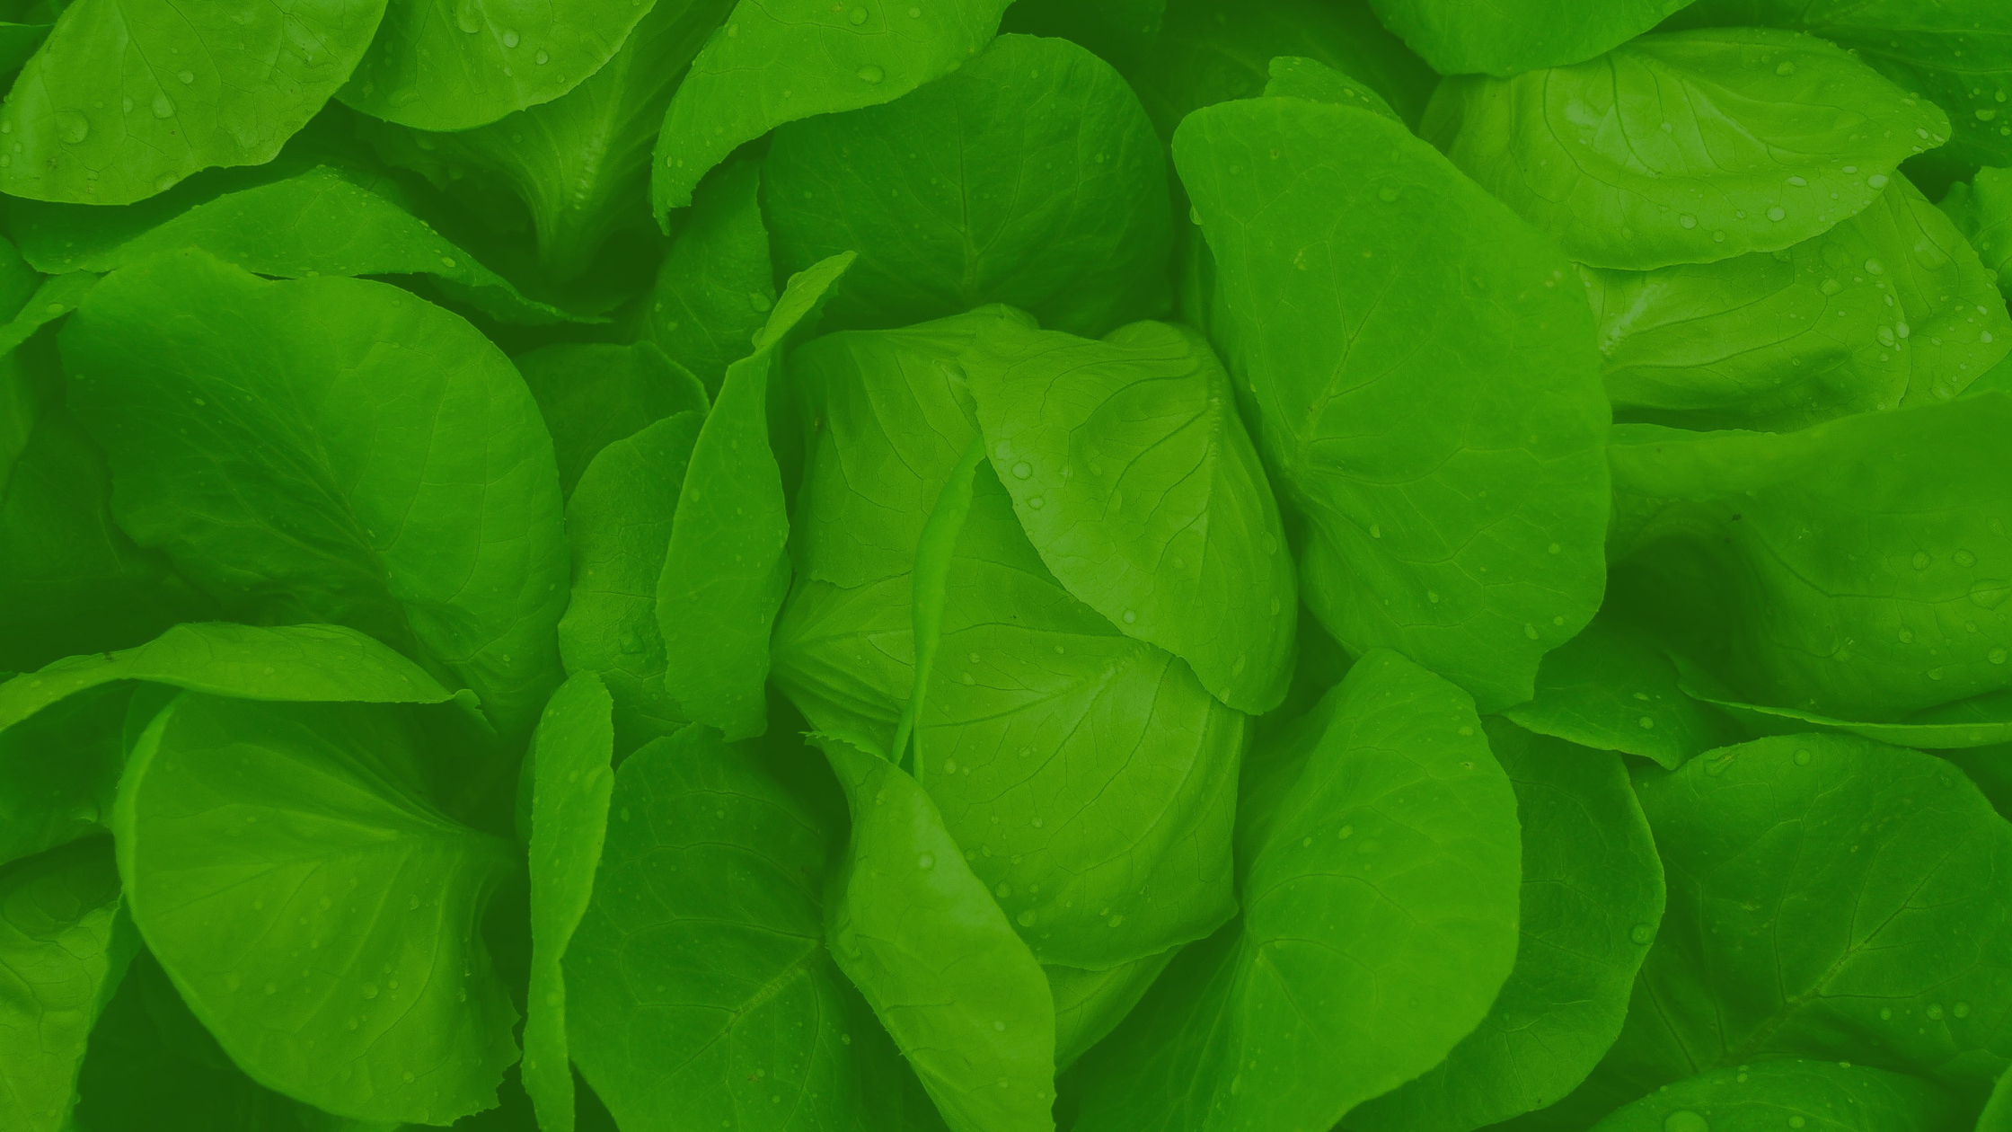


WINTER FRUIT AND VEG GROWING

Slide 2
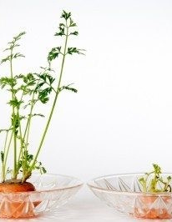
Growing carrot tops
Please note: this will not grow the carrot root, only the carrot plant
Cut the top from a grocery store carrot. You’ll need about one inch (2.5 cm.) of the root
Stick a toothpick into either side of the carrot stump and balance it on top of a small glass
Fill the glass with water up to and barely touching the bottom edge of the stump
Set the glass in a light, but not sunny window
Add water to keep it touching the edge and watch the plant sprout
https://www.gardeningknowhow.com/special/children/grow-carrot-tops.htm

Slide 3
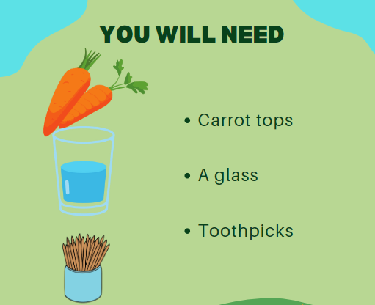

Slide 4
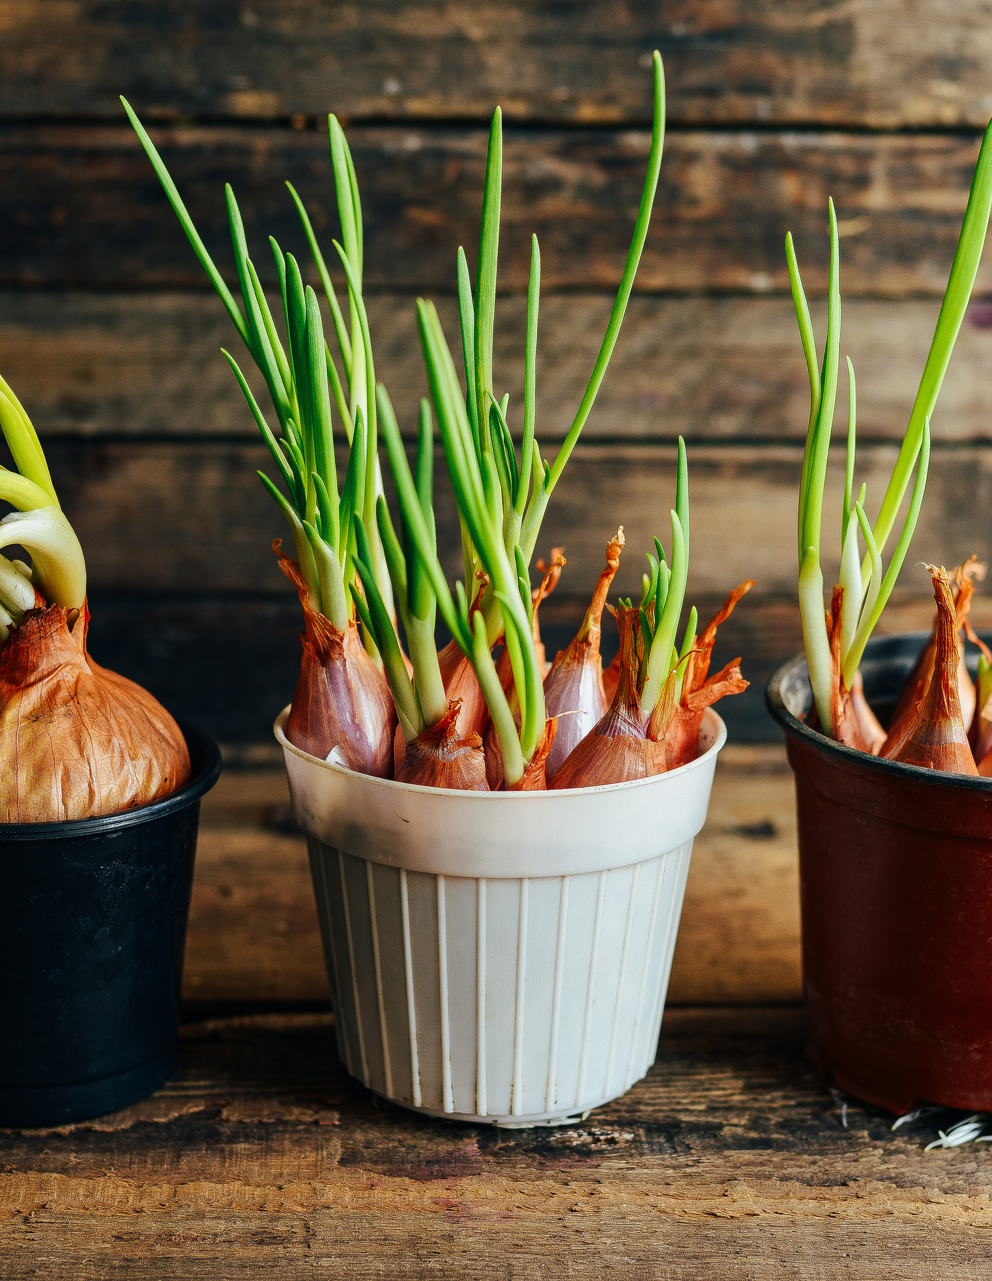
Onions
Plant Oct-Feb.
Fill large container (with drainage holes) 3/4 full with peat-free compost.
Plant onion sets (baby onions) into the compost, leaving the tip just above the soil. Space sets 10cm apart.
Water well and place in a sunny spot. Water regularly when soil is dry.
Your onions are ready to harvest when the leaves start to turn yellow and the onion is sitting above the soil!
Notes:
Autumn/winter planted onions and garlic will usually be ready the next May or June.
You can buy onion seed, but it is easier to buy sets (baby onions).
Choose large containers, approximately 30cm deep and a few feet wide.
Onions require a sunny but sheltered site with fertile and well-draining soil.
When the leaves start to turn yellow they are probably ready and the onions should be sitting a little bit above the soil. Use a hand fork or trowel to ease them out, shake the soil off the roots and spread out to dry either outside if the weather is good or in a shed or covered area.
The process of drying is called ‘curing’ and takes a couple of weeks. It will toughen the outer skin making it dry and papery, so it will keep for longer.

Slide 5
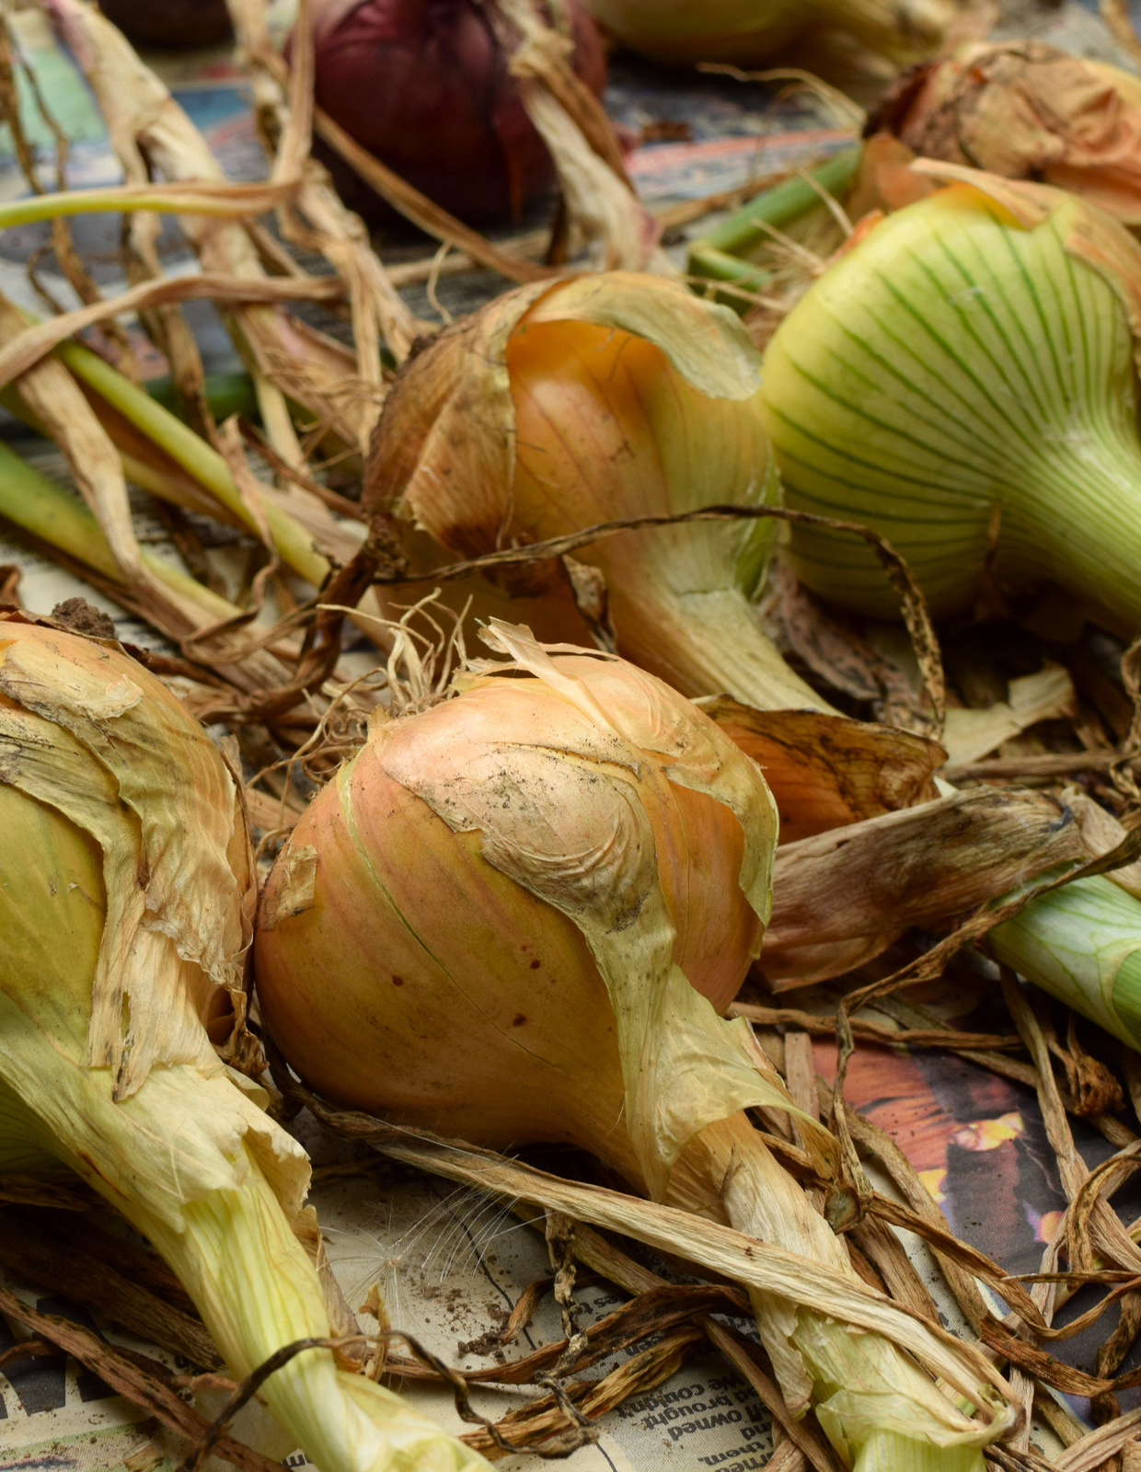
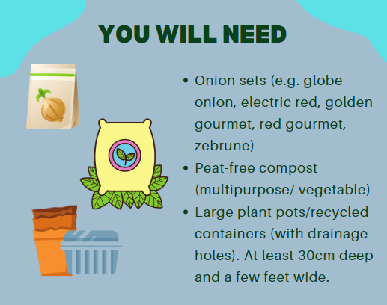
Notes:
Autumn/winter planted onions and garlic will usually be ready the next May or June.
You can buy onion seed, but it is easier to buy sets (baby onions).
Choose large containers, approximately 30cm deep and a few feet wide.
Onions require a sunny but sheltered site with fertile and well-draining soil.
When the leaves start to turn yellow they are probably ready and the onions should be sitting a little bit above the soil. Use a hand fork or trowel to ease them out, shake the soil off the roots and spread out to dry either outside if the weather is good or in a shed or covered area.
The process of drying is called ‘curing’ and takes a couple of weeks. It will toughen the outer skin making it dry and papery, so it will keep for longer.

Slide 6
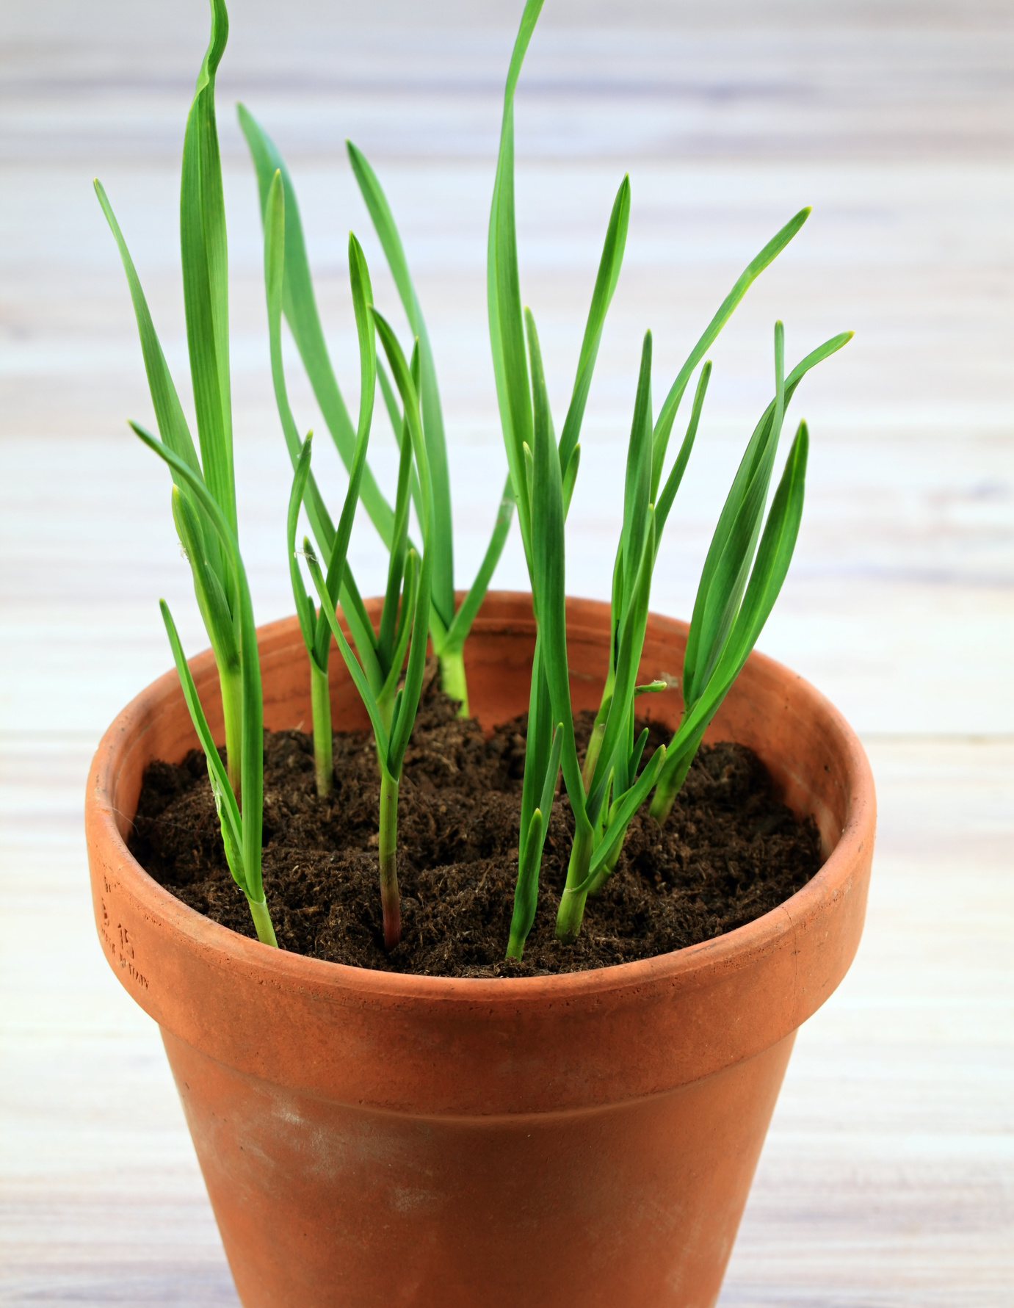
Garlic
Plant garlic cloves from October to February (although before Christmas is better). Each garlic bulb contains 10-12 cloves.
Fill a large pot with drainage holes, 3/4 full with peat-free compost.
Plant the garlic cloves 3-4cm into the soil with the pointy end facing up. Leave 15cm between cloves.
Water well and leave pot in a sunny area.
Water when soil is dry, but refrain from watering during the last few weeks of growing.
Your garlic is ready to harvest when the leaves are brown!
Notes:
Prepare your soil well. Mix in lots of good compost long before you want to start planting. Make sure you have enough space (15cm between each clove - more for elephant). Plant in an area which will receive maximum sunlight hours. Good drainage is key.
Break the bulbs into cloves, leaving skin on. Place cloves 3 - 4cm below ground surface, root down (pointy end up), 15cm apart.
Water your garlic during dry periods throughout the growing season, but stop watering completely during the last few weeks. Carefully remove any weeds as they appear. From February, apply sulphate of potash to your garlic every 6 weeks to give it all the nutrients it needs to grow successfully.
Garlic will tell you when it is time to harvest. Too early and you'll miss the final growth spurt, too late and your bulbs will rot in the ground. When the garlic falls over and the leaves are brown, it's harvest time.

Slide 7
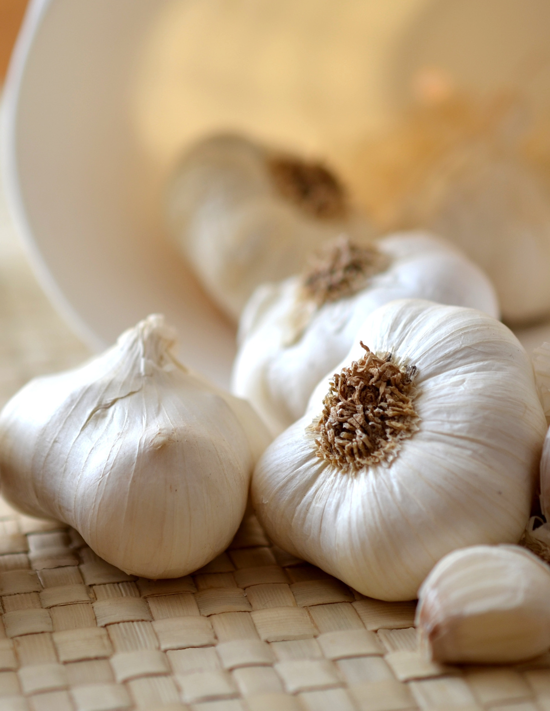
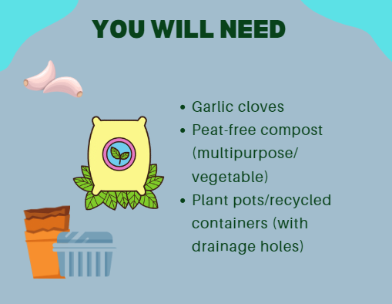
How to Grow Garlic | Growing Tips & Advice | The Garlic Farm

Slide 8
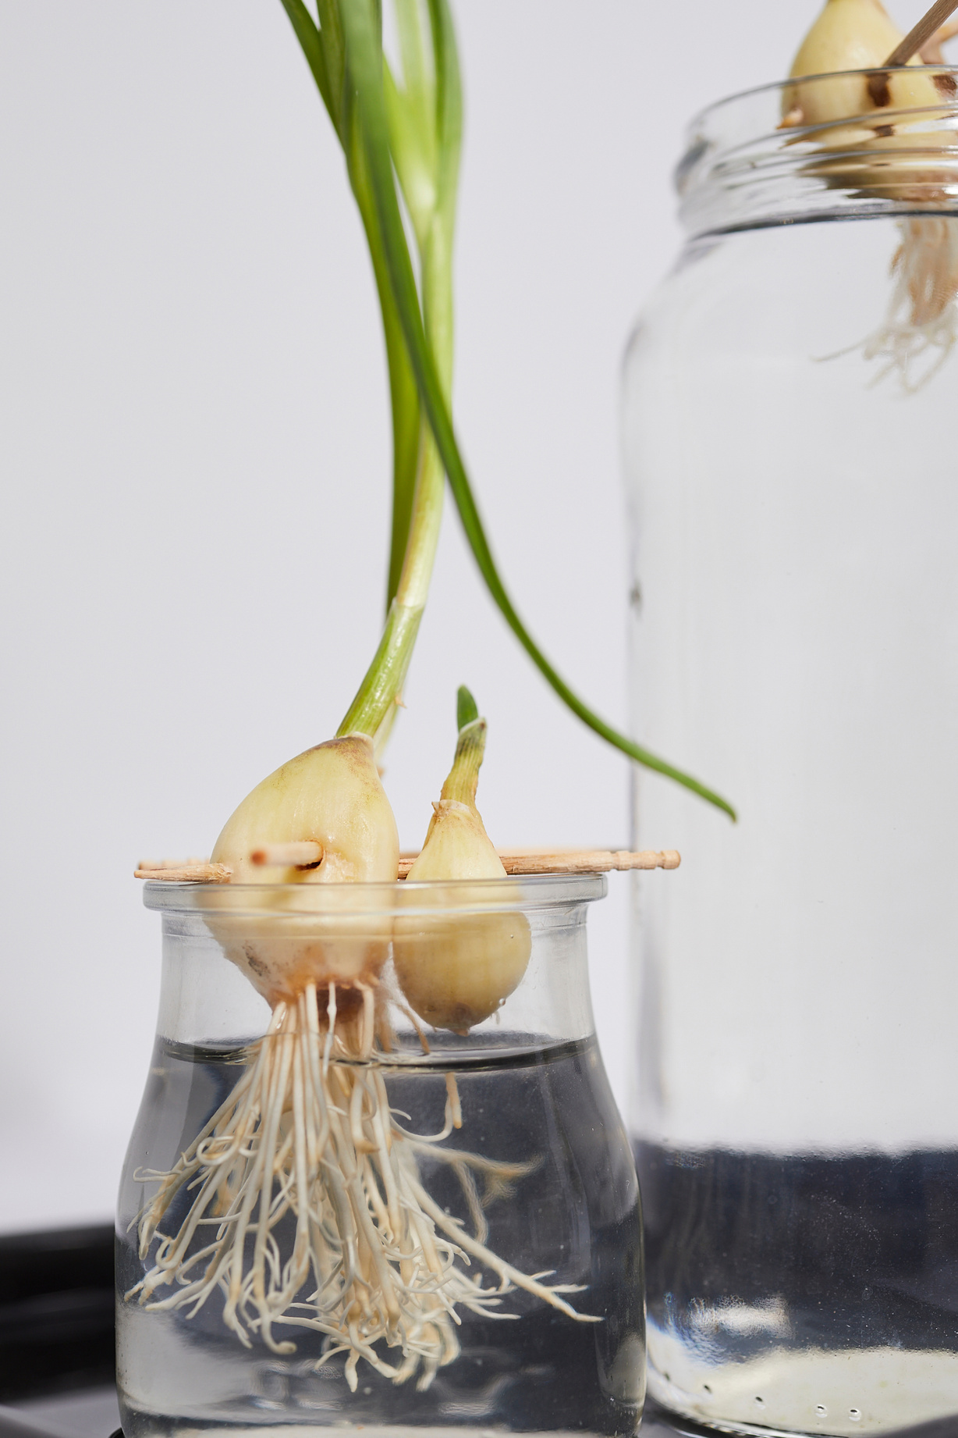
Everlasting Spring Onions
Cut the tops of shop-bought spring onions so they are all equal lengths.
Place in a glass of water just above the white part of the onion.
Leave in a sunny place and change the water regularly (every 1-2 days).
New shoots and roots begin growing after around 3 days - cut these green shoots off and use them for cooking!
The shoots will continue to regrow, leaving you with endless spring onions.
Notes:
Sort the shop-bought spring onions and take out those that don't have at least a few roots growing from the white end.
Be sure to keep changing the water, or the onions will go mushy!

Slide 9
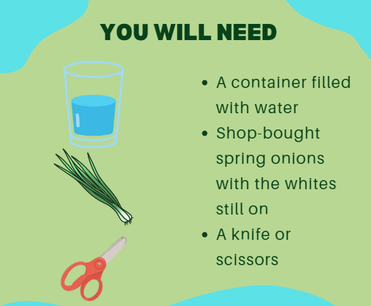

Slide 10
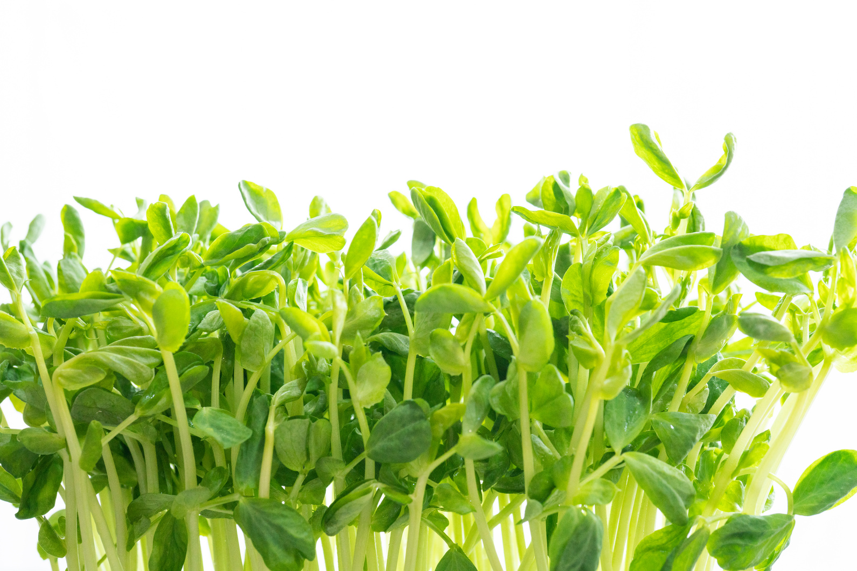
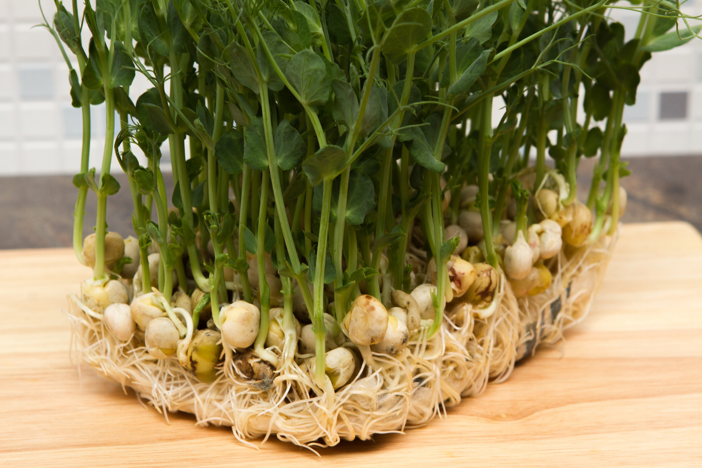
Windowsill ideas
Grow speedy pea shoots
Fill a small pot/recycled container (with drainage holes) 3/4 full with peat-free compost.
Sprinkle 8-10 peas on top.
Cover with roughly 2cm of compost, water well & place in a sunny spot. Keep soil moist.
After a few days, green shoots will begin to appear. In about 15-30 days your pea shoots will be ready to eat!
Cut above the first leaf to harvest and the plant will regrow!
Notes:
Punch holes in the bottom for drainage if there aren’t some there already.
Any dried pea you buy in the corner shop is ok. Soaking the peas overnight or for even an hour beforehand will speed up the process.
Remember to put a dish or saucer underneath your pot to catch the water if placing on a window sill.

Slide 11
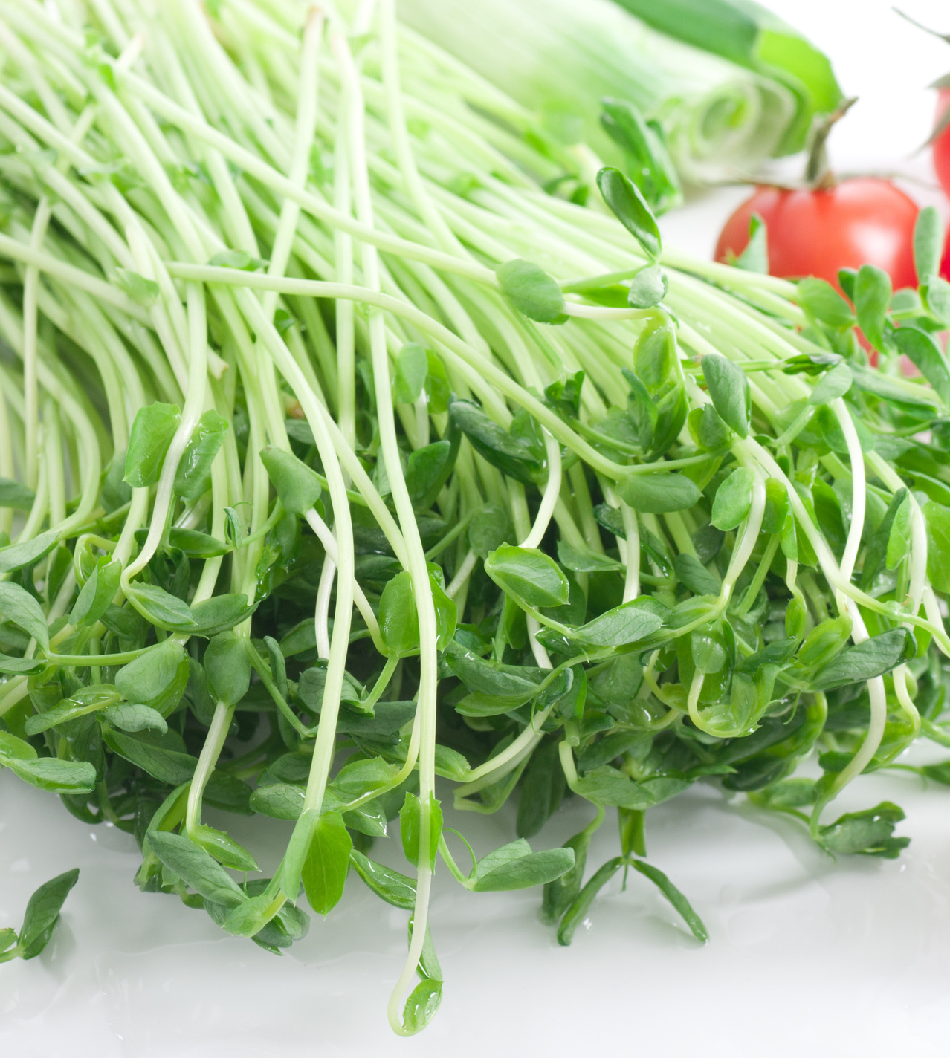
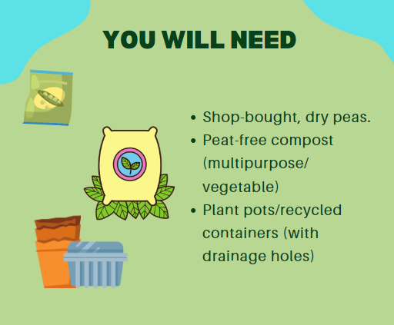

Slide 12
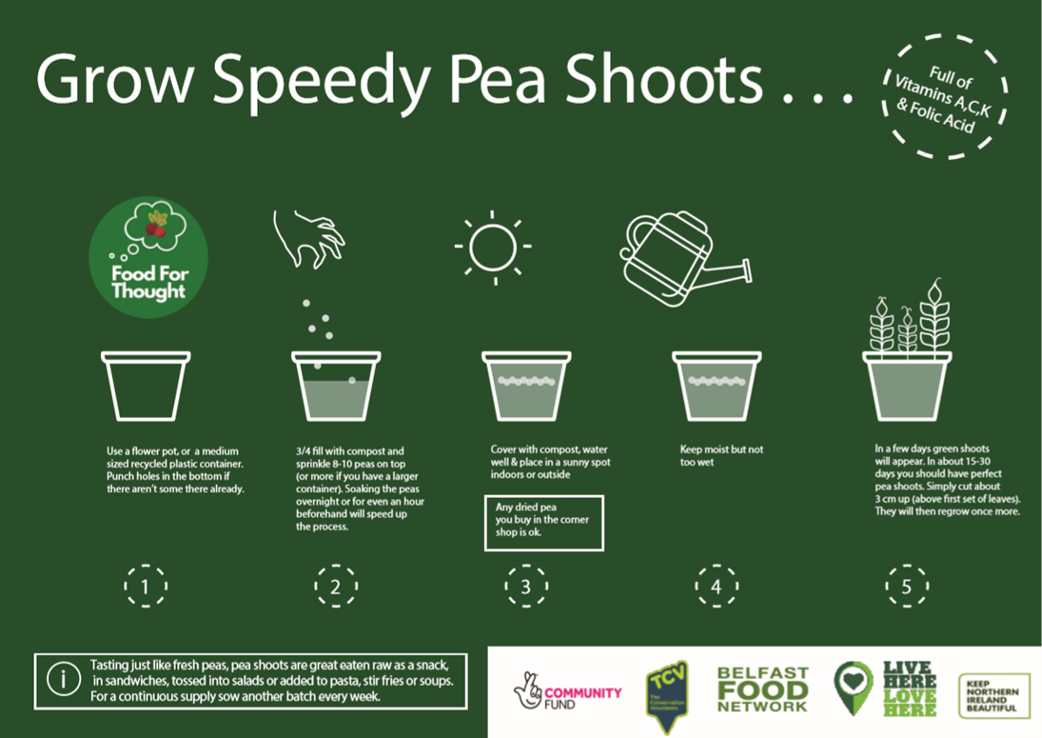

Slide 13
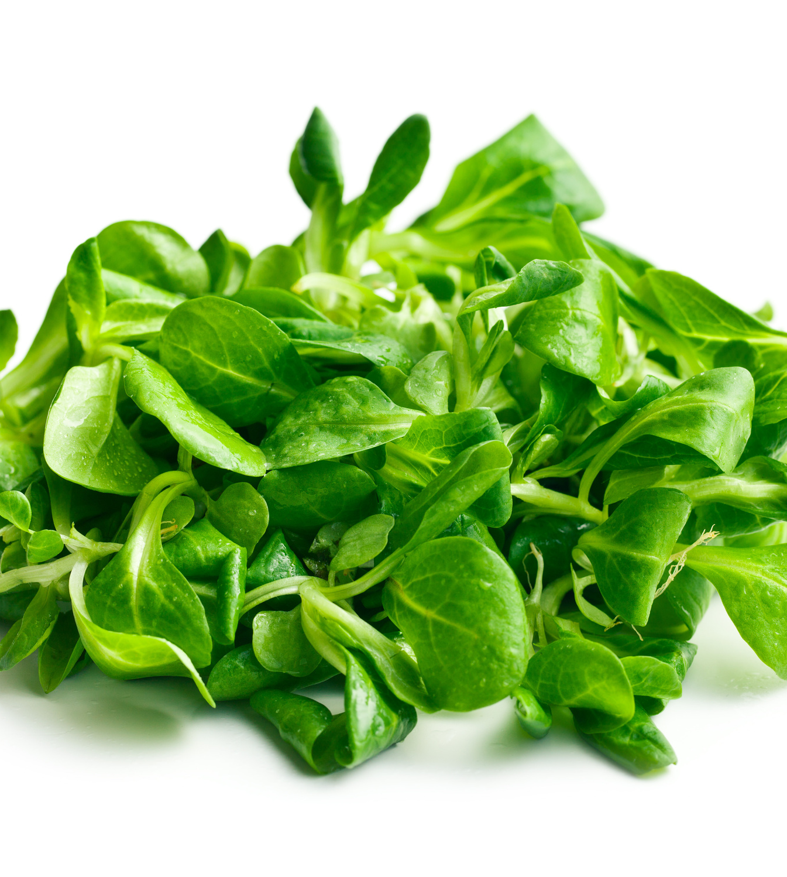
Winter Salad leaves
Sow August - October.
Fill a pot or repurposed plastic container with drainage holes, 3/4 full with peat-free compost.
Scatter your seeds on top and cover lightly with compost. Water well.
Place container in a warm, sunny spot. Keep soil moist.
Young leaves will be ready for use in salads in 6-8 weeks!
Thin plants out to 4cm apart (you can eat the thinnings!) for larger leaves.
Notes:
Choose hardy varieties of your favourite salad leaves, or experiment with more unusual crops such as winter purslane and salad burnet. One of the most reliable winter leaf crops is corn salad, or lamb’s lettuce, Valerianella locusta.
If placing pots outside raise them up on bits of old tile or purpose-made ‘pot feet’; this will help prevent waterlogging.
Winter salad leaves can be harvested from October - February.

Slide 14
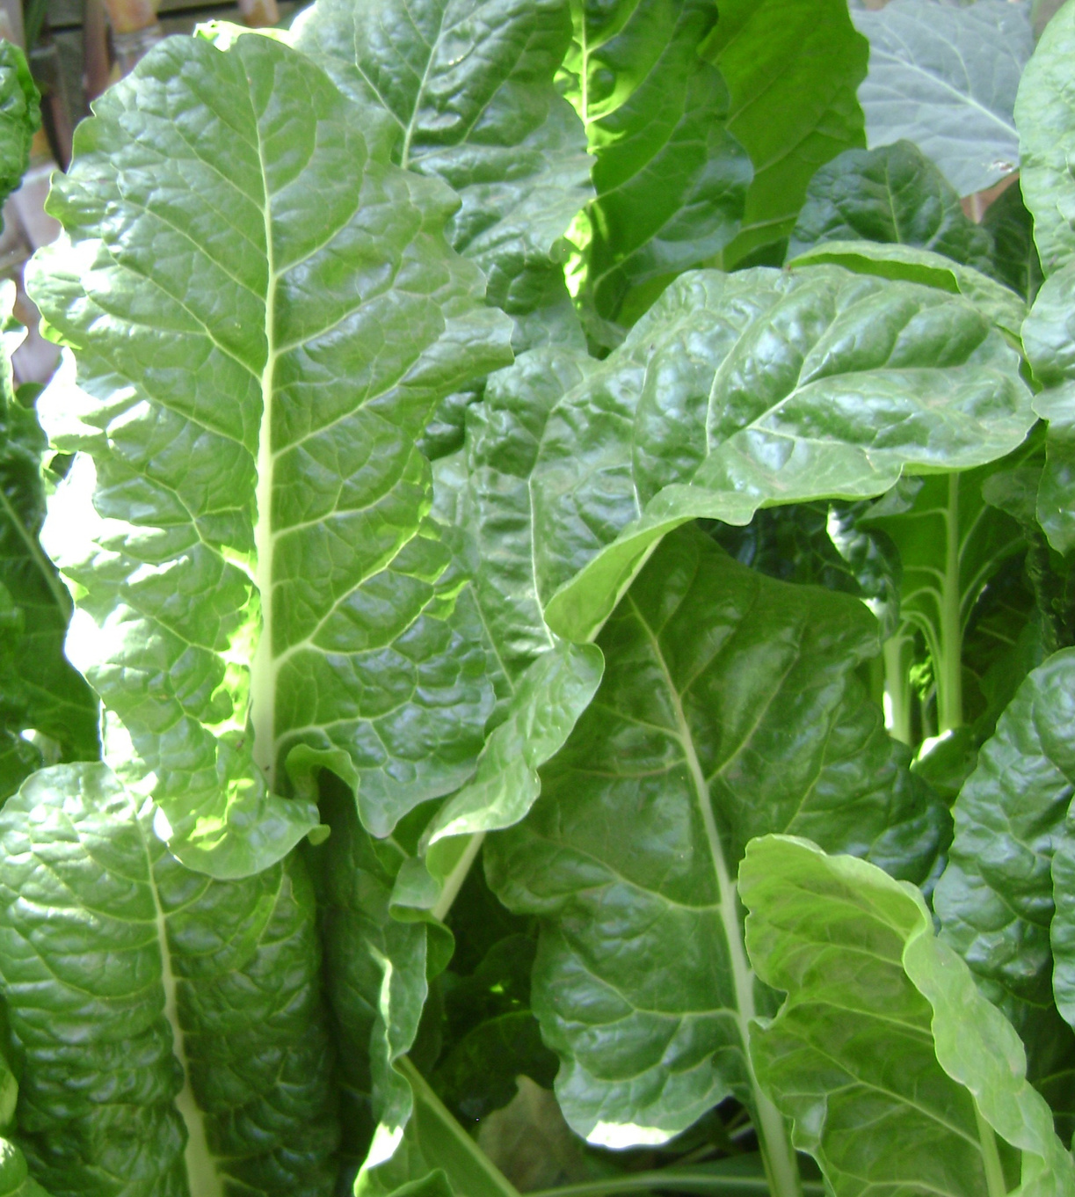
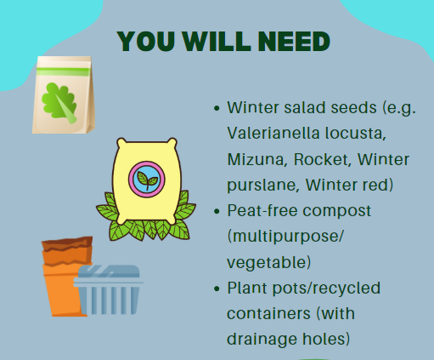

Slide 15
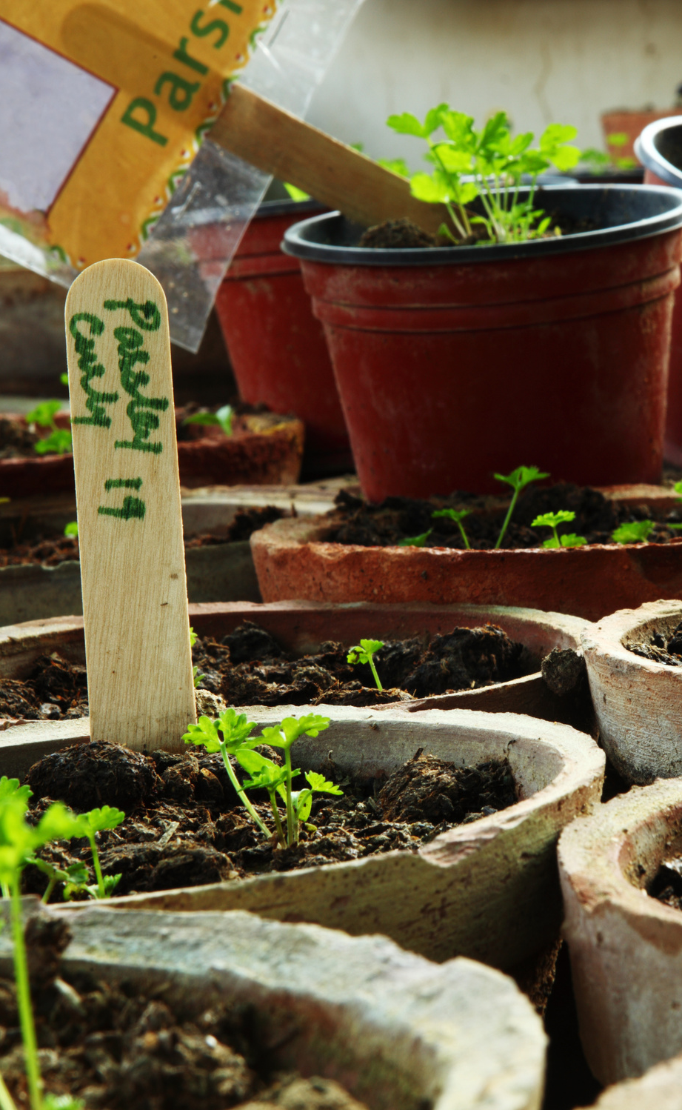
Herbs
(basil/parsley/coriander)
Fill a small pot (with drainage holes) 3/4 full with peat-free compost and scatter a few herb seeds over the surface.
Cover lightly with compost, water and leave in a sunny windowsill.
Transplant the herb to a larger pot once roots begin poling out the bottom of the pot.
Your herbs are ready to harvest when the plants are 15cm tall!
Notes:
• When the baby herbs grow to the point where you can see roots coming out of the holes in the bottom, move them into a bigger pot or recycled so they have more space to grow.
• When the plants are approx. 15cm tall pick off some of the largest outer leaves for using in your cooking.
Soft herbs can be grown in large pots and recycled containers so long as they have drainage holes in the bottom.
Remember to put a dish or saucer underneath your pot to catch the water if placing on a window sill.
It can take from 1 week to 3 weeks for seeds to germinate so watch for those green shoots peeking through.
Water occasionally, when the soil feels dry. The compost should not be soaking wet.

Slide 16
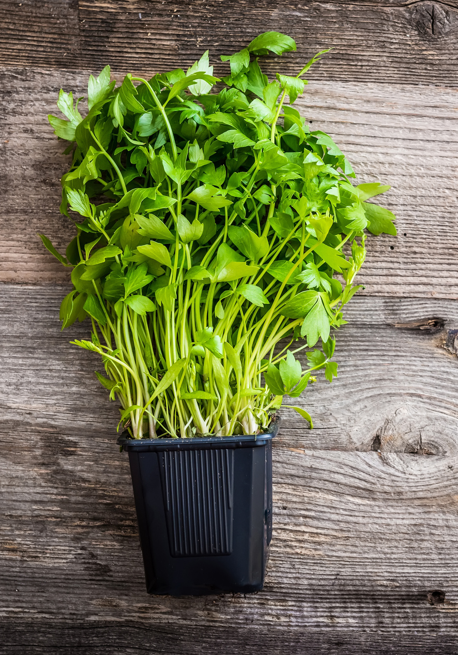
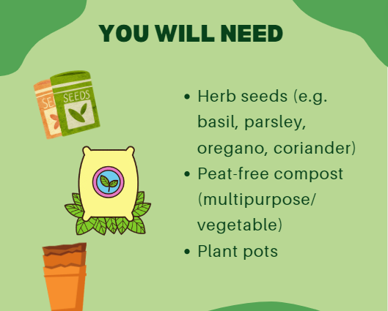
For more information:
https://www.rhs.org.uk/advice/profile?pid=679
https://ccea.org.uk/growing/march.php

Slide 17
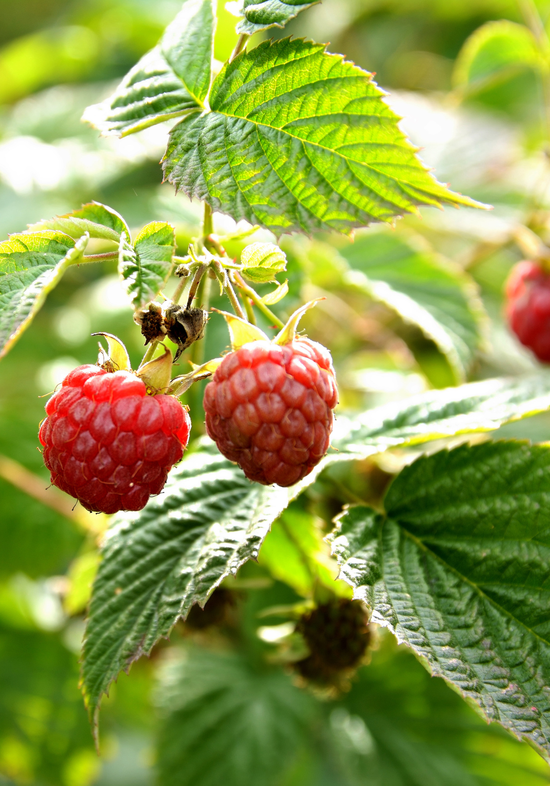
Fruit bushes
Winter is a good time to plant out soft fruit bushes such as blackcurrants and blueberries. Bearing in mind the school holidays, late cropping varieties are best.
If you have raised beds don’t use up the space with fruit bushes as it is unnecessary and they take up too much room. Fruit bushes will be happy in open soil which has been improved with compost or manure.
Choose a sheltered and sunny position if possible. Plant 1.5m (5ft) apart.
Blueberries need added ericaceous (acid) compost.
Good quality potted fruit bushes cost approx £15 – £20 each but a cheaper option is bare-rooted plants which are available between late November to late March
Sow_Grow-Munch.pdf (sustainableni.org)

