Slide 1



















Slide 2






WELCOME,
STUDENTS!

Slide 3

Global Perspective
Water
Climate Action
Key Stage 4

Slide 4









Global Perspective

Slide 5




Global Perspective
The global dimension explores our connections with the rest of the world. With a global dimension to their education, learners can engage with complex global issues and explore the links between their own lives and people, places and issues throughout the world.
The global dimension can inform the whole school ethos, leading to a school that is inclusive, just and democratic and promotes social and environmental responsibility, respect and co-operation.
Citizenship, in its context of fair decision-making, runs throughout the Eco-Schools process. The global perspective topic seeks to ensure that pupils consider the environmental, social and economic impacts of the decisions that they make through this process, on the local and global community, in the future as well as for the present

Slide 6







Global Citizenship

Slide 7


Global Citizenship
Being a global citizen is not clearly defined. As there is no global government there are no clear rules and regulations and globally, we do not have democratically-elected representatives to speak for us.
Global citizenship is more a moral understanding of our responsibilities and our rights in a global context. Being a true global citizen means that we recognise that all people have equal rights and that we value diversity.
In addition, it means we should value the earth as our common home which we all have a need and indeed a responsibility, to look after.

Slide 8





The Global Environment

Slide 9
The Global Environment
The term environment means surroundings; natural world. However, it can be narrowly defined, for example our immediate surroundings as in the classroom environment or very broadly, in relation to the global environment.
One thing that is certain is that ‘humankind’ has had a huge impact on the environment. Today, many of us have acquired so many things that we have a very comfortable life. But at what cost?
The more that people take from the environment, the more they change the pattern of nature. If we take too much, we risk upsetting this balance.
The balance of nature changes slowly over time but in recent years we have wanted more and more for ourselves and we are upsetting the balance at a faster rate, without even realising it.

Slide 10

The Global Environment
We are part of the natural environment and must look after it. If we upset the pattern too much, we may even destroy ourselves and the lives of future generations.
Trócaire’s focus is on ensuring that our global resources are shared equitably and those in power act for the common good of all.

Slide 11



Global Food

Slide 12

Global Food
There is plenty of food in the world to feed everybody.
The problem is how this food is distributed and shared.
In fact, more than one and a half times the amount of food needed to feed everybody in the world is produced each year.
Yet over 821 million, 1 in 9 people, are hungry.
If there’s really enough food in the world, why do some people still go hungry?
Hunger is caused by many factors and must be solved with many approaches. Factors include lack of investment in small farmers, particular women, unfair international trade policies and climate change.

Slide 13

Global Population

Slide 14


Global Population
Our precious finite world is currently home to over 7.8 billion people. Numbers this big are difficult to understand but what if we imagined the whole population of the world as a village of just 100 people? In this imaginary village, each person would represent about 78 million people from the real world. One hundred people would fit nicely into a small village. By learning about the villagers – who they are and how they live – perhaps we can find out more about our neighbours in the real world and the problems our planet may face in the future.
Imagining the world as a village also makes it easier for us to start thinking about all the human and environmental problems in the world and what we can do about them. It makes it easier for children to grasp the concept that the world is a large place; and many people in the world live lives much different from our own.

Slide 15

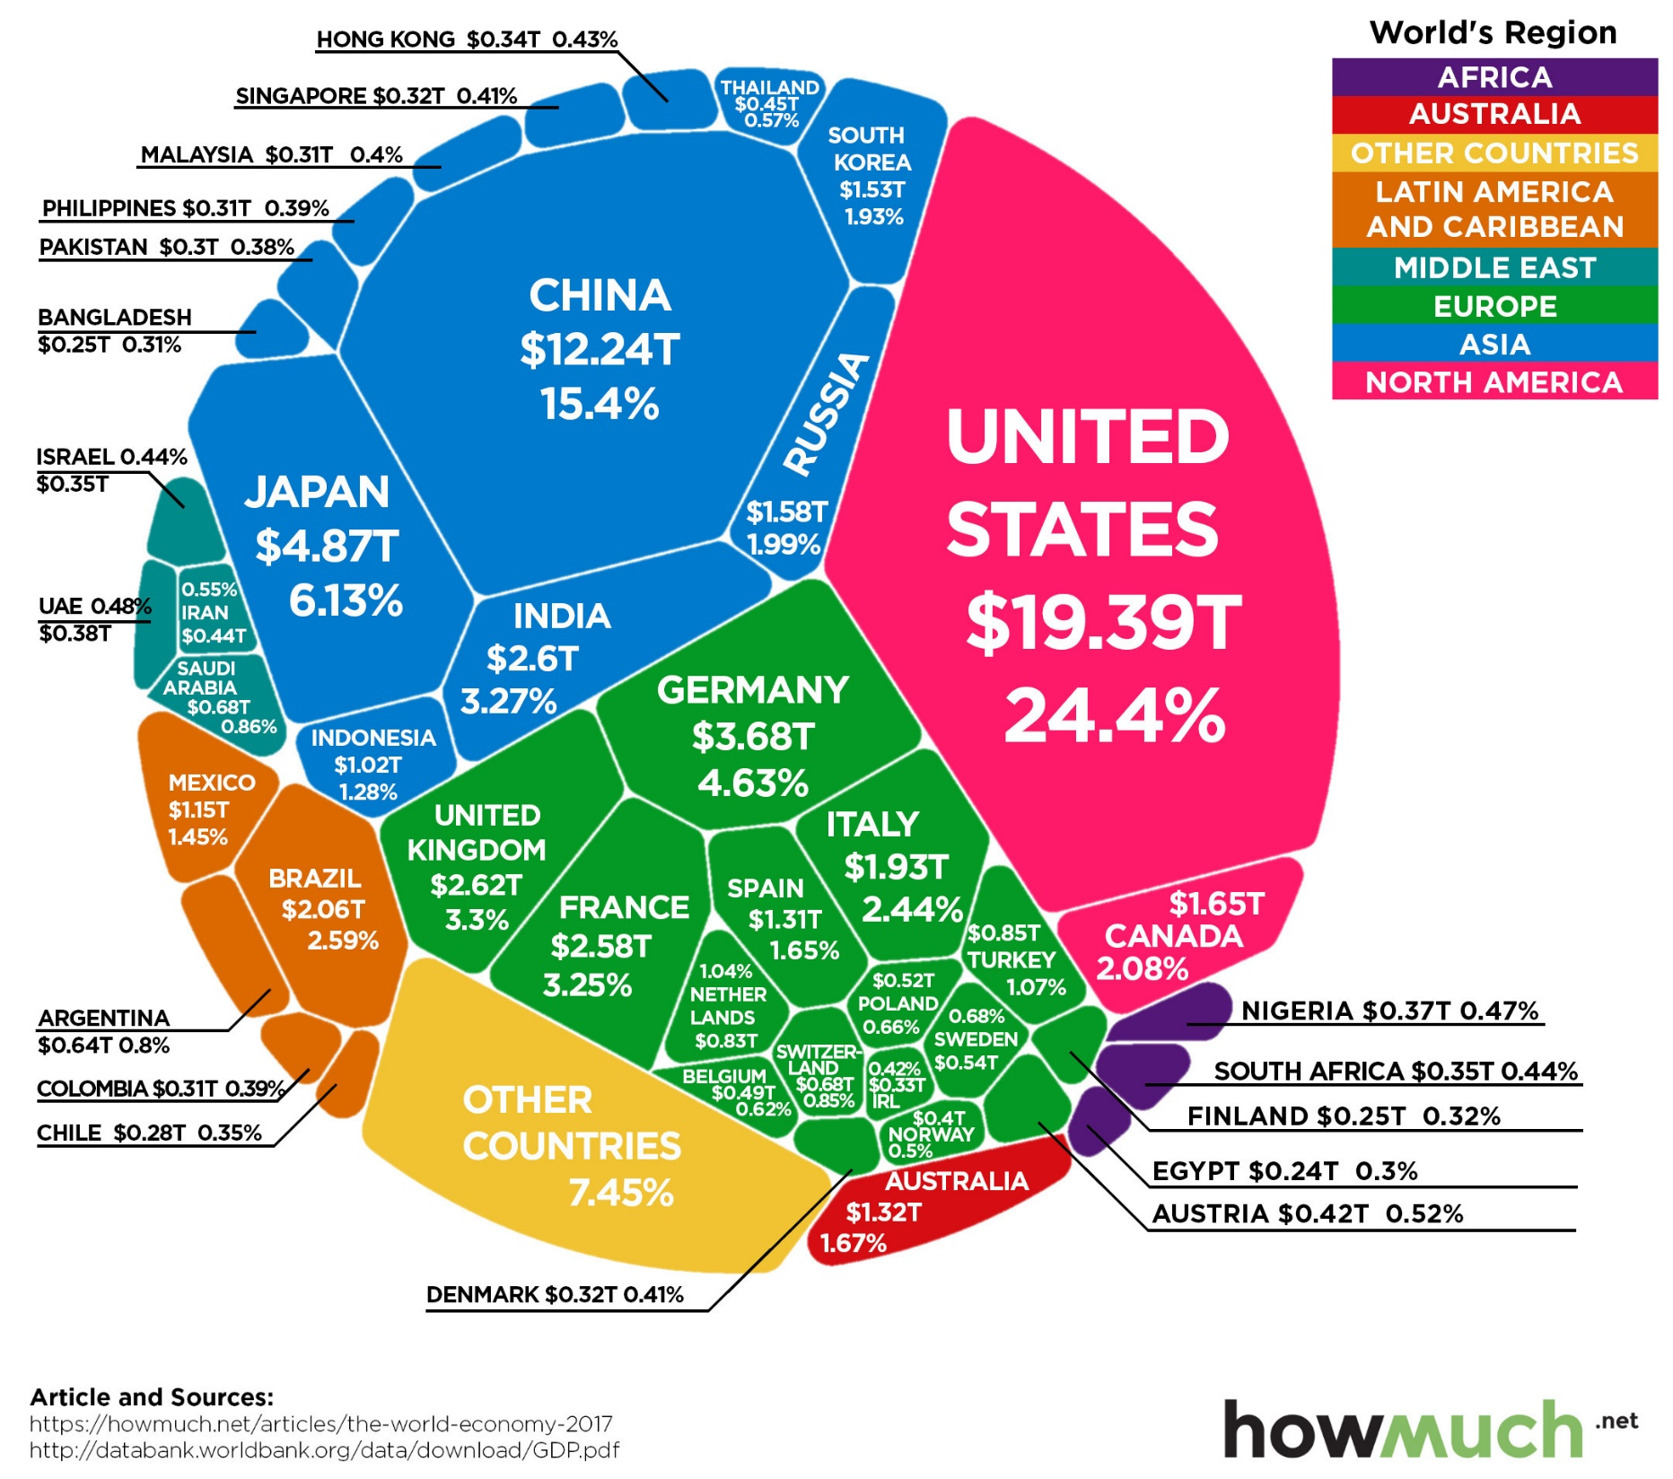
The
Global
Economy

Slide 16






How are the world’s resources
split?

Slide 17

IF THE WORLD WERE 100 PEOPLE
Language
12 Chinese
5 Spanish
5 English
3 Arabic
3 Hindi
3 Bengali
3 Portuguese
2 Russian
2 Japanese
62 Others
Housing
77 have access to shelter
23 do not
Nutrition
1 Starving
11 Undernourished
63 Adequate
22 Overweight
Gender
50 would be female
50 would be male
Age
25 aged 0-14
66 aged 15-64
9 aged 65+
Continent
60 Asians
15 Africans
11 Europeans
9 South Americans
5 North Americans
Living Area
51 live in urban areas
49 live in rural areas
Poverty
48 live on less than $2 USD per day
Water
91 have safe water
9 do not
Phones
5 have no mobile phone network
Internet
47 have access to the internet
53 do not
College
66 go to high school
Literacy
86 able to read & write
14 unable (2/3s are women)
Electricity
82 have electricity
18 do not
Religion
31 Christians
23 Muslims
15 Hindus
7 Buddhists
8 Others
16 Don’t identify with a particular religion

Slide 18




Slide 19
Debating Moots
That young adults are too concerned with materialistic goods to care about the impact it has on the environment.
That people usually spend money on things they don’t need.
That individual actions won’t have a positive impact on the environment.
That companies should be charged to dispose of the packaging.
That people are made feel guilty for drinking bottled water.
That a company should exist solely for making profits and not have to pay heed to the social and environmental concerns.
That climate change is the greatest threat in human history

Slide 20
Social Responsibility
Social responsibility is an ethical framework and suggests that an individual has an obligation to work and cooperate with other individuals and organizations for the benefit of society at large.
Social responsibility is a duty every individual has to perform so as to maintain a balance between the economy and the ecosystems. A trade-off may exist between economic development, in the material sense, and the welfare of the society and environment, though this has been challenged by many reports over the past decade.
Social responsibility means sustaining the equilibrium between the two. It pertains not only to business organizations but also to everyone whose any action impacts the environment. It is a concept that aims to ensure secure healthcare for the people living in rural areas and eliminate all barriers like distance, financial condition, etc. This responsibility can be passive, by avoiding engaging in socially harmful acts, or active, by performing activities that directly advance social goals.
Social responsibility must be intergenerational since the actions of one generation have consequences on those following.

Slide 21
Ways in which you can be more socially and environmentally responsible.
Recycle at home
Conserve energy through switching of lights and devices
Support Green vendors
Use reusables e.g. coffee cup, water bottle, lunchbox. Make your plastic promise on the KNIB website - reduce your use of single use plastic
Invest in plants at home
Try to stay healthy and eat organic fruit and veg
Use alternative modes of transport or share where possible
Get outside and volunteer
Conserve Water are – take short showers, fix leaking pipes, keep the running tap close while you brush your teeth, recycle water in your home, use water-saving appliances, collect rainwater in a rain barrel to water your garden.
Go meat free 2-3 days a week
Get involved in your school eco-committee
Be kind to everyone
Don’t buy things you don’t really need – always question yourself before purchase

Slide 22
Possible Activities
Communication: Write articles for the school website/newsletter on the Global Perspective Topic and what has been discovered.
Play an active role in your school Eco-Committee.

Slide 23



Slide 24
Global distribution of water
Water is extremely important natural resource in our everyday lives
However, it is not distributed equally across the world
In Northern Ireland, we take water for granted because it is just a turn of a tap away
Much of the world is facing the effects of a water crisis
Notes:
Video link attached: https://youtu.be/E6pjj2gVnWA?si=F7vYIYVV5cSM8Ls_

Slide 25
Water scarcity definitions
Water abundance: A more than adequate supply of water. Great in its quantity.
Physical water scarcity: There is not enough water to meet all its demands (human needs, industrial uses, agricultural use, recreational use, etc)
Economic water scarcity: There is a lack of investment in water infrastructures or poor management of water

Slide 26
Mapping of water scarcity
Use the table to complete the water scarcity global map
After completion compare and contrast the 3 global maps (water, scarcity, education levels and health levels)
Is there any correlation between the three?
If so, why do you think this is?

Slide 27
Lack of Water = Poor Health
Safe water supplies and good hygiene are fundamental to global health. Areas which lack clean and safe water often have poor health because:
The water they drink is unclean and full of disease. This can result in poor health, such as diarrhea, malaria or stomach aches.
Illness or fetching water tasks can prevent children from attending school, therefore, they are not taught basic hygiene and ways to avoid potential diseases
A lack of water, impacts the ability to grow food. This has resulted in extreme malnutrition, especially among children
70% of our bodies are water, therefore, it is vital for our survival
Drinking water can flush out germs which may live within our bodies
Illness can form, when there is a lack of water to clean bodies and clothing

Slide 28
Lack of Water = Lack of Education
Student academic performance is severely Affected but a lack of clean water, some reasons for this include:
Missing school to fetch water
Dealing with stomach pains and diarrhea from disease and hunger
Taking care of sick parents or siblings
Becoming orphans, dropping out of school to care for younger siblings
Teacher becomes sick which results in the class being cancelled for everyone
Having no toilets in the school, typically results in girls dropping out once they reach puberty

Slide 29
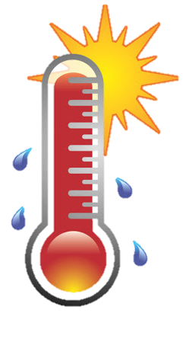
CLIMATE
ACTION!

Slide 30
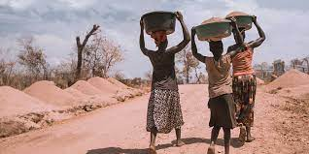
Climate Refugees
What is a Climate Refugee?
  “A person who has been forced to leave their home as a result of the effects of climate change on their environment”
Do they exist in today’s world?
  Yes, people today are being severely affected by climate change and are forced to leave
Notes:
Definitions form Oxford Languages.

Slide 31

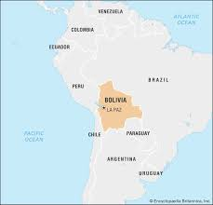
Case Study: Bolivia
How has climate change impacted their life, in regard to…
  Lifestyle
  Economy status
  Rights
How’s responsibility is it to help these people?
  Their own?
  Our responsible?
  Governmental authorities?
  The entire world?
Notes:
Link found in Key Stage 4 resource booklet

Slide 32
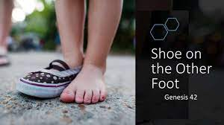
If the shoe was on the other foot.
Imagine you become a ‘climate refugee’
How would you feel?
Who would you blame?
What would you pack?
Where would you go?
Write a creative piece expressing this key point
Aim to encourage people to take action immediately and change their behavior now

Slide 33





MATERIALS NEEDED FOR CLASS
List the things your students need to get ready before class. It can be a particular textbook, the accomplished homework due for the day, or any specific materials for the topic you're about to discuss. You can also match it with corresponding photos or icons.

Slide 34



CLASS OBJECTIVES AND RULES
Objectives inform students the learning outcomes of the class. What will they know? What will they be able to do? Why is this important to know? It's an effective way to assess their learning progress.
Rules provide the structure necessary for an engaging and productive class. Keep it simple and easy to follow. It can be general to cover different situations or very specific to your students.

Slide 35



LESSON FOR THE DAY
KEY STAGE 4

Slide 36








CONCEPTS AND DEFINITIONS
Get the ball rolling by introducing the lesson's key concepts and its corresponding definitions. Duplicate this page as many times as needed to give you more space for discussion. Pair the concepts and definitions with relevant images too for a more visualized presentation of the lesson.

Slide 37

EXAMPLES AND ILLUSTRATIONS
Example 1
Example 2
Example 3

Slide 38
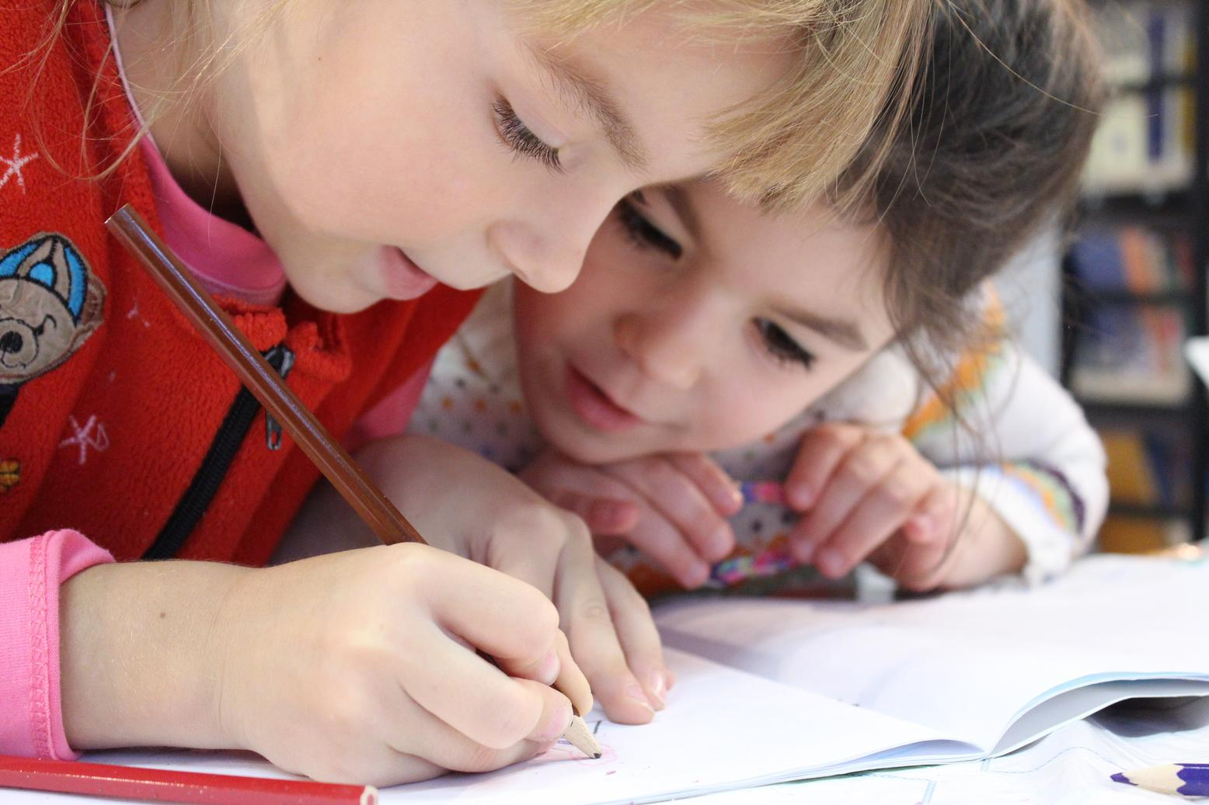
EXERCISE
Add instructions or guidelines here. You can also put in the amount of time allotted for this.
Individual exercises extend a student’s grasp of the lesson. It allows them to synthesize on their own and think of ways they can apply their new learnings in real life. Duplicate this page as many times as needed to give you more space for discussion.

Slide 39
Question 2: Write the question you want to ask your students and allot space for the answers.
WORKSHEET
Answer 2:
Add instructions or guidelines here. You can also put in the amount of time allotted for this.
Question 1: Write the question you want to ask your students and allot space for the answers.
Question 3: Write the question you want to ask your students and allot space for the answers.
Answer 3:
Answer 1:

Slide 40

ACTIVITY TIME
Add instructions or guidelines here.
You can also put in the amount of time allotted for this.
Like seatworks, student-led activities that can be done by pairs or by group widen their grasp and interpretation of the lesson. Be creative with the activity. Duplicate this page as many times as needed to give you more space for discussion.

Slide 41

SUPPLEMENTAL VIDEO
Let your students watch relevant educational videos that help reinforce the lesson for the day. It’s no secret that it helps students stay interested and engaged. Duplicate this page as many times as needed.

Slide 42

ADDITIONAL RESOURCES
Duplicate this page as many times as needed to give you more space for discussion.
Photos or screenshots of relevant articles are also effective in reinforcing a class lesson.
Maximize this space for additional resources you want to share with your students.
It's something they can easily look back on or search online in case they need a refresher.

Slide 43

CLASS RECAP
Discussion Point
Discussion Point
Discussion Point
Cap off a productive class with key summary points students can easily remember.
You can provide this for the class as a way of wrapping up everything you've discussed.
Recaps can also be led by students for a more enriching experience.

Slide 44


HOMEWORK
Add instructions or guidelines here. You can also put additional details on when and how to submit.

Slide 45















FREE ICONS
Use these free recolorable icons and illustrations in your Canva design.

Slide 46














FREE RESOURCES
Use these free recolorable icons and illustrations in your Canva design.

