Slide 1



















Slide 2






WELCOME,
STUDENTS!

Slide 3


Global Perspective
Water
Climate Change
Key Stage 5

Slide 4
Key Stage 5
Personal finance wants vs needs
How are the worlds resources split – Global population and global wealth
Throw away society article
https://www.veganfoodandliving.com/features/the-price-of-a-throwaway-society/
What is social responsibility? What is my role?
Debate:

Slide 5










Global Perspective

Slide 6




Global Perspective
The global dimension explores our connections with the rest of the world. With a global dimension to their education, learners can engage with complex global issues and explore the links between their own lives and people, places and issues throughout the world.
The global dimension can inform the whole school ethos, leading to a school that is inclusive, just and democratic and promotes social and environmental responsibility, respect and co-operation.
Citizenship, in its context of fair decision-making, runs throughout the Eco-Schools process. The global perspective topic seeks to ensure that pupils consider the environmental, social and economic impacts of the decisions that they make through this process, on the local and global community, in the future as well as for the present.

Slide 7





Global Citizenship

Slide 8


Global Citizenship
Being a global citizen is not clearly defined. As there is no global government there are no clear rules and regulations and globally, we do not have democratically-elected representatives to speak for us.
Global citizenship is more a moral understanding of our responsibilities and our rights in a global context. Being a true global citizen means that we recognise that all people have equal rights and that we value diversity.
In addition, it means we should value the earth as our common home which we all have a need and indeed a responsibility, to look after.

Slide 9





The Global Environment

Slide 10

The Global Environment
The term environment means surroundings; natural world. However, it can be narrowly defined, for example our immediate surroundings as in the classroom environment or very broadly, in relation to the global environment.
One thing that is certain is that ‘humankind’ has had a huge impact on the environment. Today, many of us have acquired so many things that we have a very comfortable life. But at what cost?
The more that people take from the environment, the more they change the pattern of nature. If we take too much, we risk upsetting this balance.
The balance of nature changes slowly over time but in recent years we have wanted more and more for ourselves, and we are upsetting the balance at a faster rate, without even realising it.

Slide 11




The Global Environment
We are part of the natural environment and must look after it. If we upset the pattern too much, we may even destroy ourselves and the lives of future generations.
Trócaire’s focus is on ensuring that our global resources are shared equitably and those in power act for the common good of all.

Slide 12




Global Population

Slide 13


Global Population
Our precious finite world is currently home to over 7.8 billion people. Numbers this big are difficult to understand but what if we imagined the whole population of the world as a village of just 100 people? In this imaginary village, each person would represent about 78 million people from the real world. One hundred people would fit nicely into a small village. By learning about the villagers – who they are and how they live – perhaps we can find out more about our neighbours in the real world and the problems our planet may face in the future.
Imagining the world as a village also makes it easier for us to start thinking about all the human and environmental problems in the world and what we can do about them. It makes it easier for children to grasp the concept that the world is a large place; and many people in the world live lives much different from our own.

Slide 14





Global Food

Slide 15


Global Food
There is plenty of food in the world to feed everybody. The problem is how this food is distributed and shared. In fact, more than one and a half times the amount of food needed to feed everybody in the world is produced each year.
Yet over 821 million, 1 in 9 people, are hungry.
If there’s really…enough food in the world, why do some people still go hungry?
Hunger is caused by many factors and must be solved with many approaches. Factors include lack of investment in small farmers, particular women, unfair international trade policies and climate change.

Slide 16
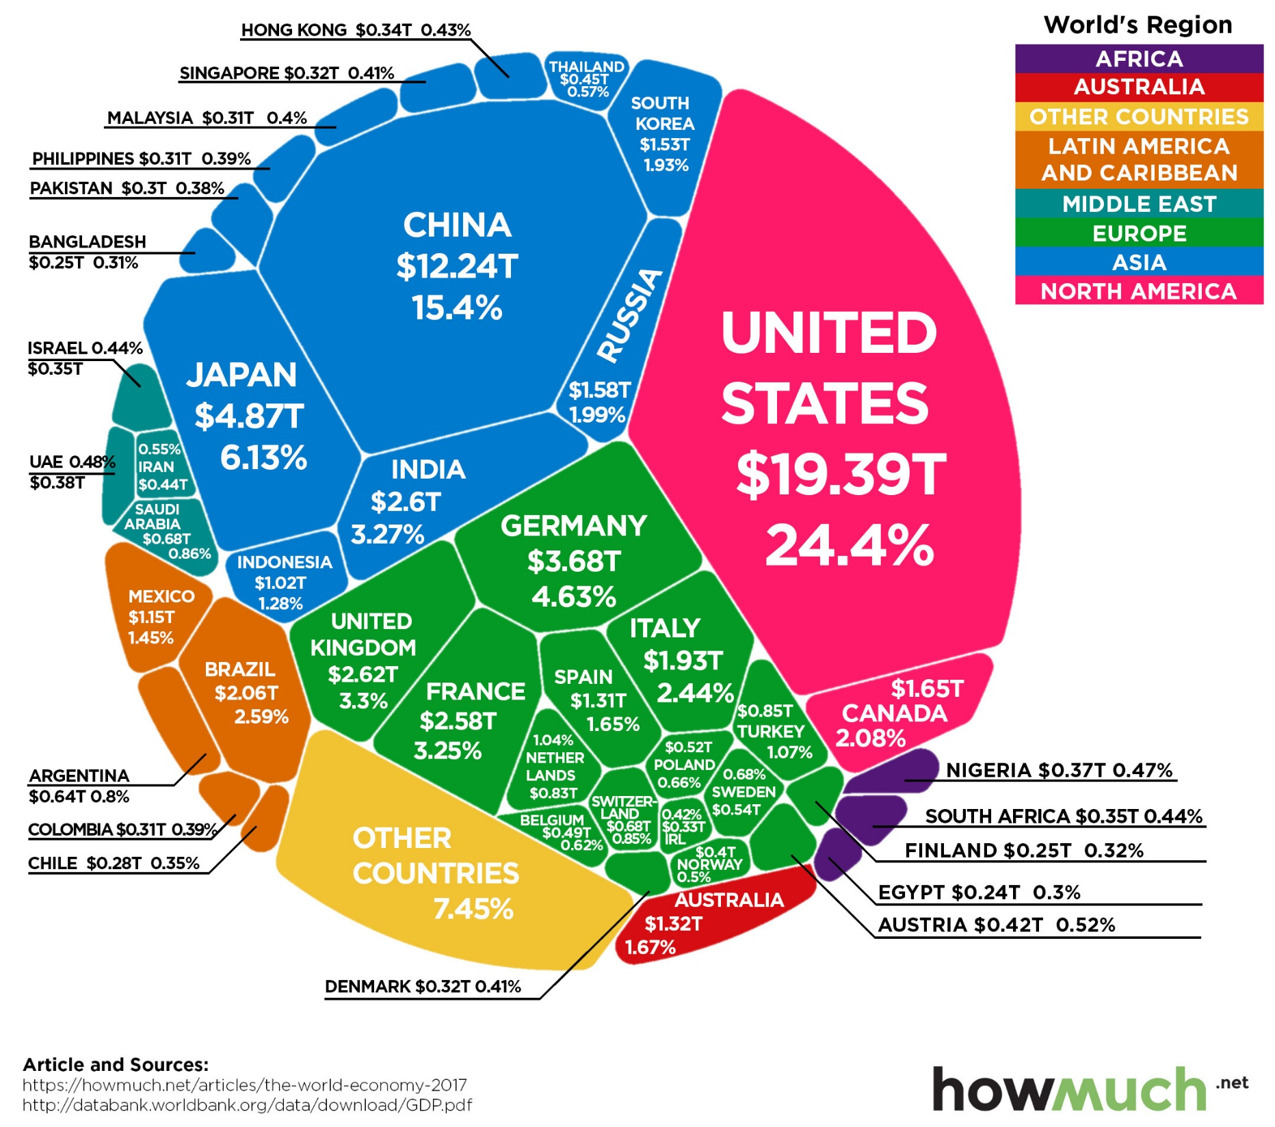
The
Global
Economy
Notes:
Provoke discussion around where the world’s wealth is

Slide 17
Personal Finances for a Young Adult.
Source of income
EMA – Education Maintenance Allowance
Part time job e.g. local shop, babysitting
Parents - chores/pocket money
Birthdays, Christmas and other occasions
Family e.g. grandparents
Blogging/social media
Claim
Other

Slide 18

How do you spend your money?
car/travel expenses
care/support for family members
cinema and concerts
clothes
food
gambling
hairdressers, beautician, etc.
Holidays
rent
car insurance
Phone handset and bill
heating
Online subscriptions music/movies/TV shows
savings
sport + fitness
Books/magazines
electricity
Wifi/internet
What proportion of your income do you allocate to the following? Тrу and give а rough percentage, e.g. 0%, 5%, 15%, 25+%.
What are the things on that list you need?
What are the things on that list you want?

Slide 19

How do you spend your money?
What things would you like to spend more/less оn?
What's the most expensive thing you've bought recently?
What thing do you most regret having bought or spent money on?
Аге you saving up to buy anything in particular?
How do you think youг spending habits may change in the next ten years?

Slide 20

IF THE WORLD WERE 100 PEOPLE
Gender
50 would be female
50 would be male
Age
25 aged 0-14
66 aged 15-64
9 aged 65+
Continent
60 Asians
15 Africans
11 Europeans
9 South Americans
5 North Americans
Living Area
51 live in urban areas
49 live in rural areas
Language
12 Chinese
5 Spanish
5 English
3 Arabic
3 Hindi
3 Bengali
3 Portuguese
2 Russian
2 Japanese
62 Others
Housing
77 have access to shelter
23 do not
Nutrition
1 Starving
11 Undernourished
63 Adequate
22 Overweight
Poverty
48 live on less than $2 USD per day
Water
91 have safe water
9 do not
Phones
5 have no mobile phone network
Internet
47 have access to the internet
53 do not
College
66 go to high school
Literacy
86 able to read & write
14 unable (2/3s are women)
Electricity
82 have electricity
18 do not
Religion
31 Christians
23 Muslims
15 Hindus
7 Buddhists
8 Others
16 Don’t identify with a particular religion

Slide 21

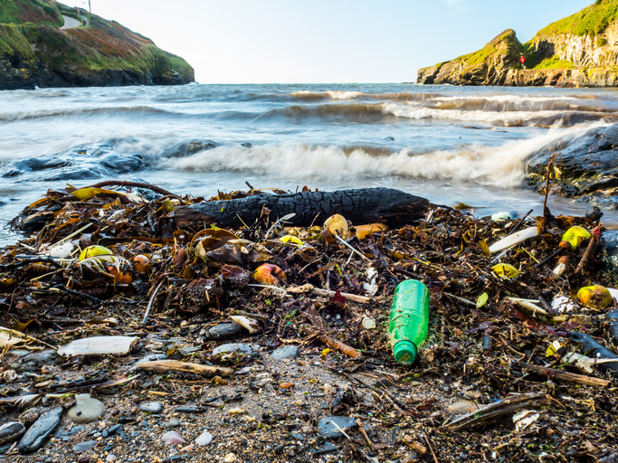
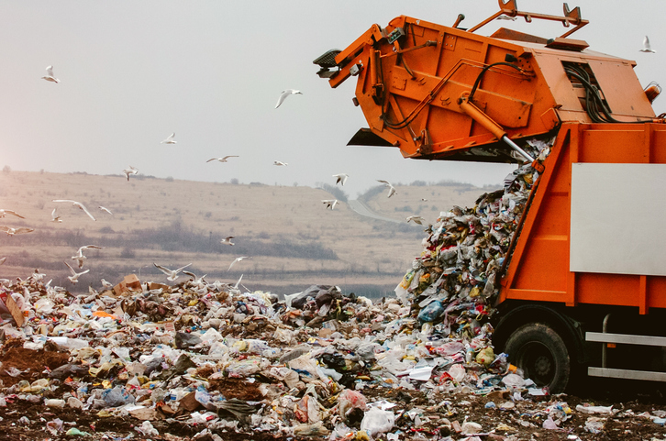
The price of a throwaway society: What happens to our rubbish?
https://www.veganfoodandliving.com/features/the-price-of-a-throwaway-society/
Notes:
Read the article to become informed of the impact

Slide 22



Group Discussion
Notes:
worksheet

Slide 23
How effective are our current recycling systems?
Should young people be educated in school about the impact of a throwaway society to avoid a scenario whereby the ‘the less they know the less they care’?
Is it fair our waste being dumped in another country?
Does dumping our waste in another country help or make the environmental situation worse?
Would this make you reconsider upgrading each time there is a new model of phone or iPad?
Would you consider avoiding the use of Single-Use Plastics?
If you could take an individual action, what would it be?
If your class/year group/school could take a group action, what would it be?

Slide 24

Social Responsibility
Social responsibility is an ethical framework and suggests that an individual has an obligation to work and cooperate with other individuals and organizations for the benefit of society at large.
Social responsibility is a duty every individual has to perform so as to maintain a balance between the economy and the ecosystems. A trade-off may exist between economic development, in the material sense, and the welfare of the society and environment, though this has been challenged by many reports over the past decade.
Social responsibility means sustaining the equilibrium between the two. It pertains not only to business organizations but also to everyone whose any action impacts the environment. It is a concept that aims to ensure secure healthcare for the people living in rural areas and eliminate all barriers like distance, financial condition, etc. This responsibility can be passive, by avoiding engaging in socially harmful acts, or active, by performing activities that directly advance social goals.
Social responsibility must be intergenerational since the actions of one generation have consequences on those following.

Slide 25
Ways in which you can be more socially and environmentally responsible.
Recycle at home
Conserve energy through switching of lights and devices
Support Green vendors
Use reusables e.g. coffee cup, water bottle, lunchbox
Invest in plants at home
Try to stay healthy and eat organic fruit and veg
Use alternative modes of transport or share where possible
Get outside and volunteer
Conserve Water are – take short showers, fix leaking pipes, keep the running tap close while you brush your teeth, recycle water in your home, use water-saving appliances, collect rainwater in a rain barrel to water your garden.
Go meat free 2-3 days a week
Make your plastic promise on the KNIB website - reduce your use of single use plastic
Get involved in your school eco-committee
Be kind to everyone
Don’t buy things you don’t really need – always question yourself before purchase

Slide 26



Slide 27

Water Wars
Water is an essential resource for human beings to survive
Increases in population and climate change is heightening the percentage of water scarcity globally
Tensions increase as regions attempt to protect water resources for the population
Who owns water? Can it be controlled?

Slide 28

Possible water war approaching
Egypt and Ethiopia are struggling to reach an agreement on the construction of the Grand Renaissance
Potential treat of leading to a water war

Slide 29

Grand Renaissance Dam
River Nile – world’s longest river
Runs alongside Egypt, Sudan and Ethiopia
Ethiopia want to construct the Grand Renaissance Dam
This will generate significant amounts of hydroelectric power

Slide 30

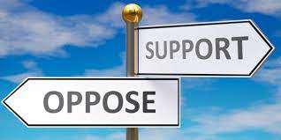
Egypt opposes…
The construction of this dam may result in a reduction in their water flow
85% of the river emerges from the Ethiopian highlands so they have the capability to control the flow of water
There are already predictions of water shortage by 2025 in Egypt

Slide 31
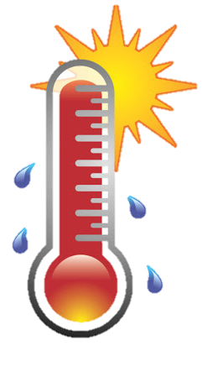
CLIMATE
CHANGE!

Slide 32

Car use impacts climate change
Climate change is a major issue which has an impact on everyone’s life, whether they are aware of it or not
Climate change is caused by human’s exploiting the Earth’s nature resources
In reality, we are consuming too much for the Earth to cope with
A major contribution to climate change is the vast amount of cars on the road
The emissions from cars severely increases CO₂ levels

Slide 33

Debate
“There are too many cars on the road. A lot of these cars are doing school trips. Children and teachers should not be transported to school by a car.”
Divide the class into groups of 6: Take on the roles of car manufacturer, a school student (just learnt to drive), environmental activist, parent, government representative, school principal/teacher
Use this debate/discussion to take act in your own school

Slide 34

Other ways to reduce climate change
Recycle at home
Conserve energy through switching of lights and devices
Support Green vendors
Use reusables e.g. coffee cup, water bottle, lunchbox
Invest in plants at home
Try to stay healthy and eat organic fruit and veg
Use alternative modes of transport or share where possible
Get outside and volunteer
Conserve Water are – take short showers, fix leaking pipes, keep the running tap close while you brush your teeth, recycle water in your home, use water-saving appliances, collect rainwater in a rain barrel to water your garden.
Go meat free 2-3 days a week
Make your plastic promise on the KNIB website - reduce your use of single use plastic
Get involved in your school eco-committee
Be kind to everyone
Don’t buy things you don’t really need – always question yourself before purchase

Slide 35






MATERIALS NEEDED FOR CLASS
List the things your students need to get ready before class. It can be a particular textbook, the accomplished homework due for the day, or any specific materials for the topic you're about to discuss. You can also match it with corresponding photos or icons.

Slide 36





CLASS OBJECTIVES AND RULES
Objectives inform students the learning outcomes of the class. What will they know? What will they be able to do? Why is this important to know? It's an effective way to assess their learning progress.
Rules provide the structure necessary for an engaging and productive class. Keep it simple and easy to follow. It can be general to cover different situations or very specific to your students.

Slide 37


LESSON FOR THE DAY
KEY STAGE 5

Slide 38






CONCEPTS AND DEFINITIONS
Get the ball rolling by introducing the lesson's key concepts and its corresponding definitions. Duplicate this page as many times as needed to give you more space for discussion. Pair the concepts and definitions with relevant images too for a more visualized presentation of the lesson.

Slide 39

EXAMPLES AND ILLUSTRATIONS
Example 1
Example 2
Example 3

Slide 40

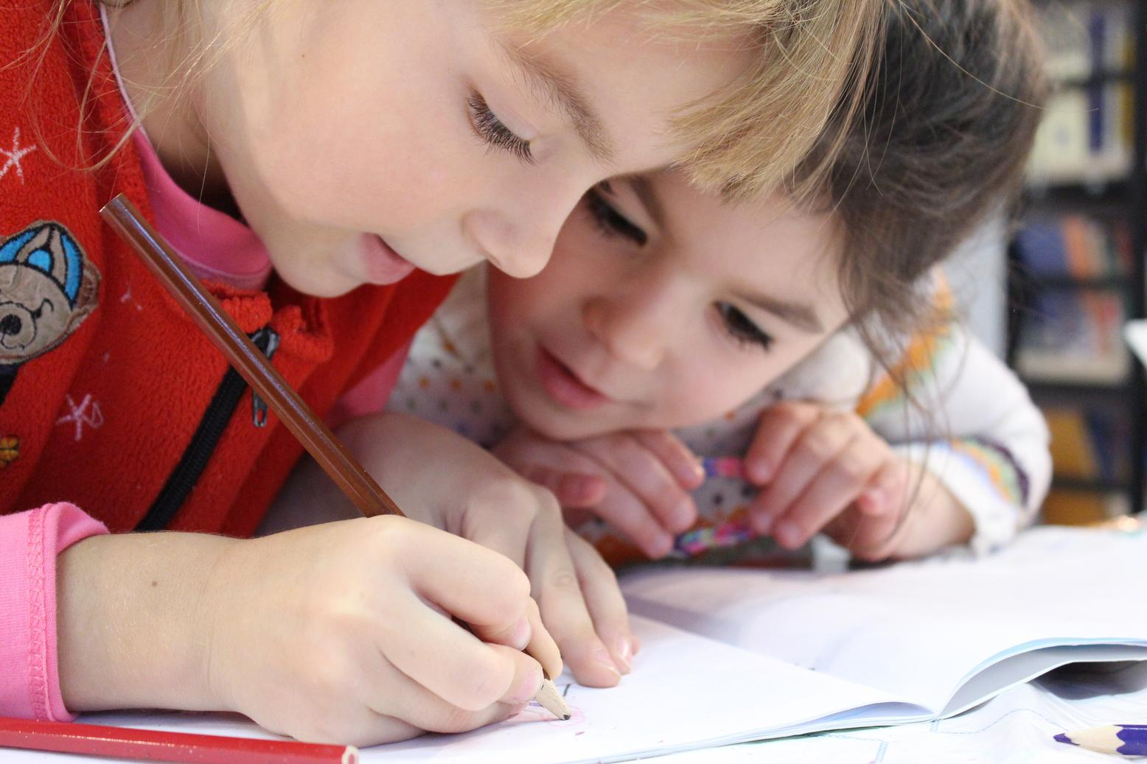
EXERCISE
Add instructions or guidelines here.
You can also put in the amount of time allotted for this.
Individual exercises extend a student’s grasp of the lesson. It allows them to synthesize on their own and think of ways they can apply their new learnings in real life. Duplicate this page as many times as needed to give you more space for discussion.

Slide 41
Question 2: Write the question you want to ask your students and allot space for the answers.
WORKSHEET
Answer 2:
Add instructions or guidelines here. You can also put in the amount of time allotted for this.
Question 1: Write the question you want to ask your students and allot space for the answers.
Question 3: Write the question you want to ask your students and allot space for the answers.
Answer 1:
Answer 3:

Slide 42

ACTIVITY TIME
Add instructions or guidelines here.
You can also put in the amount of time allotted for this.
Like seatworks, student-led activities that can be done by pairs or by group widen their grasp and interpretation of the lesson. Be creative with the activity. Duplicate this page as many times as needed to give you more space for discussion.

Slide 43

SUPPLEMENTAL VIDEO
Let your students watch relevant educational videos that help reinforce the lesson for the day. It’s no secret that it helps students stay interested and engaged. Duplicate this page as many times as needed.

Slide 44

ADDITIONAL RESOURCES
Duplicate this page as many times as needed to give you more space for discussion.
Photos or screenshots of relevant articles are also effective in reinforcing a class lesson.
Maximize this space for additional resources you want to share with your students.
It's something they can easily look back on or search online in case they need a refresher.

Slide 45

CLASS RECAP
Discussion Point
Discussion Point
Discussion Point
Cap off a productive class with key summary points students can easily remember.
You can provide this for the class as a way of wrapping up everything you've discussed.
Recaps can also be led by students for a more enriching experience.

Slide 46


HOMEWORK
Add instructions or guidelines here. You can also put additional details on when and how to submit.

Slide 47













FREE ICONS
Use these free recolorable icons and illustrations in your Canva design.

Slide 48















FREE RESOURCES
Use these free recolorable icons and illustrations in your Canva design.

