Slide 1

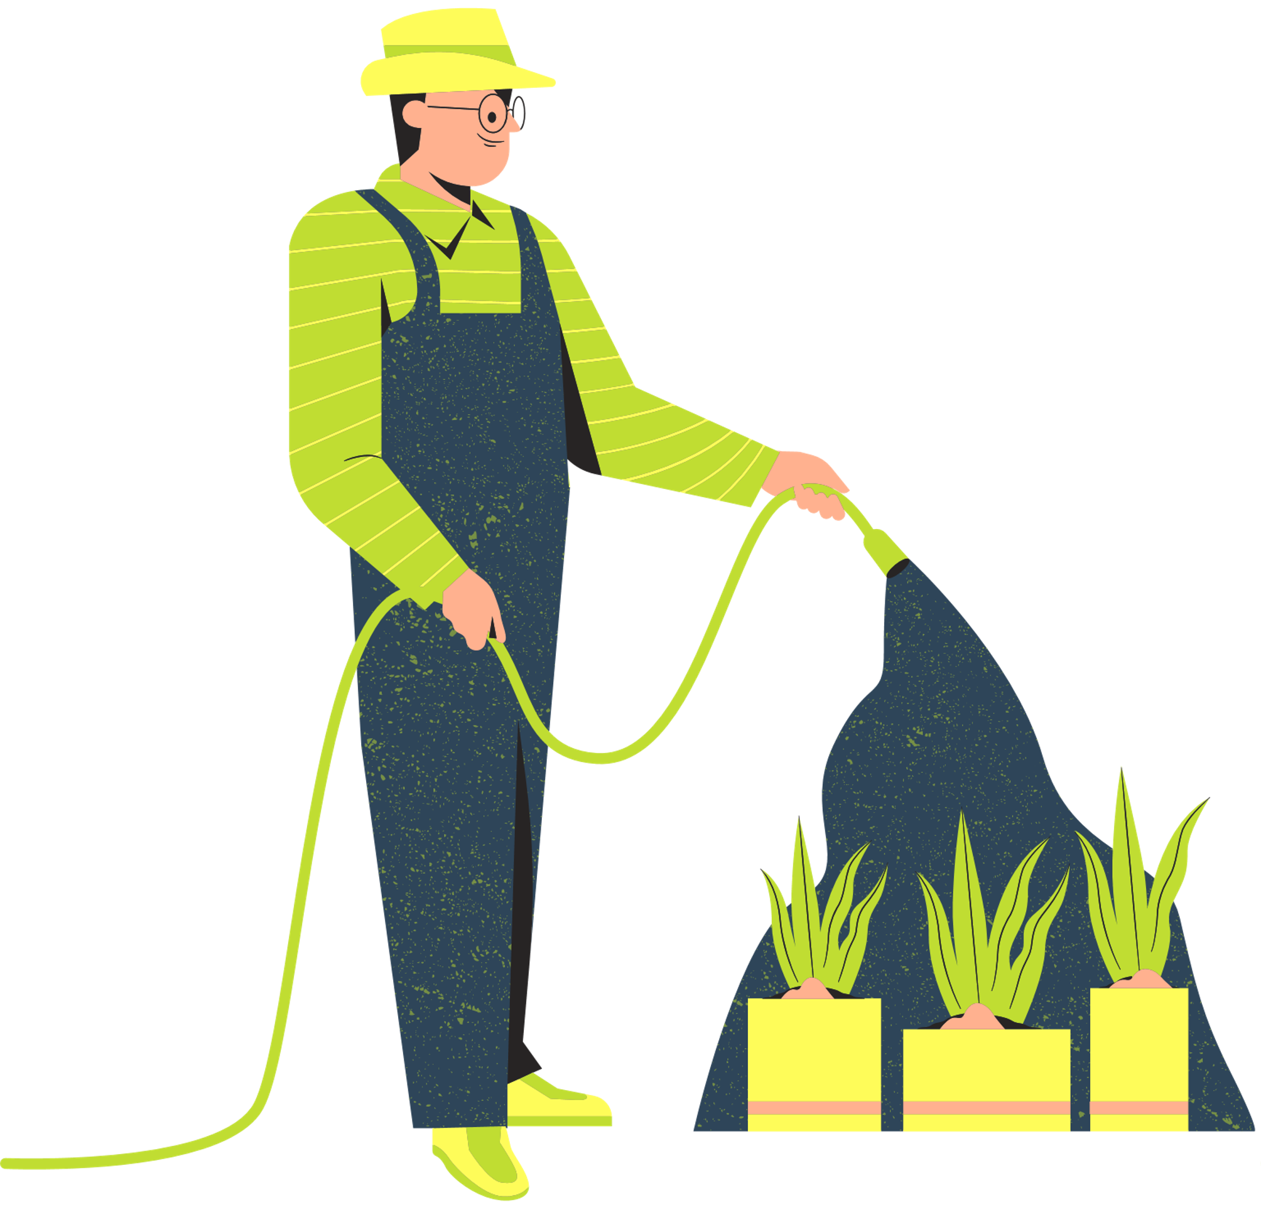

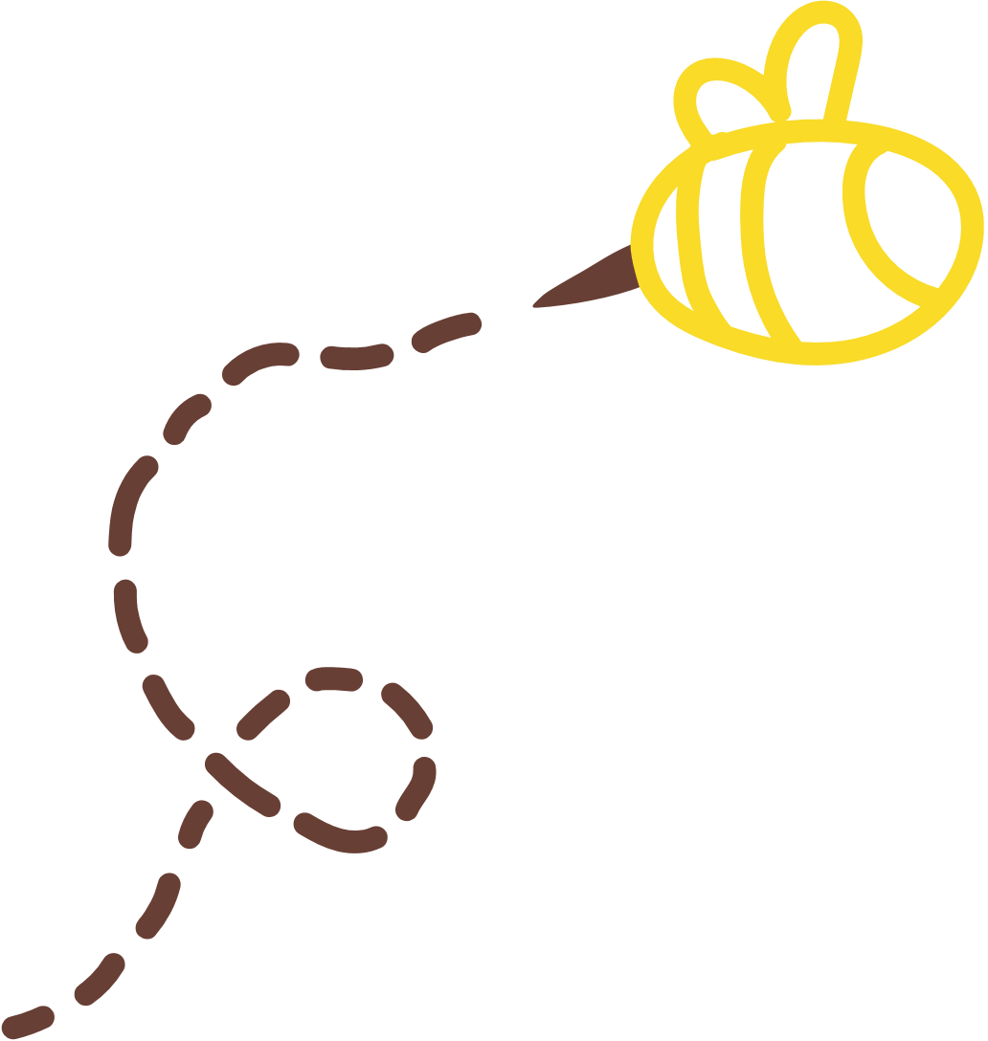
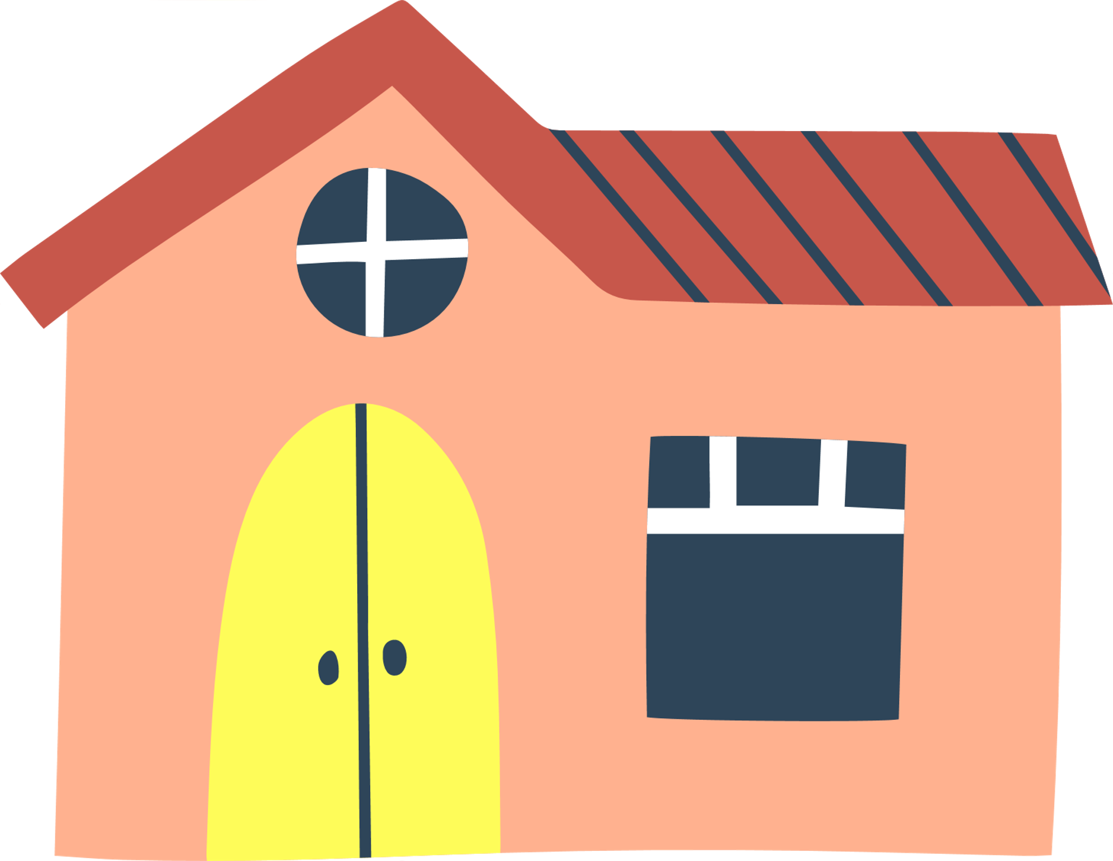
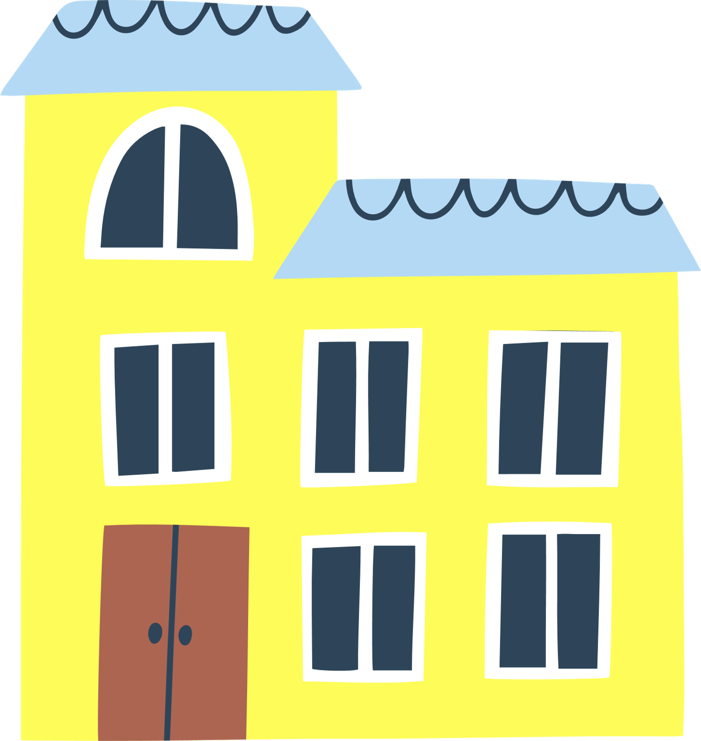


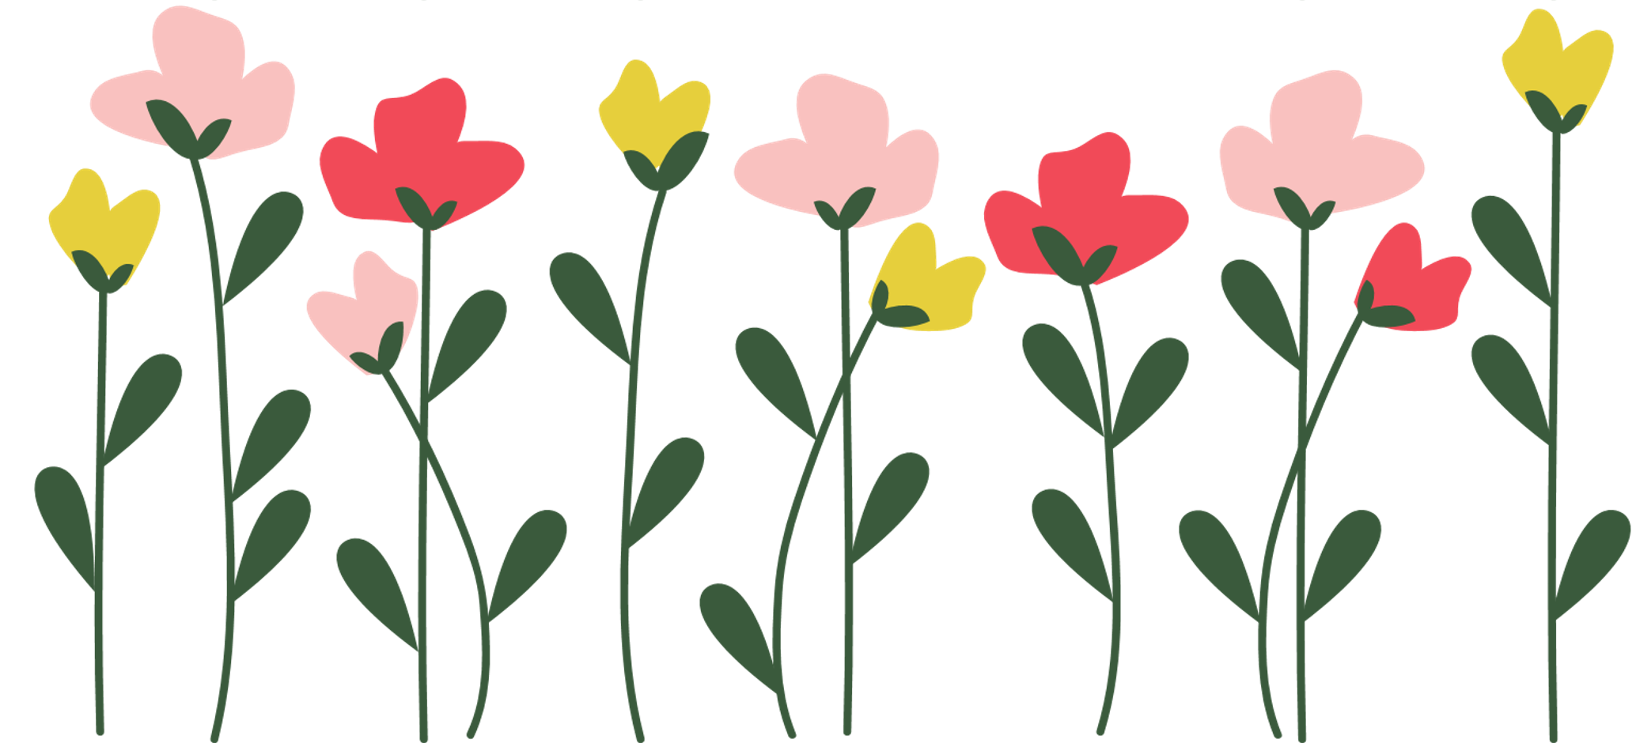

How to Improve Biodiversity at School

Slide 2


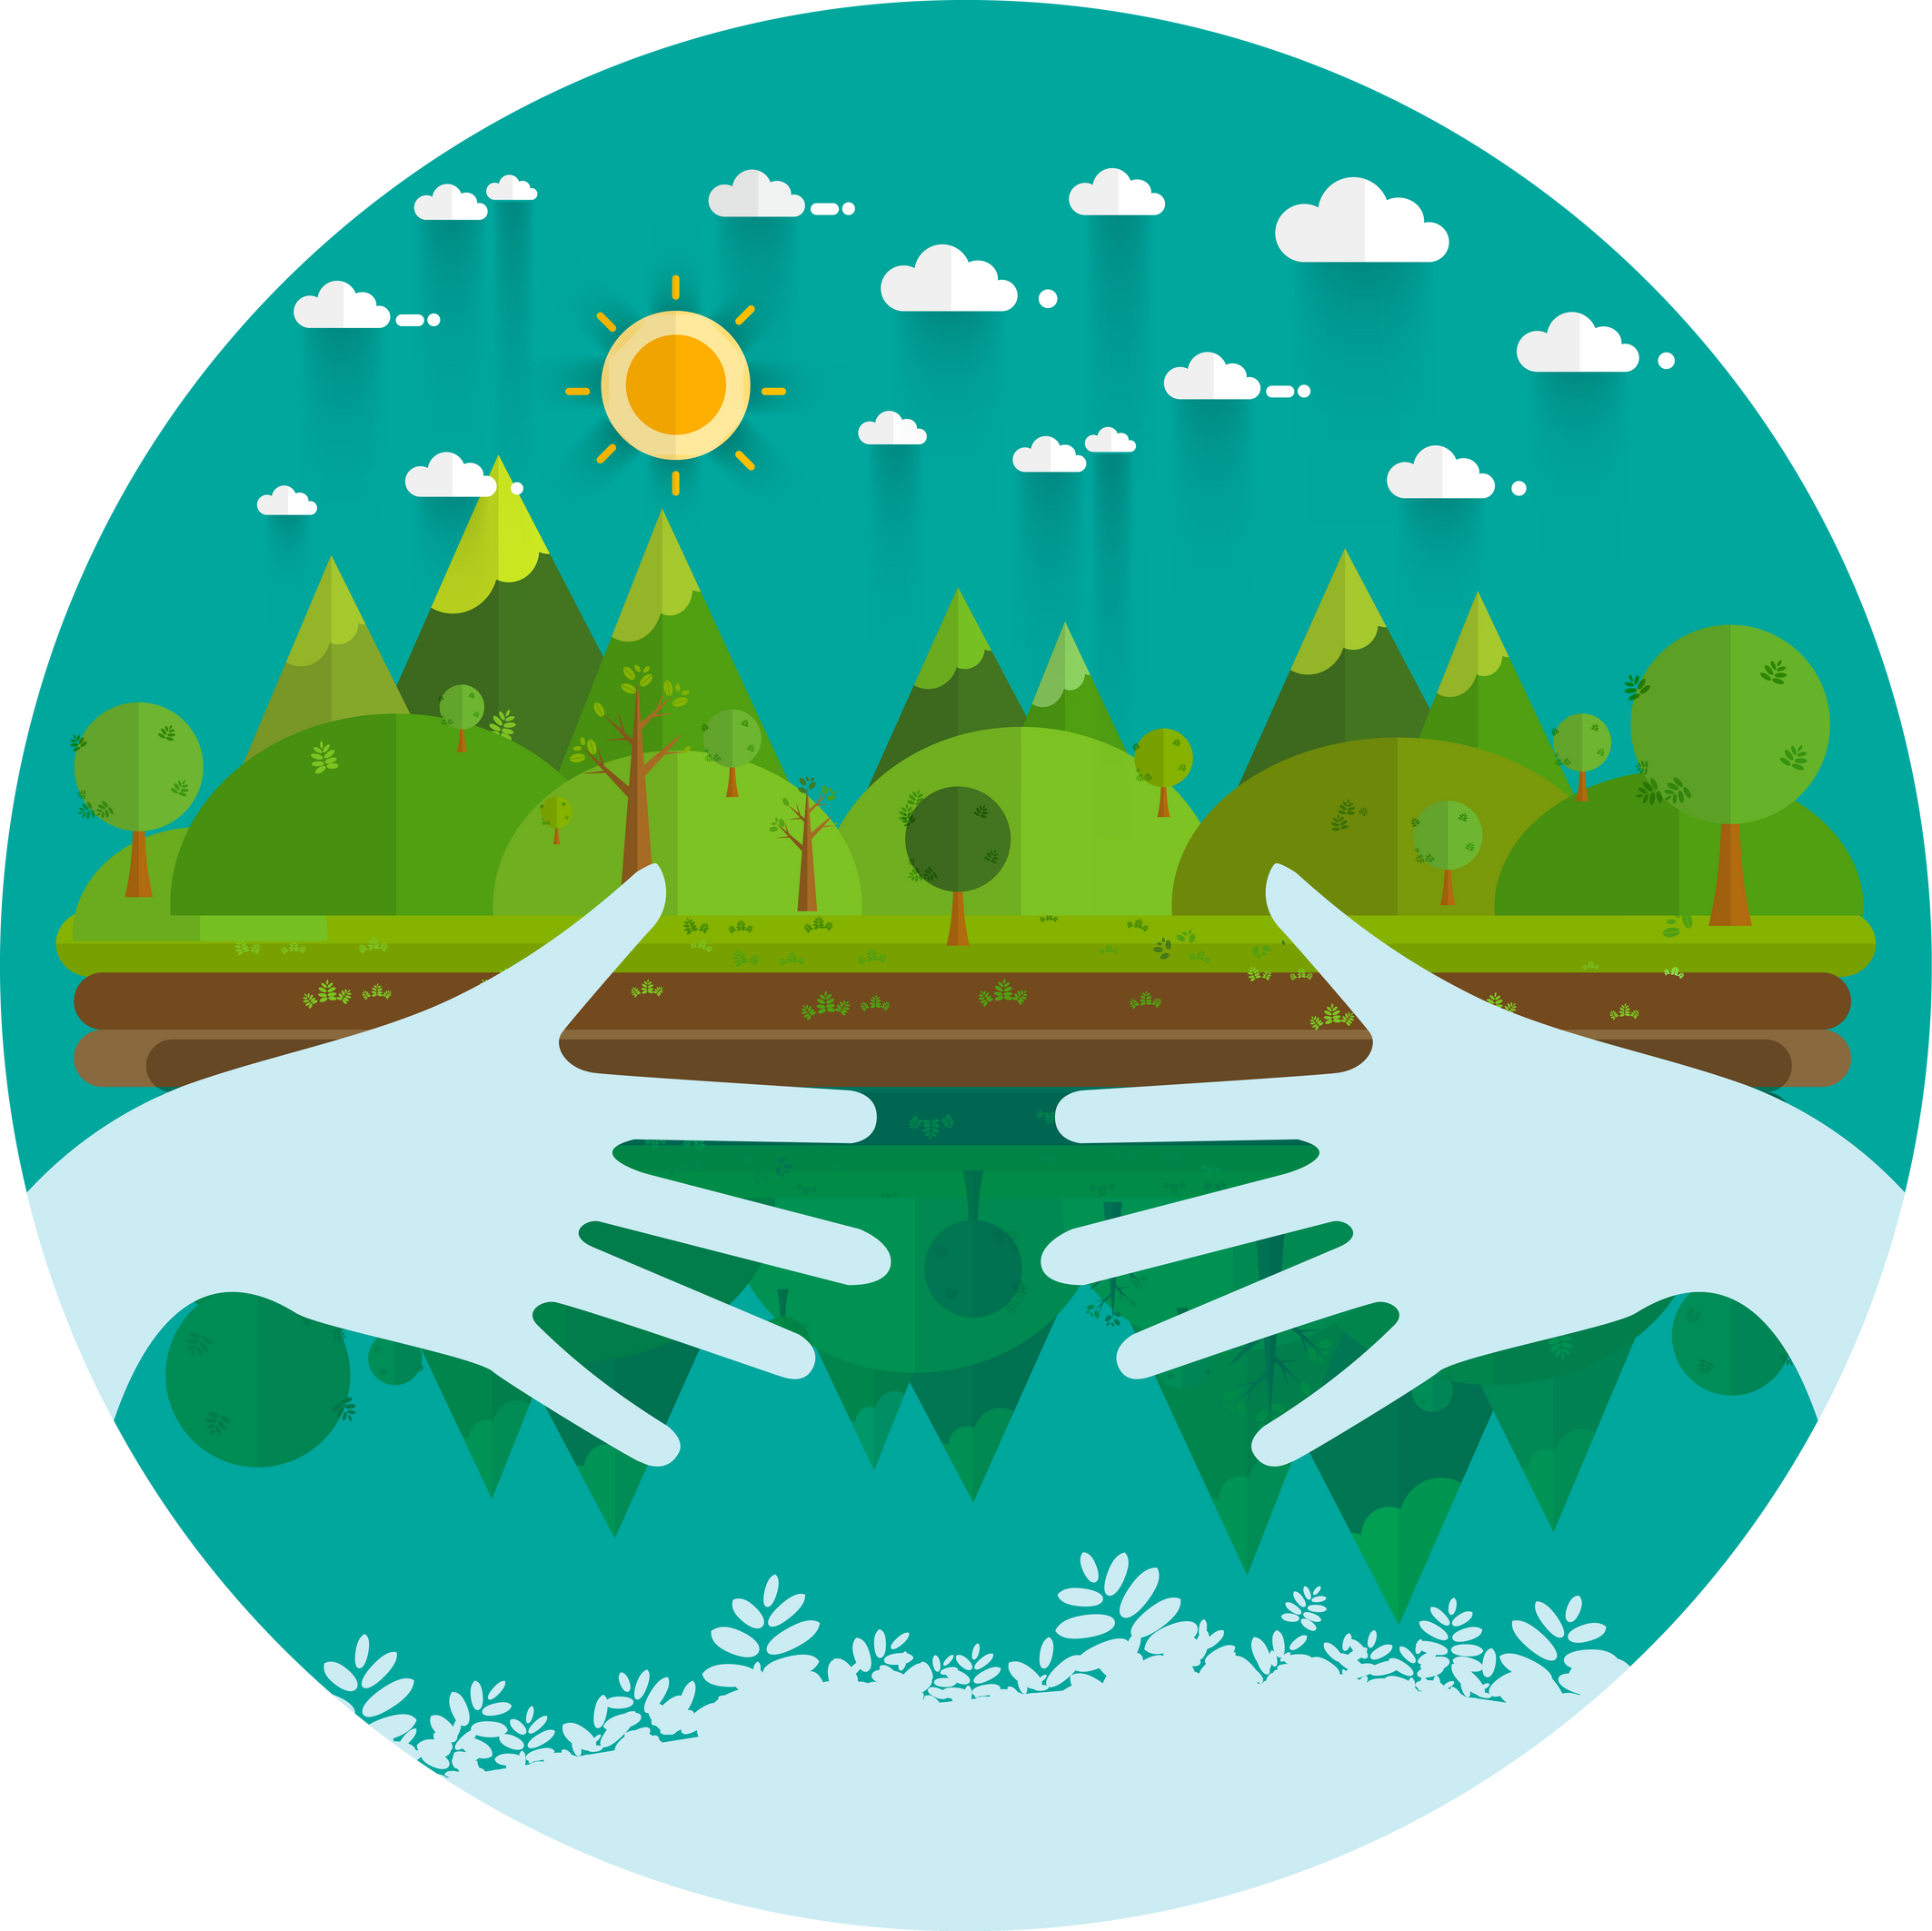

The importance
of protecting
the environment
Provides food and clean water
Natural medicines
Building materials
Pollination
Knowing and learning
Wellbeing
Habitat for wildlife
Notes:
Services that biodiversity provides, both tangible and intangible
(research pollination economic value – bumblebees are so important in the UK!)
-traditional honeybee not native to UK (not always good for the environment, high demand)
-Irish black bee is native to the UK
-100 native species of bees in Ireland
All Ireland Pollinator Plan – lots of resources (signs etc.)
-knowledge, mental health
-not only important for us, but also important for other wildlife

Slide 3


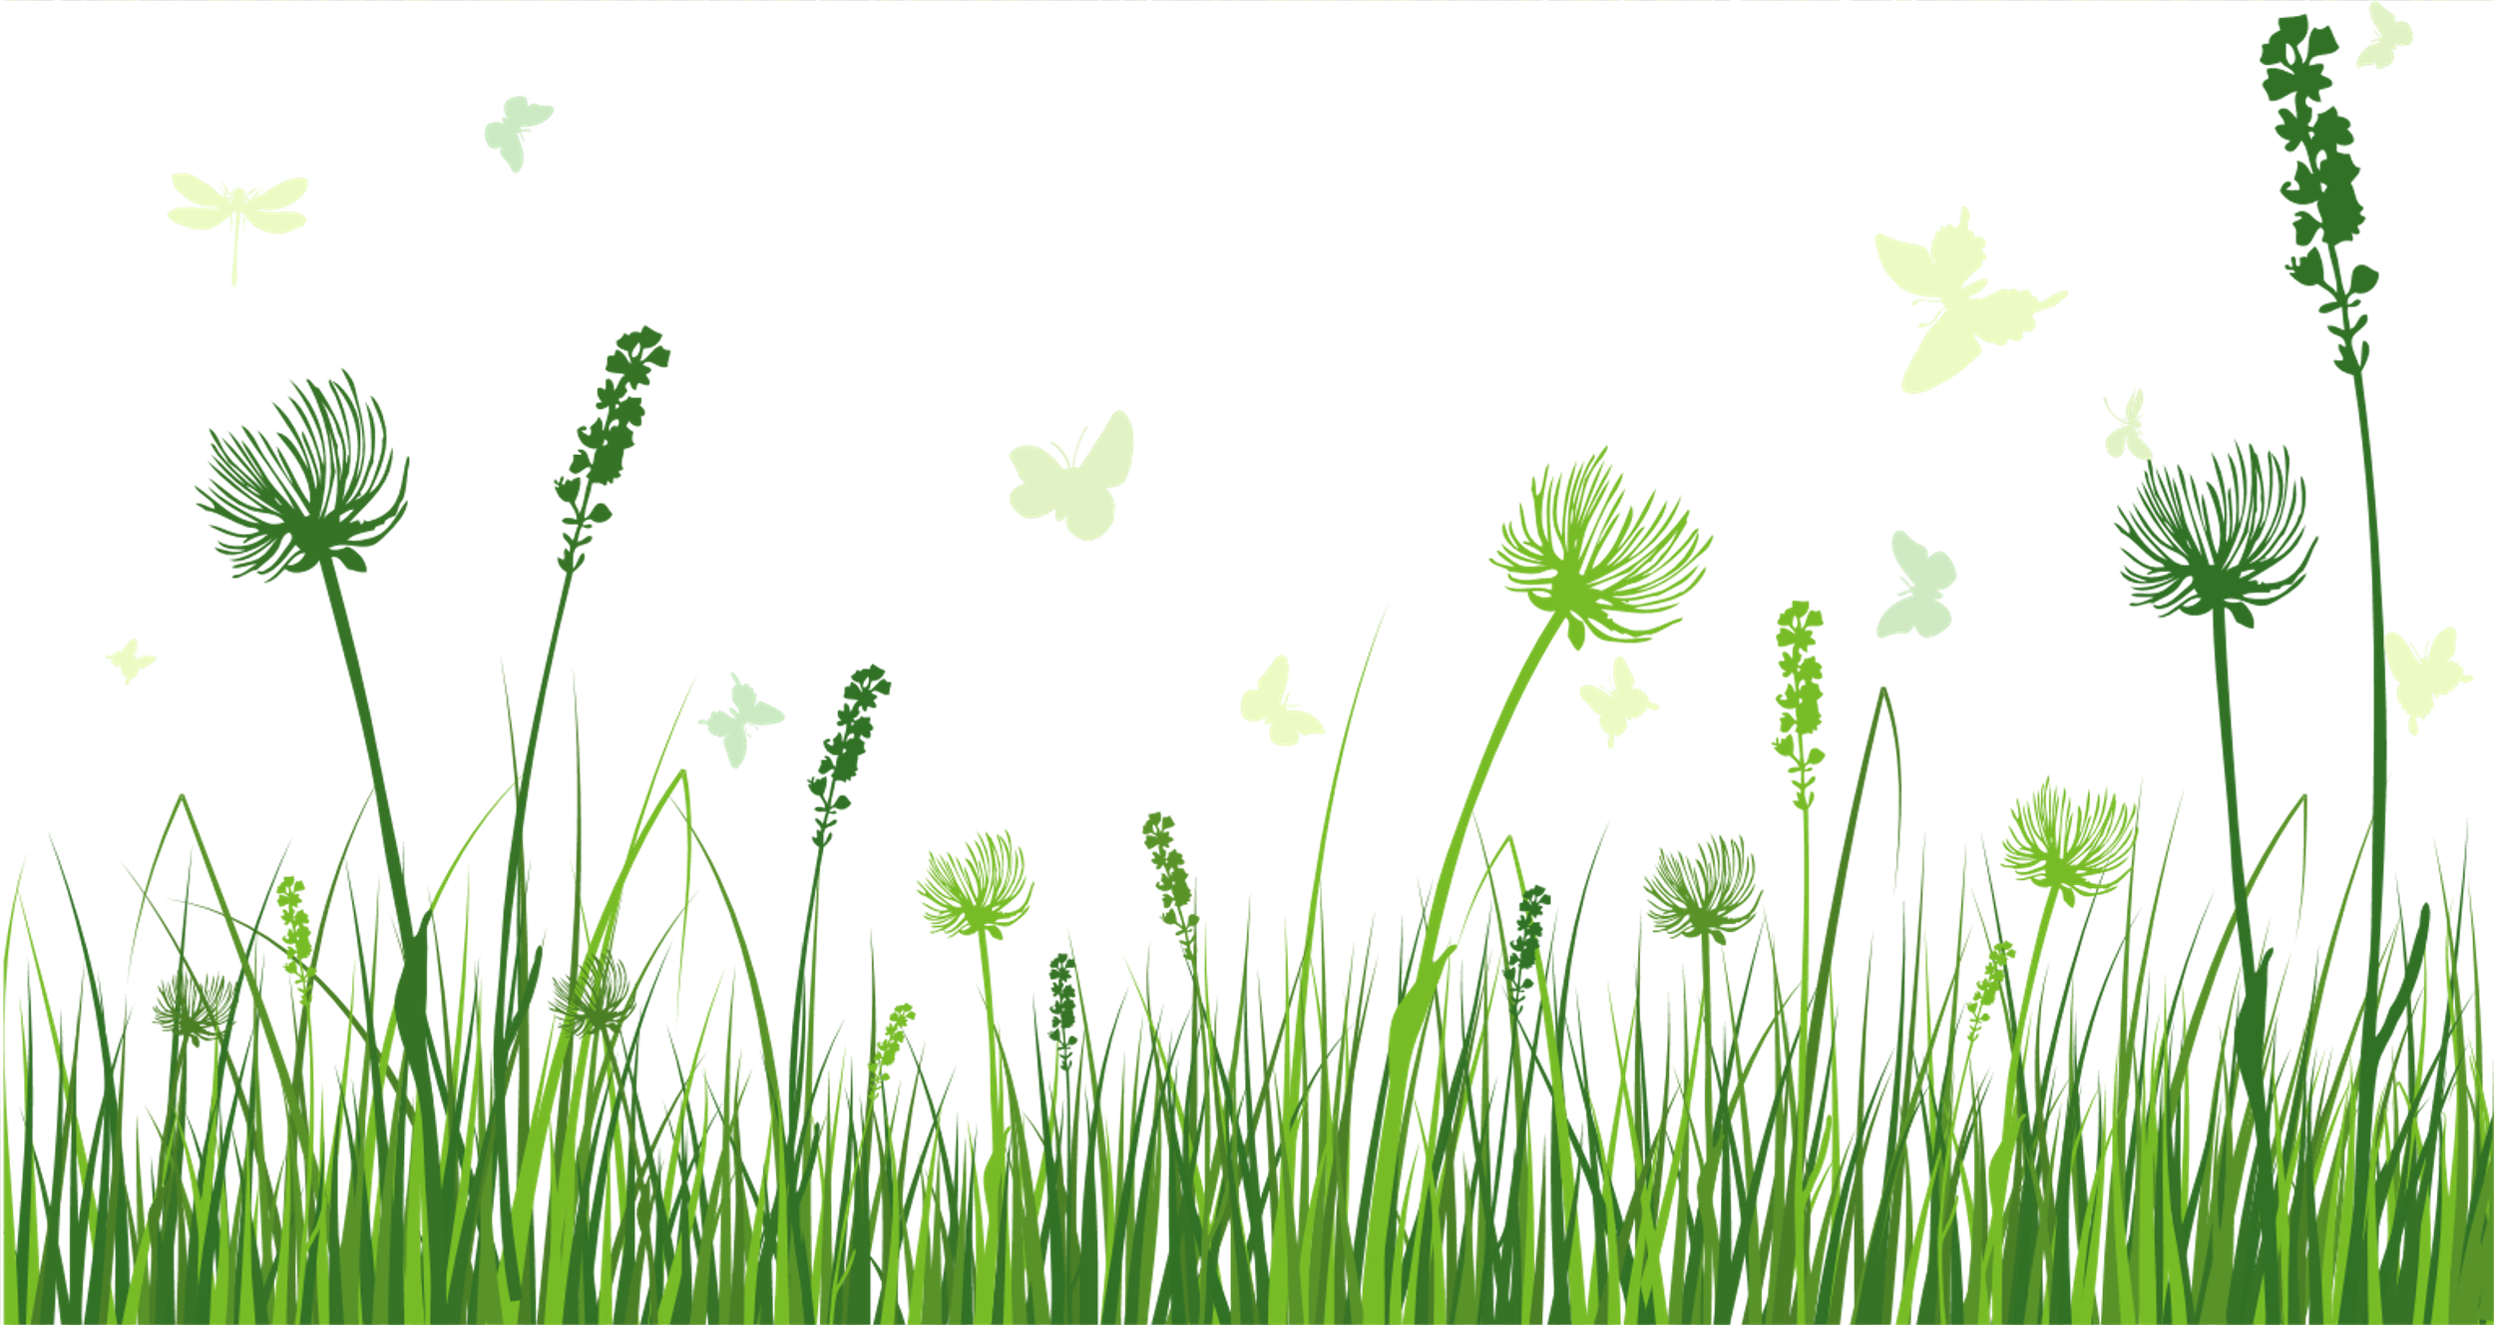
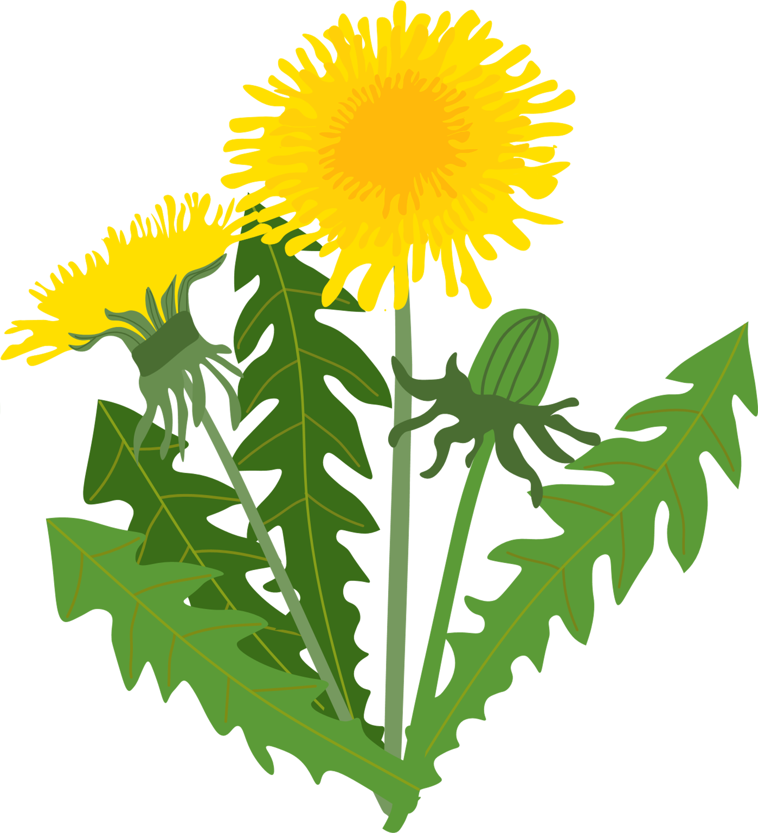
Natural Meadows
Native
Don't sow, let it grow
Reduce grass cutting
Pollinator habitat
Plant pollinator-friendly plants
Make signs
Sign up to All-Ireland Pollinator Plan
Notes:
Actions that schools can take! Natural meadows
-Make sure you buy from local, organic seeds (from the island of Ireland). Look for seed mixes that are native, perennial. Natural seed bank under grass. Let grass grow until autumn, cut and take away cuttings (so that it doesn’t return nutrients to the soil).
-possibly make some KNIB-branded pollinator signs?
-Signs can help community etc. Understand why you have a “wild” area

Slide 4
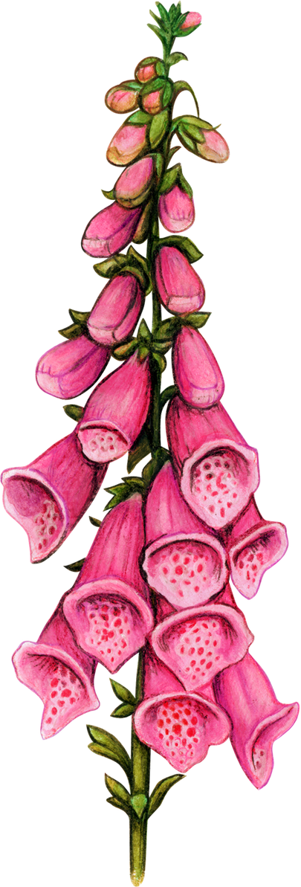

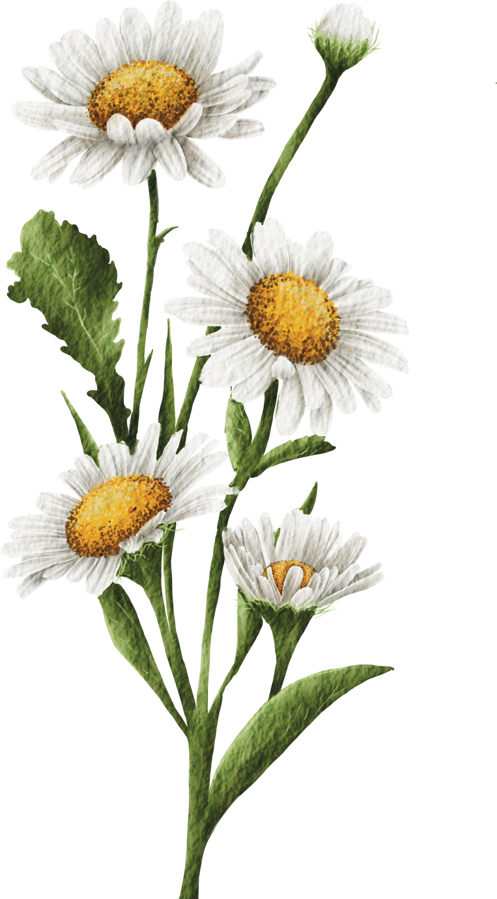
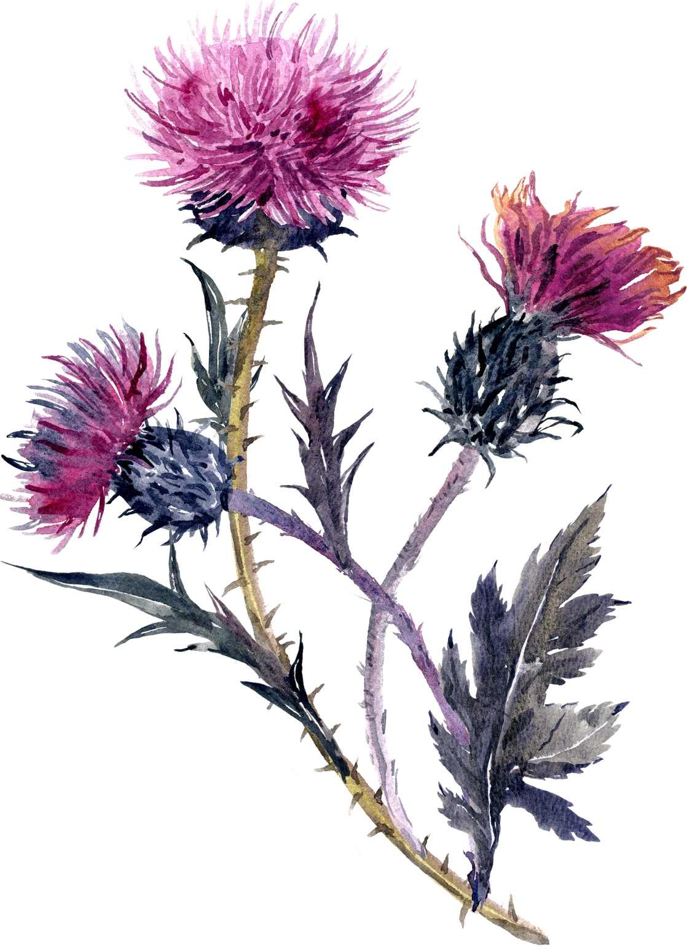
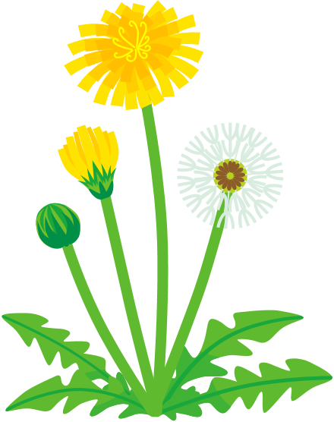
Notes:
Foxglove, white clover (white star), dandelion, common daisy, knapweed (or thistle) (birds like the seeds from this plant! Can collect once it’s gone to seed for bird tables)

Slide 5
white
clover
common
daisy
dandelion
foxglove
knapweed

Slide 6


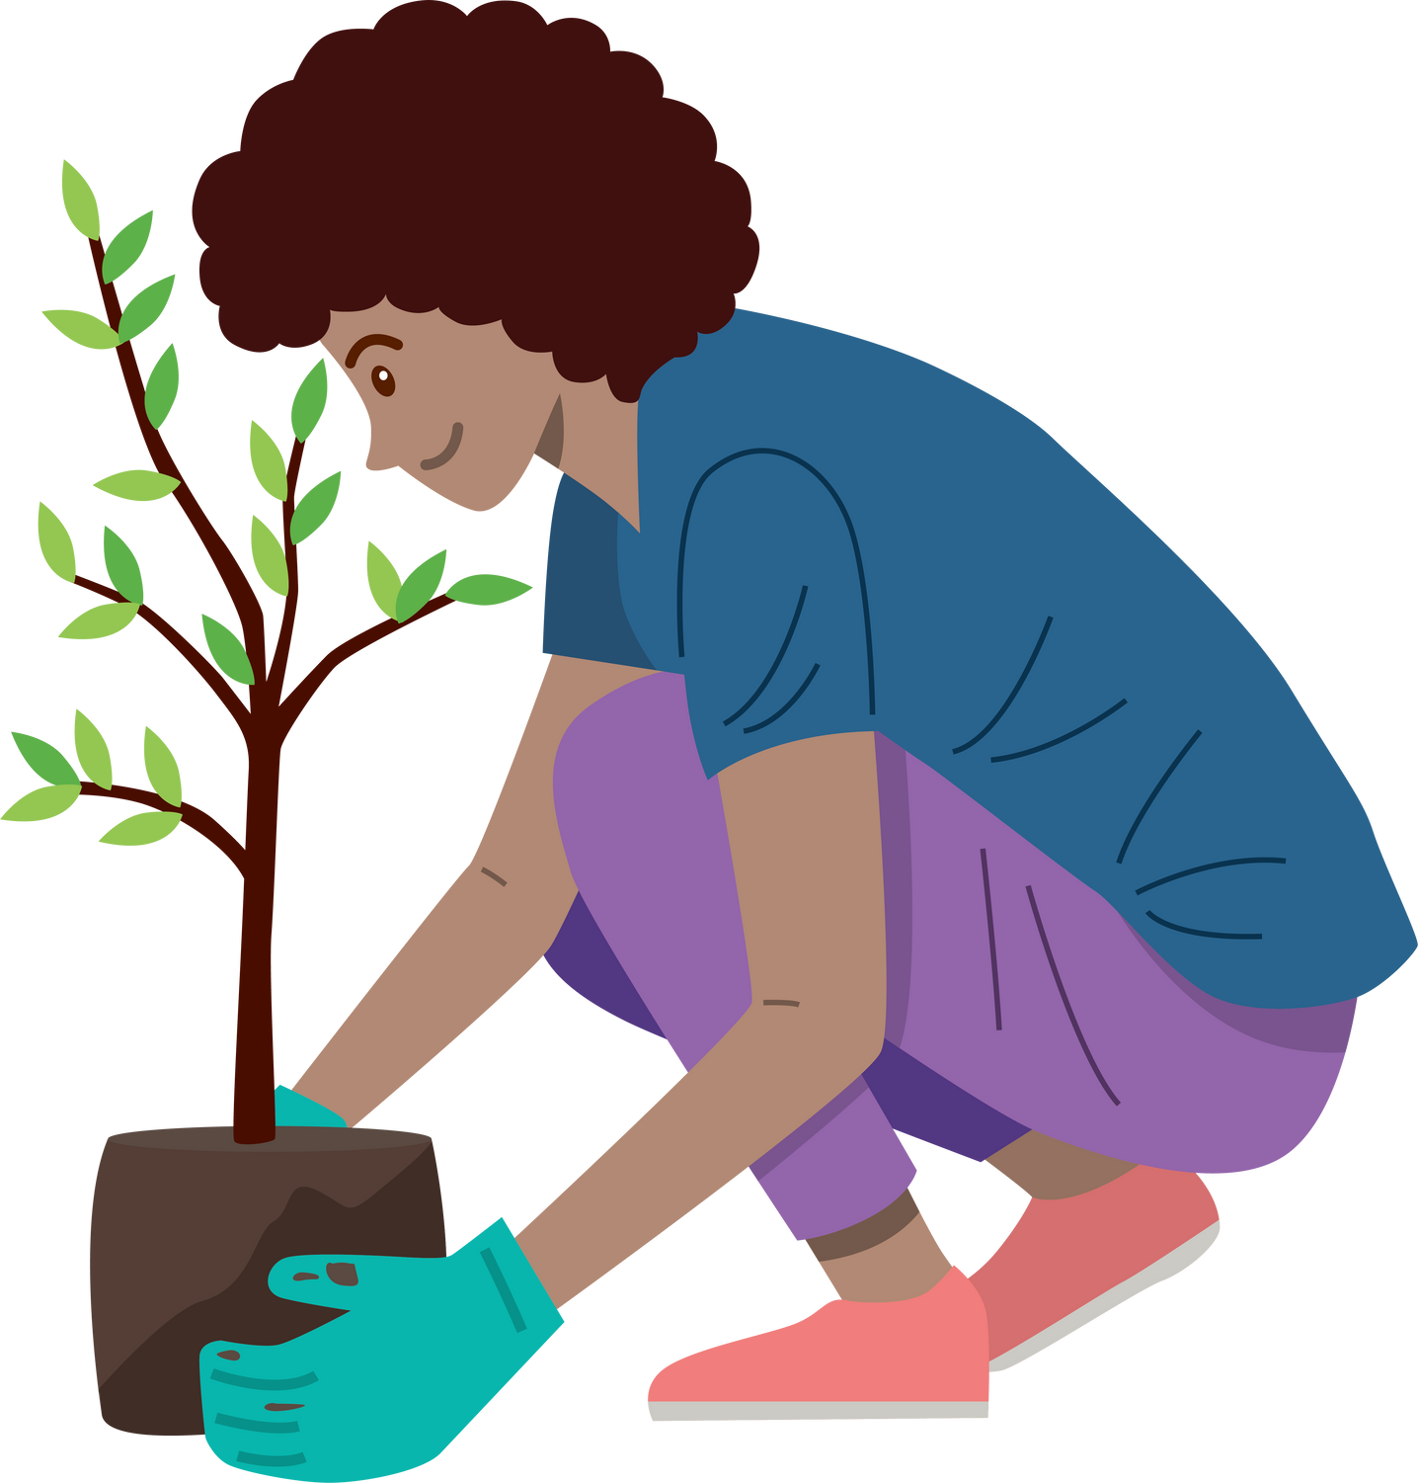


Plant trees
Native - birch, holly, oak, hawthorn, rowan...
Oak trees support over 2,000 species!
Habitat, shelter and carbon
Orchard planting
Pollen and nectar
New hedgerows project - competition
Why are hedgerows important?
Notes:
Native trees will support more of our native species. They depend on the native trees for resources. All trees are good, but it’s better to focus on growing native species.
-heritage apple varieties, not native but closest
-heritage plum, pears trees
Hedgerow Heroes Project is ending, there is another round coming up – you can apply to be a part of the programme! (stepping stones for nature, can jump from place to place, hedgerows become like a map).

Slide 7
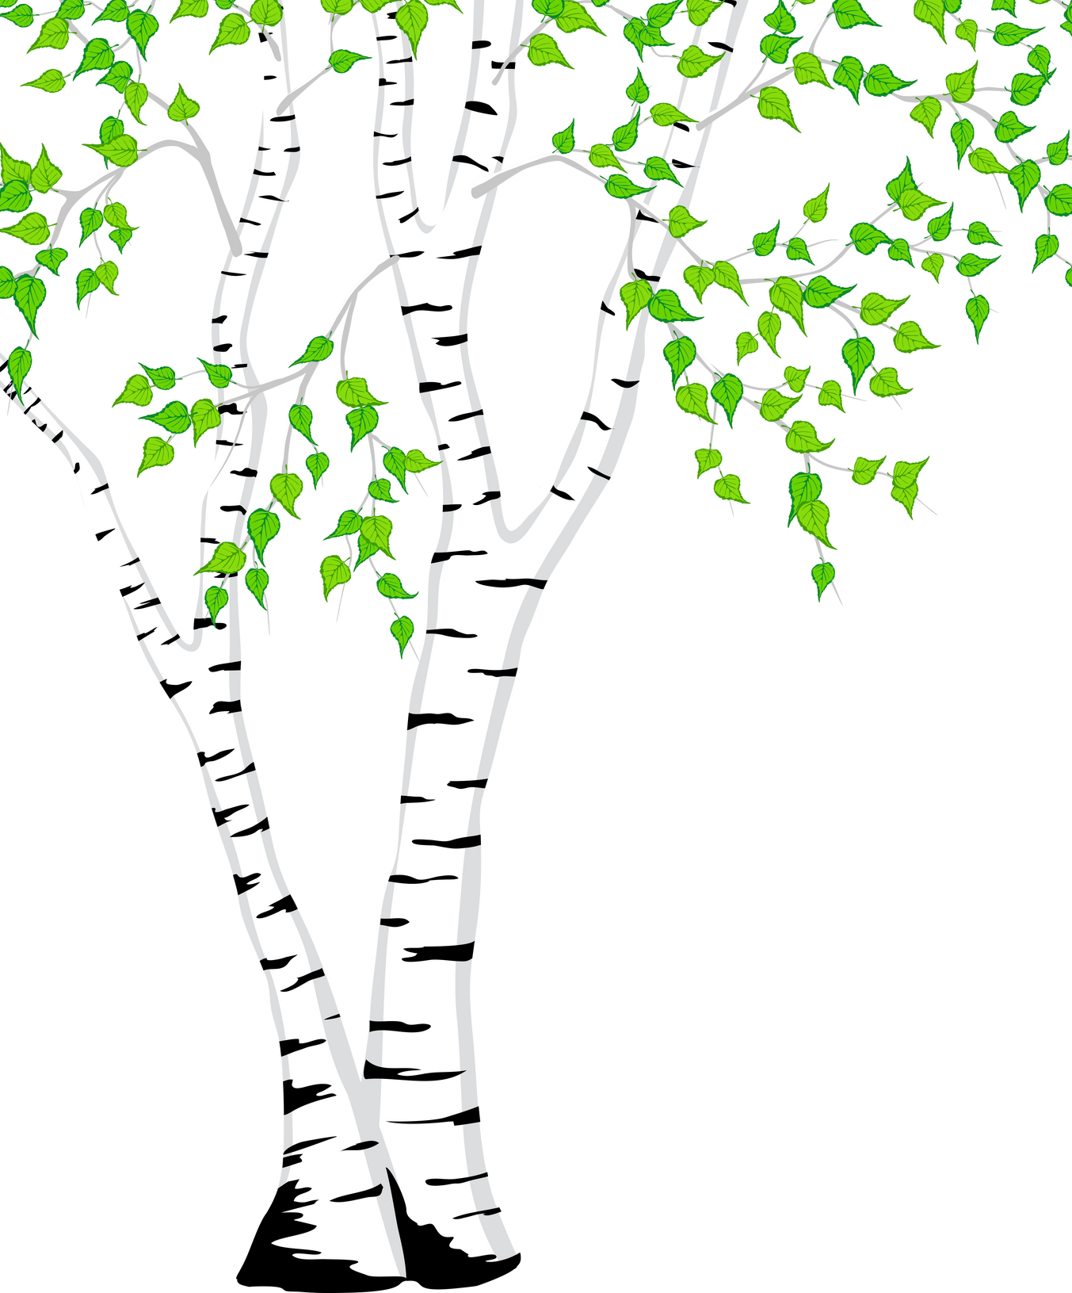
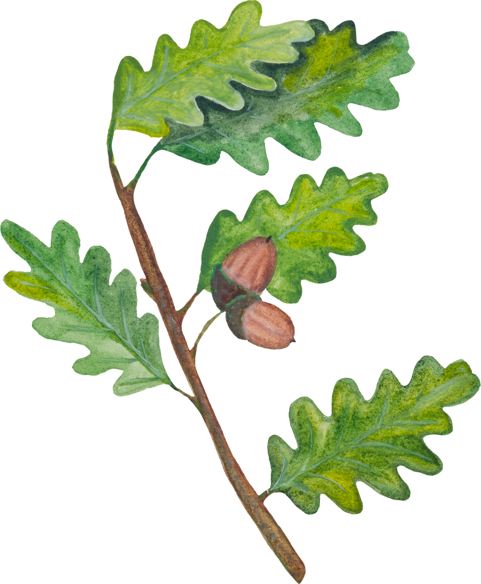
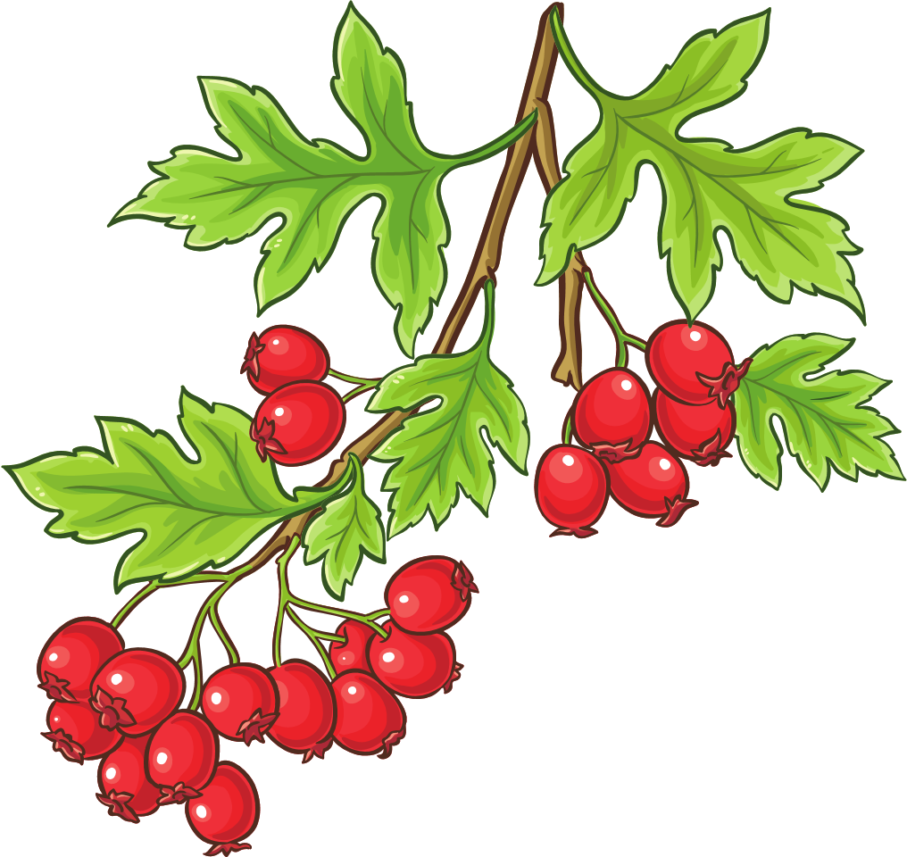
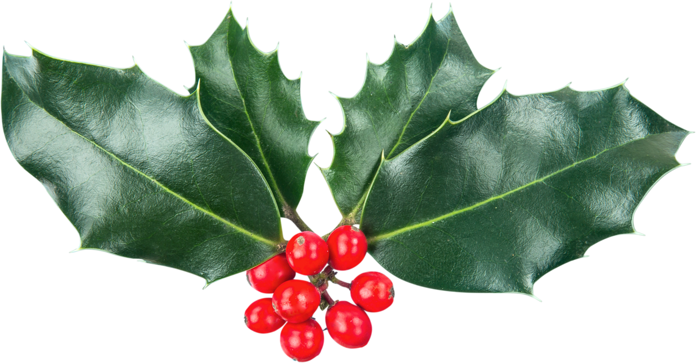
Notes:
Silver birch, holly, oak, hawthorn trees
Silver birch – silver and downy birch are 2 native species. An old birch tree, aged bark folds on itself and creates holes that sometimes bats hibernate in, etc.
Holly – great for birds
Oak – can support over 2000 species
Hawthorn – great hedgerow plant (lovely smell, great for pollinators, great habitat). Berries are edible, BUT the seed inside is poisonous. Great for making jams!

Slide 8
oak
silver
birch
holly
hawthorn

Slide 9

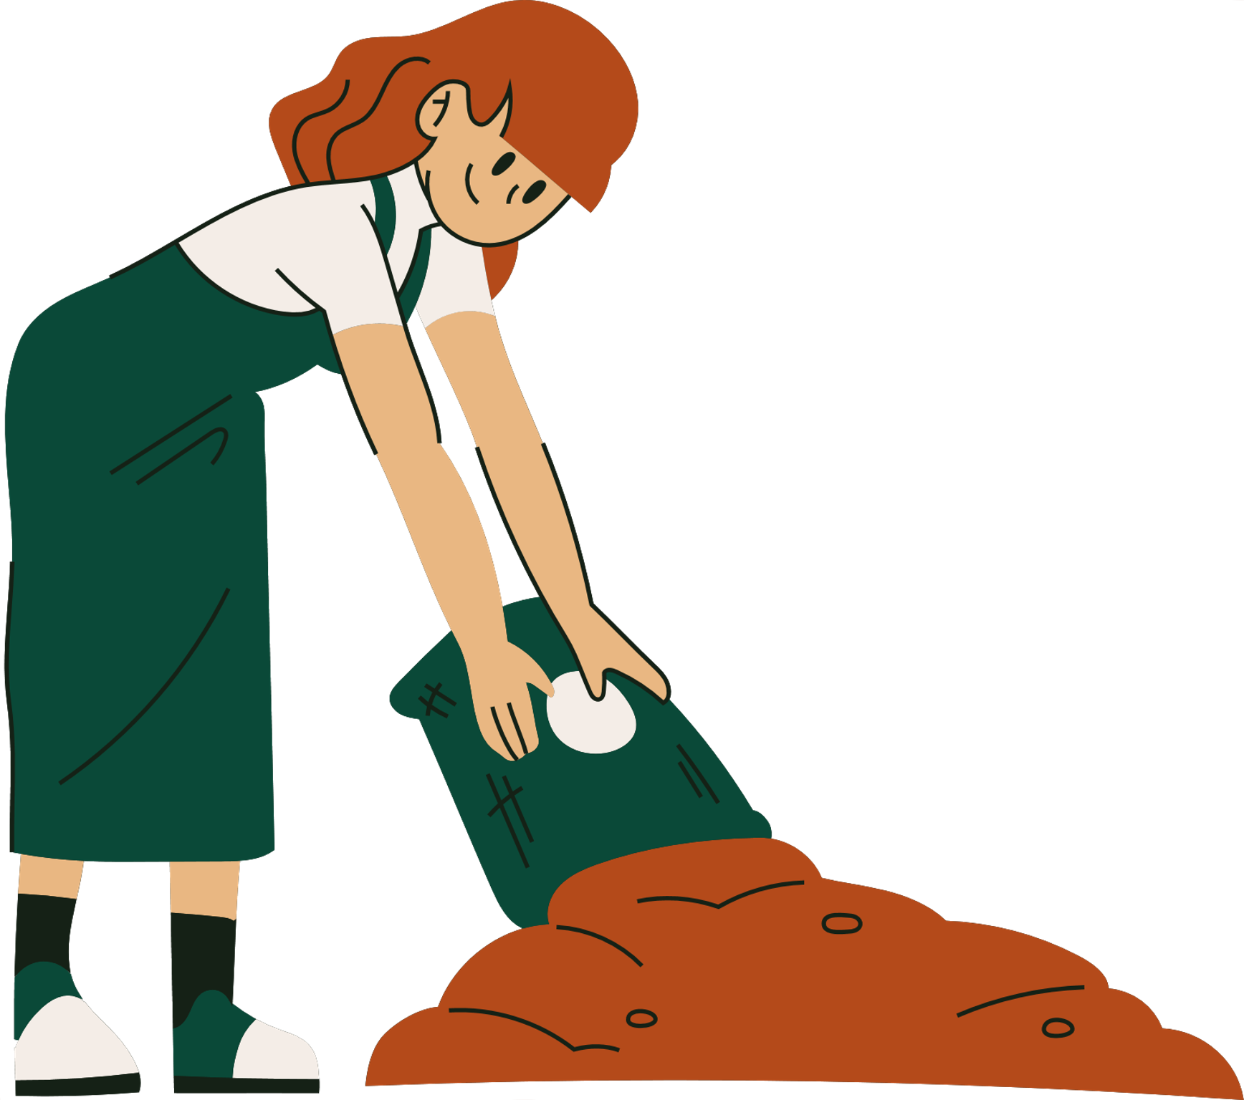
Composting and Habitats
Make your own composting area - no cooked food!
Go peat free! - that means don't use peat-based compost
Messy is good
Create log piles
Don't disturb leaf piles/under hedges in autumn/winter
Don't cut hedges in spring/summer
Notes:
Another activity that students can do/learn about
-cooked food attracts rats – so avoid that!
-great science activity – tracking temperature
-needs to be turned regularly, shouldn’t be wet (needs to be aerated)
-woodlice, centipedes, rove beetles, worms are normal and good! Do a bug hunt/tally!
-Peat free, if buying! Need to protect/preserve peat lands. *Realize it’s a contentious issue, but good to reduce or not use too much.
-Log piles – deadwood is a great habitat,
-leaf piles, hedges in autumn and winter often house pollinators and other species
-hedges in spring/summer provide nesting areas for breeding birds

Slide 10



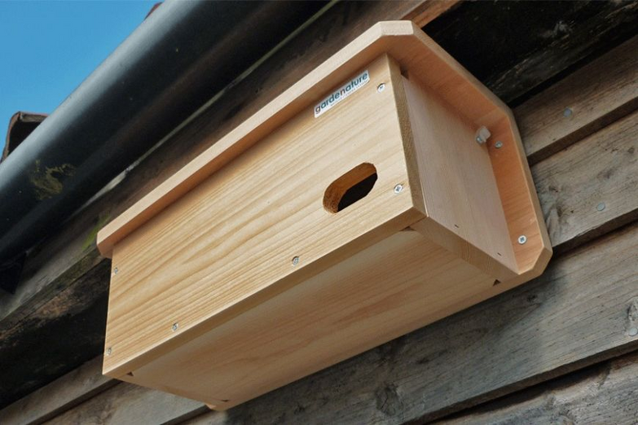
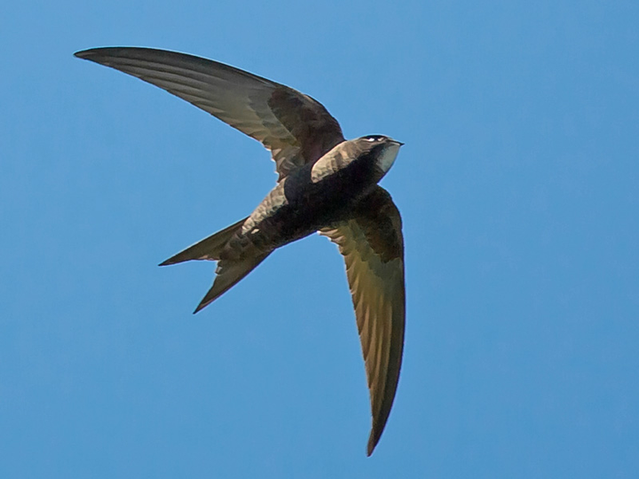
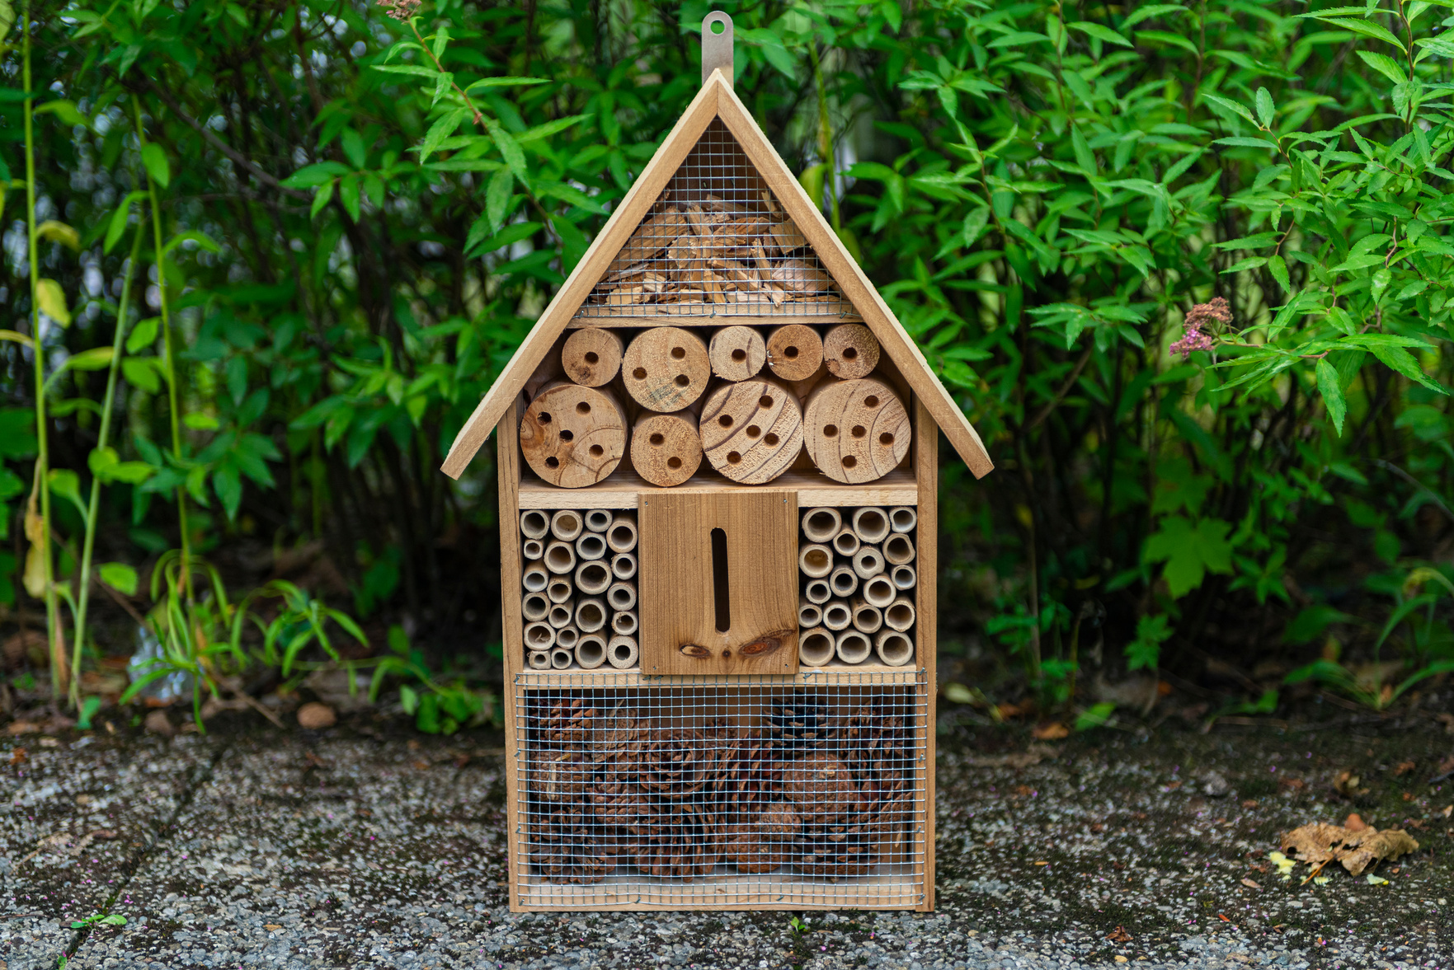
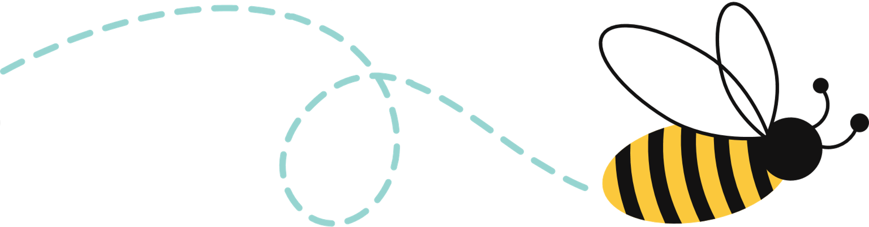
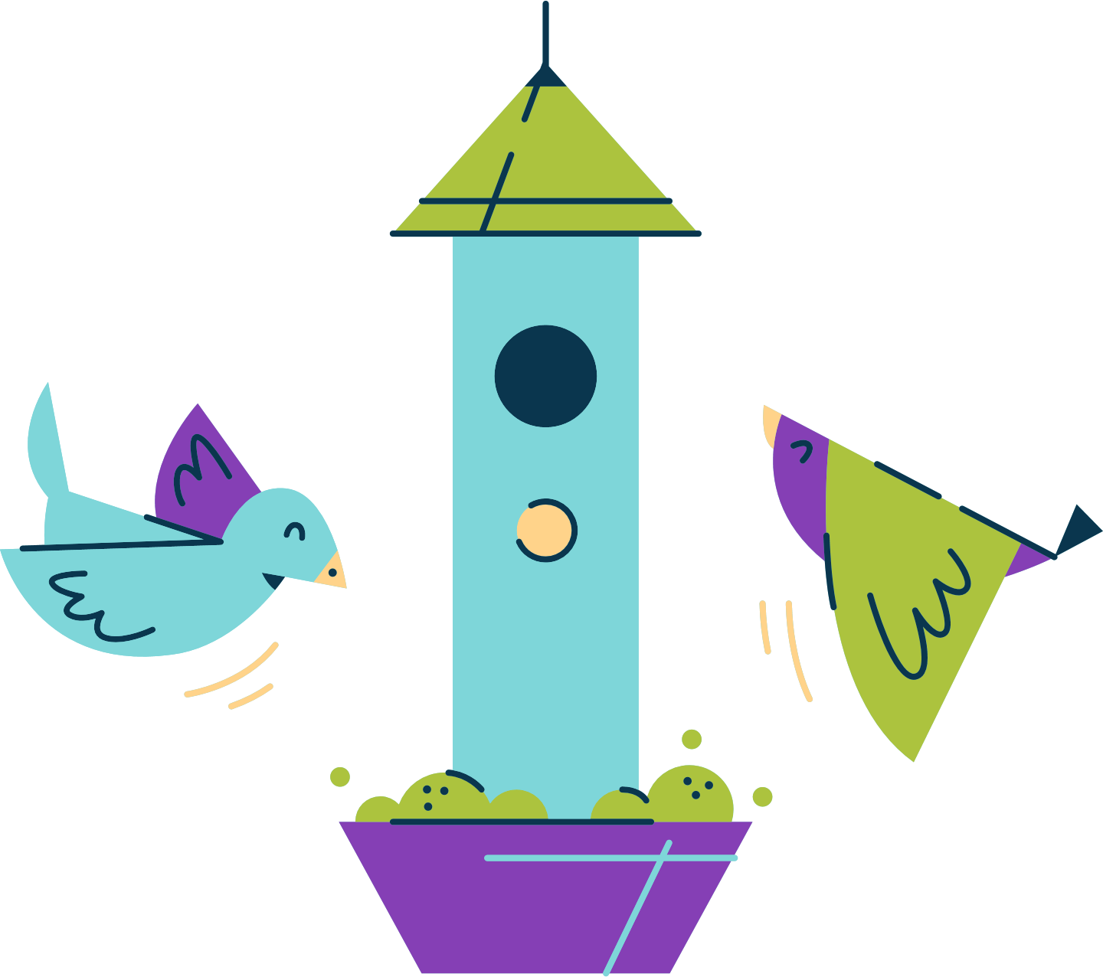
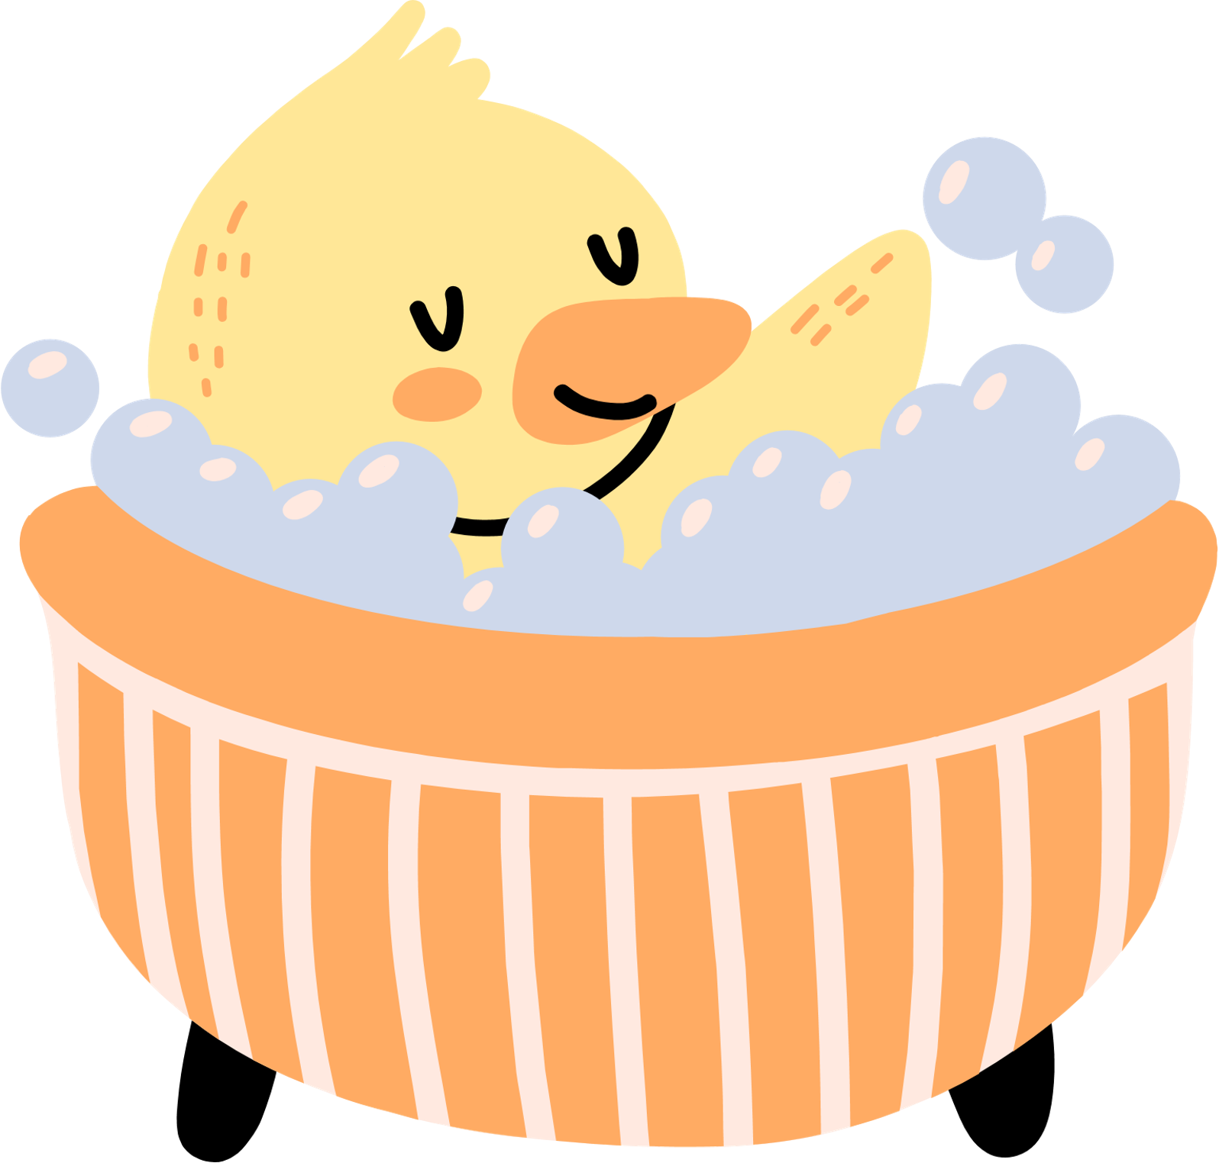
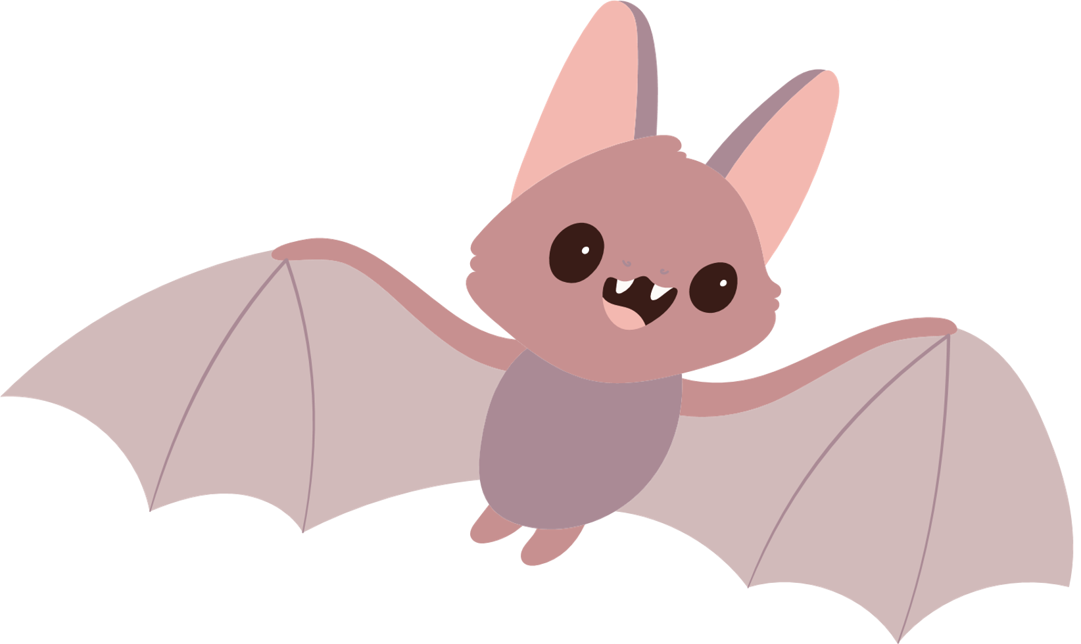
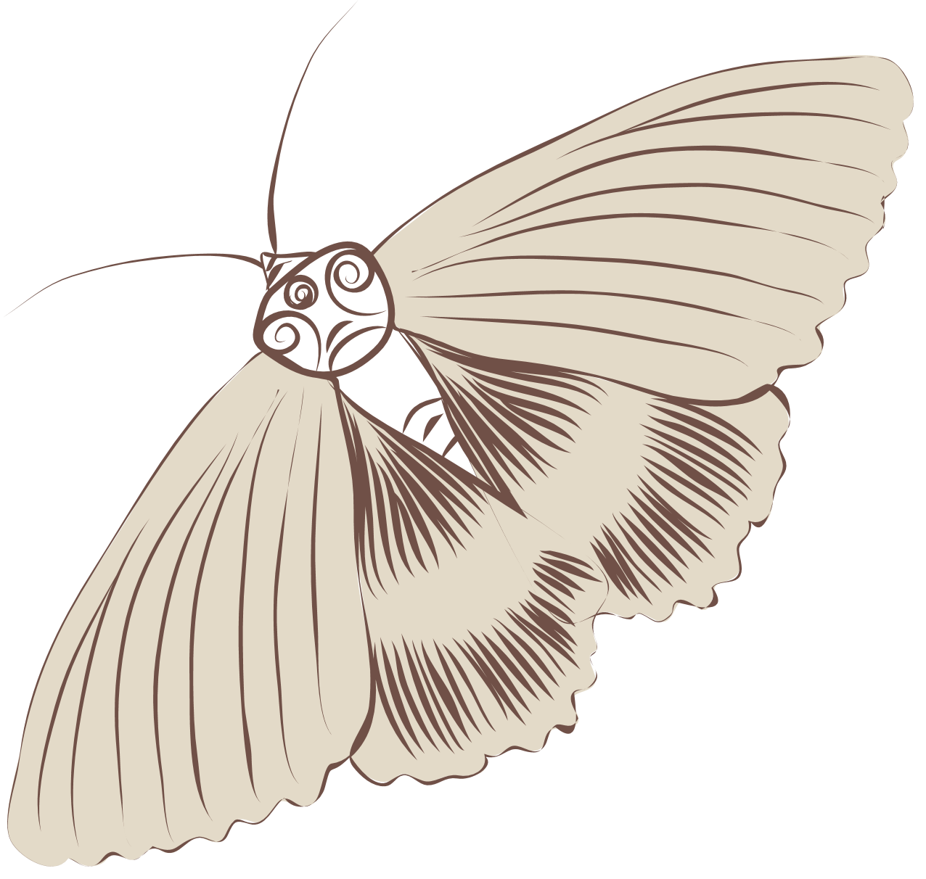
Give a Helping Hand - Install Wildlife Homes
Notes:
-Swift box –fly their whole lives (will fly for 2 years straight, even sleeping and breeding while flying), travel between here and South Africa
-bug hotel – drilled holes are for solitary bees
-slot is for moths and butterflies
-current advice: bug hotel should not be bigger than a bird box because disease can spread easily if too big. Better to have lot of small insect hotels.
How to get some? Can try to make some if you have some extra wood, donations from PTA. NHBS website provides great quality boxes and nests.
-Can target different species with the food in your bird feeders. Remember to clean your bird feeders so you don’t spread disease!

Slide 11


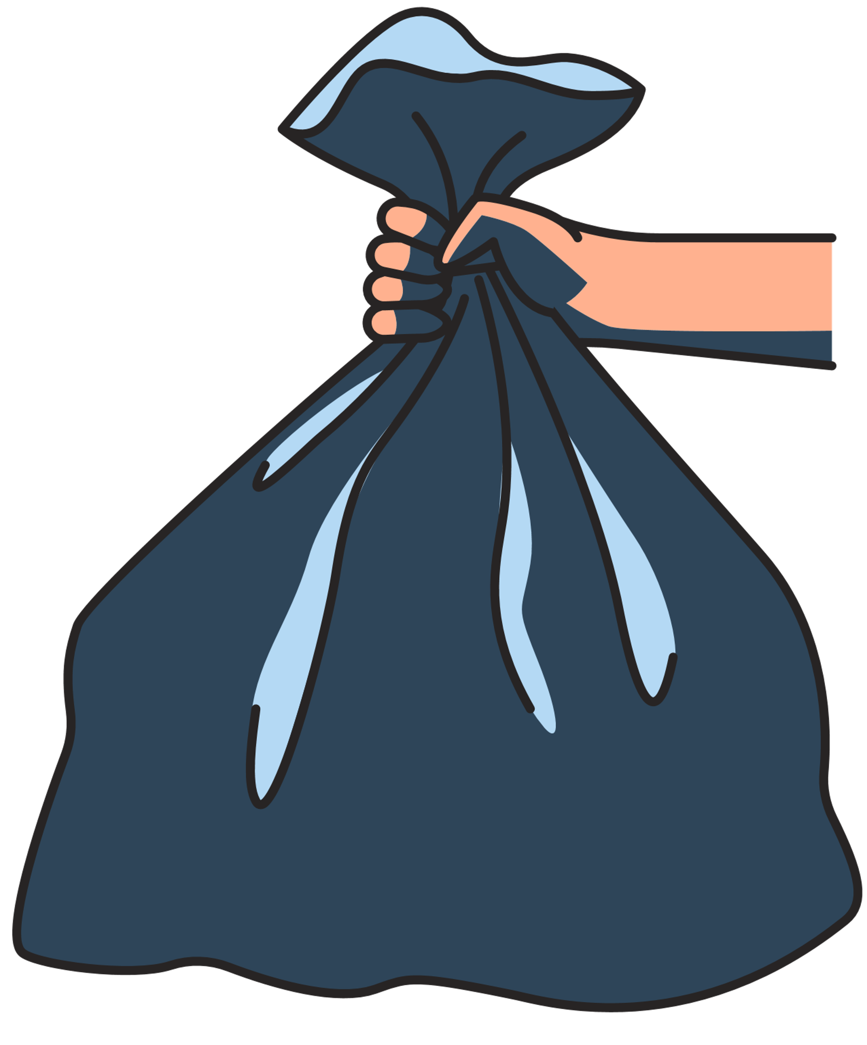
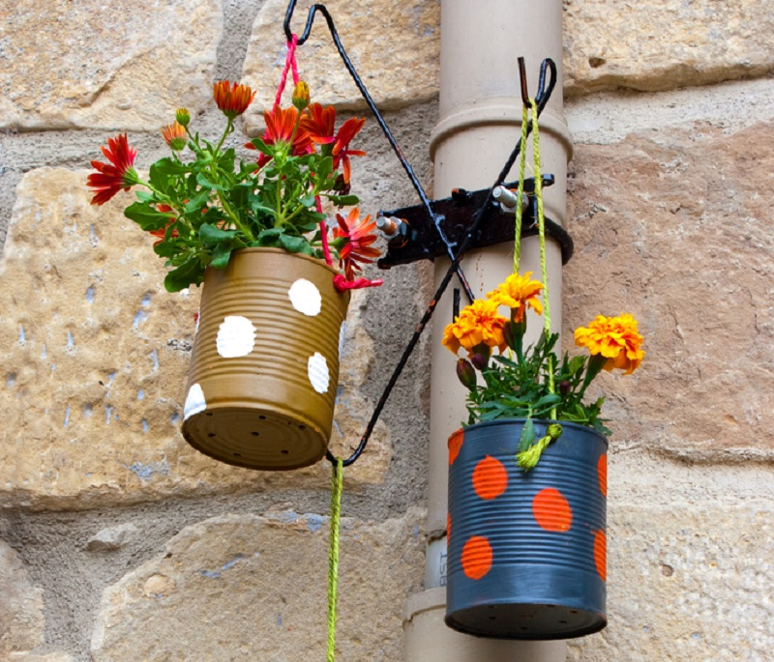
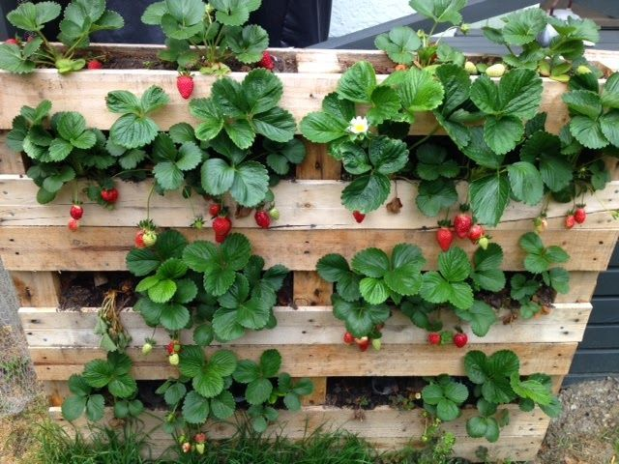

Using Recycled
Items
Notes:
Aluminum cans for flower pots
Wood pellet for growing strawberries
Litter picking

Slide 12

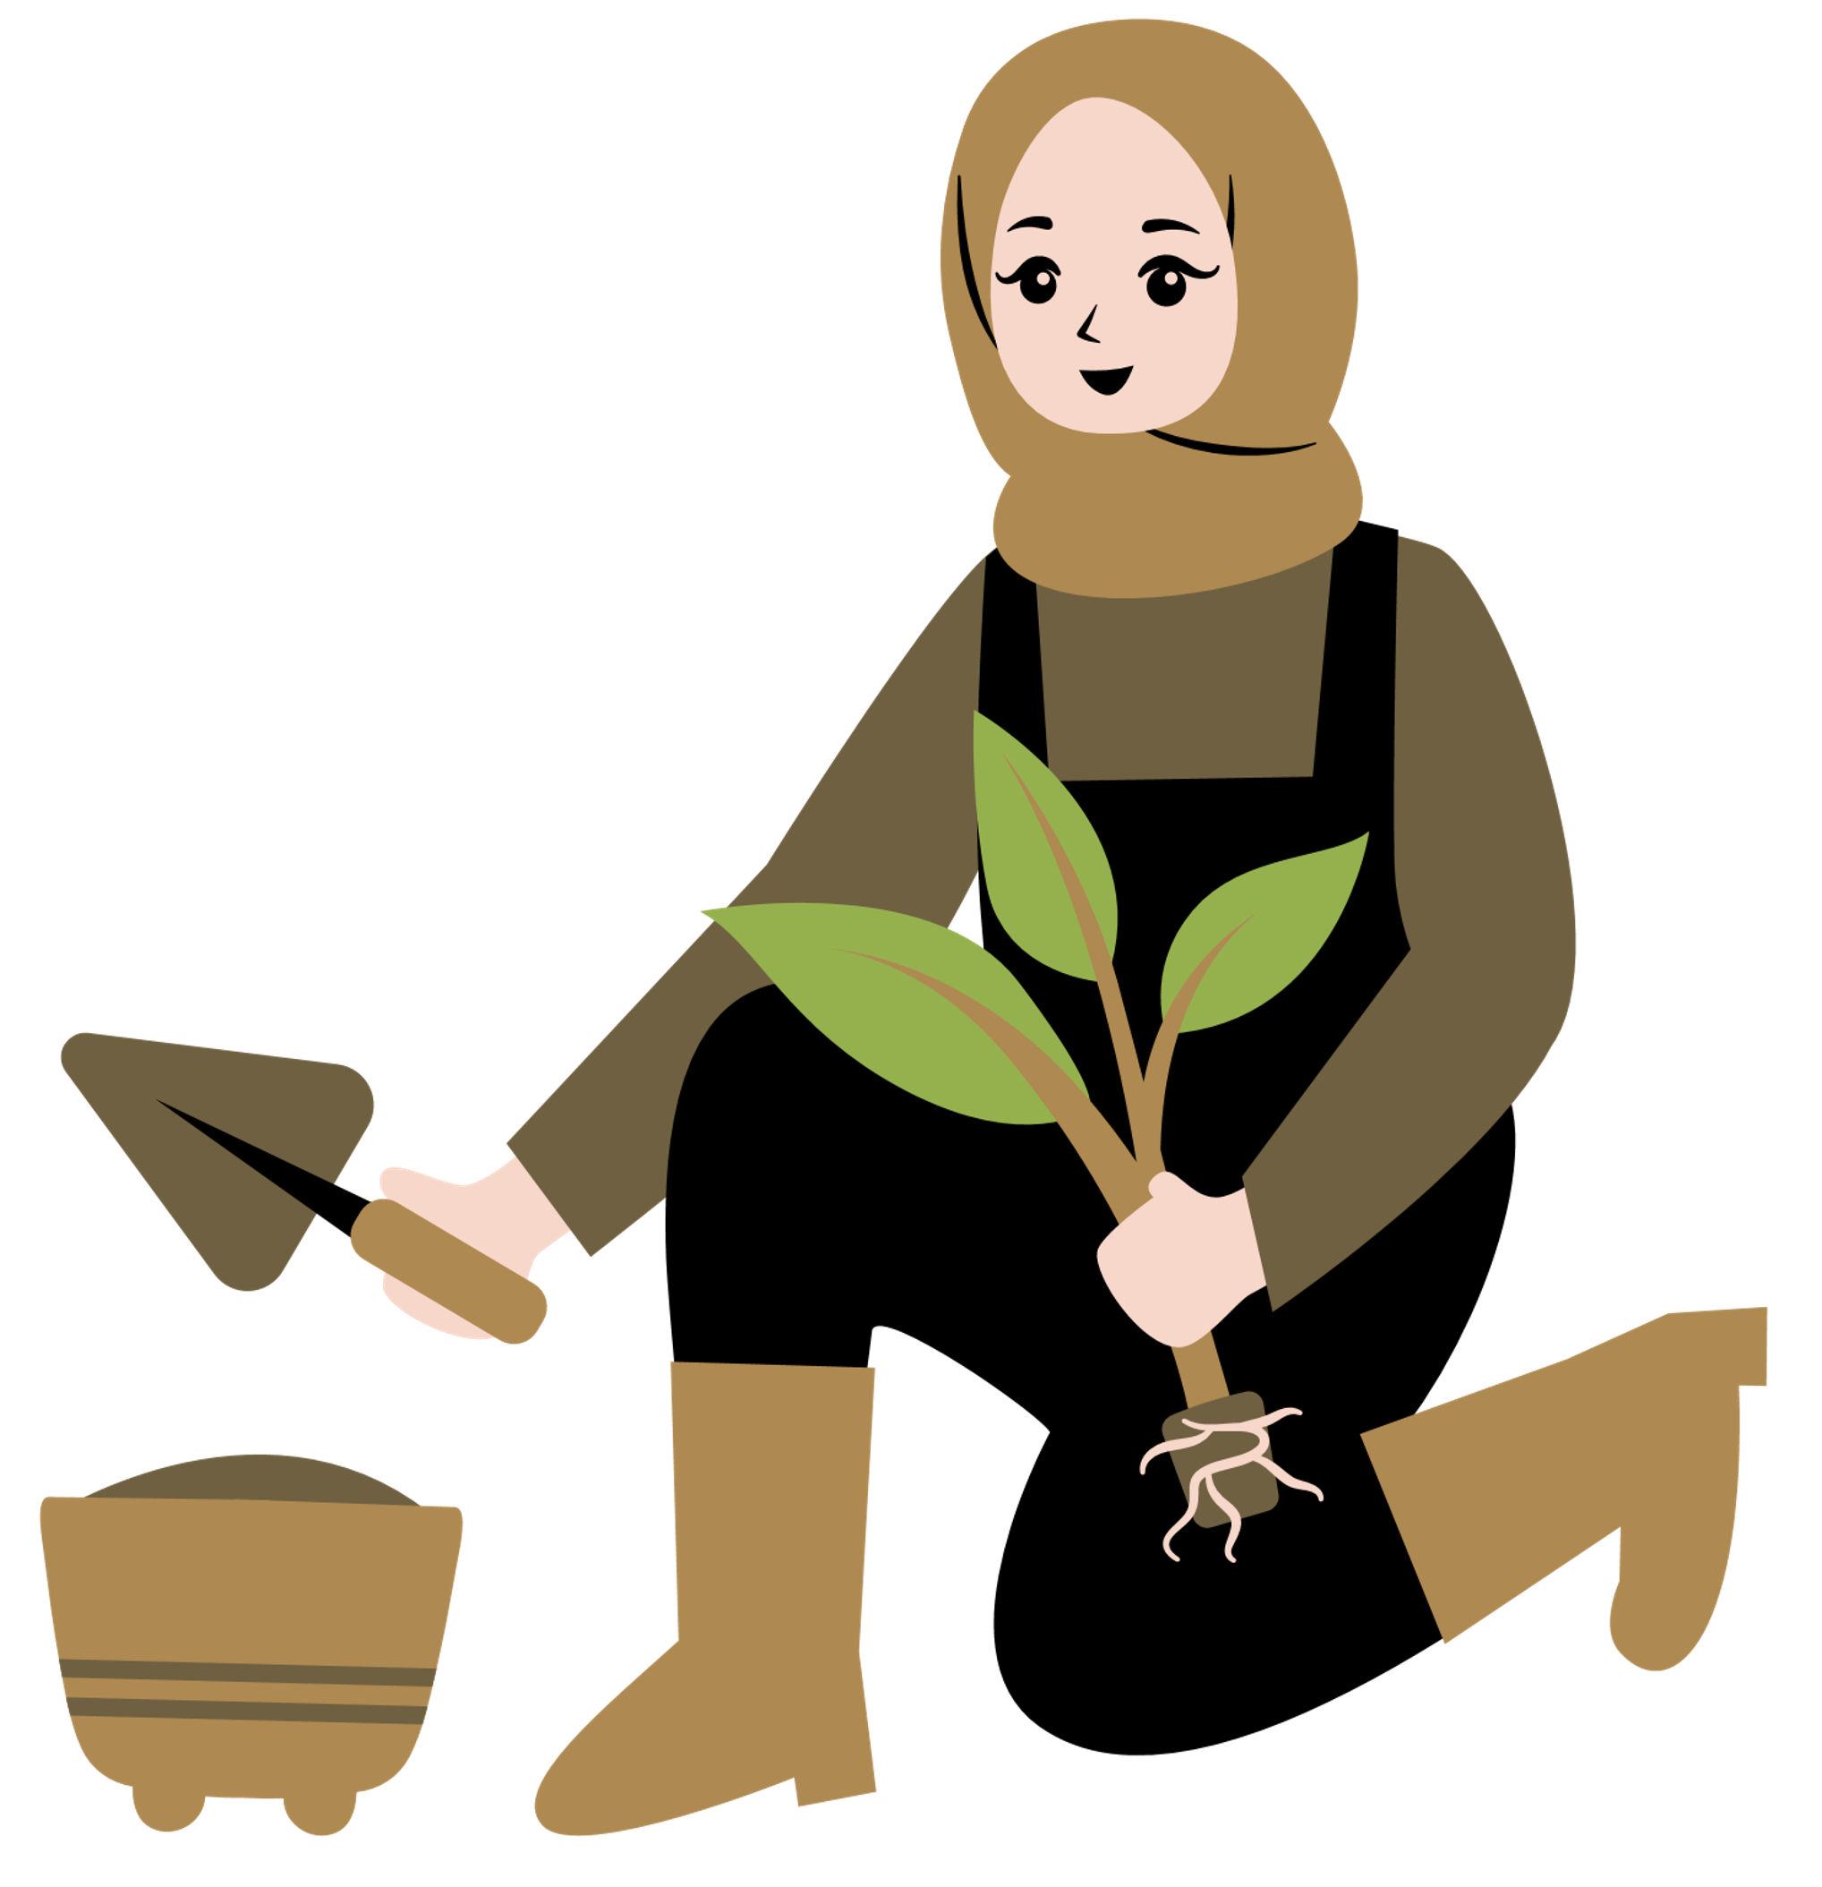

Create a Biodiversity Action Plan
Make a map of your school's habitats
Create a list of species - monitor change
what do you want your school to look like?
What other habitats will you create?
What will you change?
Create a plan of action for next 3* years
Learn, enjoy and be responsible
Notes:
Start on your GF action plan!

Slide 13
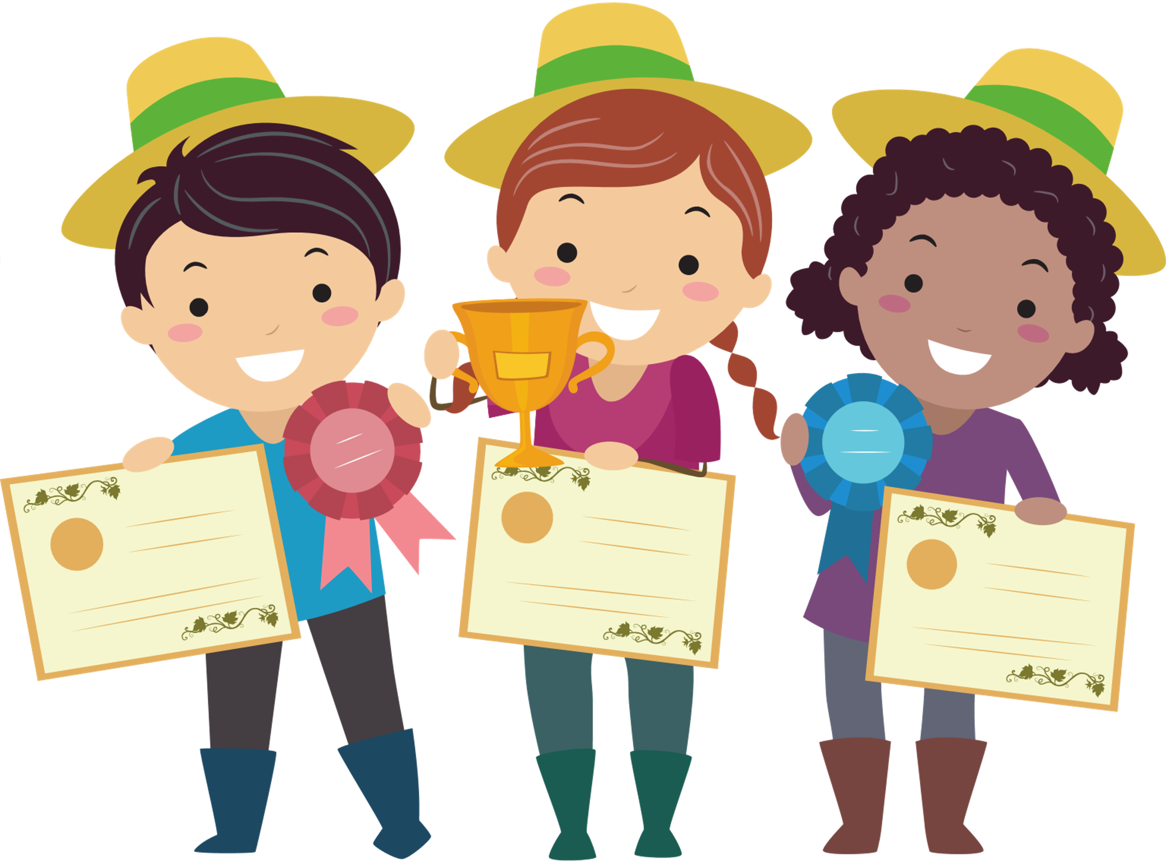


Thank You
Let's take care of our biodiversity
Well done!

